Slide 1
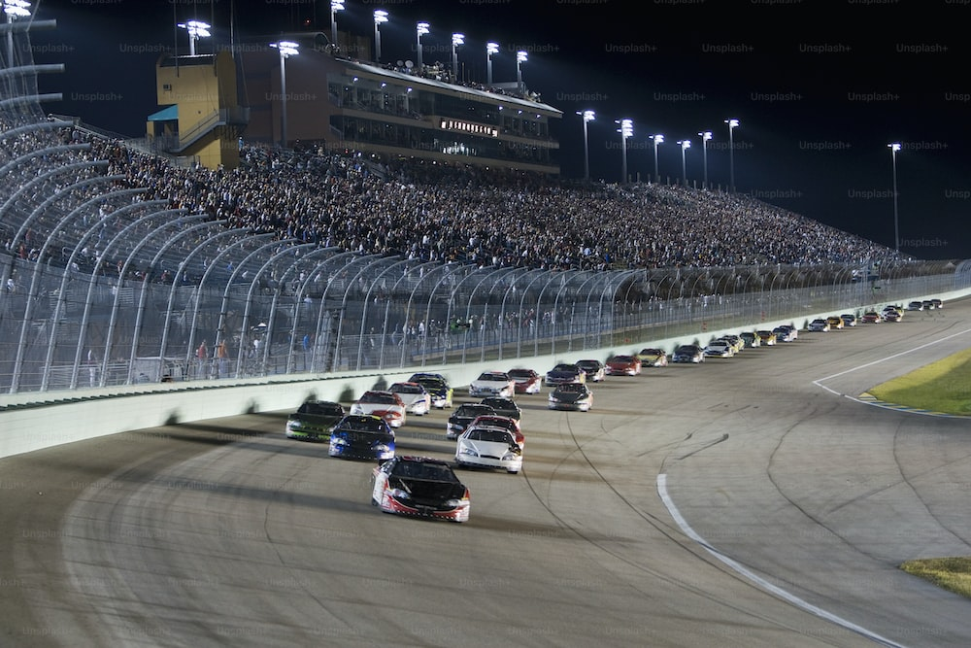
Predicting Points in F1 Formula Dataset
Raghupati Bhetwal

Slide 2

Introduction
Purpose of the report: Predicting points scored in the F1 Formula dataset using ML models
Dataset: F1 Formula dataset from Formula 1 Kaggle
Features: 'grid', 'position_x', 'laps', 'fastestLap', 'rank', 'circuitId'
Target variable: 'points_x'

Slide 3

Selected columns
'grid': Starting grid position of the driver
'points_x': Number of points scored by the driver in a race
'position_x': Finishing position of the driver in a race
'laps': Total number of laps completed by the driver
'fastestLap': Lap time of the driver's fastest lap
'rank': Overall rank or position of the driver in the championship standings
'circuitId': Unique identifier of the race circuit ….

Slide 4
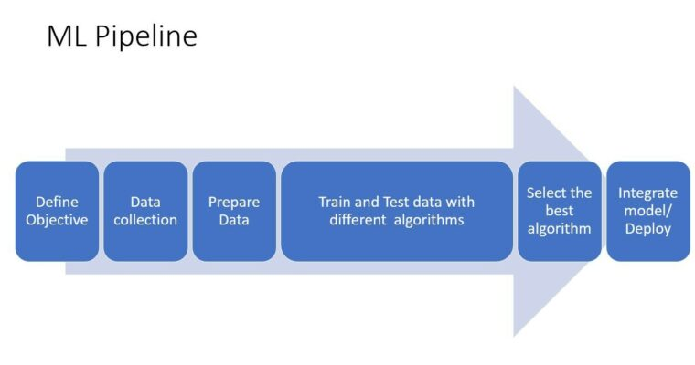
Method

Slide 5
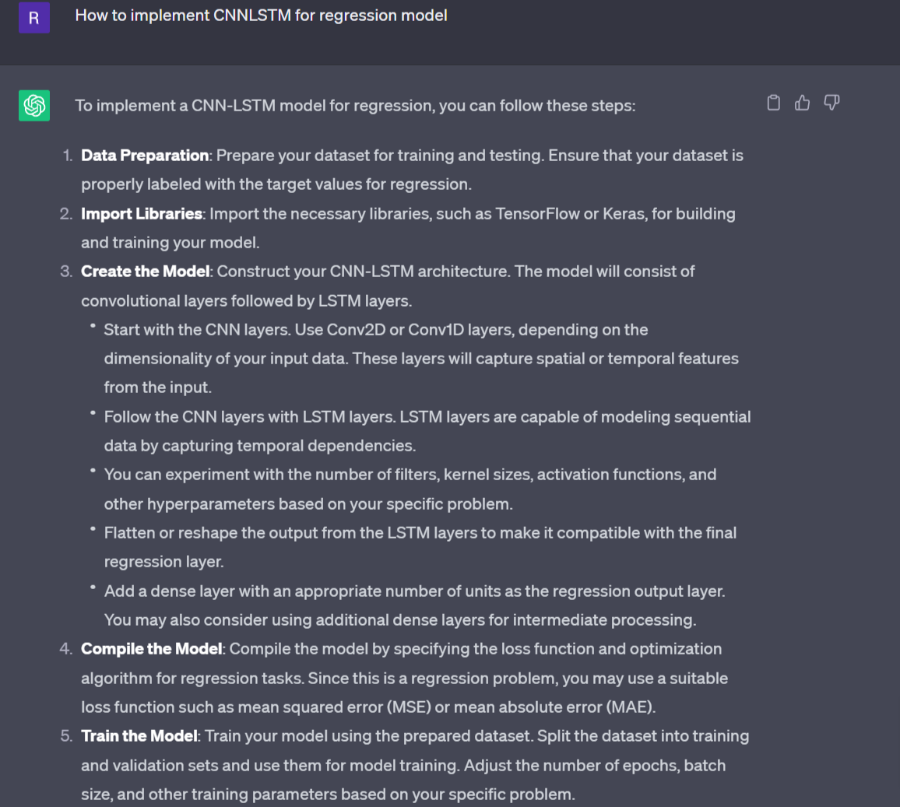
ChatGPT

Slide 6
Data Preprocessing
Missing values: Checked and found no missing values
Duplicate rows: Checked and found no duplicate rows
Exploratory Data Analysis (EDA): Visualizations using seaborn and matplotlib
Scaling : Min-Max Scaler

Slide 7
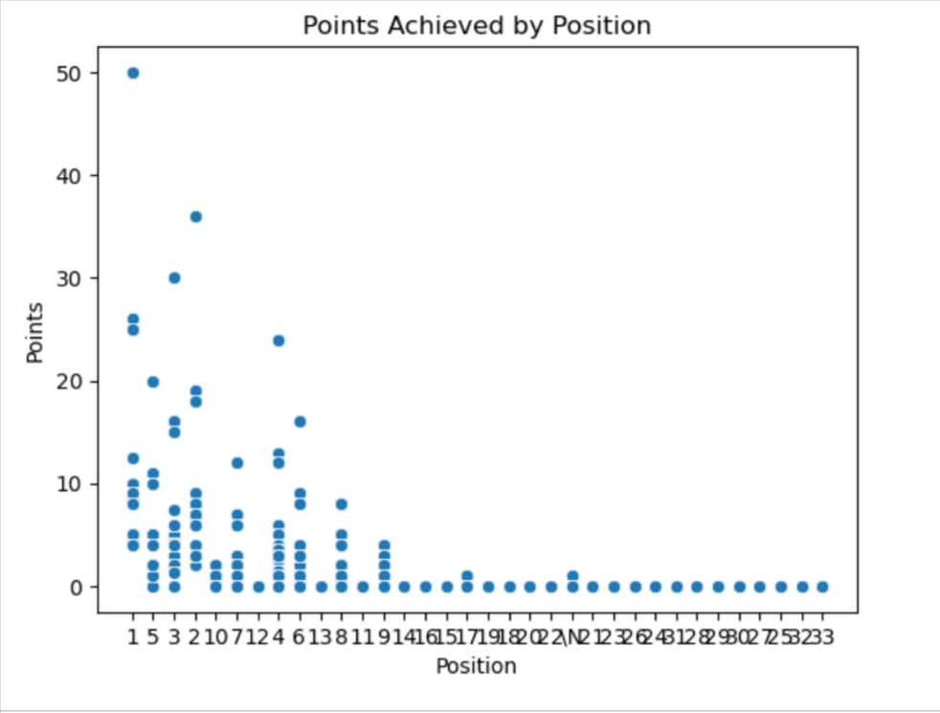
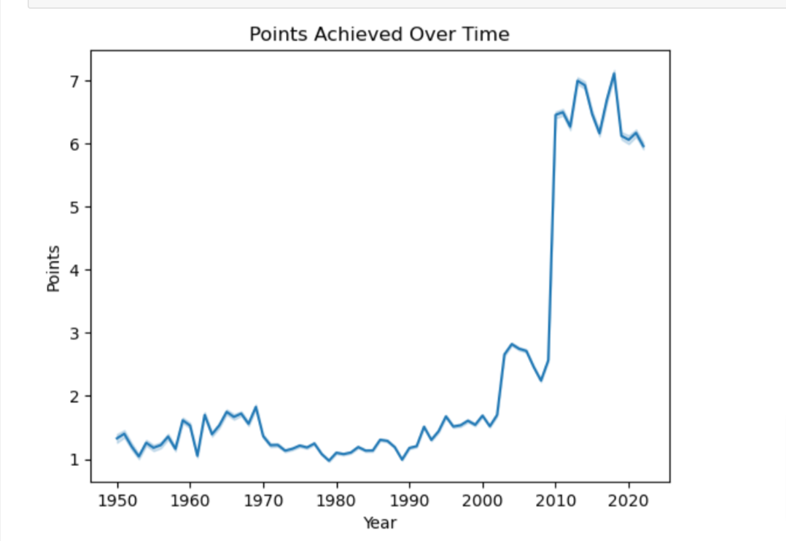
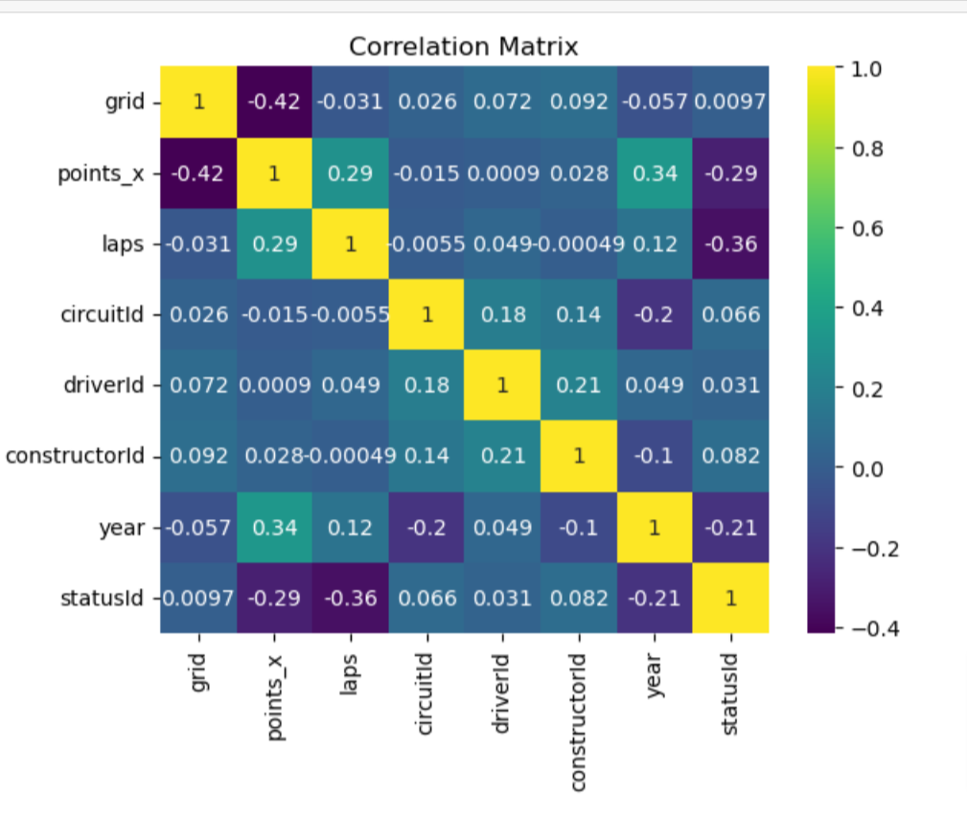
EDA Visualization

Slide 8
Model training:
a) Feature Selection: Selected relevant features
b) Handling Missing Values: Replaced missing values with NaN and dropped rows
c) Feature Scaling: Applied Min-Max scaling to selected features
d) Train-Test Split: Divided dataset into training and testing sets (80:20 ratio)

Slide 9
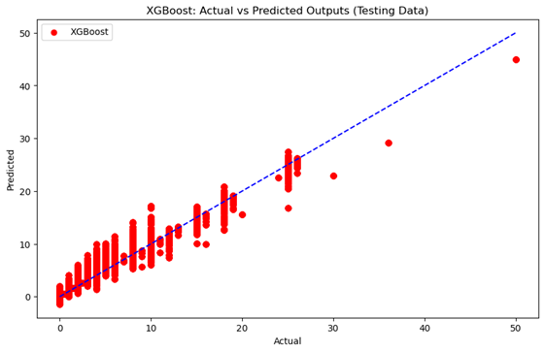
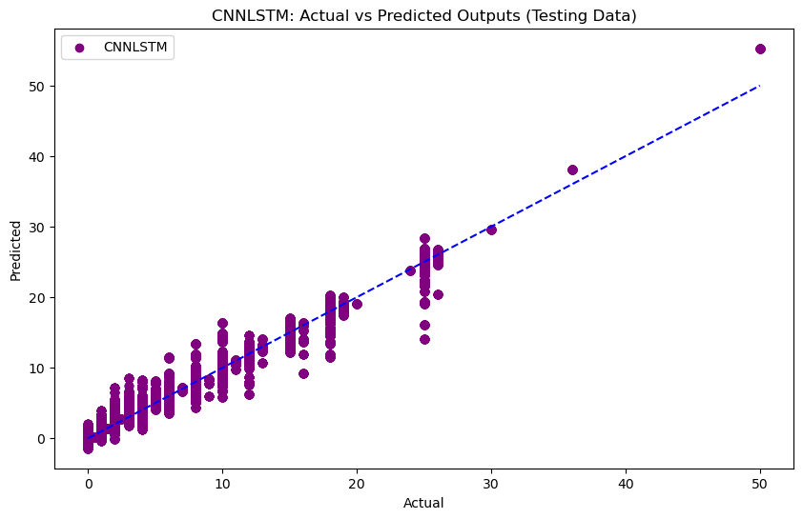
Model Performance

Slide 10
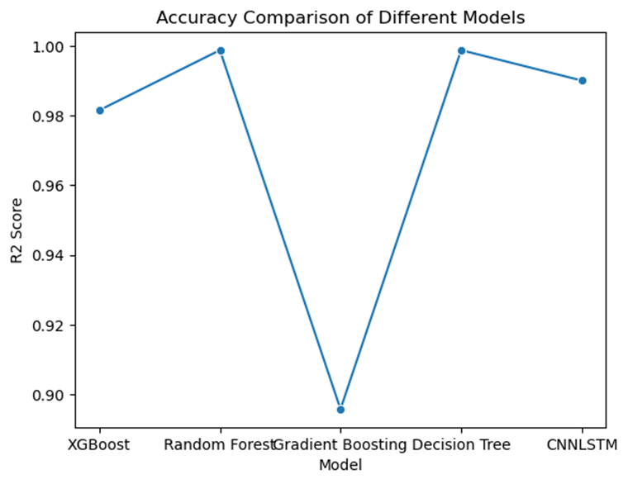
Result
MODEL | R2_Score
XGBoost | 0.981504
Random Forest | 0.998735
Gradient Boosting | 0.895842
Decision Tree | 0.998735
CNNLSTM | 0.990026

Slide 12
References
https://www.kaggle.com/datasets/rohanrao/formula-1-world-championship-1950-2020
https://scikit-learn.org/stable/modules/generated/sklearn.ensemble.RandomForestRegressor.html
https://machinelearningmastery.com/cnn-long-short-term-memory-networks/
Lectures slide by Prof. Galyna Tabunshchyk.
Images: Unsplash

