Slide 1
News Headlines as predictors of Flex company stock movement: Using Unigrams, Bigrams, Trigrams, and Fourgrams
Raghu Kowshik January 25, 2017

Slide 2
Introduction
Financial analysts, researchers, and Financial executives of Firms are interested in knowing how to predict stock price movement.
In recent years, a variety of Machine learning algorithms have been widely used to come up with prediction approaches.
Based on the assumption that news headlines impact the stock market trends, this project attempts to study the accuracy of machine learning algorithms in predicting a Firm’s stock movement.
In this study, the validity and accuracy of Five models were tested
Results show a best accuracy rate of 56%, and a lowest accuracy of 51%.

Slide 3
Data sources
The stock price data for Flex Ltd company was collected from http://www.nasdaq.com/symbol/Flex/historical for the past 13 months, from December 1, 2015 to December 30, 2016.
The daily stock price data contains 5 attributes namely Open, High, Low, Close, and Volume, Adjusted Close.
The news headlines were collected for the same period from http://www.newsmax.com/Archives/Newsfront/16/2016/12/.
The newsmax.com headlines consisted of 20 headlines per day.
The two data chunks were merged to form a single data File in csv format with 274 observations.
After merging the two data sets, the data set used for this project had the following variables: date, close, volume, open, high, hl1-hl20.
The h1 through h20 were the 20 headline text for each day.

Slide 4
Data processing
Prior to processing the data set, a new variable called “label”, was added.
The “label” variable was assigned binary values 0 or 1.
If the stock value at close was less than the open value, then the variable “label” was assigned 0,
If the stock value at close was greater than or equal to the open value, then the variable “label” was assigned a 1.
Headlines were combined into one text group for each day and a sentence separation was added
All punctuation except headline separators were removed,
Unnecessary words and space were removed, headline text was transformed to lower case
Dataset was divided into two sets: train and test. The train data set was used to train the model, and the test data set was used to make predictions.

Slide 5
The model
Generalized linear Model
I glmnet.fit.1 <- cv.glmnet(x=xtrain, y=ytrain, family=‘binomial’, alpha=0)
Prediction Using the Regularization Technique
I preds <- predict(glmnet.fit.1, newx=xtest, type=‘response’, s=‘lambda.min’)
– Text processing using Document Term Matrix

Slide 6
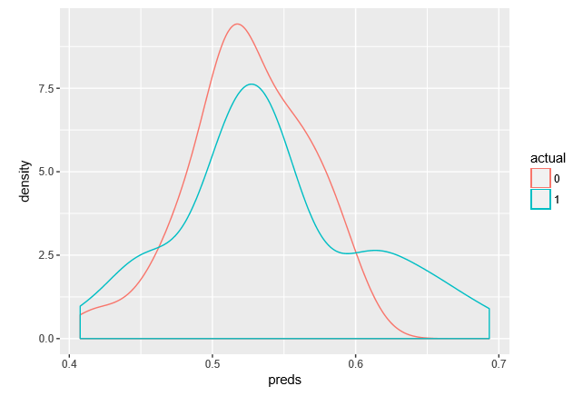
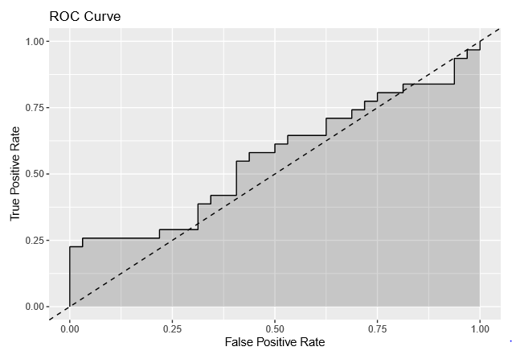

results
Dual Density Plot
AUC Score
ROC Curve
AUC, or Area Under Curve, is a metric for binary classiﬁcation. It’s the second most popular one, after accuracy.
With an AUC score of 0.5605, we have a 56% probability that the true positive rate is accurate. This is not great, but better than random guessing.
Dual density plot of the predicted probabilities, for each of the true values 0 (stock is down) or 1 (stock is up or unchanged).
The discernable separation between the 0 plot and the 1 plot. confirms we have a reasonable prediction model.
The relation between true positives and false positives
The dotted line is the threshold curve.
Prediction curve is not coinciding with the threshold.
We have a not so great, but reasonable prediction model, an indicator of future Flex stock trend.

Slide 7
summary
This study has few limitations. The dataset is small, only 274 observations, 3 variables used in the analysis, and 20+ unused variables. Although 5 models were tested in this study, the methodology was identical.
The predictions of stock movement up or down, indicated by 1 or 0, were separated, indicating that the model predictions are significantly better than random guessing for stock price going up and stock price going down.
The training data set had 219 observations, and the test dataset 55 observations in this study.
Perhaps a larger data set of 5 years duration might have better variation in text and oﬀer better, more accurate prediction results.

Slide 8
Future work
Try other methods including Naive Bayes classiﬁcation and Support Vector Machine for more accurate prediction models.
A larger data set of at least 5 years should be used.

Slide 9
Questions/Comments
Thank You

