Slide 1
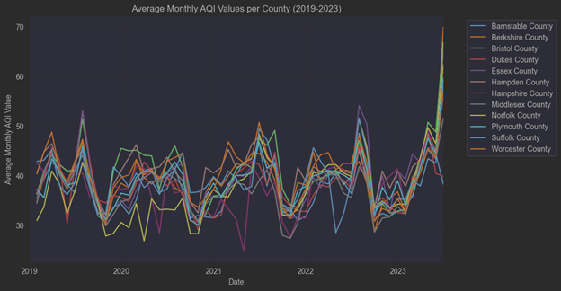
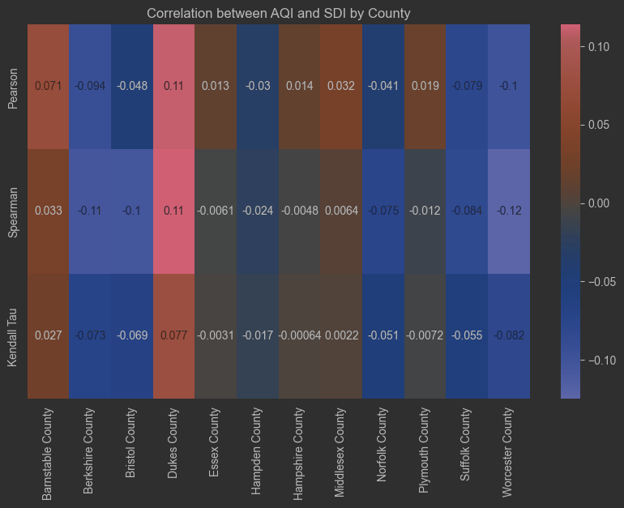
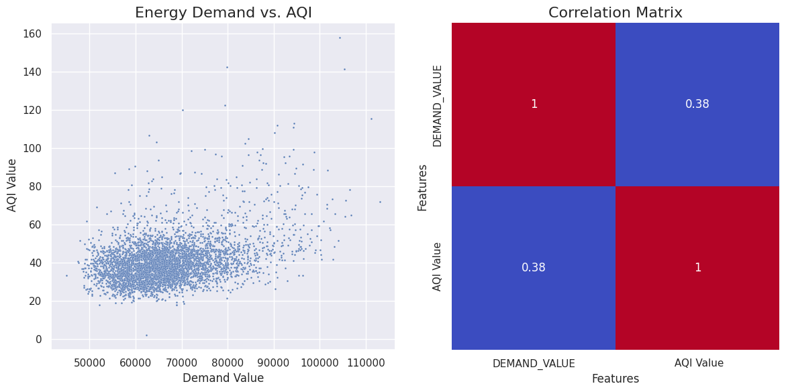
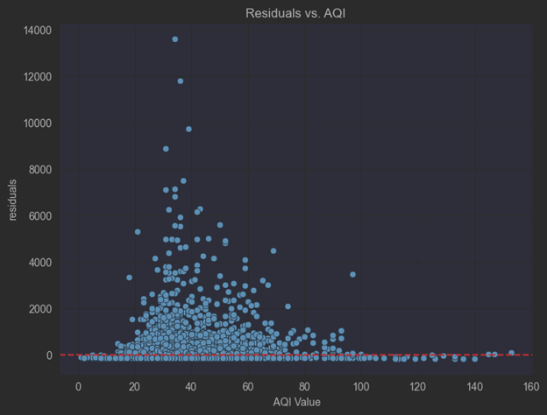
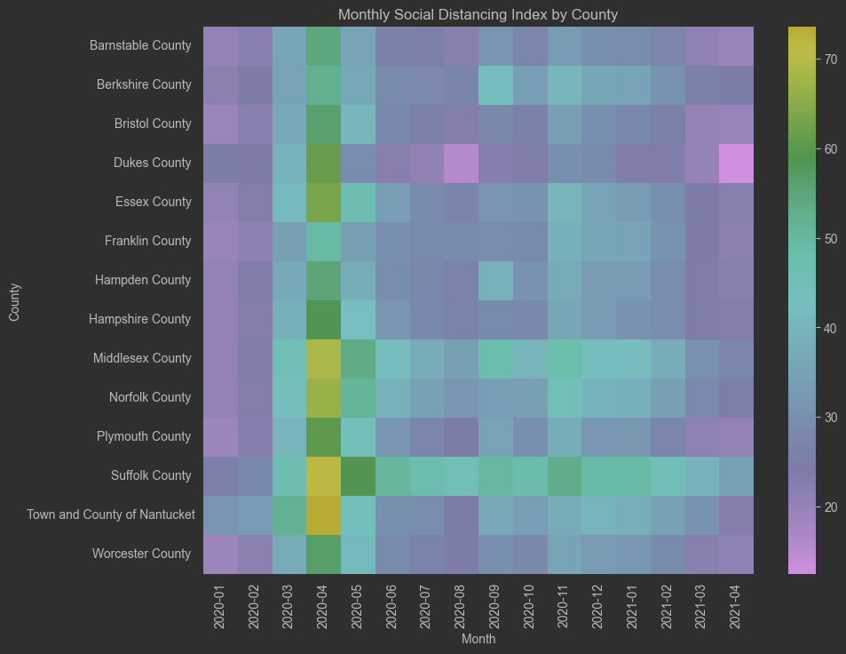
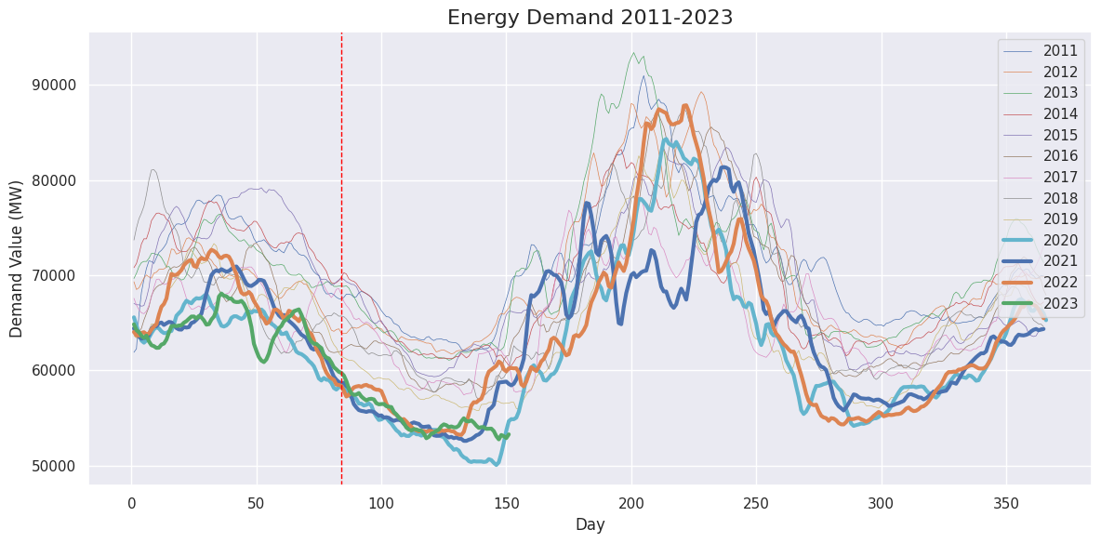
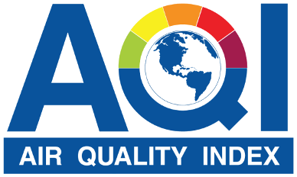
Exploring the Environmental Impact: Can staying at home enhance Air Quality
AQI values per County – Pre & Post Covid Start
AQI & Social Distancing
Weak correlation between vehicle emissions and air quality
SDI imperfect for tracking emission changes
AQI vs Energy Demand
AQI vs Residuals
Monthly Social Distancing Index
MA Energy Demand as AQI Driver?
No clear trend suggests a non-linear relationship between COVID and AQI
Energy demand shows weak to moderate correlation with AQI

