Slide 1
FraudFusion
DS 5500 – Capstone Project
Anish Rao, Raghu Ram Sattanapalle
April 15th, 2025

Slide 2
Presentation Overview
Problem Specification
Personal Learning Objectives
Team Learning Objectives
Related Work
Amendments
Solution Design
Tool list
Methodology
Timeline & Key Milestones
Sample Code
Results
Postmortem
Contributions
References

Slide 3
Problem Specification
Presenter: Anish
Main Problem:
Financial fraud detection is a challenging problem with extreme class imbalance, with fraudulent transactions making up less than 0.1% of all transactions.
Asymmetric misclassification costs: Missing fraud is costlier than false positives.
Goal:
Our main goal is to improve the synthetic fraud data generation process to more accurately represent the real data
Significance:
Potentially reduce financial losses by capturing more fraudulent transactions.
Notes:
Main problem with fraud datasets, extreme class imbalance between fraudulent and not fraud transactions
So we need high quality synthetic data to improve the model learning
Main goal in this project, Improve synthetic generation process for fraud data, so it more accurately represent real data
Main benefit of using synthetic data is that
It could potentially reduce financial losses by capturing more fraudulent transactions

Slide 4
Personal Learning Objectives
Presenter: Anish
Anish:
I was not really familiar with generative models before working on this project, so increasing the depth of my knowledge on this topic is my primary objective
More experience building advanced machine learning models from scratch
Develop expertise in designing custom loss functions for specialized domains
Raghu:
Enhance proficiency in statistical analysis and data visualization methods to assess the quality of generated data
Develop and refine expertise in the practical application of generative AI techniques
Mastery in implementing and evaluating diffusion models for complex data
Notes:
I wanted to get more experience with generative models and building advanced machine learning models from scratch
Learn more about designing custom loss functions for specialized domains

Slide 5
Team Learning Objectives
Presenter: Anish
Collective Technical Goals:
Master implementation of specialized diffusion models for tabular data with mixed feature types
Develop a systematic approach for evaluating synthetic data quality beyond basic distribution matching
Create reproducible methodologies for fraud detection that balance precision and recall trade-offs
Collaboration Enhancements:
Strengthen capability to iterate rapidly through model versions with structured evaluation criteria
Develop a shared vocabulary and framework for discussing generative model performance
Expected Takeaways:
Comprehensive workflow for synthetic data generation in highly imbalanced domains
Transferable approaches for custom loss function design in financial applications
Notes:
Technical Goals:
Master implementation of diffusion models that are tailored for mixed-type tabular data.
Develop systematic methods to evaluate synthetic data quality beyond just distribution comparisons.
Create reproducible fraud detection workflows that balance precision and recall effectively.
Collaboration Enhancements:
We wanted to have a structured evaluation criteria for discussing generative and classifier model performance.
Expected Takeaways:
Understanding the full workflow for synthetic data generation in imbalanced domains.

Slide 6
Related Work
Presenter: Anish
FinDiff [1]: Diffusion models for financial tabular data generation
Imb-FinDiff [2]: Conditional diffusion models for class imbalance
TabDDPM [3]: Diffusion models for generic tabular data
Dual-Track Diffusion Approach [4]: Separate diffusion models for fraud detection
FraudDiffuse [5]: Diffusion-based fraud augmentation
Notes:
I'd like to highlight key research papers that informed our approach.
FinDiff adapted diffusion models for general financial tabular data,
while Imb-FinDiff focused on class imbalance issues that are critical in fraud detection.
TabDDPM provided foundational techniques for tabular data modeling with diffusion.
the dual-track approach showed the value of separate diffusion models for different transaction types.
Finally, FraudDiffuse introduced applying diffusion models specifically to fraud data augmentation, which our work extends.
Our work builds upon these foundations while introducing several key innovations -
especially in distribution-aware modeling for important features like transaction amount
and we also introduced specialized loss components that improve synthetic fraud quality.

Slide 7
Amendments
Presenter: Anish
Initially we planned to work with two different financial data sets for fraud but given the decrease in manpower we decided to scale down to one data set.
Notes:
We initially planned to work with two different datasets for the project but since one person had to leave the group we decided to scale down to one dataset

Slide 8
Solution Design
Presenter: Anish
Input Data
Data Preprocessing
Feature Engineering
Standardization/Normalization
Diffusion Model
Diffusion Model Iteration (v1.0 – v7.0)
XGBOOST Classification
Augment Dataset with Synthetic data
Generate Synthetic Data
Evaluate and Compare (Classifier)
Evaluate Synthetic Data
Notes:
This slide outlines the full workflow we followed for the project
We start with the basic data cleaning and preprocessing steps
Next, we apply feature engineering to extract meaningful features like the temporal and geographical features,
followed by standardization or normalization to ensure the data is ready for modeling.
From here, the workflow splits into two key branches.
First, we run an XGBoost classifier using just the real data. This gives us a baseline performance that we’ll later compare against.
On the other side, we feed the standardized data into a diffusion model. We go through multiple iterations of this model—from version 1.0 to 7.0—tuning and improving it each time.
With each version, we generate synthetic data that we then evaluate for quality. Once we were confident in the synthetic samples, we augment the original dataset with this new data.
And then we rerun the XGBoost classifier on the augmented datasets with different amounts of synthetic data and compare the results.

Slide 9
Tool list
Presenter: Anish
Software:
Programming Language: Python 3.10
Deep Learning Framework: PyTorch 2.6.0+cu118 with CUDA support
Machine Learning Libraries:
∗ XGBoost 2.1.3 for classification models
∗ Scikit-learn 1.0.2 for preprocessing and evaluation
∗ Pandas 2.2.3 and NumPy 1.26.4 for data manipulation
∗ Joblib 1.4.2 for parallel processing
Visualization and Statistical Testing:
∗ Matplotlib 3.10.0 and Seaborn 0.13.2 for visualization
∗ SciPy 1.13.1 for statistical tests (Kolmogorov-Smirnov, Anderson-Darling)
∗ TQDM 4.67.1 for progress tracking during lengthy model training and generation
Hardware:
GPU: NVIDIA GeForce RTX 4060 with 8GB VRAM for diffusion model training
CPU: Intel Core i7 14700F (20 cores: 8P + 12E) for data preprocessing and classifier training

Slide 10
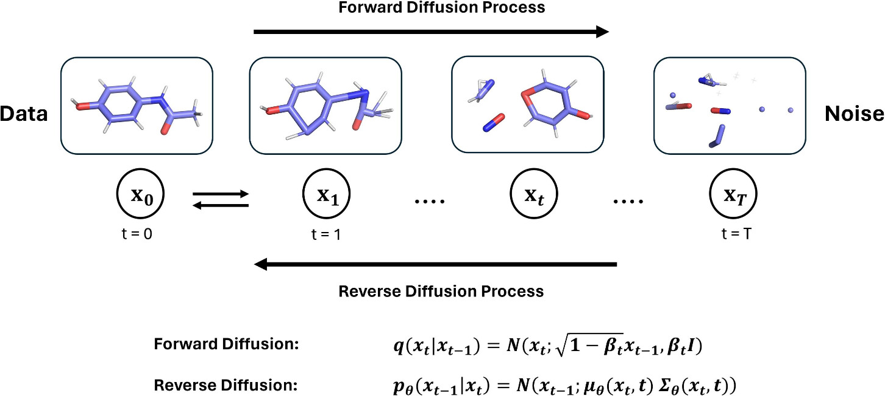
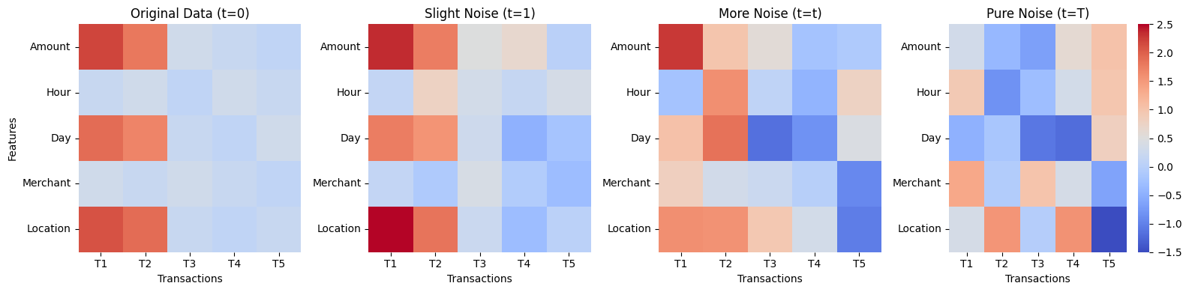
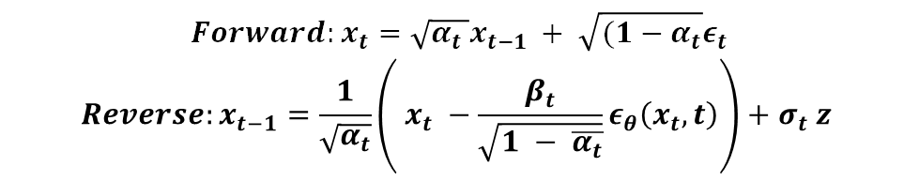
Methodology: Models Used
Presenter: Raghu
$$Forward:x_{t}=\sqrt{α_{t} }x_{t−1 }+ \sqrt{(1−α_{t}}ε_{t}$$
$$Reverse:x_{t−1}=\frac{1}{\sqrt{α_{t}}}\left( x_{t} −\frac{β_{t}}{\sqrt{1 − \overline{α_{t}}}}ε_{θ}\left(x_{t}, t\right)\right)+σ_{t} z$$
Enhanced Diffusion Model:
• Multi-modal neural network with feature-specific handling
• Custom loss function with 5 components for fraud-specific patterns
• Bimodal modeling for transaction amounts
• 600-step diffusion process with distribution-preserving post-processing
XGBoost Classification Models
Baseline XGBoost model trained on original imbalanced data
Augmented XGBoost model trained on data enhanced with synthetic fraud samples
Notes:
This slide explains our methodology for generating synthetic fraud data using diffusion models.
The top visualizations show how diffusion works: starting with structured transaction data on the left, we see clear patterns in the Amount and Hour rows where fraud transactions share similar characteristics. As we move right, we gradually add noise until we reach pure random noise at the far right.
The diffusion process has two key phases:-
Forward process: gradually adds noise to real fraud data according to this equation-
Reverse process: learns to denoise and generate new synthetic samples
Our enhanced diffusion model includes several innovations:
- Multi-modal architecture handling different feature types simultaneously
- A composite loss function with 5 components specifically designed for fraud patterns
Bimodal modeling for transaction amounts, capturing both small test transactions and large fraudulent purchases
A 600-step generation process with distribution-preserving post-processing
For classification, we trained XGBoost models in two configurations:
A baseline model on the original imbalanced data
Augmented models using our synthetic fraud samples to address imbalance
This approach significantly improved fraud detection performance, especially recall, while maintaining overall discriminative power

Slide 11
Timeline & Key Milestones
Presenter: Raghu
Phase 1: Project Initiation & Data Understanding
Phase 2:
Base Model Development
Phase 3:
Model Architecture
Refinement
Phase 5:
Final Implementation & Evaluation
Phase 4:
Advanced Model Versions
Jan 21st
Project start & dataset acquisition
Feb 3rd
Exploratory data analysis & Baseline XG Boost model
Feb 7th
First baseline diffusion model implemented
Feb 11th
Versions 2-4 completed with initial and custom loss functions
Feb 12-18th
Extensive architecture and model understanding
Feb 25th
Model development with improved distribution modeling (V5)
March 1st
Final diffusion model
March 1-10th
Dual validation methodology & implemented
March 10 – 31st Final report & comprehensive evaluation
Notes:
We began on January 21st with project initiation, acquiring our dataset from Kaggle. Unlike some projects, we didn't need to collect data ourselves, which allowed us to dive straight into data understanding. From January 24th through February 3rd, we conducted comprehensive exploratory data analysis. This phase was crucial as it revealed those distinctive bimodal fraud patterns I mentioned earlier, which shaped our entire approach.
Phase 2 focused on base model development. By February 7th, we had implemented our first baseline diffusion model along with the necessary data processing pipeline. Moving quickly, we iterated through Versions 2 through 4 by February 11th, incorporating our initial set of customized loss functions. However, during this phase, we encountered significant model convergence challenges.
This led to our third phase from February 12th to 18th, where we focused intensively on model architecture refinement. We conducted extensive hyperparameter testing and made critical architectural adjustments. We had to adjust our original plan here, prioritizing model stability improvements before adding more sophisticated feature enhancements.
Once we had a stable architecture, we moved into Phase 4, developing our advanced model versions. By February 25th, we completed Version 5, which showed significant improvements in modeling the complex distribution patterns in fraud transactions, particularly for transaction amounts.
Our final phase began on March 1st when we completed Version 7 of our diffusion model—our final version—along with our baseline XGBoost classifier + dual validation track. The next ten days were dedicated to implementing our dual validation methodology and comprehensively evaluating our models. We submitted our final report on March 10th, successfully demonstrating a 5.75 percentage point improvement in fraud detection recall.
Throughout this timeline, our biggest adjustment was allocating more time than initially planned to architecture testing and stability enhancements, which ultimately proved crucial to our success with the final model versions.

Slide 12
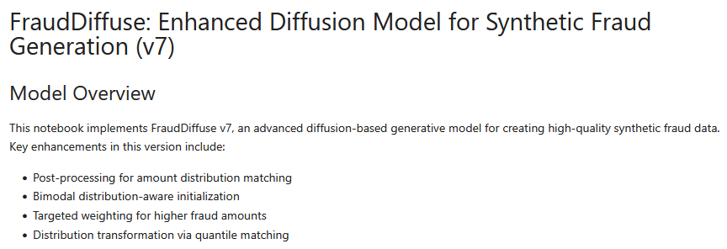
Sample Video/Code
Presenter: Raghu

Slide 13
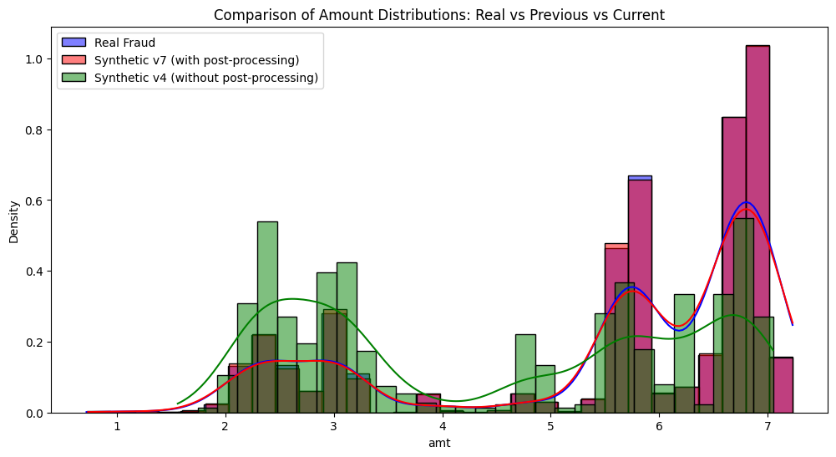
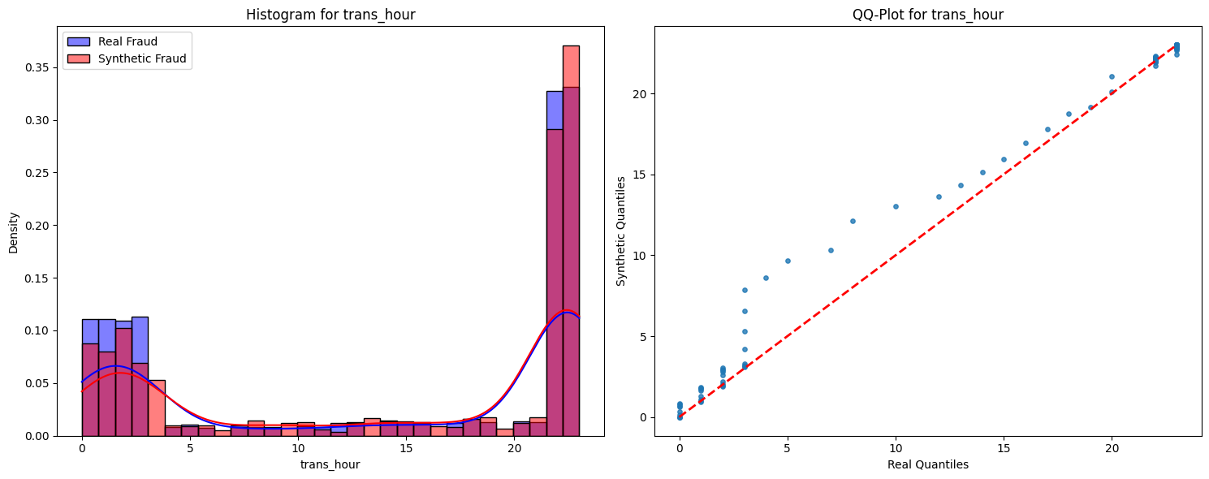
Results (Diffusion Model)
Presenter: Raghu
Bimodal Amount Distribution Captured
Version 7 (with post-processing) accurately reproduces both peaks
Significant improvement over Version 4 (without post-processing)
Excellent Quantile Matching (Example: 'trans_hour' feature)
Linear trend in QQ-plot indicates synthetic data quantiles closely align with real data quantiles
Confirms good distribution matching across features
Notes:
To visually validate the quality of our synthetic data, let's look at these figures. First, here's the amount distribution (Figure 5). You can clearly see the bimodal pattern in real fraud data. Our enhanced Version 7, with post-processing, accurately captures both peaks of this distribution, a significant improvement over earlier versions like Version 4 which missed the second peak.
We also used QQ-plots to assess distribution matching for individual features. This QQ-plot for 'trans_hour' (Figure 4) is just one example. The linear trend shows excellent quantile alignment, indicating our synthetic data closely mirrors the real data's distribution across various features.
These visual validations, along with statistical metrics, confirm the high quality of our generated synthetic fraud data.

Slide 14
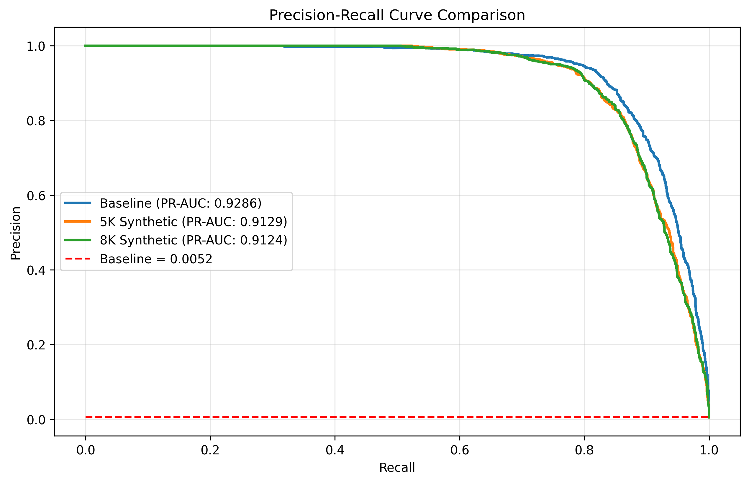
Results (Classifier Model)
Presenter: Raghu
Metric | Baseline | 5000 Synthetic | 8000 Synthetic
ROC-AUC | 0.9990 | 0.9984 | 0.9984
PR-AUC | 0.9287 | 0.9129 | 0.9124
F1 Score | 0.8701 | 0.7918 | 0.8069
Sensitivity/Recall | 0.8275 | 0.8850 | 0.8777
Specificity | 0.9173 | 0.9982 | 0.9984
Precision | 0.9173 | 0.7164 | 0.7466

Slide 15
Postmortem
Presenter: Raghu
Deepened understanding of diffusion models and their application in generating high-quality synthetic data for imbalanced classification problems
Helped develop stronger skills in financial fraud detection and appreciate the challenges of working with highly imbalanced datasets
Enhanced expertise in designing complex loss functions that enforce specific statistical properties in generated data
Model improvement isn’t just about architecture changes – sometimes targeted distribution matching and feature specific optimizations make the biggest difference
Taught us importance of rigorous validation methodologies when working with synthetic data

Slide 16
Future Direction
Model Enhancements:
Temporal Modeling: Incorporate sequence modeling for transaction streams to detect complex fraud patterns over time
Transfer Learning: Pre-train diffusion models on larger financial datasets, then fine – tune for specific types
Expanded Applications:
Cross-Domain: Apply to insurance fraud, anti-money laundering, and other financial crimes
Multimodal Fusion: Combine transaction data with text (e.g., transaction descriptions)
Further Research:
Adaptive Generation: Design systems that dynamically adjust synthetic data characteristics based on classifier feedback
Advanced Distribution Matching: Explore adversarial distribution matching for even more realistic synthetic data

Slide 17
Contributions (Raghu)
Presenter: Raghu
Feature Engineering:
Developed cyclic encoding for temporal fraud patterns
Diffusion Model development & testing:
Developed & enhanced FraudDiffuse architecture with custom components for mixed data types
Designed & implemented custom loss functions (Amount distribution & Feature weighted MSE loss)
Created framework for synthetic data quality assessment
Implemented specialized bimodal distribution matching for transaction amounts
Implemented post –processing distribution transformation techniques

Slide 18
Contributions (Anish)
Presenter: Anish
Feature Engineering & Data Preprocessing:
Developed comprehensive pipeline for cleaning and preparing transaction data for diffusion model iterations
Created specialized transformations for temporal and categorical features
Diffusion Model development & testing:
Architecture & Hyper-parameter testing for diffusion model improvements
XGBoost Implementation:
Designed and optimized the fraud detection classifier pipeline
Created controlled synthetic data augmentation framework
Conducted performance analysis across precision-recall spectrum

Slide 19
References
Sattarov, T., Schreyer, M., & Borth, D. (2023). FinDiff: Diffusion models for financial tabular data generation. Proceedings of the 4th ACM International Conference on AI in Finance.
Schreyer, M., Sattarov, T., Sim, A., & Wu, K. (2024). Imb-FinDiff: Conditional diffusion models for class imbalance synthesis of financial tabular data. Proceedings of the 5th ACM International Conference on AI in Finance.
Kotelnikov, A., Baranchuk, D., Rubachev, I., & Babenko, A. (2023). TabDDPM: Modelling tabular data with diffusion models. Journal of Machine Learning Research.
Pushkarenko, N., & Zaslavskyi, V. (2024). Synthetic data generation for fraud detection using diffusion models. Financial Technology and Machine Learning.
Roy, R., Tiwari, D., & Pandey, A. (2023). FraudDiffuse: Diffusion-aided synthetic fraud augmentation for improved fraud detection. arXiv preprint.

Slide 20
Questions?

Slide 21
Thank you!

