Slide 1

Soundit
Nicholas Patel Raghu Ram Sattanapalle
Jinpeng Chen

Slide 2
Introduction
Soundit is a music streaming platform designed to offer a personalized and immersive music experience
Explore a vast collection of music, create and manage playlists, follow favorite artists, and enjoy personalized recommendations

Slide 3
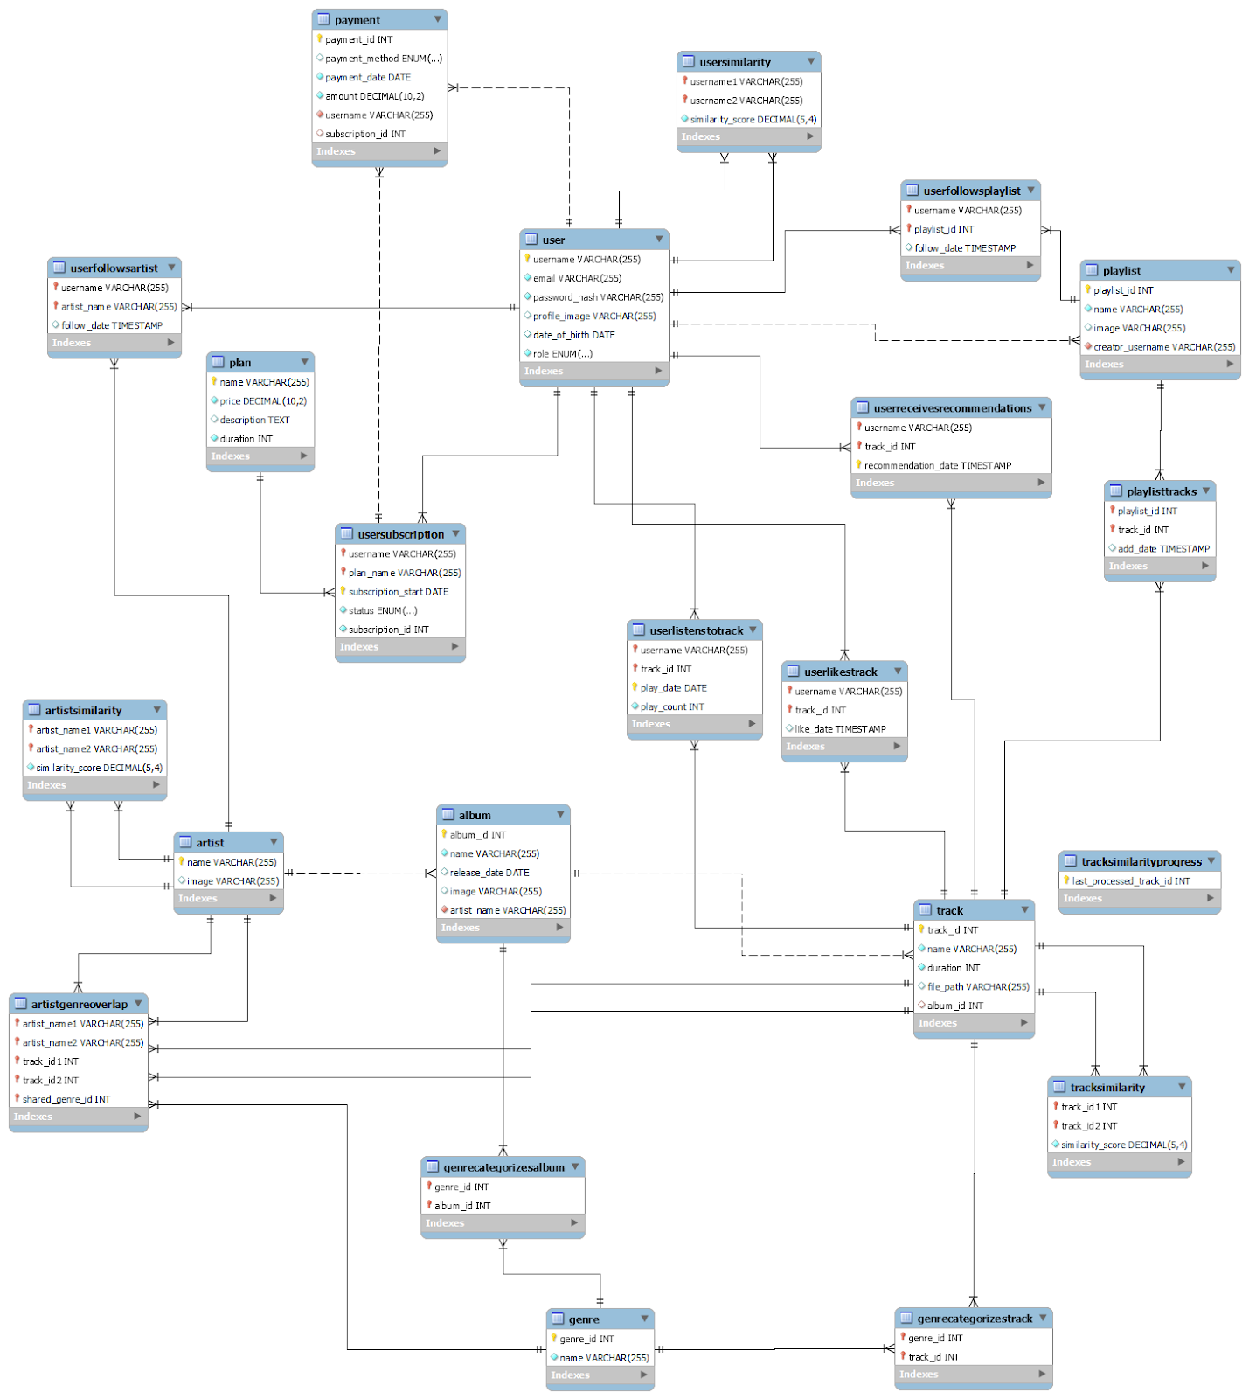
Database Schema Overview
The schema illustrates how user interactions, such as listening to tracks or following artists, paying for a plan are recorded
It also shows the relational design between artists, albums, and tracks, ensuring a dynamic and robust data model.

Slide 4
System Architecture
Database Layer:
Utilizes MySQL to store all user and music data.
Robust schema design to support complex queries and data relationships.
Server Layer:
Flask Application acts as the server backend.
Processes RESTful API requests and manages data flow between the database and frontend.
Frontend:
Developed in JavaScript with Node.js for server-side scripting.
Implements a responsive design for an engaging user experience.

Slide 5
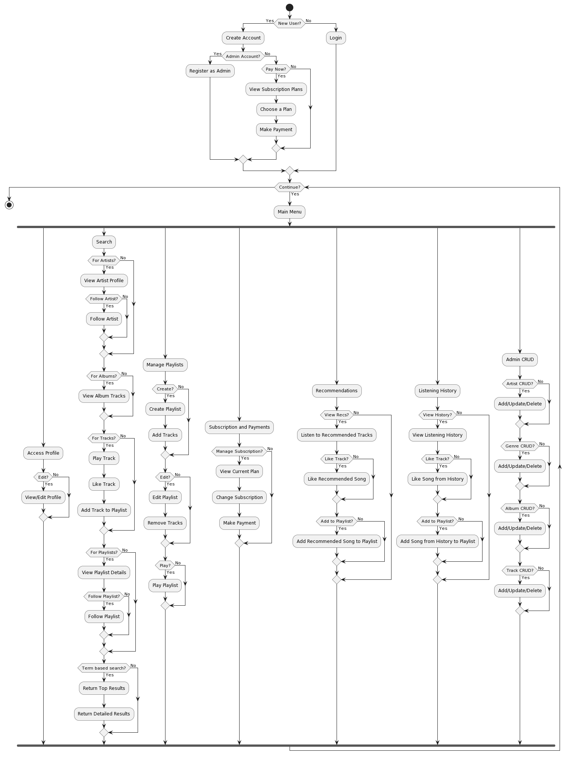
User Functionality and Utility

Slide 6
CRUD Operations Demonstration

Slide 7
Thank you!

