Slide 1


Cloud-Powered Certificate Generator and Mailer System
Presented by:
PAVAN PRASANNA SAI TEJA SURAMPALLI
RAGHU RAMA RAJU INDUKURI
TRIVIKRAM TEJOSH TANDRA
TEJASRI YEKKALA
KARRIPETI GAYATHRI
Mentors:
Mr. ANIL KUMAR VARANASI
Mrs. SUMANA BETHALA

Slide 2
Agenda: From Code to Cloud
Project Overview & Backend
1
Introduction to the system and core technologies.
Code Structure & Dependencies
2
Deep dive into the modular design and Spring Boot essentials.
PDF & Email Logic
3
Understanding certificate generation and automated email delivery.
AWS EC2 Deployment
4
Setting up and running our application on a cloud instance.
DevOps with GitHub
5
Automated workflows.

Slide 3
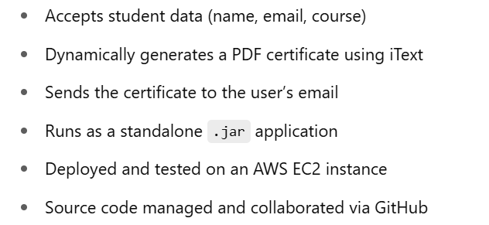
Project Overview: Core Functionality
This project is a Java Spring Boot application that allows users to generate PDF certificates and send them via email automatically. It is deployed on AWS EC2 and tested using Postman, demonstrating both cloud computing and DevOps practices.
Key Features:

Slide 4
Backend Technologies: The Foundation
Java 17 & Spring Boot
Maven
Modern Java for robust backend services, with Spring Boot for rapid application development using MVC architecture.
Dependency management and build automation for consistent project setup.
iTextPDF
Java Mail API
Powerful library for dynamic and customizable PDF document generation.
Enables seamless integration of email sending functionalities within the application.

Slide 5
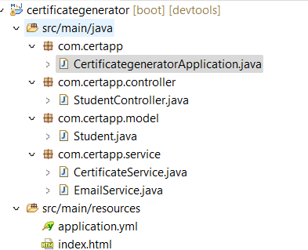
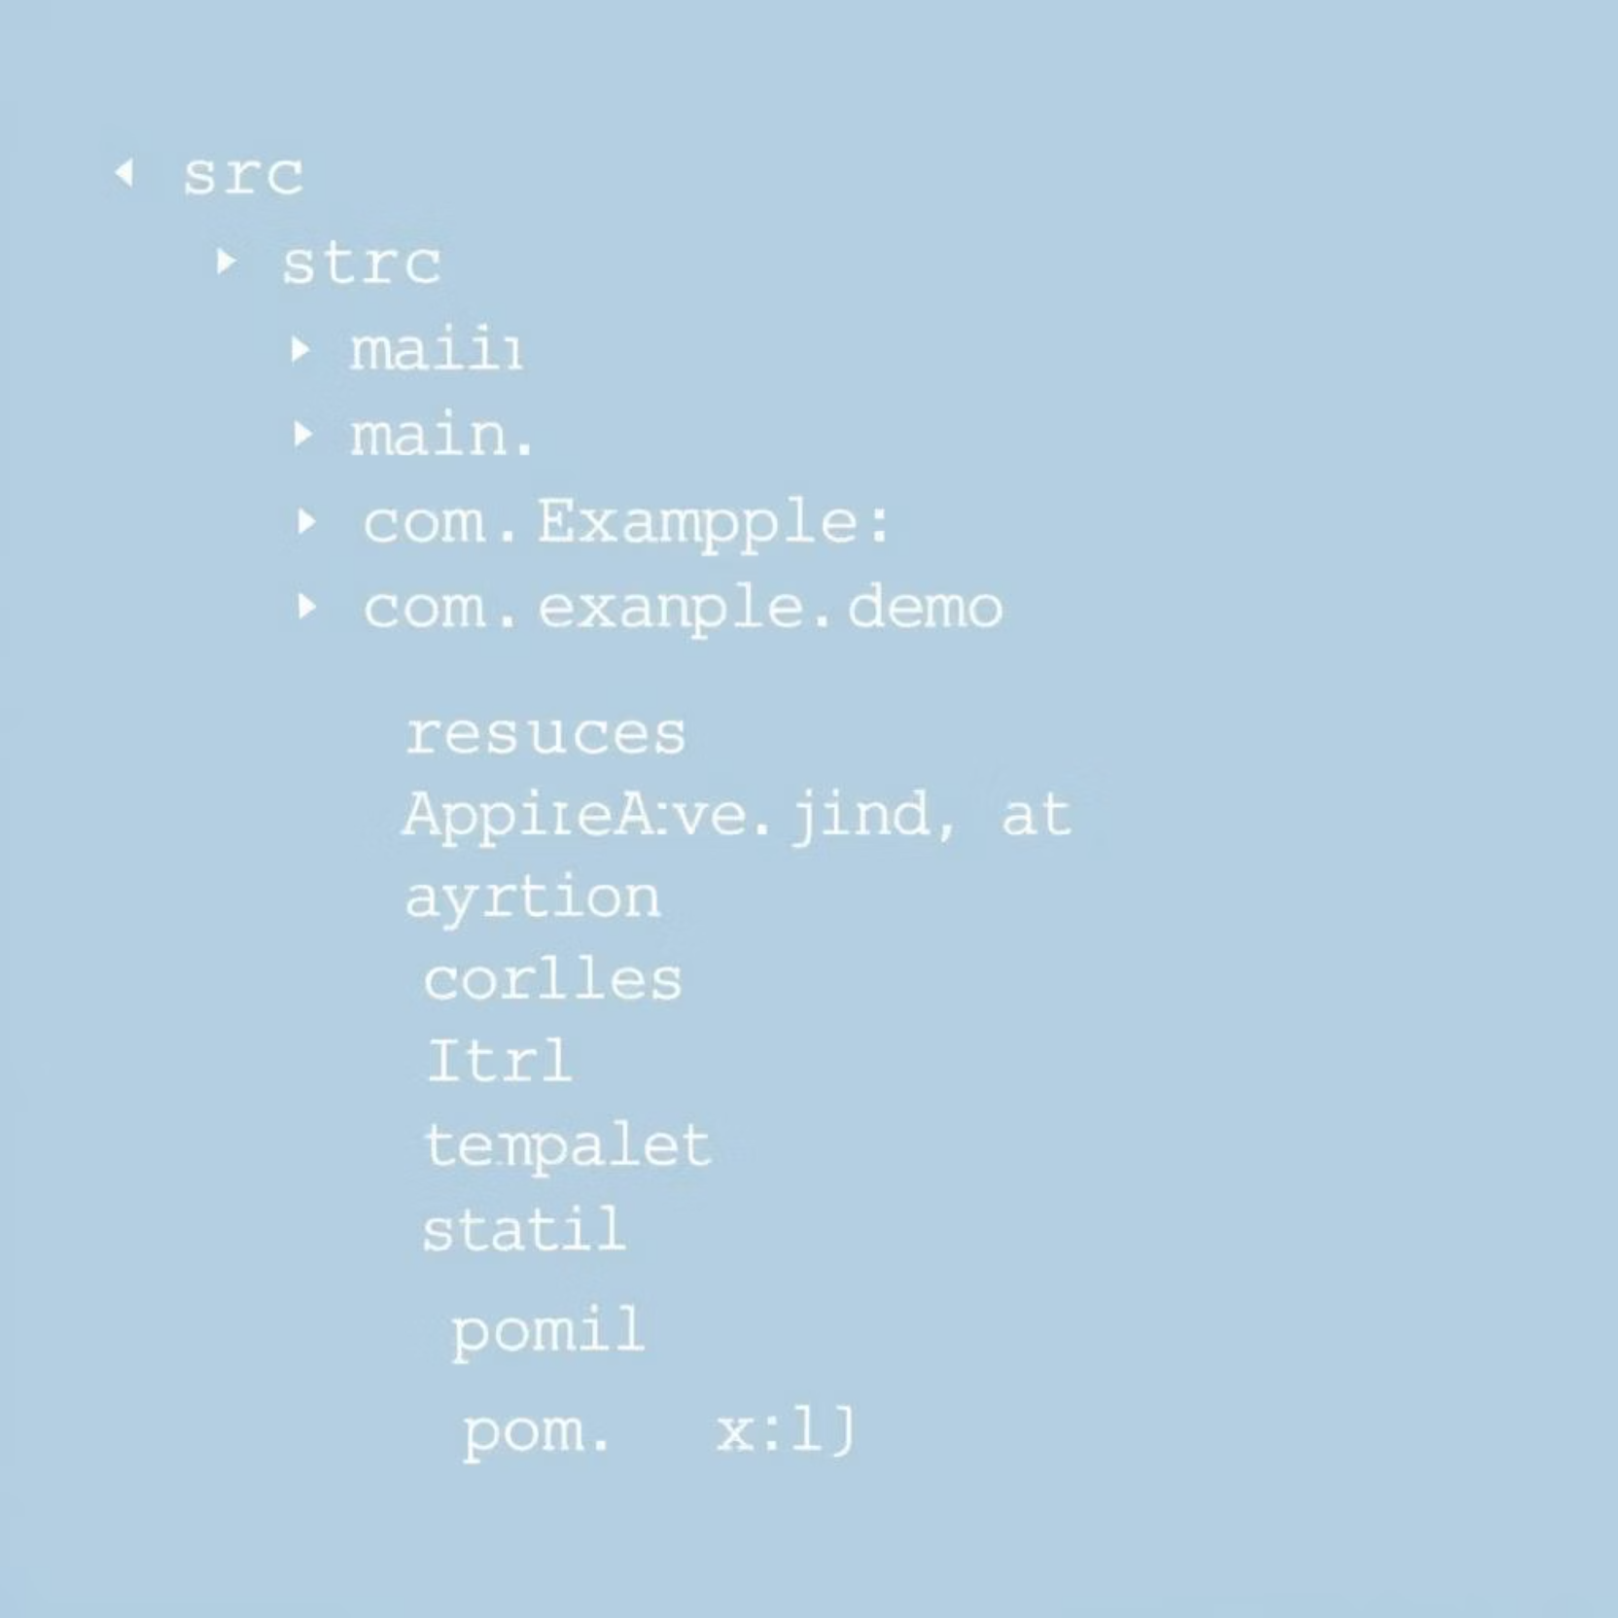
Modular Code Structure
Project Layout
com.certapp: Main application entry point
controller: Handles HTTP requests and responses
model: Data structures and business objects
service: Business logic
application.yml: Configuration properties
index.html: Simple web interface

Slide 6
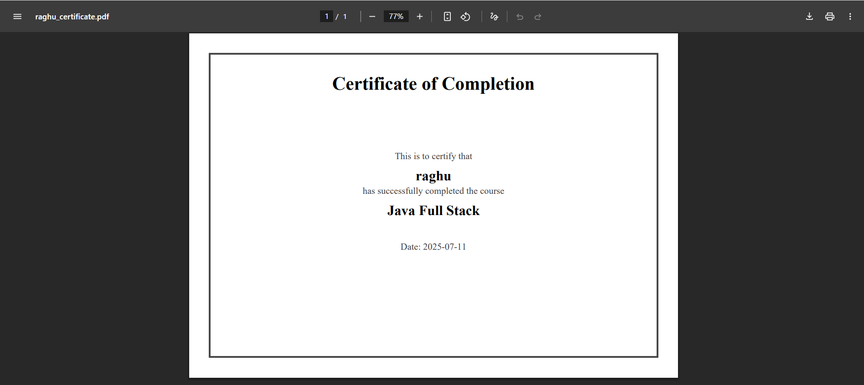
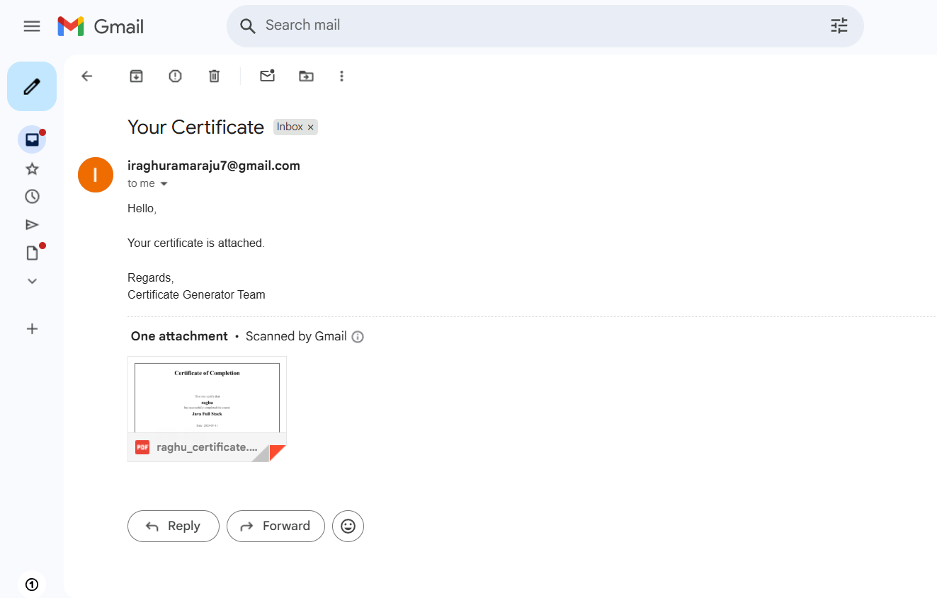
PDF Generation (Using iText)
What It Does:
Takes student info like name, email, and course.
Creates a PDF certificate with that data.
How It Works:
We used the iTextPDF library (dependency in pom.xml)
Inside the code (CertificateService.java), we:
Create a new PDF document
Add text (student details)
Save it as a .pdf file
Email Sending (Using JavaMailSender)
What It Does:
Sends the generated PDF certificate to the student's email address
How It Works:
We used Spring Boot Mail (spring-boot-starter-mail)
Configured sender email in application.yml
In the backend:
We attach the PDF file
Compose an email with a message
Send it using JavaMailSender

Slide 7
AWS EC2 Deployment
AWS EC2 Fundamentals
Elastic Compute Cloud (EC2) provides scalable computing capacity in the cloud.
Instance Creation & SSH
Launch an EC2 instance, configure security groups, and securely connect via SSH using a key pair.
Java Runtime Setup
Install Java Development Kit (JDK) 17 on the EC2 instance for application execution.
JAR Transfer & Execution
Transfer the compiled JAR file using `scp`. Run the application with `java -jar`.
Network Configuration
Set an inbound rule for port 8080 in the security group to allow external access. Access via public IP.

Slide 8
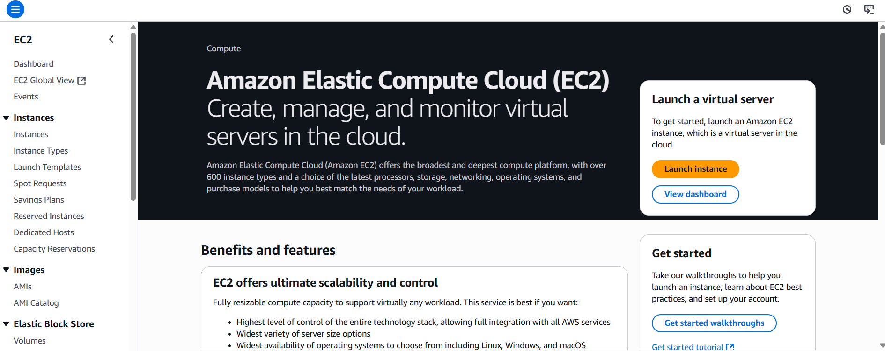
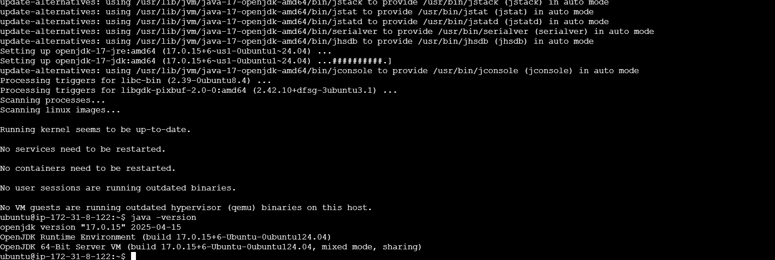
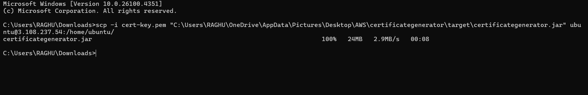
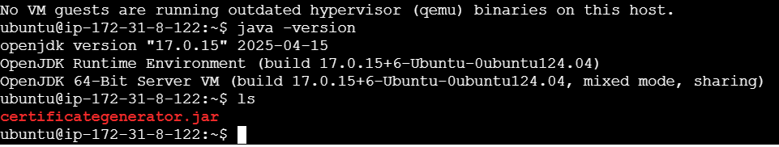
Installed Java in Ec2
EC2 Instance
Successful transfer of the certificategenerator.jar

Slide 9
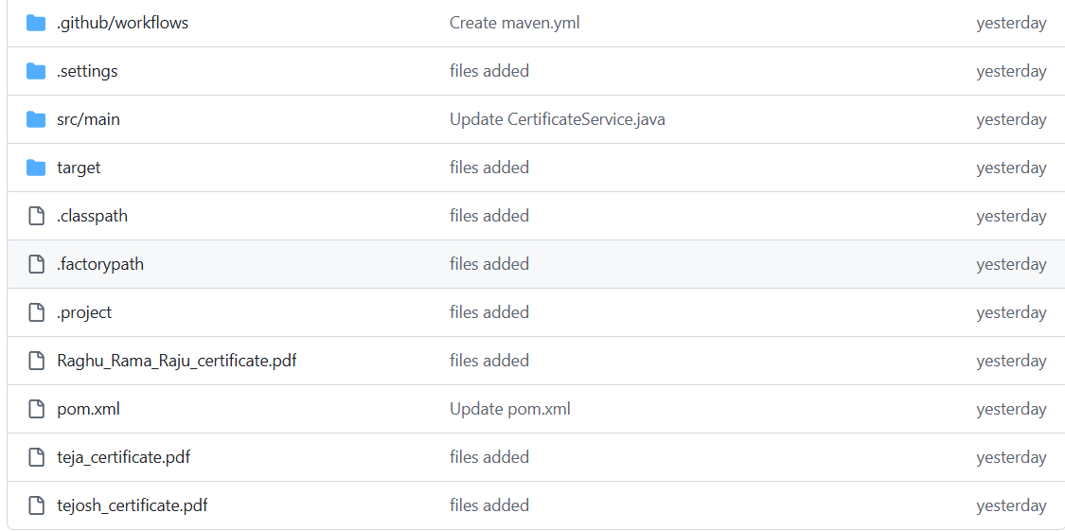
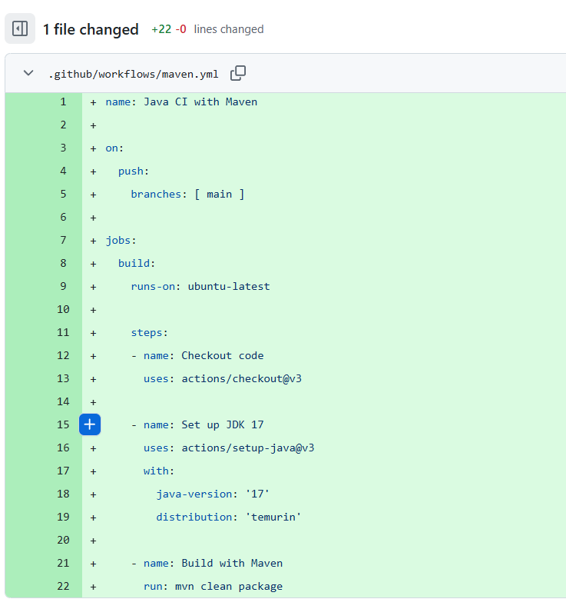
DevOps Approach in Our Project
What We Used:
GitHub for version control
Team collaboration via GitHub repo
Code pushed and maintained centrally
Team Workflow:
Each member cloned the repo
Worked on assigned module (Controller, Model, Service, etc.)
Pushed changes using Git
GitHub Actions
What We Planned:
Set up GitHub Actions for CI (Continuous Integration)
Auto-build the project on every push using Maven
Added .github/workflows/maven.yml
Automate testing and deployment

Slide 10
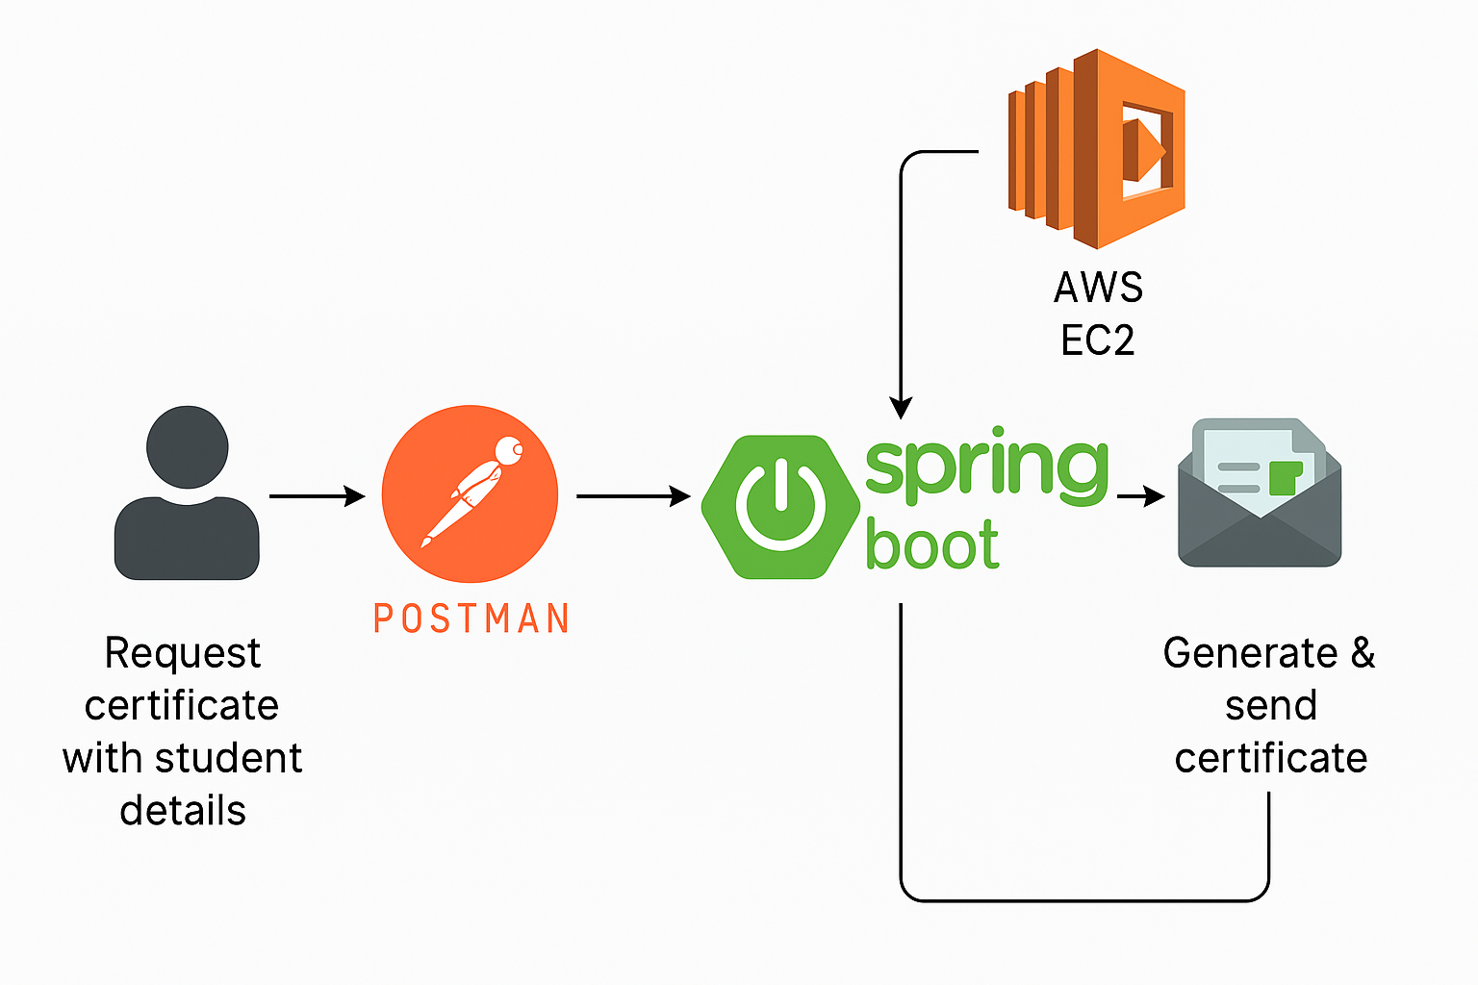
Conclusion & Future Scope
Conclusion
Successfully built a Spring Boot-based Certificate Generator
Deployed on AWS EC2 and tested via Postman
Generated and sent PDF certificates via email
Followed basic DevOps practices using GitHub
Future Scope
Add front-end interface (React/Angular)
Store data using a database (MySQL/PostgreSQL)
Add authentication and admin dashboard
Containerize with Docker and deploy using Kubernetes
Project Architecture

