Slide 1

Project - Phase 1
Global Comparison of Leading Nations
Team Members:
Raghu Vamsi [22bds014]
Satvik Reddy [22bds020]
Raj Kumar [22bds055]
Suhaas [22bds056]
Github Repo Link: GitHub

Slide 2
Overview of the Project: This project focuses on comparing key global players like the USA, Russia, China, India, Canada, Australia, and others using a diverse dataset covering economic, social, environmental, technological, and military metrics. The goal is to visualize and analyze these countries across various indicators to provide valuable insights into their development, growth, and global standing. Dataset / Feature Description: The dataset includes a comprehensive comparison of countries based on: Economic Indicators: GDP, inflation rates, unemployment rates, etc. Social Indicators: Literacy rates, healthcare quality, life expectancy, etc. Environmental Indicators: CO2 emissions, renewable energy share, forest coverage, etc. Technological Advancements: Internet penetration, smartphone adoption, etc. Military Spending: Military expenditure, number of active military personnel, etc. The dataset covers information from 2000 to 2023, providing a holistic view of each country’s progress across multiple dimensions.

Slide 3
Project’s Scope / Deliverables: Interactive visualizations comparing key metrics across selected countries. Insights on country performance in terms of economic strength, social well-being, environmental sustainability, and military power. Dashboards highlighting key trends and allowing for comparisons between nations. Mid-term focus on building interactive dashboards using Power BI for better decision-making and presentation.
Tools and Technologies Used:
Pandas, NumPy: For data manipulation and analysis. Seaborn, Plotly: For advanced visualizations. Power BI (Upcoming): For interactive dashboard creation.

Slide 4
Progress Achieved (Phase 1)
Key Milestones & Tasks Completed
Data Analysis and Integrity Check (100%)
The dataset was thoroughly examined, and all key metrics (economic, social, environmental, military) were analyzed.
Checked for any outliers or missing values in the data, and found that the dataset was clean and ready for further analysis.
Advanced Data Exploration and Insights (100%)
Explored key indicators like GDP, population, literacy rates, healthcare access, and military spending to understand the trends and differences between countries.
Identified crucial insights regarding country-level performance across various domains.
Initial Visualizations Using Plotly (100%)
Developed advanced visualizations in Plotly, comparing countries across several key metrics like economic performance, social indicators, and military spending.
These visualizations provided foundational knowledge that will be used for creating interactive dashboards in Power BI.

Slide 5
Percentage of Work Completed:
Approximately 40% of the project has been completed, including data analysis, quality checks, and initial visualizations.
Challenges Faced & Solutions Implemented
Challenge: No outliers or missing data were found, which reduced complexity in the data cleaning phase.
Solution: This allowed for smoother transition to visualization work, enabling efficient creation of advanced graphs and comparisons in Plotly. The experience gained in this phase will guide the development of more interactive visualizations in Power BI in the upcoming phase.

Slide 6
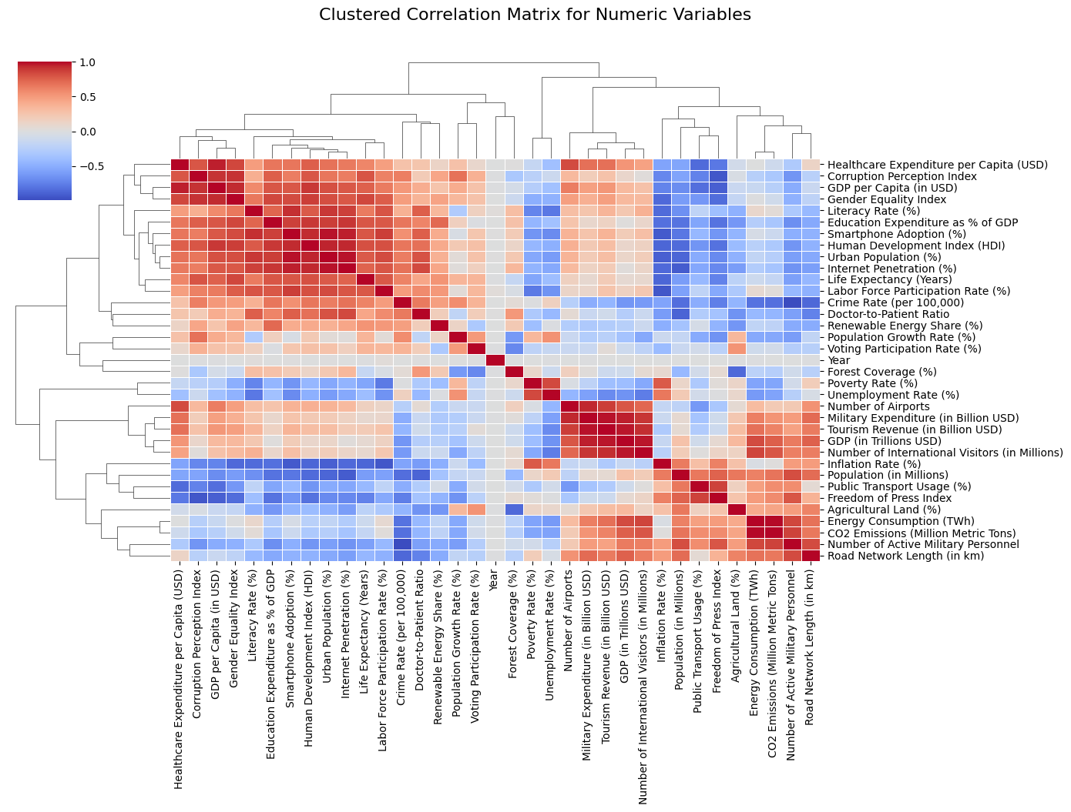
Best Results and Visualizations Achieved:

Slide 7
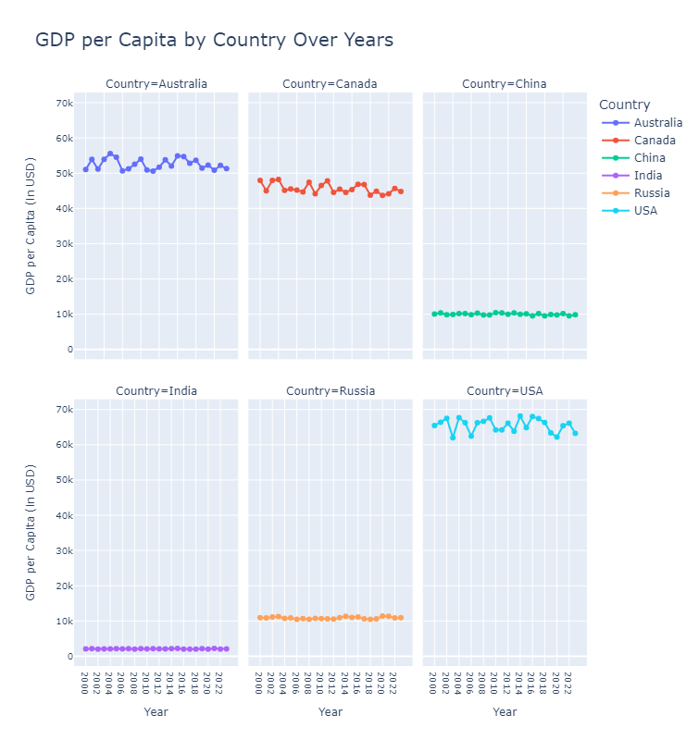
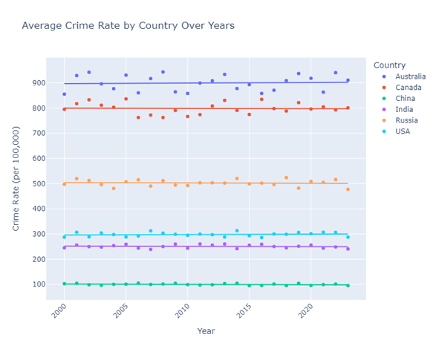

Slide 8
Plan for Next Phase
The next phase focuses on building interactive dashboards in Power BI to present the insights gained from the dataset. The goal is to create a user-friendly interface that allows for dynamic exploration and comparison of key metrics across selected countries.
Timeline & Milestones
Week 1: Power BI Setup & Data Import
Set up Power BI environment and import the dataset.
Establish data relationships and ensure proper data structure for effective analysis.
Create an initial dashboard layout to guide the design process.
Week 2: Development of Economic and Social Dashboards
Create interactive visualizations for economic indicators (GDP, inflation, unemployment).
Develop social metrics dashboards focusing on literacy rates, healthcare quality, and life expectancy.
Implement filters and slicers for user interaction, enabling detailed comparisons.
Week 3: Environmental and Technological Dashboards
Build visualizations to compare environmental indicators (CO2 emissions, renewable energy usage).
Develop dashboards highlighting technological advancements (internet penetration, mobile subscriptions).
Ensure visualizations are clear and informative, with user-friendly navigation.

Slide 9
Week 4: Military Metrics and Final Touches
Create dashboards for military spending and personnel metrics.
Refine all dashboards based on feedback from initial testing to improve clarity and usability.
Conduct performance testing to ensure smooth interaction and loading times.
Week 5: Comprehensive Review and Presentation Preparation
Perform a thorough review of all dashboards and visualizations for accuracy and effectiveness.
Prepare presentation materials to showcase the interactive dashboards and findings.
Phase Completion Target:
The goal is to complete this phase within 5 weeks, achieving approximately 60% of the total project.
Upcoming Milestones:
Fully functional interactive dashboards ready for review.
Enhanced user experience through dynamic filters and drill-down capabilities.
Finalized visualizations covering economic, social, environmental, technological, and military indicators.

Slide 10
Conclusion / References
Project Summary and Progress The project has progressed well in Phase 1, with around 40% completed. We’ve analyzed the dataset comparing countries like the USA, Russia, China, India, Canada, and Australia. After checking for any outliers (none found), we created advanced visualizations using Plotly. These visualizations show key economic, social, environmental, and military indicators, providing important insights for policymakers and researchers. Comparing these indicators helps us understand global trends and make better decisions.
Significance This project is valuable because it helps us visualize global data, making it easier to spot differences and opportunities for growth. This is useful for planning policies and research.

Slide 11
Tools & Technologies:
Python Libraries:
Pandas: For data manipulation and analysis.
Numpy: For numerical computations.
Seaborn & Plotly: For data visualization and creating interactive plots.
Jupyter Notebook: For conducting data analysis and visualizations.
Dataset:
A comprehensive dataset comparing various indicators across selected countries, covering economic, social, environmental, and military metrics.
References:
Online resources and tutorials for best practices in Power BI (upcoming) for interactive dashboard development.
Relevant research articles and reports on global economic and social indicators to contextualize findings.

Slide 12
Thank You !!!

