Slide 1
Employee Data Analysis using Excel
STUDENT NAME: Sree Raghul.R
REGISTER NO:D22cm189(9D22AF9969489289D8E476CA3D77CFC9)
DEPARTMENT: Commerce
COLLEGE : Patrician College of Arts and Science

Slide 2
PROJECT TITLE
Employee Attrition Analysis using Excel

Slide 3


AGENDA
Problem Statement
Project Overview
End Users
Our Solution and Proposition
Dataset Description
Modelling Approach
Results and Discussion
Conclusion
3/21/2024 Annual Review

Slide 4

PROBLEM STATEMENT
Our client is ABC a leading firm and is doing well in the sector. It is recently facing a steep increase in its employee attrition . Employee attrition has gone up from 14% to 25% in the last 1 year . We are asked to prepare a strategy to immediately tackle this issue such that the firm’s business is not hampered and also to propose an efficient employee satisfaction program for long run. Currently, no such program is in place . Further salary hikes are not an option.

Slide 5

PROJECT OVERVIEW
The Employee Attrition dataset encompasses detailed information about employees, capturing essential parameters such as:
Employee Information: Employee ID, age, gender, education, and marital status.
Job Role and Department: Information on the job role, department, and job level.
Compensation and Benefits: Salary, stock options, and other benefits.
Work Experience: Years at company, years in current role, and years with current manager.
Performance and Satisfaction: Performance ratings, job satisfaction, and work-life balance.
Attrition Status: Whether the employee has left the company (yes or no).

Slide 6

WHO ARE THE END USERS?
Employers want to reduce turnover because recruiting and training new hires is costly. When an employee voluntarily leaves an organization, however, there may be benefits to an employer, such as:
Decrease in labor costs: Layoffs can occur due to a change in business operations or a decline in profits. Unfortunately, layoffs can significantly reduce employee morale, leading to additional turnover and difficulties with future hiring. When employees leave by choice, the company can decrease costs and reduce the risk of layoffs.
Shifting of resources: By choosing not to refill a position, employers can assign new duties to other employees, change departmental workflows or shift resources within an organization.
New dynamics: Attrition offers opportunities for new ideas and dynamics. It can refresh an organization and provide current employees with new opportunities.
Culture change: It’s not always easy to change an organization’s culture, especially without replacing entire teams. Natural employee attrition allows employers to refresh a company culture without firing or layoffs
.
.

Slide 7

OUR SOLUTION AND ITS VALUE PROPOSITION
Formula-job satisfaction
Pivot-summary
Bar, pie –Data visualization

Slide 8
Dataset Description
Employee=-Kaggle
13 features
8 features
Employee Age
Martial status
Attrition Status
Department
Distance From home
Job satisfaction
Monthly income
Years at company

Slide 9

THE "WOW" IN OUR SOLUTION
Job Satisfaction-IFS(H2>=4,”very high”,H2>=3,”high”,H2>=2,”medium”,
TRUE,”low”)
3/21/2024 Annual Review
9

Slide 10
MODELLING
Data collection
Techniques
Results
Pivot table
Bar chart
Pie chart
10

Slide 11
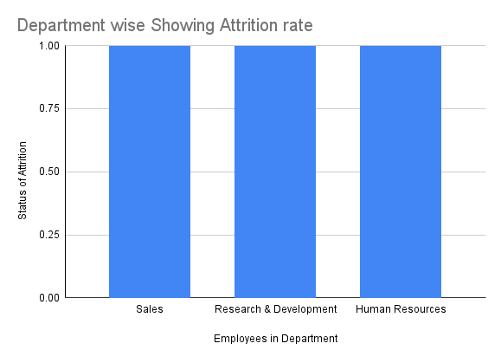
RESULTS
11

Slide 12
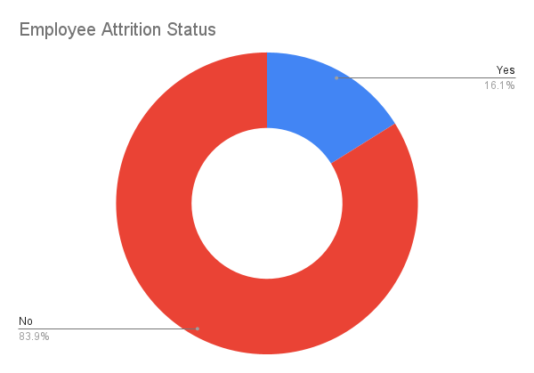


Slide 13
conclusion
In conclusion, employee attrition is a critical aspect of HRM that impacts an organization’s stability and success. By understanding its Status And Rates of Department wise in Attrition , businesses can proactively address attrition and create a work environment that retains valuable talent.

