Slide 1


Team: All Test Cases Passed
Members: Raghul, Sachin Abhinav

Slide 2
Problem Statement
Develop an enhanced shopping experience by leveraging visual AI technology to improve product search, recommendations, and item identification in text, image, or video content. The goal is to create a more seamless, personalized, and engaging shopping experience for customers by harnessing the power of visual AI and computer vision technologies.
Current Scenario
Difficulty in Identifying Products - Users often struggle to find specific fashion items seen in videos due to the lack of integration between Entertainment content and Shopping.
Scope of Innovation
Fashion Item Identification
Allowing users to identify fashion products featured in video content with relevent metadata utilizing computer vision, advanced object detection and image recognition algorithms to analyze video frames in real-time.
Product Search
Implementing a robust visual similarity search engine that compares identified fashion items against Amazon's extensive fashion product database with deep learning models.
Recommendations
Developing personalized product recommendations based on visual similarity and user preferences, providing users with direct links to the products on Amazon.

Slide 3
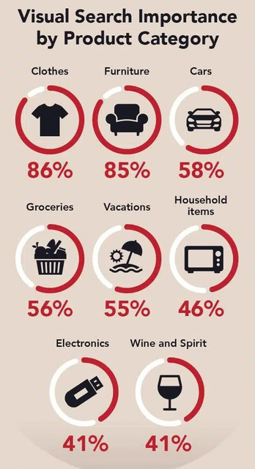
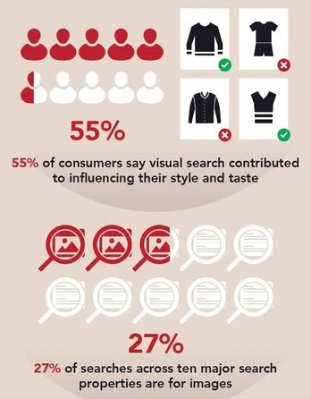
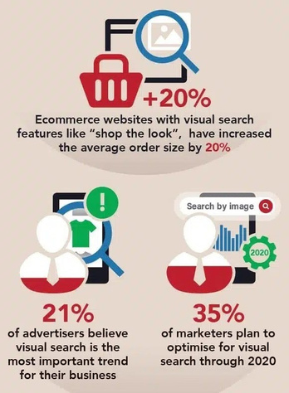
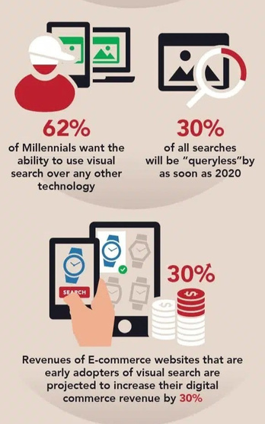
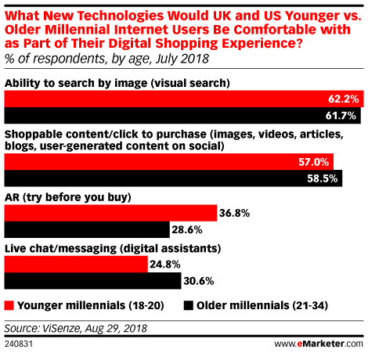
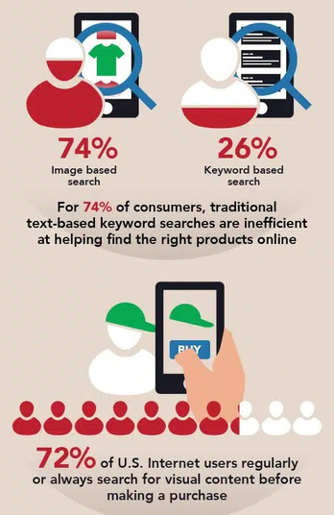
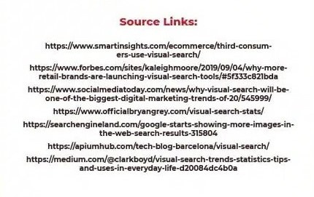
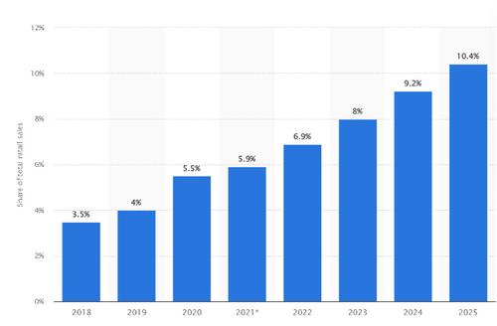
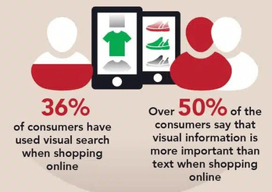
Research & Statistics

Slide 4
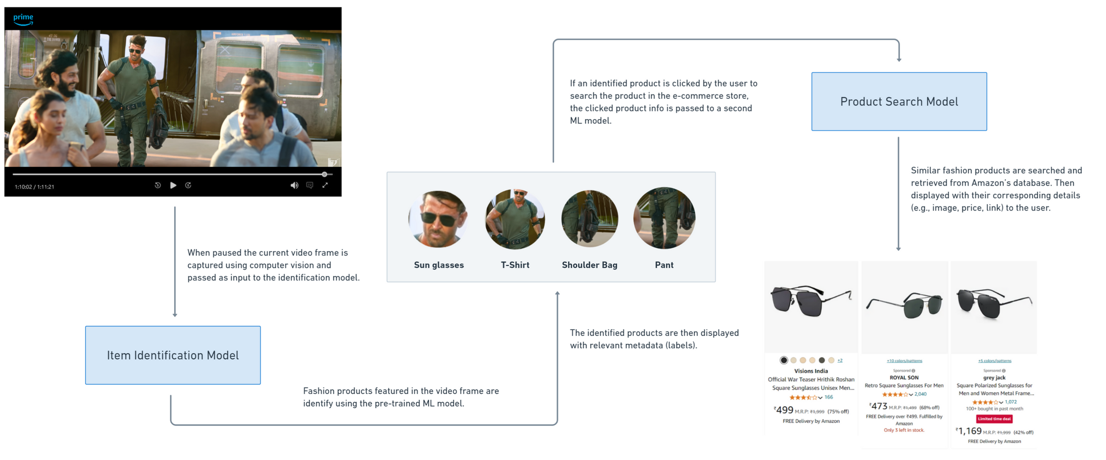
Pipeline

Slide 5
How It would be
Imagine a user watching a movie/show on Amazon Prime.
Suddenly sees a unique gadget or a attractive fashion product being used. With AI-driven image search, they can pause the video, click on the gadget/fashion product, and instantly be taken to its product page on Amazon’s e-commerce site. This feature not only provides convenience but also capitalizes on the user’s immediate interest, making the purchase more likely.

Slide 6
Technologies
PostgreSQL, React, Python, Flask for website Tech Stack.
Tensorflow for models trainings.
YOLOv8 model for Fashion Product Detection from the video frame.
ResNet50 for feature vector extraction from the images of products detected.
Nearest Neighbours Algorithm to predict the closest image vectors for similar image search functionality.
Implementation
User Interaction: User pauses the movie/show at a frame.
Fashion Product Detection: The fashion products in the paused frame are identified and highlighted.
Feature Extraction: The products detected are vectorized with feature extraction.
Vector Similarity Search: Similar fashion products are filtered by finding the nearest neighbors on the feature vectors of products in the Amazon database.

Slide 7
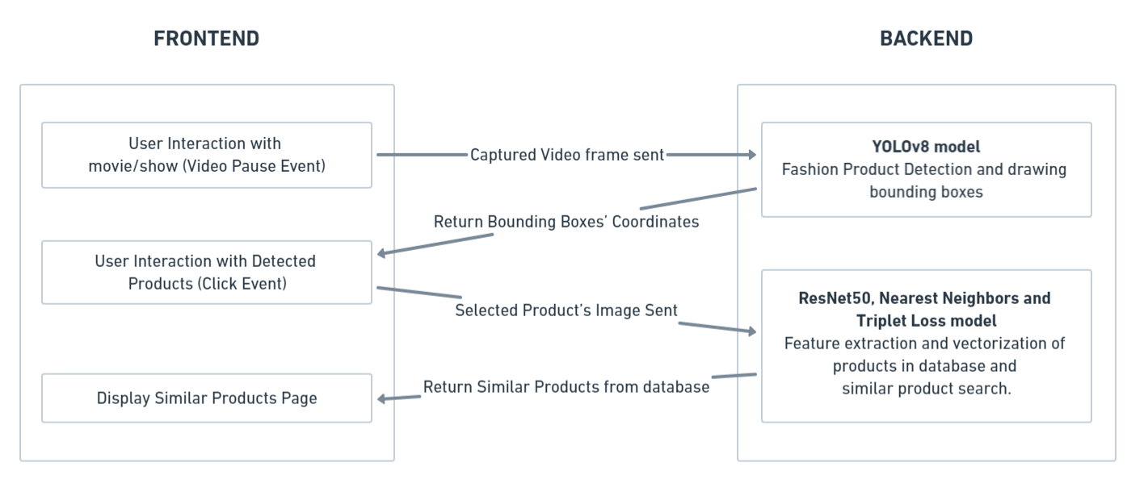
Flowchart

Slide 8
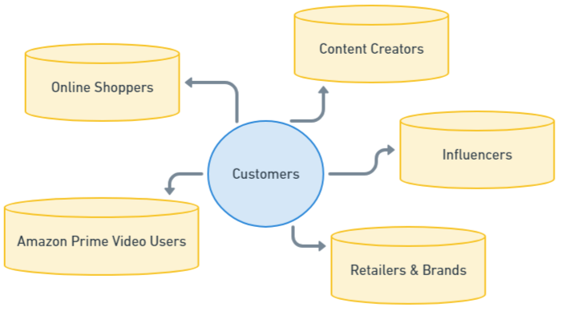
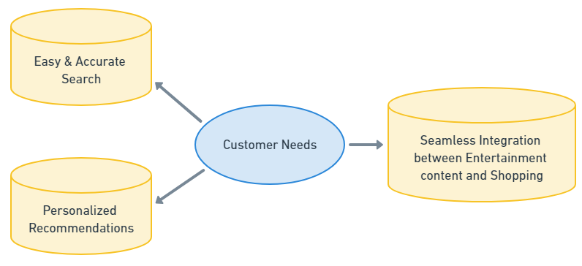

Who is Our Customer
Customer Needs

Slide 9
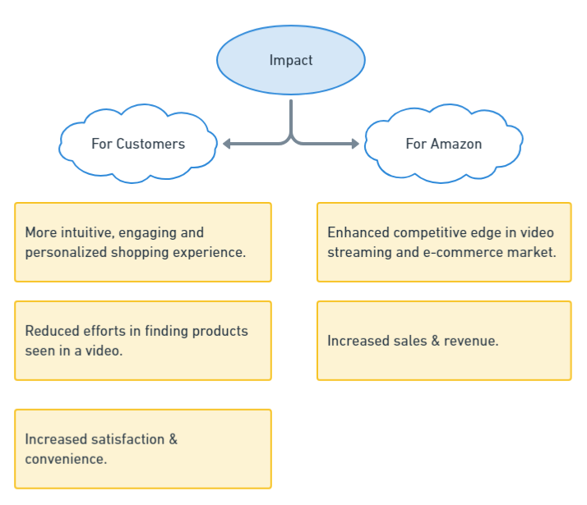
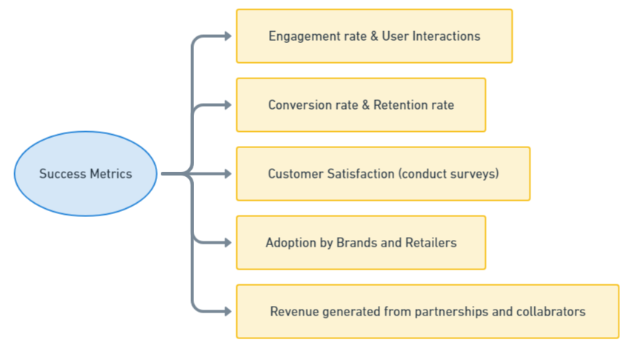
Success Metrics
Impact

Slide 10
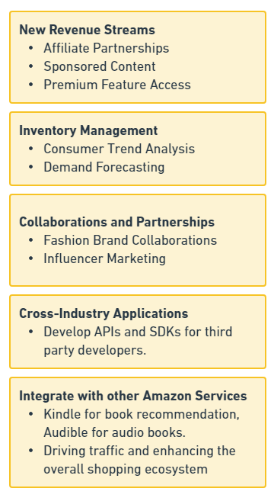
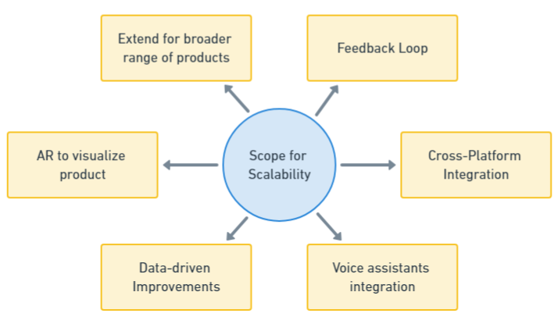
Scope for Scalability
Marketplace Domain Expansion

Slide 11
Thank You
GitHub Repo: https://github.com/Raghul-V/HackonWithAmazon

