Slide 1
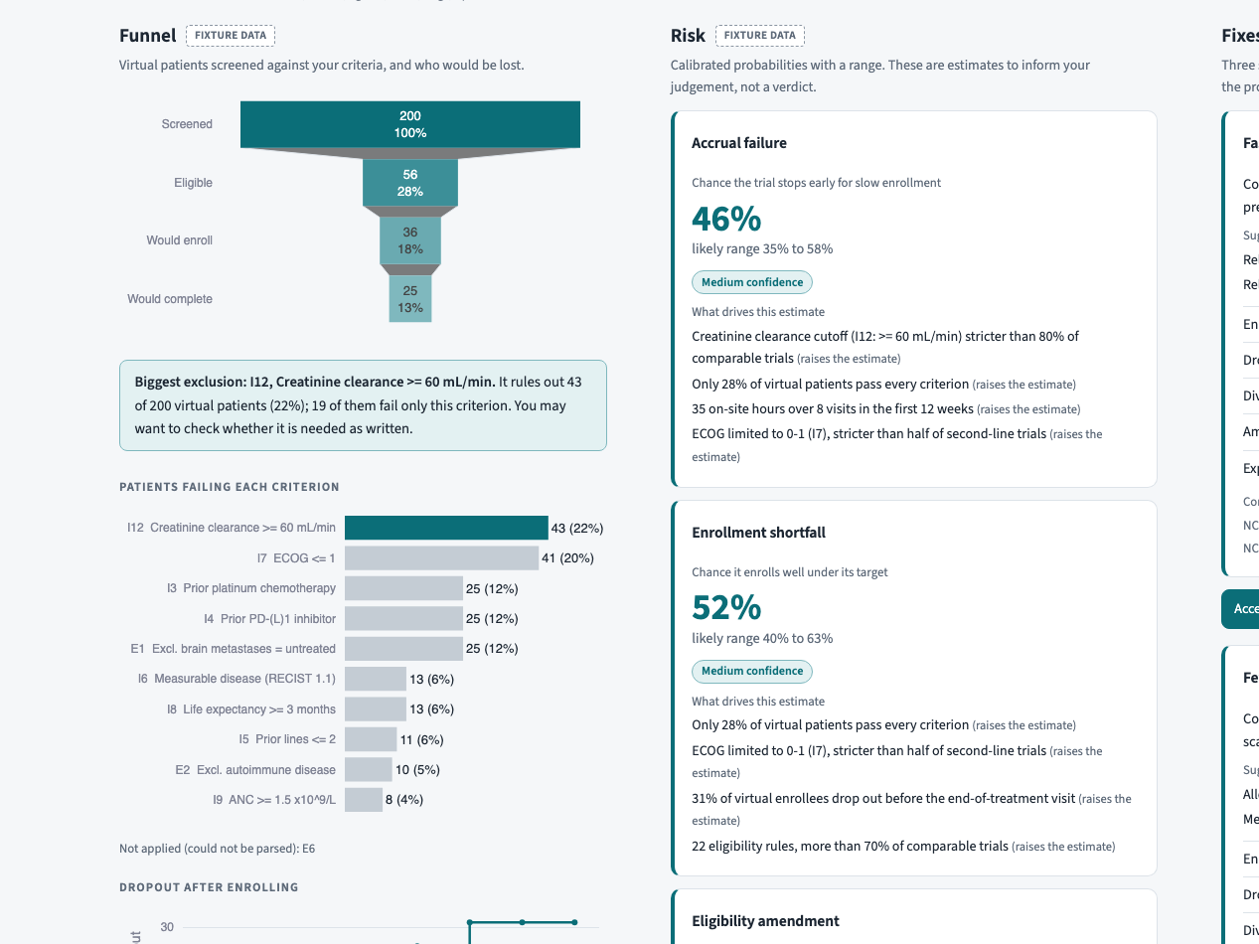
Clinova
Test-fly your NSCLC trial on thousands of virtual patients before enrolling a real one
Every prediction is graded against how real ClinicalTrials.gov trials turned out
https://github.com/RaghulKS/Clinova
1 / 12
Notes:
Clinova is a flight simulator for non-small cell lung cancer trial protocols. A study designer pastes a draft protocol or an NCT ID, and Clinova shows where enrollment will stall and where patients will drop out, before the protocol is final. The difference from other tools is proof: every prediction is graded against how real ClinicalTrials.gov trials turned out, on trials the model never saw. Clinova advises the author; it never approves a protocol. Pitch wording: docs/ARCHITECTURE.md section 1.

Slide 2
THE PROBLEM
Most trial delays are written into the protocol before the first patient is screened
57%
$535K
34.5%
of protocols need a substantial amendment
median cost of one Phase III amendment
of cancer-trial terminations: low accrual, the top reason
45% of those are avoidable
$141K in Phase II, plus about 3 months
22.74% of 8,687 US cancer trials terminated
Clinova pulls the two levers the FDA cost study names: looser enrollment rules and simpler protocols
Sources: docs/ARCHITECTURE.md
2 / 12
Notes:
Delays are designed in. 57% of protocols get a substantial amendment and 45% of those were avoidable (Starter Sheet 01). Each costs a median $141K in Phase II and $535K in Phase III plus about 3 months (Starter Sheet 01). Of 8,687 US cancer trials, 22.74% were terminated, and accrual was the top specific reason at 34.5% (PMC10028157). All figures: docs/ARCHITECTURE.md section 2. The FDA-commissioned cost study names looser enrollment rules and simpler protocols.

Slide 3
WHY NOW
Public version history and LLM parsing make protocol risk checkable today
1
2
3
Amendments are public
LLMs read eligibility
Design is the AI gap
ClinicalTrials.gov keeps every registered version, so a widened rule is a checkable label
Gemini turns free-text criteria into rules that code can check on virtual patients
Tufts CSDD 2024: full AI adoption is lowest in trial design and planning
Sources: docs/ARCHITECTURE.md
3 / 12
Notes:
Three things changed. First, ClinicalTrials.gov keeps every registered version of a protocol, so when a sponsor widens a rule, that edit is public. Starter Sheet 01 assumes amendment data is private; we use version history as a public proxy instead, so every claim can be checked. Second, an LLM can turn free-text eligibility into rules code can check. Third, the Tufts CSDD 2024 benchmark finds full AI adoption lowest in trial design and planning. Source: docs/ARCHITECTURE.md sections 2 and 3.

Slide 4
WHAT CLINOVA DOES
Clinova test-flies a protocol in five steps, from draft text to a graded risk
1
2
3
4
5
Read
Simulate
Calibrate
Optimize
Learn
Draft text or NCT ID to coded rules and visits
Virtual NSCLC cohort, screened in code; persona agents decide
LightGBM on real trials, explained by SHAP
Test edits; trade-offs with ranges and dollars
Log every prediction, score it when the trial ends
Sources: docs/ARCHITECTURE.md
4 / 12
Notes:
Five steps. Read: Gemini turns eligibility rules and the visit schedule into code-checkable logic. Simulate: a virtual NSCLC cohort is screened in code, then persona agents decide whether to enroll and when they would drop out. Calibrate: LightGBM trained on real ClinicalTrials.gov trials gives calibrated risk, explained by SHAP. Optimize: test edits such as relaxing a criterion or cutting a visit, with ranges and a dollar value. Learn: every prediction is logged and scored when the trial ends. Source: docs/ARCHITECTURE.md section 1.

Slide 5
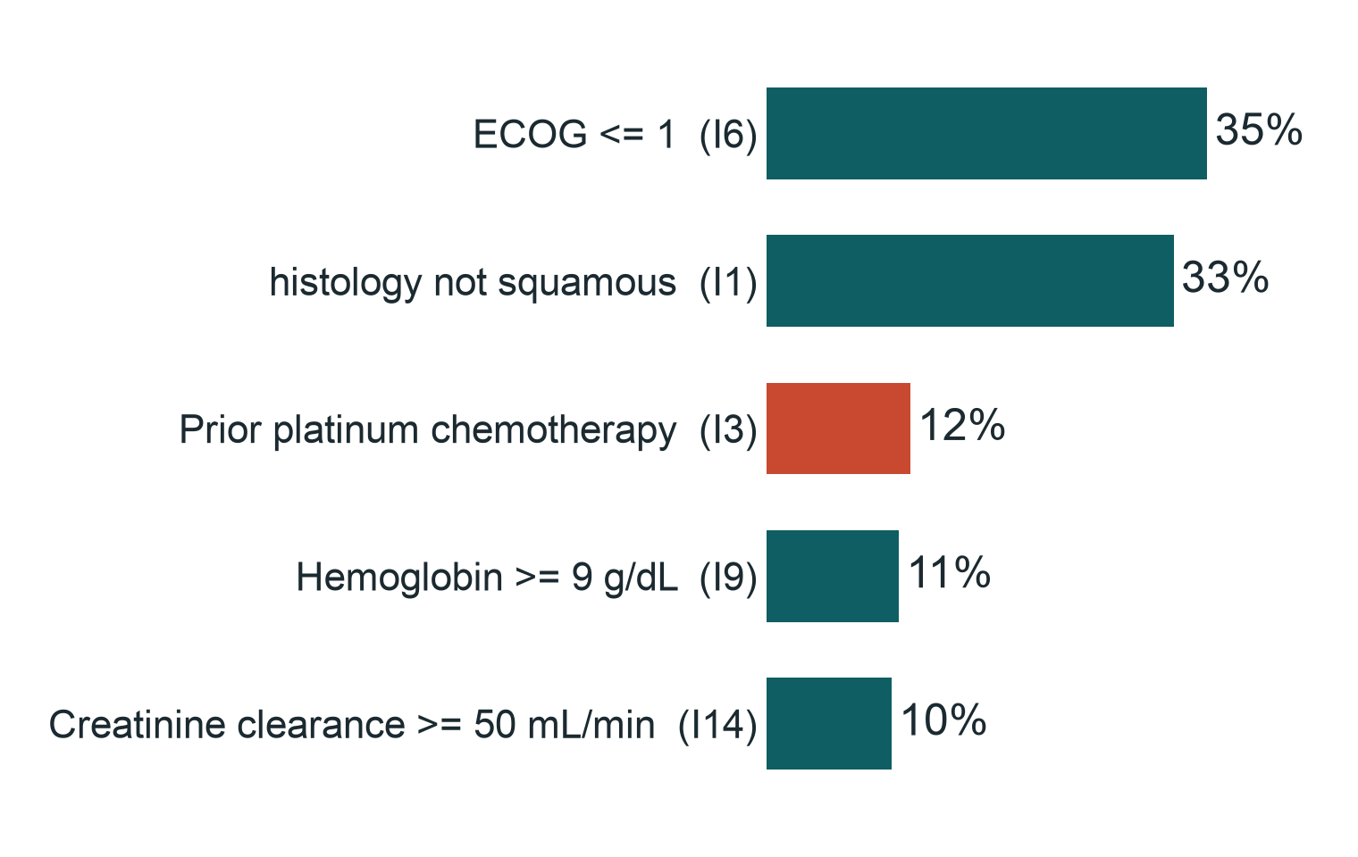
BACKTEST ON A REAL TERMINATED TRIAL
DRAFT: placeholder numbers
Backtest: from NCT03232892's first protocol, Clinova finds where enrollment stalls
NCT03232892
Terminated 2019-09-11: “Low Accrual”
21.4% of 1,000 virtual patients pass the first registered criteria
ECOG <= 1 excludes the most (35%)
Did our top 3 flags include the widened rule? [TBD: demo flags (docs/deck/data/demo.json)]
Coral bars: rules the sponsor later widened
Sources: docs/demo_trial.md, docs/gate1_e2e.json (seed 1), docs/deck/data/demo.json
5 / 12
Notes:
This is a real trial, NCT03232892, from the test split, terminated on 2019-09-11 with the stop reason "Low Accrual" (docs/demo_trial.md). We load only its first registered protocol. 21.4% of 1,000 virtual patients pass every criterion, and ECOG <= 1 removes 35% on its own (funnel: docs/gate1_e2e.json (seed 1)). Later the sponsor removed prior platinum, cardiac condition. Did our top 3 flags include the widened rule? [TBD: demo flags (docs/deck/data/demo.json)]. Flags: docs/deck/data/demo.json. Version histories confirm the change only from first versus current text.

Slide 6
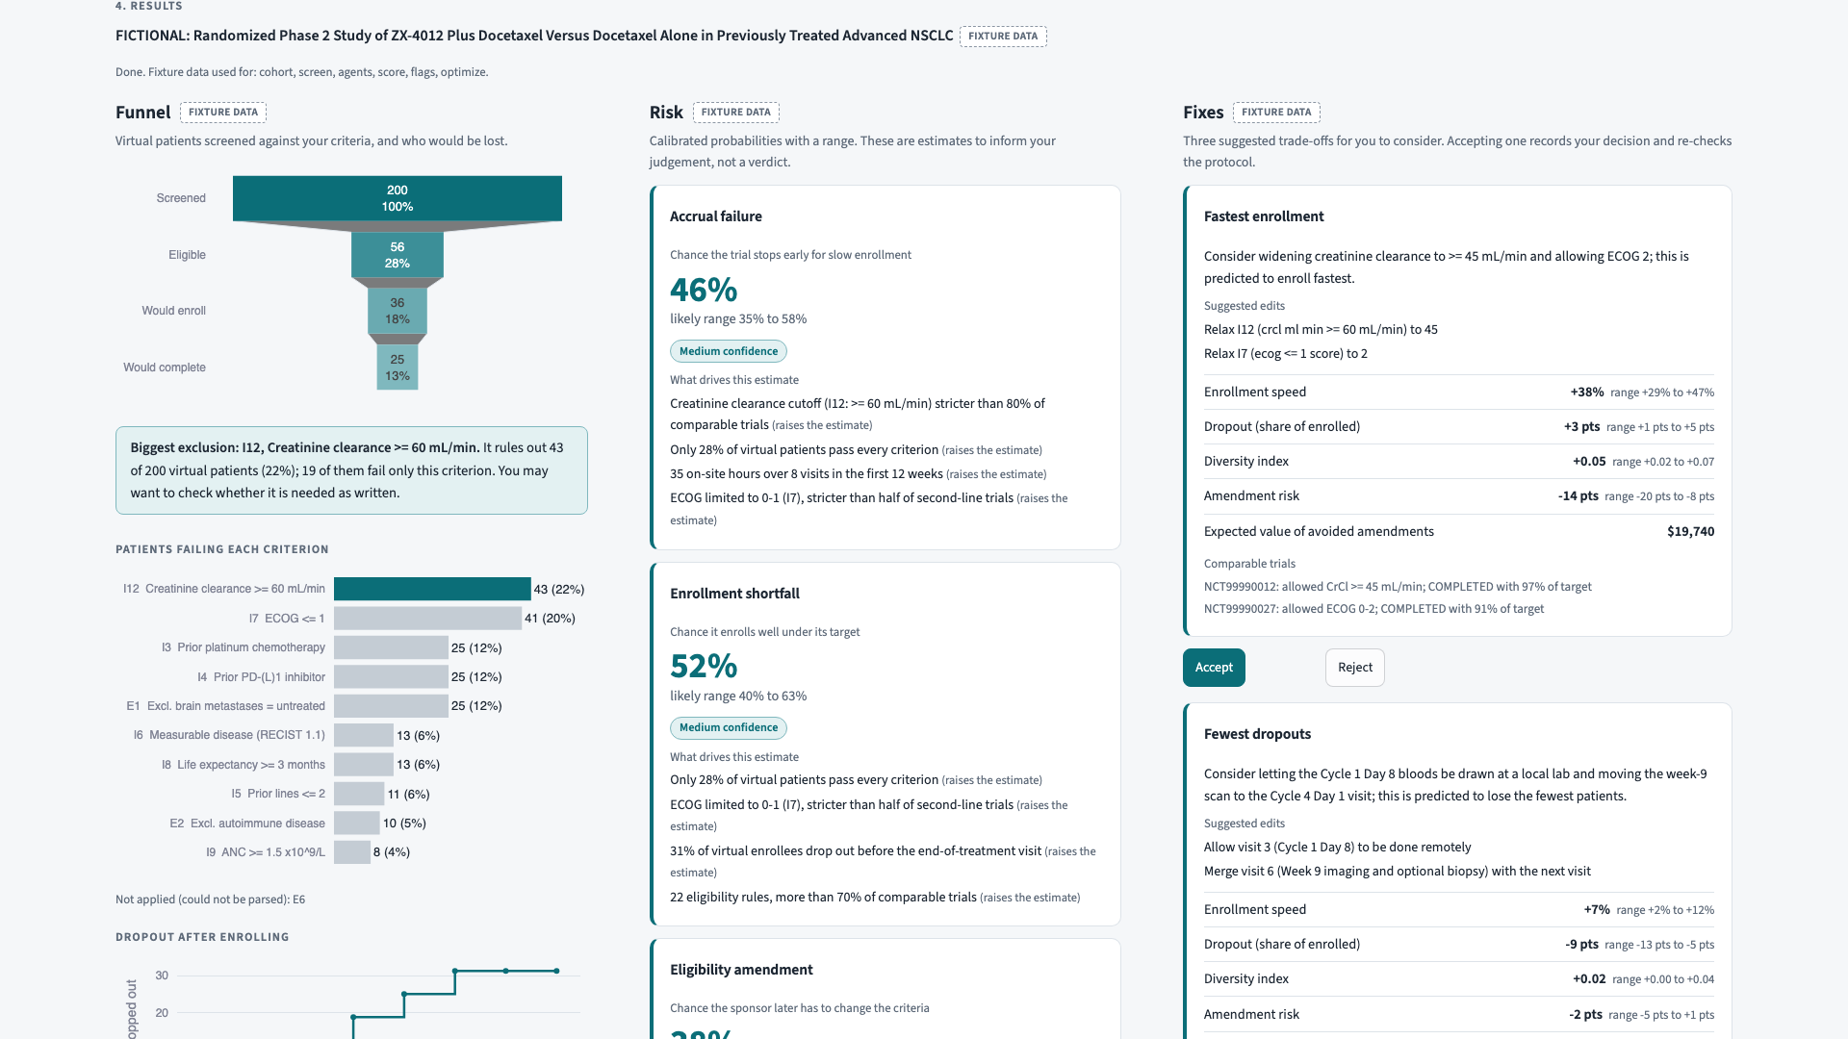
LIVE DEMO
One screen shows the funnel, the calibrated risk and three fixes
Funnel: who is excluded by which rule, who enrolls, who completes
Risk: calibrated probability with a range and top drivers in plain words
Fixes: three trade-offs; accept one and it re-runs in seconds
Sources: docs/screens/03-results.png
6 / 12
Notes:
This is the results screen of the running app. Left, the funnel: virtual patients screened, excluded by each criterion, enrolled and completing, with the biggest exclusion highlighted. Middle, risk: calibrated probabilities of accrual failure, enrollment shortfall and amendment, each with a range, a confidence badge and the top drivers in plain words. Right, three fixes. Everything else sits behind tabs: validation, replay, community pulse and the audit log. Screenshot: docs/screens/03-results.png.

Slide 7
OPTIMIZER
DRAFT: placeholder numbers
The optimizer proposes three trade-offs, each with a range and a dollar value
[TBD: demo fixes from docs/deck/data/demo.json]
Sources: docs/deck/data/demo.json
7 / 12
Notes:
For NCT03232892 the optimizer, Optuna NSGA-II over at most three edits, returns three representative fixes. [TBD: fix numbers]. Ranges span five cohort seeds. The dollar figure is the expected value of avoided amendments: the drop in amendment probability times the phase's median amendment cost. Accepting a fix logs the decision and re-runs the screen in seconds. Numbers: docs/deck/data/demo.json.

Slide 8
ARCHITECTURE
Small, tested modules around one Tiger Data store, built entirely by AI agents
ClinicalTrials.gov
+ version history
Ingest + labels
Criteria parser
(Gemini)
Cohort + code
screen
Persona agents
(Gemini)
Tiger Data
Postgres + pgvector
Learning loop
ledger + replay
LightGBM + SHAP
calibrated risk
Optimizer
NSGA-II
Built by AI agents: four orchestrators across two model families ran 27 task prompts, coordinated by git tags and reviewing each other's work
FastAPI +
Streamlit app
Sources: docs/ARCHITECTURE.md, orchestration/tasks/
8 / 12
Notes:
ClinicalTrials.gov records and their version history are ingested and labelled into Tiger Data, which is Postgres with TimescaleDB and pgvector. Gemini parses criteria; a code screen and persona agents simulate the cohort; LightGBM with SHAP scores risk; the optimizer re-scores every candidate edit in milliseconds; the learning loop logs and grades every prediction. Judges run it with one Docker Compose command and cached AI outputs. Four AI orchestrators across two model families ran 27 task prompts (count of orchestration/tasks/*.md).

Slide 9
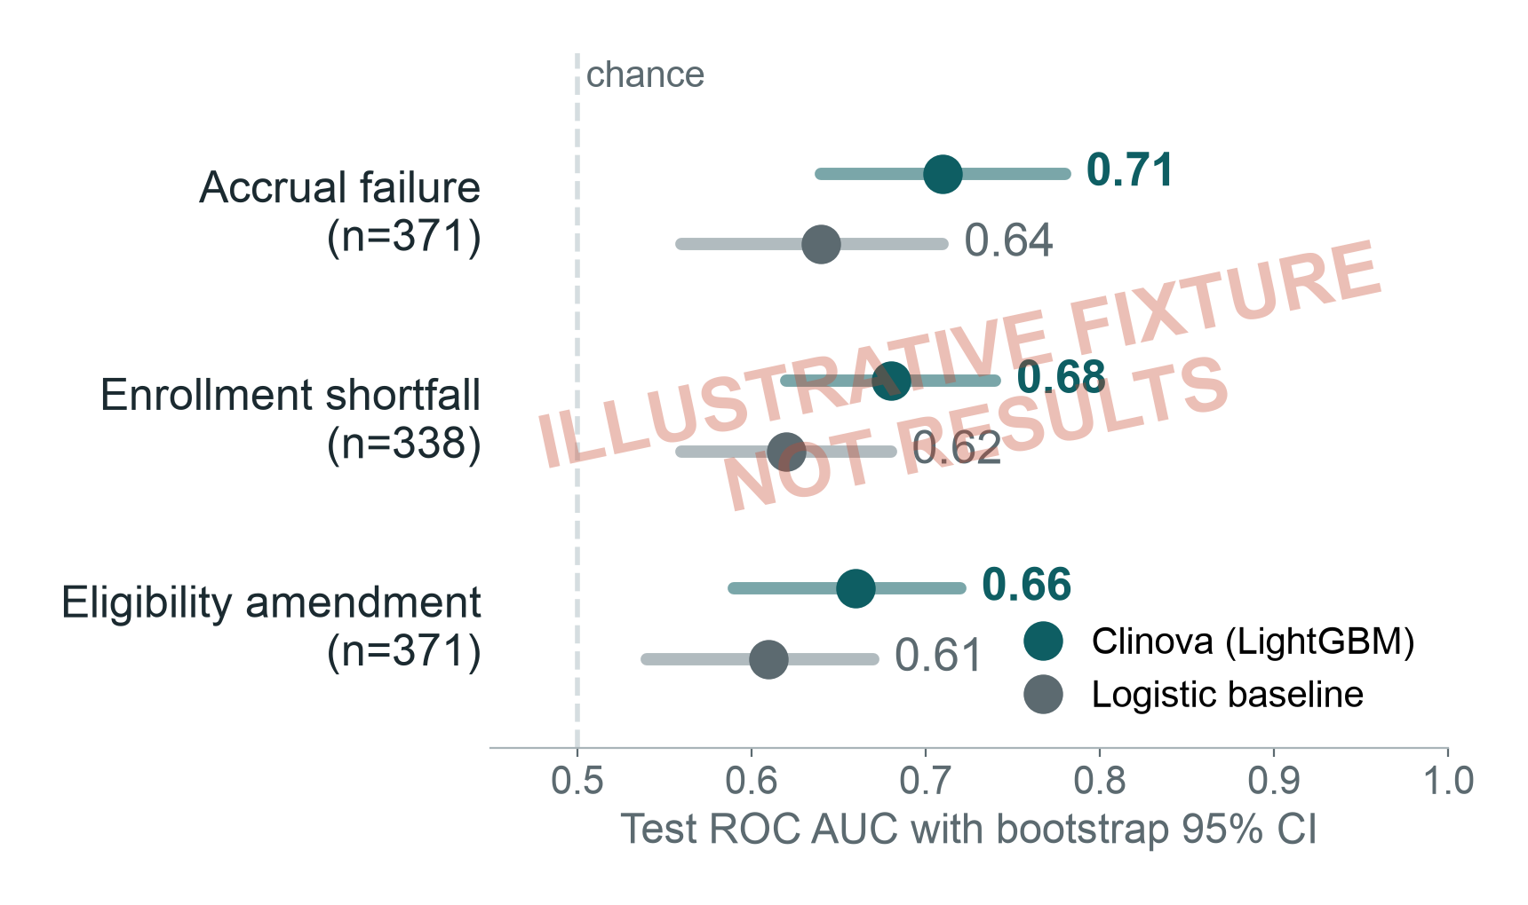
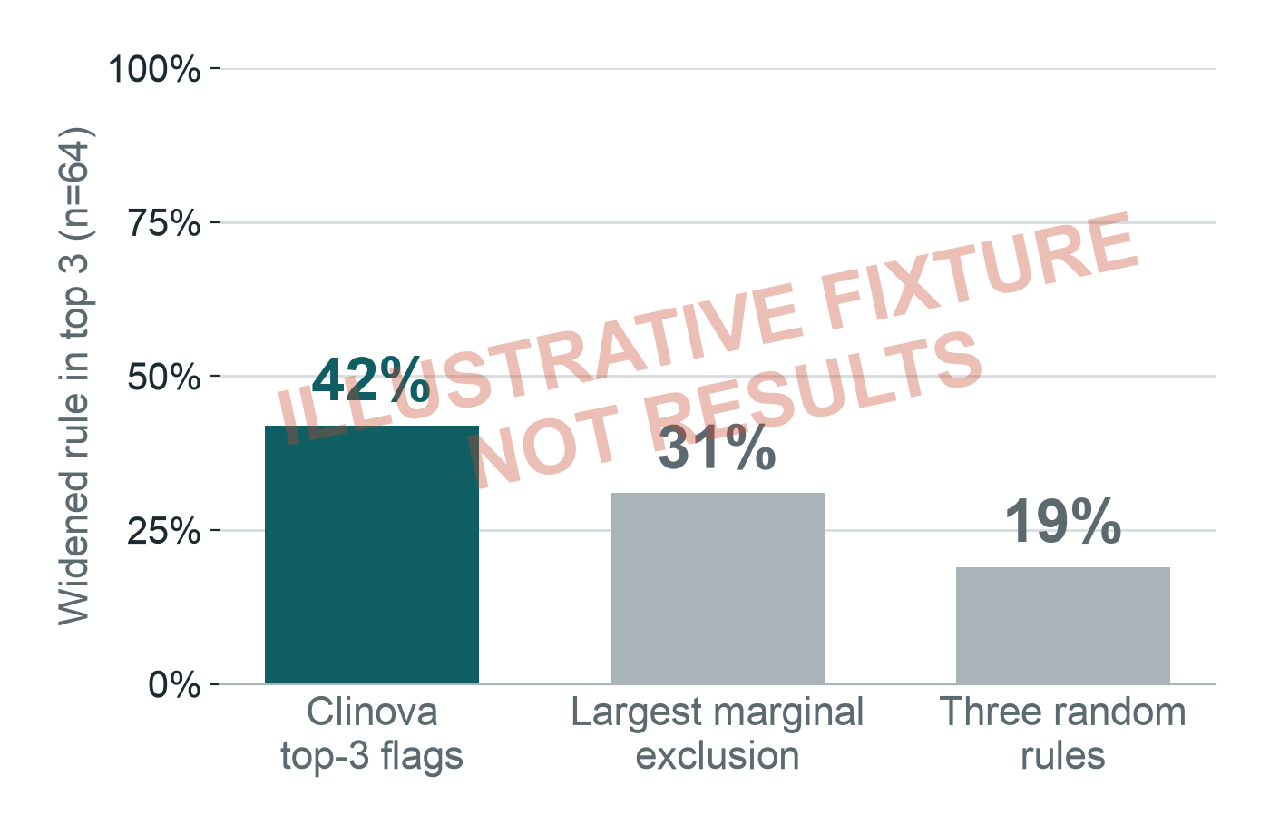
VALIDATION ON TRIALS THE MODEL NEVER SAW
DRAFT: placeholder numbers
On unseen trials, Clinova's accrual-failure AUC is [TBD: metrics.json accrual_fail AUC] vs [TBD: metrics.json accrual_fail AUC baseline] for a baseline
Accrual failure: AUC [TBD: metrics.json accrual_fail AUC] (95% CI ) vs baseline [TBD: metrics.json accrual_fail AUC baseline] ()
Hit rate: [TBD: metrics.json hit_rate] (random [TBD: metrics.json hit_rate random], largest exclusion [TBD: metrics.json hit_rate marginal])
Simulation ablation: [TBD: metrics.json ablation diff]
Sources: docs/metrics.json
9 / 12
Notes:
Time split: train on trials that started before 2018 ([TBD: metrics.json n_train] labelled), test on 2018 or later ([TBD: metrics.json n_test]). Accrual-failure AUC is [TBD: metrics.json accrual_fail AUC], 95% CI , against [TBD: metrics.json accrual_fail AUC baseline] for a ten-feature logistic baseline; Brier [TBD: Brier] vs [TBD: baseline Brier]. Shortfall AUC is [TBD: metrics.json shortfall AUC] vs [TBD: metrics.json shortfall AUC baseline]. Hit rate: [TBD: metrics.json hit_rate] (random [TBD: metrics.json hit_rate random], largest exclusion [TBD: metrics.json hit_rate marginal]). Simulation ablation: [TBD: metrics.json ablation diff]. Model [TBD: model_version]; every number is from docs/metrics.json.

Slide 10
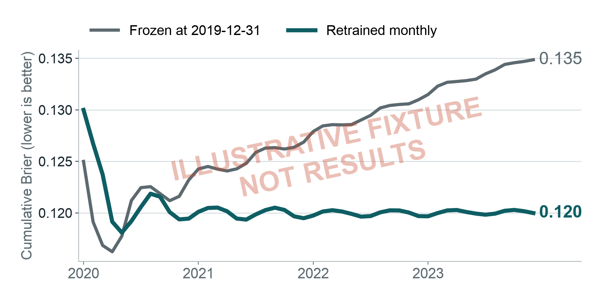
LEARNING LOOP
DRAFT: placeholder numbers
The learning loop grades every prediction; retrained Brier [TBD: replay.json retrained Brier] vs frozen [TBD: replay.json frozen Brier]
Replay [TBD: first month] to [TBD: last month]: score each month, then learn its outcomes
Pooled Brier over [TBD: replay.json windows] scored windows: retrained [TBD: replay.json retrained Brier], frozen [TBD: replay.json frozen Brier]
Every live prediction is logged in Tiger Data and scored when the trial ends
Sources: docs/replay.json
10 / 12
Notes:
The replay freezes a model on [TBD: freeze date], then steps month by month from [TBD: first month] to [TBD: last month]: it scores trials whose outcome arrives within ? months, then adds that month's outcomes and retrains. The frozen arm never retrains. Pooled over [TBD: replay.json windows] scored windows the retrained Brier is [TBD: replay.json retrained Brier] against [TBD: replay.json frozen Brier] frozen. Windows overlap, so this is descriptive, not a significance test. Source: docs/replay.json.

Slide 11
LIMITATIONS AND RESPONSIBLE USE
We show what the evidence can and cannot support
Registry edits are a proxy
Stop reasons are free text
A widened rule on ClinicalTrials.gov is public evidence of an amendment, not the same thing
Some terminations are business decisions; labels were spot-checked by a second model
Personas are synthetic
Predictions are correlational
General-population records with clinical traits from published distributions, labelled as assumptions
Risk scores rank protocols; they do not prove that a rule caused a failure
Clinova advises; the author decides. No real patient data. Every decision is logged.
Sources: docs/ARCHITECTURE.md, docs/metrics.json
11 / 12
Notes:
Four limits. Registry edits are a public proxy for amendments, not the same thing. Stop reasons are free text, and some terminations are business decisions. Personas are general-population records given clinical traits from published distributions, labelled as assumptions. Predictions are correlational. On responsible use: no real patient data is used; Clinova advises the protocol author, logs every accept and reject, and never approves a protocol. Source: docs/ARCHITECTURE.md section 10 and the caveats in docs/metrics.json notes.

Slide 12
ROADMAP
Next: more indications, site-level simulation and structured protocol input
1
Lymphoma, ophthalmology and immunology
Run it yourself
2
Site-level enrollment simulation
github.com/RaghulKS/Clinova
3
Persona model tuned on expert feedback
MIT license. docker compose up, then open the app; demo mode needs no API keys.
4
Structured protocol input (ICH M11)
5
Full GxP validation package
Sources: docs/ARCHITECTURE.md
12 / 12
Notes:
Next steps: expand beyond NSCLC to lymphoma, ophthalmology and immunology; simulate enrollment site by site; tune the persona model on expert feedback; accept structured protocols in ICH M11 format; and build a full GxP validation package. Everything is open source under MIT at https://github.com/RaghulKS/Clinova. One docker compose command starts the database, API and app, and demo mode runs on cached AI outputs with no keys. Roadmap: docs/ARCHITECTURE.md section 12.

