Slide 1
UNIX SHELL SCRIPTING
- RAGHUL RAMESH

Slide 2
Unix – An Introduction :
The UNIX operating system is a set of programs that act as a link between the computer and the user.
The computer programs that allocate the system resources and coordinate all the details of the computer's internals is called the operating system or kernel.
Unix was originally developed in 1969 by a group of AT&T employees at Bell Labs, including Ken Thompson, Dennis Ritchie.
UNIX is a multi-user, multi-tasking and time sharing operating system.
UNIX is a machine independent operating system (Portable)
UNIX has a very organized file and directory system that allows users to organize and maintain files.

Slide 3
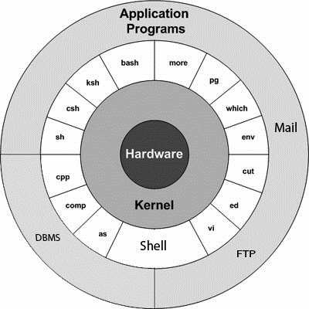
Components of UNIX OS
The components of UNIX OS are
1)Kernel
2)Shell
3)Utilities

Slide 4
Cont…
KERNEL
The Kernel is the heart of the system. It contains a set of programs normally written in C to communicate with the hardware.
The Kernel acts as the interface between the computer hardware and various programs/application/shell.
The following are the tasks done by the Kernel
1) I/O management
2) Process management
3) Device management
4) File management
5) Memory management
SHELL
Computer understands the language of 0's and 1's called the binary language.
The Shell is an special program that takes in the human understandable command and if it is an valid one it will pass on to the Kernel for execution.

Slide 5
Cont…
-COMMANDS and UTILITIES:
There are various command and utilities which you would use in your day to day activities. cp, mv, cat and grep etc. are few examples of commands and utilities. There are over 250 standard commands plus numerous others provided through 3rd party software. All the commands come along with various optional options.

Slide 6
Unix flavours:
AIX - developed by IBM for use on its mainframe computers
HP-UX - developed by Hewlett-Packard for its HP 9000 series of business servers
SCO Unix by The Santa Cruz Operation Inc.
Solaris by Sun Microsystems
Irix by Silicon Graphics, Inc.
Linux by several groups
Xenix

Slide 7
Shell Types:
In UNIX there are two major types of shells:
The Bourne shell. If you are using a Bourne-type shell, the default prompt is the $ character.
Bourne shell ( sh)
Korn shell ( ksh)
Bourne Again shell ( bash)
POSIX shell ( sh)
The C shell. If you are using a C-type shell, the default prompt is the % character.
C shell ( csh)
TENEX/TOPS C shell ( tcsh)

Slide 8
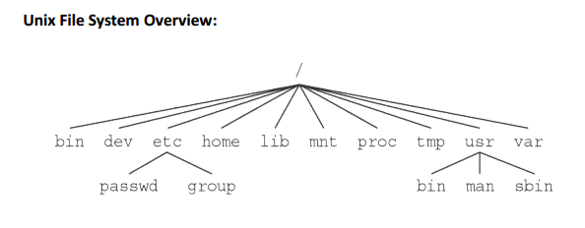
DIRECTORY STRUCTURE
All the files are grouped together in the directory structure. The file-system is arranged in a hierarchical structure, like an inverted tree. The top of the hierarchy is traditionally called root (written as a slash / )

Slide 9
Unix Commands-An Overview
FILE COMMANDS:
touch Create a new file Usage: touch <filename>
cp Copy Files Usage: cp [options] source_file destination_file Options: -r recursively copy directory structures.
mv Move or Rename files or directories Usage: mv [options] <old-filepath> <new-filepath> Options: -i query user for confirmation rm Remove Files
Usage: rm [options] <filname> Options: -r recursively remove directory structures.
-i query user for confirmation. cat View complete file content.
Usage: cat <filename>

Slide 10
Unix Commands-An Overview
more View file contents in sections determined by the size of the terminal.
Usage: more <filename> less View file contents in sections determined by the size of the terminal.
Has more options and search features than more.
Usage: less [options] <filename>
compress Reduces the size of the file. and adds the extension .Z
Usage: compress <filename>
uncompress / Restores a compressed file.
zcat Usage: uncompress <filename>
Usage: zcat <filename>

Slide 11
Unix Commands-An Overview
DIRECTORY COMMANDS:
cd Change directory.
Usage: cd <filename>
Eg: cd my-directory
cd go to home directory
cd .. go up one directory
pwd Print working directory on the terminal.
ls List the content of a directory.
Usage: ls [options] or ls [options] <directory-path>
Options: -l list all files in long format.
(permissions, users, filesize,date, and time are displayed).
-a list all files including those beginning with a “.” / -R recursively list subdirectories encountered.

Slide 12
Unix Commands-An Overview
mkdir Create a new directory.
Usage: mkdir <directory-path> rmdir Remove a directory if its empty.
Usage: rmdir <directory-path> SYMBOLIC LINKS: ln Create symbolic links between files or between directories.
Usage: ln [options] <file-to-be-linked> <new-file>
ln [options] <directory-to-be-linked> <my-directory>
Options: -s allows linking across file systems and allows the display of the link’s name upon ls -l.
Eg: ln -s course-file myfile
Eg: ln -s course-directory myspace

Slide 13
Unix Commands-An Overview
TERMINAL COMMANDS:
clear Clears the terminal.
echo Write a string to standard output.
Usage: echo “string” or
echo ‘string’ repeat Repeats commands.
Usage: repeat <number> <command> INFORMATION COMMANDS: history Lists the commands typed during the session.
Options: -r displays the list in reverse.

Slide 14
Unix Commands-An Overview
hostname Displays the computer’s or server’s name on the terminal. who Displays who is on the system who am i Displays the invoking user wc Counts and displays the number of lines, words and characters of a file,
Usage: wc [options] <filename>
Options: -c count character only.
-l count lines only.
-w count words only date, cal Display Date and cal whatis whatis cp cp(1) - Copies files.
cp ("1") - copy files and directories

Slide 15
Unix Commands-An Overview
PERMISSIONS AND FILE STORAGE: chmod Set the permission on a file or a directory
Usage: chmod [options] < permission> passwd Change the password. df Displays the amount of free and used disk space du Displays the amount of disk usage. quota Displays the amount of disk space used.
Options: -v Display user’s quota on all file systems quota -v
Disk quotas for user ecibat01 (uid ramesh_k): 11MB

Slide 16
Unix Commands-An Overview
PROCESSES: ps Displays the active processes. Includes the process number, process name and process time.
Options: -a kill Terminates a process.
Usage: kill [options] <process-number>
Options: -9 absolute kill. control z Stops a current process.

Slide 17
Unix Commands-An Overview
ENVIRONMENT: env Show all the environment variables.
Usage: env
Some Environment variables:
HOME : home directory
PATH: search path for commands
TERM: terminal type
USER: username
DISPLAY: the name of the machine to which the display is sent.
SHELL: the current shell
PWD: the current directory.
EDITOR : the default text editor

Slide 18
Unix Commands-An Overview
printenv Show all or specified environment variable.
Usage: printenv
printenv <variable-name> will print only this variable setenv Sets a particular environment variable.
Usage: setenv <variable-name> <value>
Eg: setenv EDITOR emacs.
setenv DISPLAY bernini.arc.cmu.edu:0.0 NETWORKING: telnet Connects to a remote computer. Essential telnetting steps:
telnet <remote-hostname>
Eg: telnet janus.arc.cmu.edu

Slide 19
Unix Commands-An Overview
ftp File transfer program: Allows the get and put of files between computer accounts.
Usage: ftp <remote-hostname>
Inside ftp: put <local-filename>
get <remote-filename>
mget <filename>gets multiple files.
eg: mget *
mput <filename> puts multiple files.
eg mput *
lcd changes the local directory.
help lists all ftp commands.
quit or bye exits ftp.

Slide 20
Unix Commands-An Overview
finger Display information about local or remote users.
Usage: finger <user-name>
finger <user-id>
UNIX FILTERS: grep Search a file for a matching pattern or regular expression.
Usage: grep [options] <regular-expression> <file-name>
Options: -n print lines and line numbers
-v prints all the lines that do not contain the expression.
Eg: grep [a-z]*.C filename
grep *[SITE]* filename

Slide 21
Unix Commands-An Overview
spell To report the incorrect spells Usage: Welcom to Learneng ctrl+d Welcome
Learning
head To print top 10 lines
tail To Print 10 lines from the bottom
sort sorts the contents of a text file, line by line. find Search the system for filenames
Usage: find <pathname> <condition>
cmp Compare 2 files.
Usage: cmp <file1> <file2>
diff Reports the lines that differ between 2 files Usage: cmp <file1> <file2>

Slide 22
Vi - Editor
Modes of operation of Vi
1) Command mode
2) Insert mode
COMMAND MODE
Vi starts up with this mode.
Whatever we type in this mode is taken as a command and not as a text that needs to be inserted into the file.
This mode helps us to move around the file.
INSERT MODE
We must give 'i' to get into insert mode from the command mode.
This text that we type will get into the file only on this mode.
We must give ESC (escape) to quit from the insert mode and get into the command mode.

Slide 23
Vi - Editor
Vi Commands
Entering into Vi
Command used : 1) vi file_name 2) view file_name
NOTE : "view" command will open the file in read only mode
Moving by word
w --> beginning of next word
nw --> beginning of nth word
b --> back to previous word
nb --> back to nth previous word
e --> end of next word
ne --> end of nth next word

Slide 24
Vi - Editor
Moving by line
down arrow --> move down one line
up arrow --> move up one line
j --> down one line
k --> up one line
+ --> begenning of next line down
- --> begenning of next line up
^ --> first character of current line
$ --> last character of the current line
Moving by block
( --> beginning of the sentance
) --> end of the sentance
{ --> begining of the paragraph
} --> end of the paragraph

Slide 25
Vi - Editor
Moving by screen
ctrl + f --> forward 1 screen
ctrl + b --> backward 1 screen
ctrl + d --> down 1/2 screen
ctrl + u --> up 1/2 screen
H --> top line on screen
M --> mid screen
L --> last line on screen
Moving within the file
1G --> first line in the file
G --> last line in the file
nG --> nth line in the file

Slide 26
Vi - Editor
Inserting text
i --> insert test after cursor
I --> insert text at the beginning of line
a --> append test after cursor
A --> append test at the end of the line
o --> open a blank line after the current line for inserting text
O --> open a blank line before the current line for inserting text
Exiting vi
:q --> quit - if you have made any changes, vi will warn you of this, and you'll need to use one of the other quits.
:w --> write edit buffer to disk
:w file_name --> write edit buffer to disk as filename
:wq --> write edit buffer to disk and quit
ZZ --> write edit buffer to disk and quit
:q! --> quit without writing edit buffer to disk

Slide 27
Vi - Editor
Deleting text
x --> delete character at the cursor
dh --> delete the character before the cursor
nx --> delete n characters at the cursor
dw --> delete the next word
db --> delete the previous word
dnw --> delete n words from the cursor
dnb --> delete n words before the cursor
d0 --> delete to the beginning of the line
d( --> delete to the beginning of the sentence
d) --> delete to the end of the sentence
d{ --> delete to the beginning of the paragraph
d} --> delete to the end of the paragraph
dd --> delete the current line
ndd --> delete n lines from the current line

Slide 28
Vi - Editor
Searching & replacing words
/str --> search forward for a string
?str --> search backward for a string
n --> find next occurrence of the current string
N --> find next occurrence of the current string in the reverse direction
:s/old/new --> substitute the new for the first occurrence of the old in the current line
:s/old/new/g --> substitute the new for the all occurrence of the old in the current line
:1,10s/old/new --> substitute the new for the all occurrence of the old within the 1st and the 10th line
:.,$s/old/new --> substitute the new for the all occurrence of the old from the current line to the end

Slide 29
What is Shell?
A shell is an environment in which we can run our commands, programs, and shell scripts
The shell provides you with an interface to the UNIX system.

Slide 30
What is a Shell Script?
The basic concept of a shell script is a list of commands, which are listed in the order of execution.
A good shell script will have comments, preceded by a pound sign, #, describing the steps.
Shell scripts and functions are both interpreted. This means they are not compiled.
Example Script:
#!/bin/bash
# Author : Ramesh K
# Copyright : Altimetrik
# Script follows here:
pwd
ls

Slide 31
Shell Variables
A variable is a character string capable of storing a value. value assigned could be a number, text, filename, device, or any other type of data.
Rules:-
contain only letters (a-z or A-Z)
Digits (0-9)
Can contain Underscore character
Unix Variables are case sensitive.

Slide 32
Defining & Accessing Variables:
-Defining Variables
variable_name=variable_value
Example:
NAME=RAMESH
-Accessing Values:
echo $variable_value
Example:
echo $NAME

Slide 33
Variable Types
-Local Variables:-
A local variable is a variable that is present within the current instance of the shell. It is not available to programs that are started by the shell.
-Environment Variables
An environment variable is a variable that is available to any child process of the shell.
-Shell Variables
A shell variable are environment variable that is set by the shell and is required by the shell in order to function correctly

Slide 34
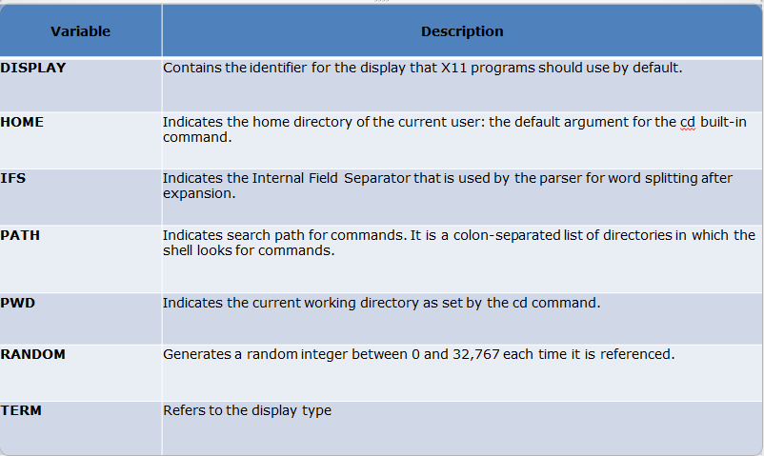
Shell Variables

Slide 35
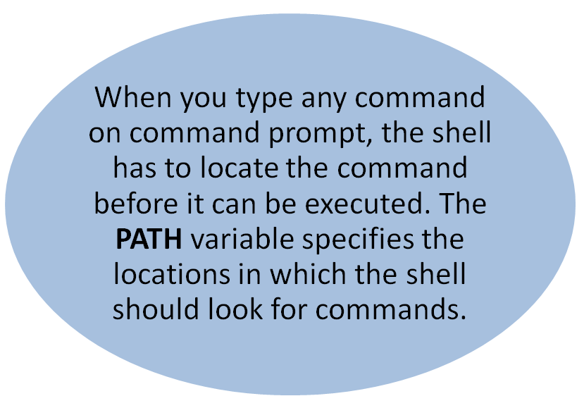
Info…

Slide 36
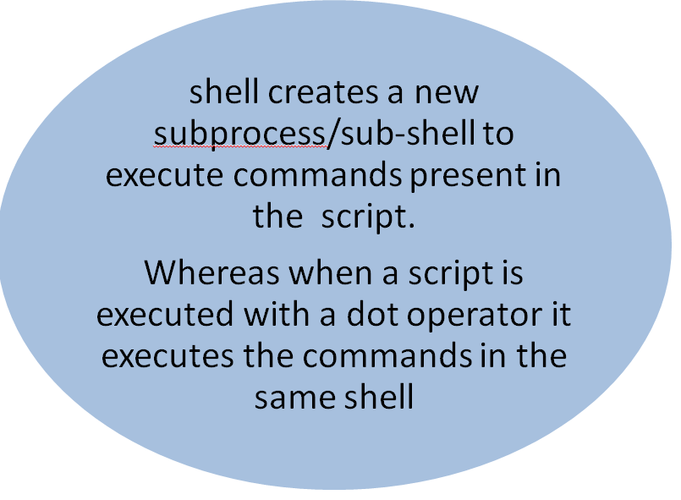
Info…

Slide 37
Special Variables:
$0 : The filename of the current script.
$1, $2, $3,...$9 : positional parameters with which a script was invoked.
$# : The number of arguments supplied to a script.
$* : All the arguments are double quoted. If a script receives two arguments, $* is equivalent to $1 $2.
$@ : All the arguments are individually double quoted. If a script receives two arguments, $@ is equivalent to $1 $2.
$? : The exit status of the last command executed.
$$ : The process number of the current shell. For shell scripts, this is the process ID under which they are executing.
$! : The process number of the last background command.

Slide 38
Conditional Statements
-Unix Shell supports conditional statements which are used to perform different actions based on different conditions.
The if...else statements
The case...esac statement

Slide 39
The if...else statements
Unix Shell supports following forms of if..else statement
if...fi statement
if...else...fi statement
if...elif...else...fi statement

Slide 40
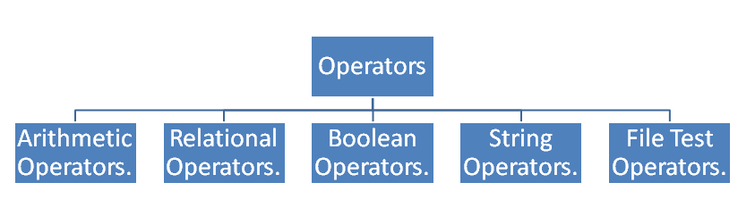
Shell Basic Operators

Slide 41
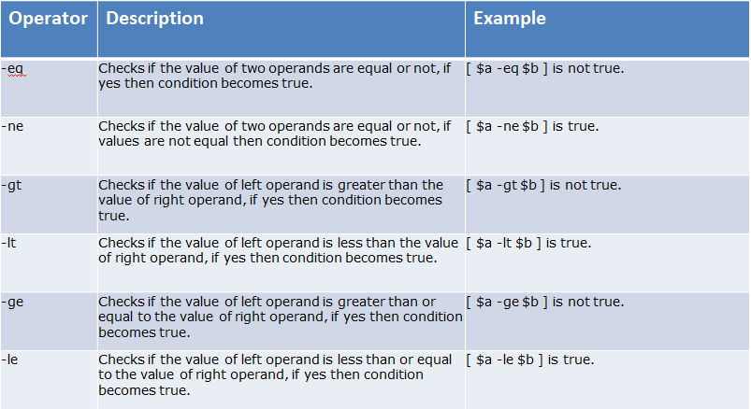
Relational Operator

Slide 42
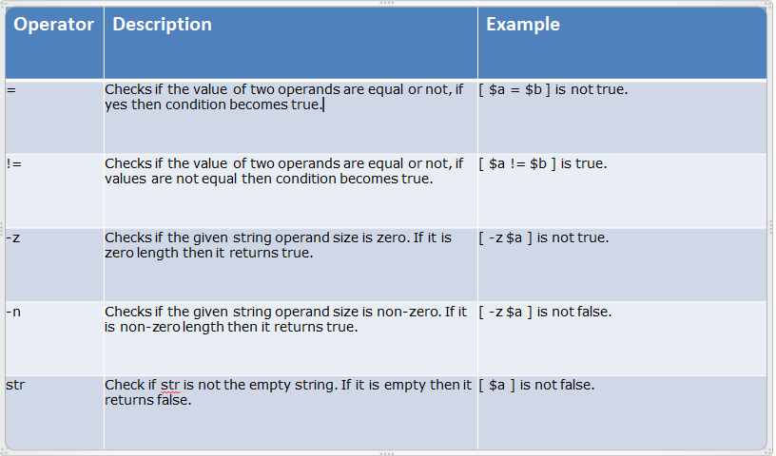
String Operator

Slide 43
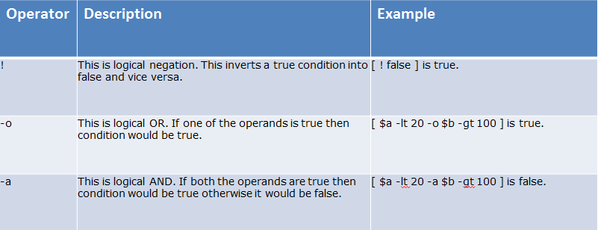
Boolean Operator

Slide 44
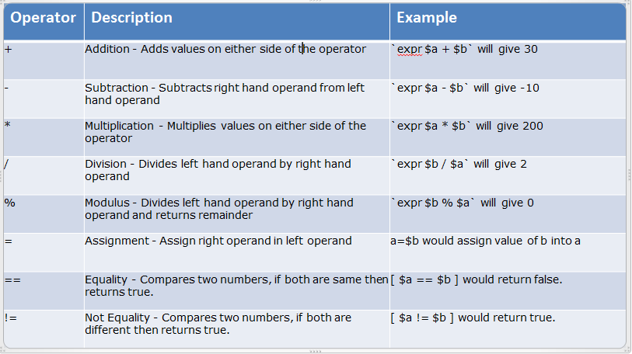
Arithmetic Operator

Slide 45
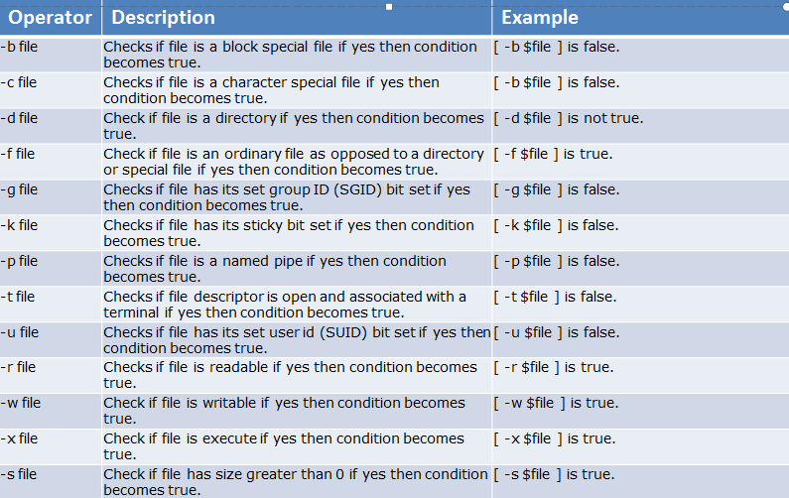
File Test Operator

Slide 46
The case...esac Statement
case word in
pattern1)
Statement(s) to be executed if pattern1 matches
;;
pattern2)
Statement(s) to be executed if pattern2 matches
;;
pattern3)
Statement(s) to be executed if pattern3 matches
;;
esac

Slide 47
Shell Loop
The while loop
The for loop
The until loop
The select loop

Slide 48
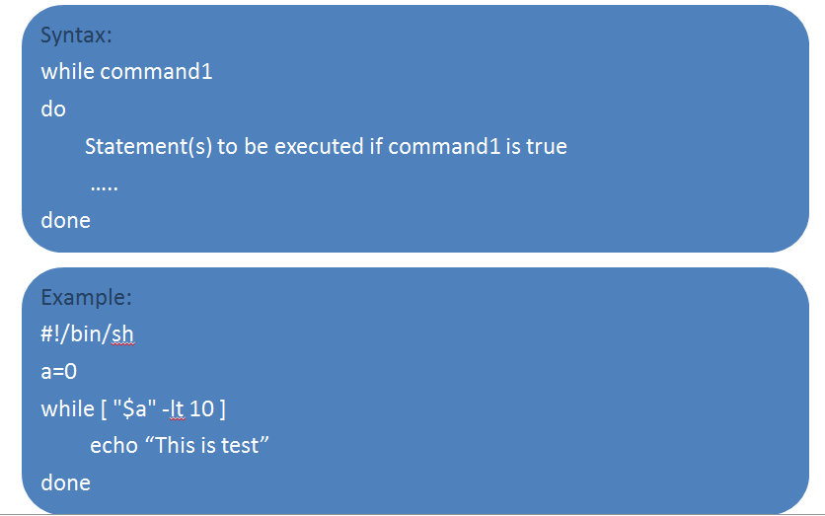
The while loop

Slide 49
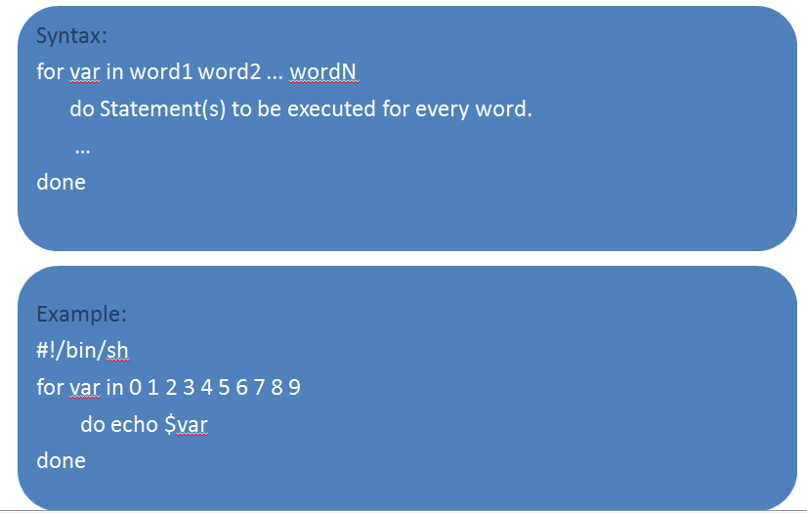
The for loop

Slide 50
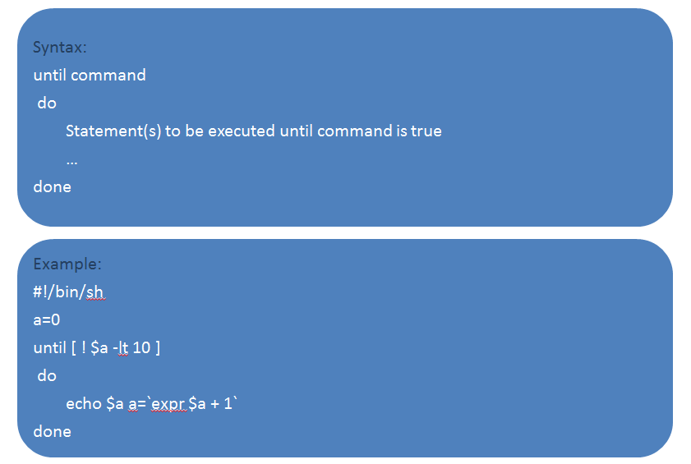
The until loop

Slide 51
The select Loop:
#!/bin/ksh
select DRINK in tea cofee water juice appe all none
do
case $DRINK in
tea|cofee|water|all)
echo "Go to canteen"
;;
juice|appe)
echo "Available at home"
;;
none)
break
;;
*) echo "ERROR: Invalid selection"
;;
esac
done

Slide 52
break and continue Statement
break statement
The break statement is used to terminate the execution of the entire loop, after completing the execution of all of the lines of code up to the break statement. It then steps down to the code following the end of the loop
continue statement
The continue statement is similar to the break command, except that it causes the current iteration of the loop to exit, rather than the entire loop.

Slide 53
Command Substitution
Command substitution is the mechanism by which the shell performs a given set of commands and then substitutes their output in the place of the commands.
`command`
Example:
#!/bin/sh
USERS=`who | wc -l`
echo "Logged in user are $USERS"

Slide 54
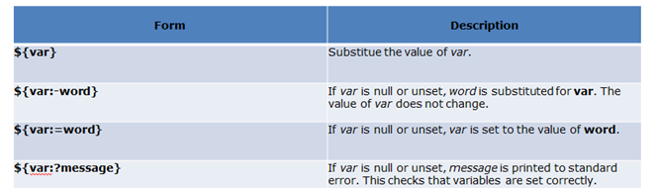
Variable Substitution

Slide 55
The Metacharacters
Unix Shell provides various metacharacters which have special meaning while using them in any Shell Script and causes termination of a word unless quoted
* ? [ ] ' " \ $ ; & ( ) | ^ < > new-line space tab

Slide 56
Cont…
$ for parameter substitution.
Backquotes : \$ to enable literal dollar signs.
\` to enable literal backquotes.
\" to enable embedded double quotes.
\\ to enable embedded backslashes.
All other \ characters are literal (not special).

Slide 57
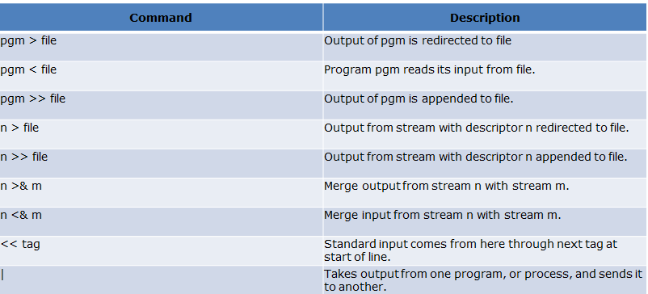
Shell Input/Output Redirections

Slide 58
Arrays
Defining Array Values:
array_name[index]=value
array_name is the name of the array, index is the index of the item in the array that you want to set, and value is the value you want to set for that item.
Example : NAME[0]=“Ramesh"
NAME[1]=“Mani"
NAME[2]=“Kathir"
NAME[3]=“Sekar"
NAME[4]=“Sharmila"
Accessing Array Values
${array_name[index]}
array_name is the name of the array, index is the index of the item in the array that you want to set, and value is the value you want to set for that item.
Example : echo "First Index: ${NAME[0]}"
echo "Second Index: ${NAME[1]}"

Slide 59
Shell Functions
Functions enable you to break down the overall functionality of a script into smaller, logical subsections, which can then be called upon to perform their individual task when it is needed
Syntax:
function_name ()
{
list of commands
}

Slide 60
Pass Parameters to a Function
You can define a function which would accept parameters while calling those function. These parameters would be represented by $1, $2 and so on.
Example:
#!/bin/sh
Hello ()
{
echo "Hello World $1 $2"
}
# Invoke your function
Hello Ramesh Kandasamy

Slide 61
Returning Values from Functions
#!/bin/sh
# Define your function here
Hello ()
{
echo "Hello World $1 $2"
return 10
}
# Invoke your function
Hello Ramesh Kandasamy
# Capture value returnd by last command
ret=$?
echo "Return value is $ret"

Slide 62
Nested Functions
One of the more interesting features of functions is that they can call themselves as well as call other functions. A function that calls itself is known as a recursive function.
#!/bin/sh
# Calling one function from another
number_one () {
echo "This is the first function speaking..."
number_two
}
number_two () {
echo "This is now the second function speaking..."
}
# Calling function one.
number_one This would produce following result −
This is the first function speaking...
This is now the second function speaking...

Slide 63
Database Connection:
user= USER1;
pass = Pass1
Sqlplus –s $user/$pass@Server << EOF
Select * from employee;
exit;
EOF

Slide 64
Regular Expressions:
What is it?
- String of ordinary and meta charecters which can be used to match more than one type of pattern
- used in grep , egrep, awk, vi sed etc
-Some examples of metacharacters are
[],^,$,{},etc
Regular expression is collections of Atom and Operator
- Atom specify the nature and position of the search
-Operator provides robust constructs for using atoms in a more advanced way

Slide 65
Regular Expressions(Contd…)
Atoms
Character
. This may contain any printable character(alpha-numeric or special)
.(dot)
.Represent any single character except newline
Range/Class
.Matches any one character from the set []
Anchor
Back Reference

Slide 66
Regular Expressions(Contd…)
Operators
- Alteration |
- Repetition \{s,e\}
- Grouping ()
- Shorthand * + ?

Slide 67
Summary of Regular Expressions
. Matches any single characters except newline
\ Suppress special meaning of meta-characters
[] Matches any one character from the set
^ matches at the beginning of line
$ Matches at end of line
| Matches alternate regular expression
() Groups regular expressions to be matched
\{s,e}\ Matches occurrences of preceding character s through e times
* Matches zero or more occurrences of preceding regular expression
+ Matches one or more occurrences of preceding regular expression
? Matches zero or one occurrences of preceding regular expression

Slide 68
Introduction to sed
sed stands for stream editor
A non-interactive , command line editor
Can be on-liner sed command or a script with multiple commands
Supports all regular text editing operations
Used to perform series of edit operations on same file(s)
Automates text editing of multiple large files

Slide 69
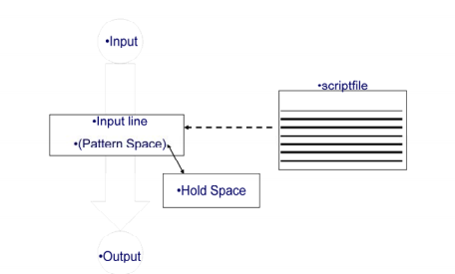
sed Architecture

Slide 70
Scripts
A script is nothing more than a file of commands
Each commands consists of up to two addresses and an action , where the address can be a regular expression or line number

Slide 71
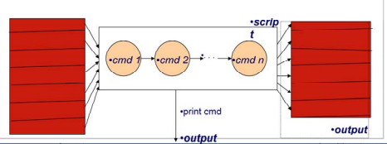
Sed Flow of Control
sed then reads the next line in the input file and restarts from the beginning of the script file
All commands in the script file are compared to , and potentially act on, all lines in the input file

Slide 72
Addressing
sed stands for stream editor
An address can be either a line number or a pattern, enclosed a slashes (/pattern/)
A pattern is described using regular expressions
If no pattern is specified , the command will be applied to all lines of the input file
To refer to the last line: $

Slide 73
Addressing (con…)
Most Commands will accept two addresses
If only one address in given, the command operates only on that line
If two comma separated addresses are given, then the command operates on a range of lines between the first and second address, inclusively
The ! Operator can be used to negate an address, ie: address! command causes command to be applied to all lines that do not match address

Slide 74
Sed commands
Command is a single letter
Example : Deletion : d
[address 1][,address 2]d
-Delete the addressed line(s) from the pattern space;
line(s) not passed to standard output
-A new line of input is read and editing resumes with the first command of the script.

Slide 75
Sed commands
sed commands have the general form
-[address[, address]][!]command [arguments]
sed copies each input line into a pattern space
-if the address of the command matches the line in the pattern space , the command is applied on that line
-if the command has no address , it is applied to each line as it enters pattern space
-if a command changes the line in pattern space, subsequent commands operate on the modified line
When all commands have been read, the line in pattern space is written to standard output and a newline is read into pattern space

Slide 76
Sed commands
Although sed contains many editing commands, we are only going to cover the following subset:
s – substitute d - deletion
a – append p –print
i – insert y- transform

Slide 77
Example
sed example
- sed –e ‘s/sed/SED/I’ input.txt
- sed –e ‘1,3s/sed/SED/I’ input file - sed –e ‘s/old/new/’ –e ‘s/fast/slow/’ <in.txt >out.txt

Slide 78
Print Command
The print command can be used to force the pattern space to be output, useful if –n option has been specified
Syntax : [adress1[,address2]]p
Example:
1,5p will display lines 1 through 5
/^$/ ,$p will display the lines from the first blank line through the last line of the file

Slide 79
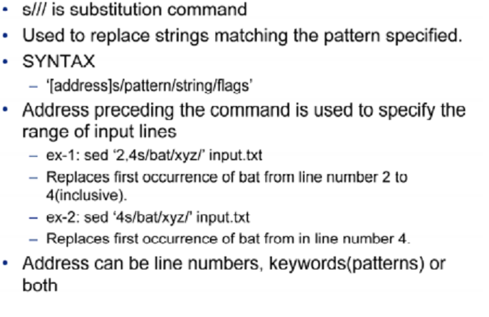
Substitute command:

Slide 80
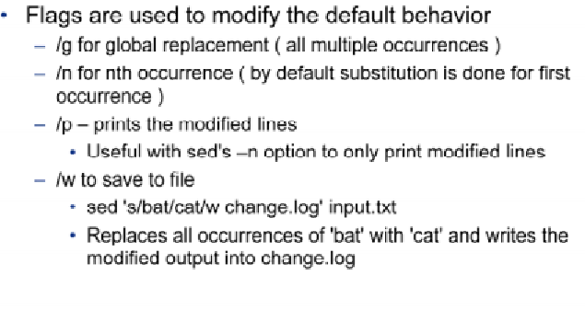
Substitute command:

Slide 81
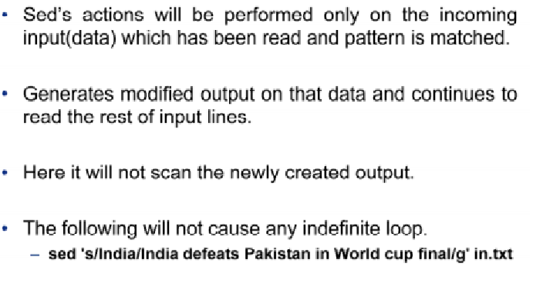
Sed is not recursive

Slide 82
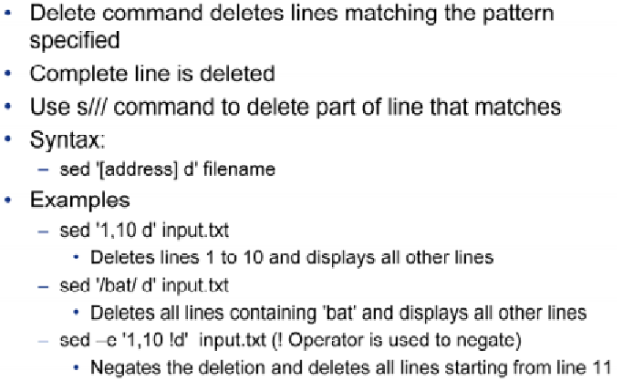
Delete & print

Slide 83
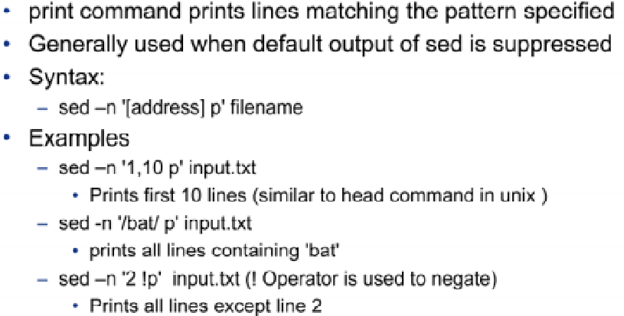
Delete and print

Slide 84
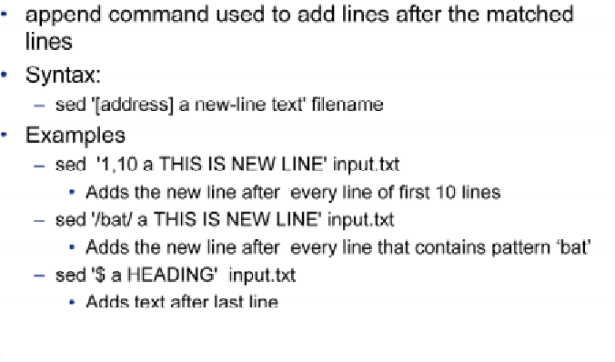
Editing Command-Append

Slide 85
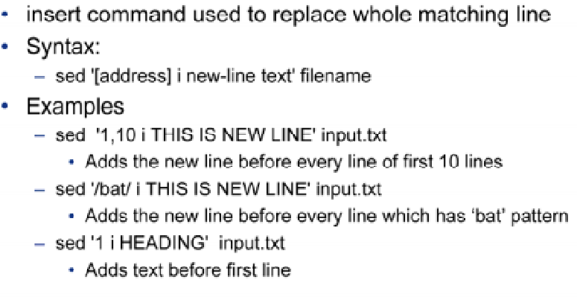
Editing Command-Insert

Slide 86
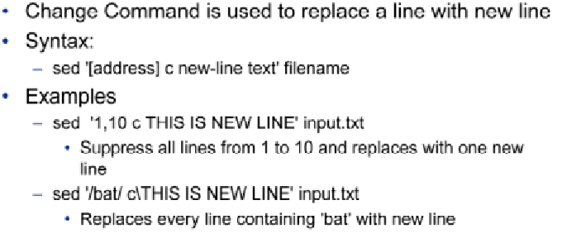
Editing Command – change:

Slide 87
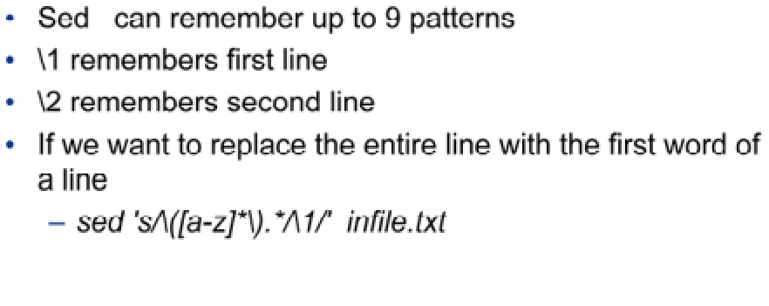
Remembered patterns in sed

Slide 88
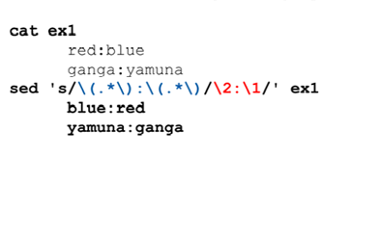
Replacement pattern Examples:

Slide 89
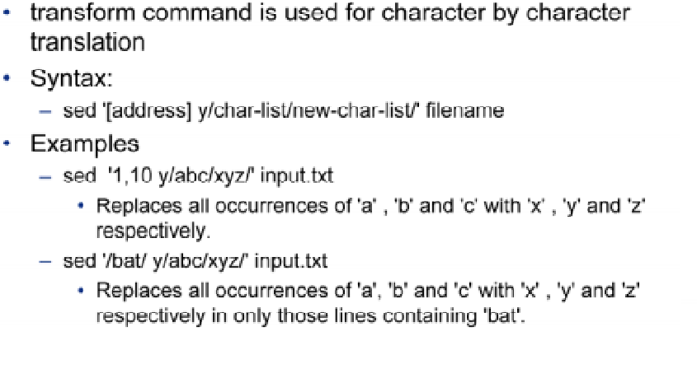
Editing Commands - Transform

Slide 90
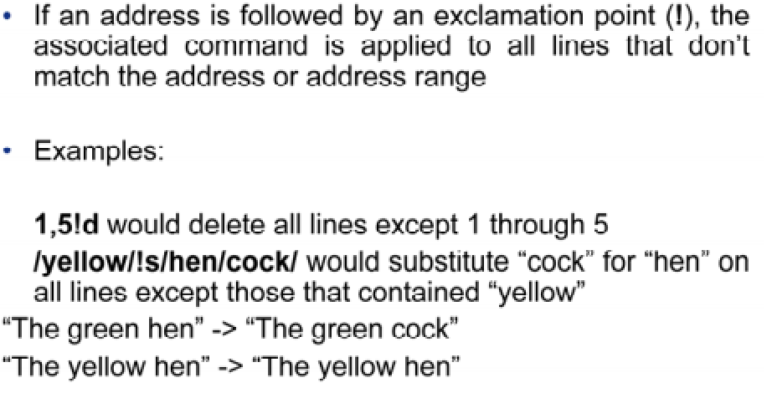
Using ! (not)

Slide 91
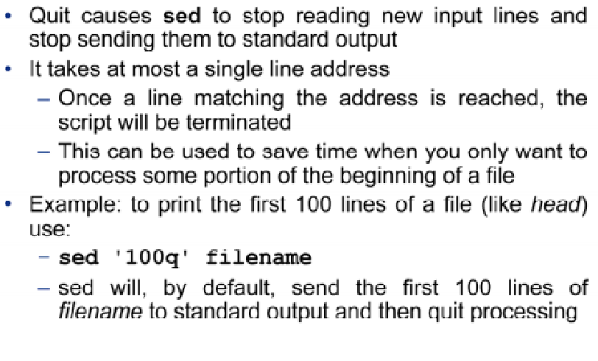
Quit

Slide 92
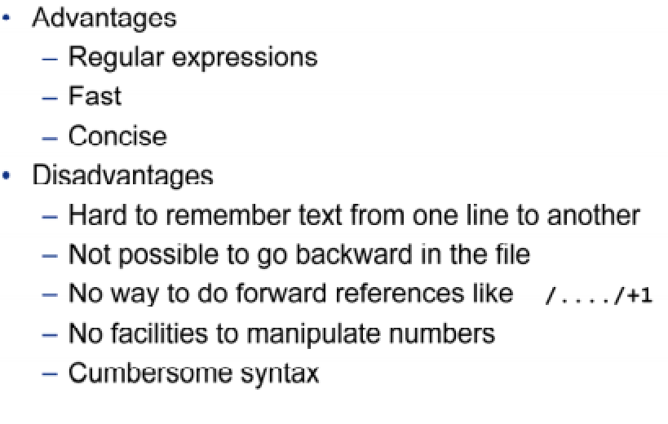
Advantages and Disadvantages:

Slide 93
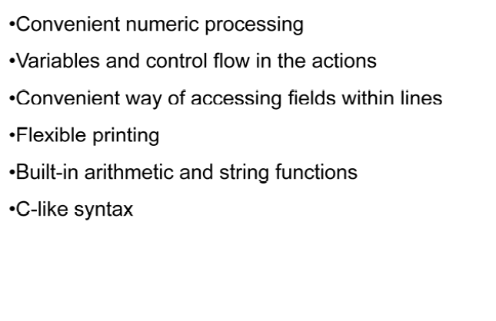
Advantages of awk over sed

Slide 94
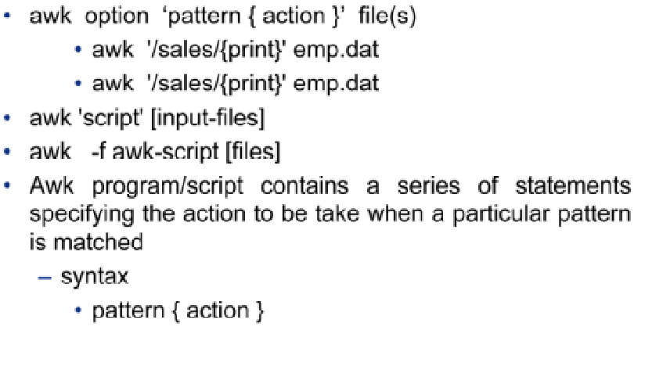
Awk - syntax

Slide 95
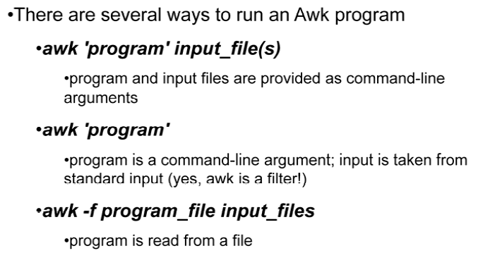
Running AWK Program

Slide 96
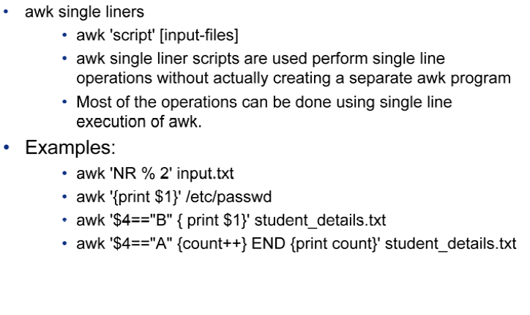
Running awk program

Slide 97
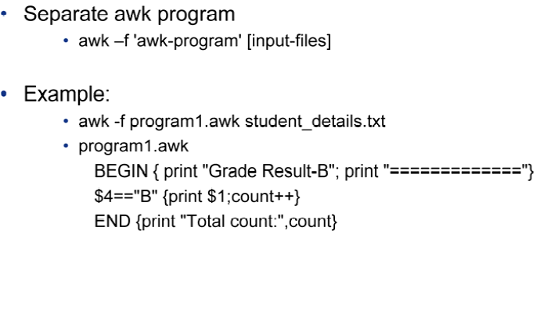
Running AWK program

Slide 98
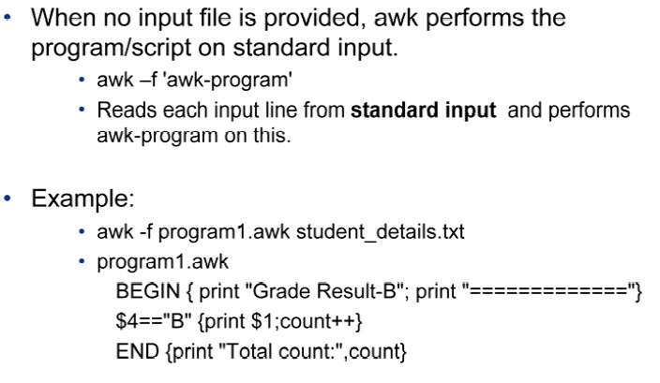
Running AWK Program

Slide 99
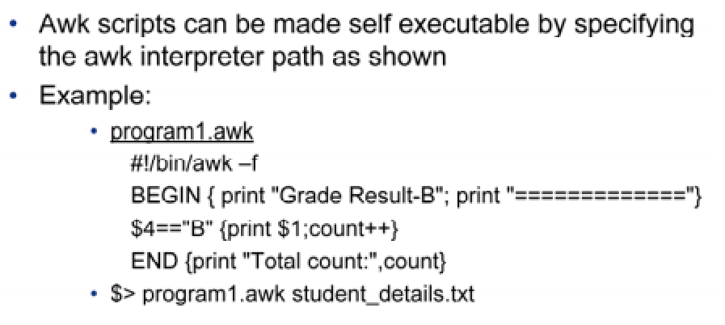
Running AWK Program

Slide 100
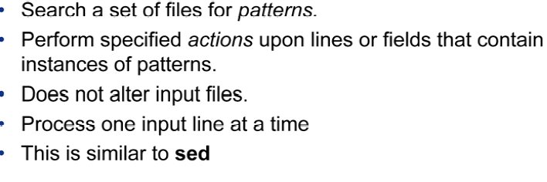
How does awk work?

Slide 101
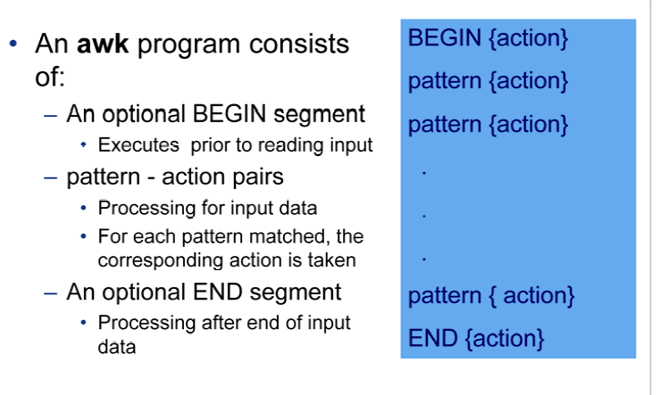
Awk program structure

Slide 102
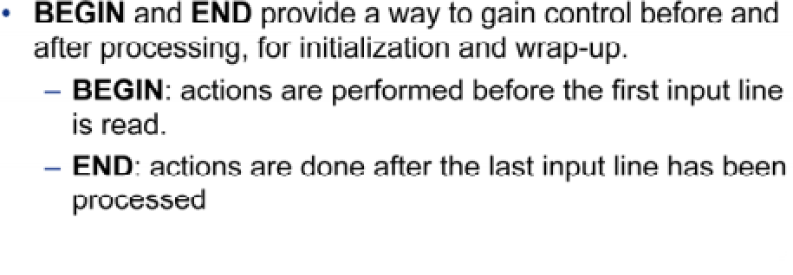
BEGIN and END patterns

Slide 103
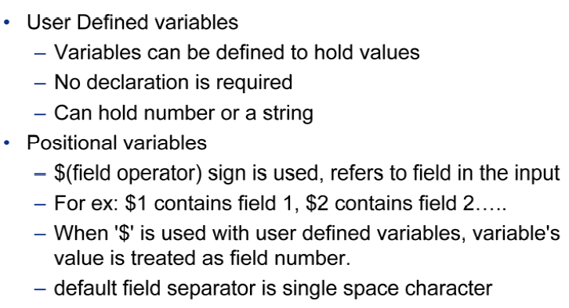
AWK Variable:

Slide 104
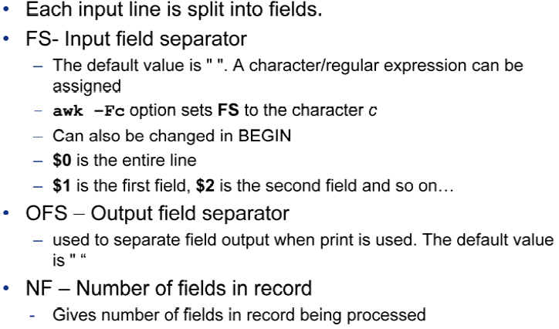
Awk built in variables

Slide 105
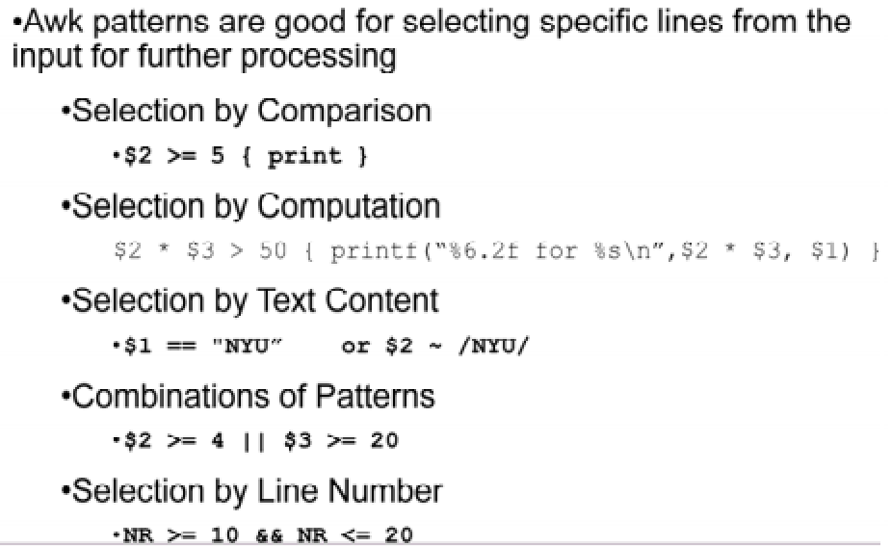
Selection in Awk

Slide 106
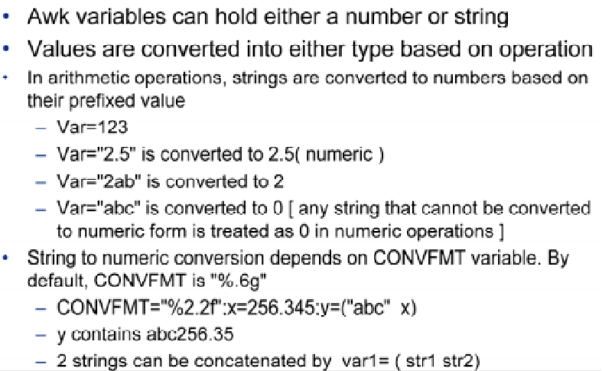
Awk variables –Type conversion

Slide 107
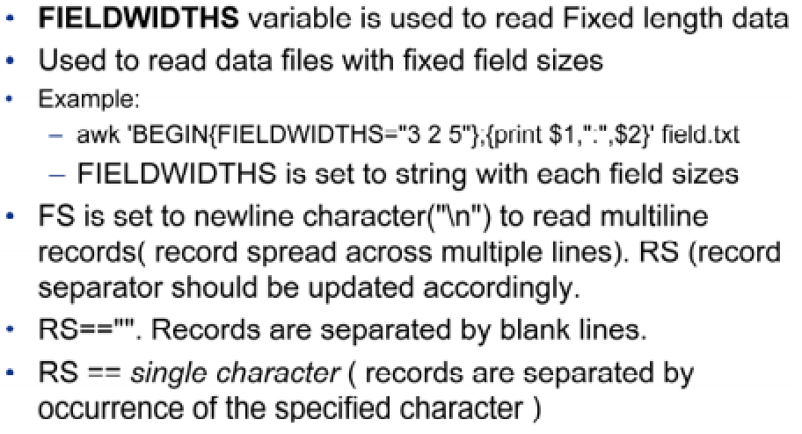
Reading input files

Slide 108
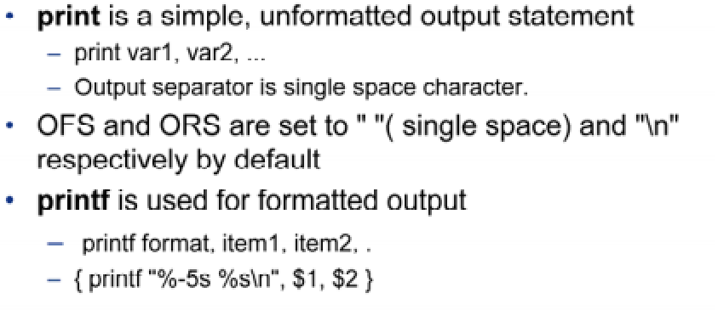
Printing Output

Slide 109
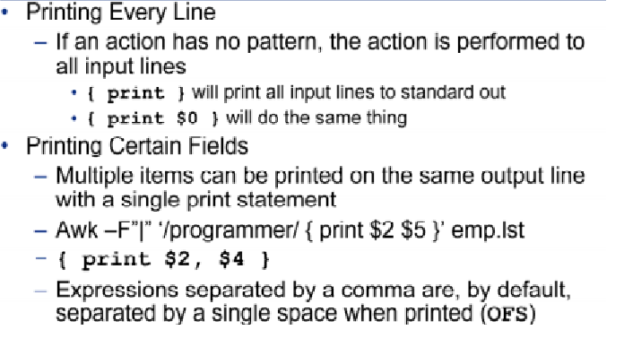
Sample Output from awk

Slide 110
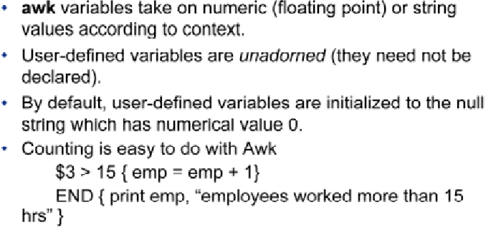
Computing with awk

Slide 111

Example:

Slide 112

Handling Text

Slide 113

SELF STUDY:- awk operatios

Slide 114

Awk operators

Slide 115

Awk operators

Slide 116

Awk operators

Slide 117

Awk operators

Slide 118
Functions
Awk provide huge set of built-in functions.
index(mainstring, findstring)
length([string])
sub(regexp, replacement [,target])
substr(string, start,[length])
systime()

Slide 119

Qns:

Slide 120
THANK YOU!

