Slide 1
Trade Promotion Optimization
Impact of Trade Promotions on Volume Sales
Confidential
22-12-23
Mangesh, Geet Desai Raghul Singh

Slide 2
Approach
01
02
03
04
05
06
07
08
｜
｜
｜
｜
｜
｜
｜
｜
Objective
Data Exploration
Data Preprocessing
Exploratory Data Analysis
Hypothesis
Feature Engineering & Model Building
Model Results
Conclusion
Model Results

Slide 3
Objective
Problem Statement & Questions to be Answered:
How different promotions are affecting the Volume Sales at Promotion Group * Retailer Level.
Quantify the effects of Promotions and Promo Groups on Volume Sales.
Explore and analyze data to provide additional actionable insights for the stakeholders.

Slide 4
Data Exploration
Sales Data: Data Dictionary
Column Name | Description
Retailer | Retailer
Category | Category
Sub.Category | Sub.Category
Segment | Segment
Sub.Segment | Sub.Segment
Manufacturer | Manufacturer
Brand | Brand
Sub.Brand | Sub.Brand
Packsize | Packsize
Product.Type | Product.Type
Promo.Group | All SKUs within Promo group are promoted together
APN | Individual item/SKU
Date | Date
Unit.Sales | Unit.Sales
Val.Sales | Val.Sales
Vol.Sales | Vol.Sales
Wtd.Selling.Dist | Weighted selling distribution (Number of stores selling the item weighted by store sales)
ppg_to_model | Flag for In-scope PPGs for modeling. Out of scope PPGs can be used to measure impact on in-scope PPGs

Slide 5
Data Exploration – Initial Observation
Sales Data:
The sales data comprises of 137,400 entries across 19 different dimensions.
Data is provided for a single market/country at Category x Manufacturer x Brand x Retailer x Item x Week level.
We have data for 2 retailers with 30 Promo Groups, however the ppgs to model are 6, with that we are proceeding with our analysis.
The sales data spans a total of 113 weeks, covering the period from August 5, 2018, to September 27, 2020.
Promotion Data:
Promotion data has 1884 entries across 9 different dimensions.
Data is provided at Retailer x Promo Group x Week level.
Meanwhile, within the promotion data, the "PPG“ (Promo Group) attribute comprises only 6 distinct values, which matches with Sales data.
The promotion data consists of 158 weeks' worth of information, encompassing the period from December 31, 2017, to January 3, 2021.

Slide 6
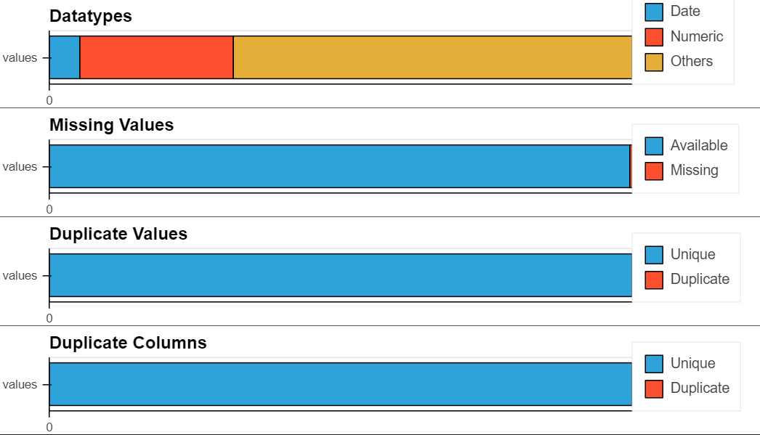
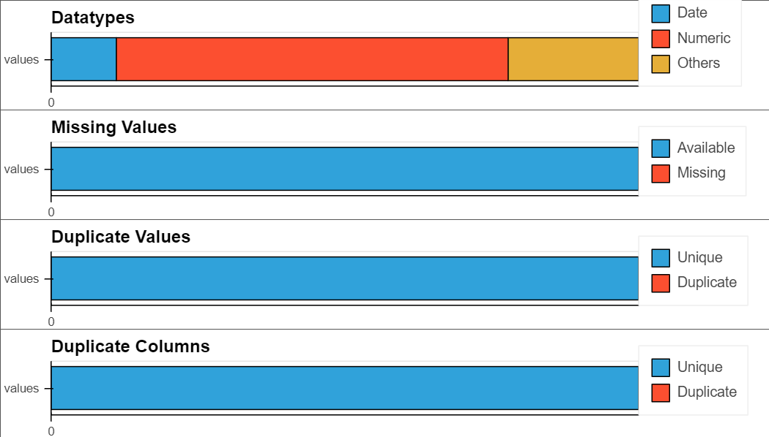
Data Exploration – Dataset Health Analysis
Sales Data: Variable Types
Promo Data: Variable Types
26% of 5 Numerical variable
68% of 13 Other data types variable
5% of 1 Datetime Variable
Sales data has Sub.Segment field which has 7.81% of missing value.
67% of 6 Numerical Variable
22% of 2 other Variable
11% 0f 1 Datetime
There is no missing value in Promo data.

Slide 7
Data Preprocessing – Data Aggregation and Merging
Sales Data & Promo Data:
Preparing data model ready and EDA ready for our analysis.
Sales Data:
Filtering the relevant data by setting ‘ppg_to_model’ flag as 1.
Aggregating the dataset into Retailer * Promo Group(PPG) * Week level.
Promo Data:
Merging sales data with the promo data on Date(weekly), Retailer and Promo.Group(PPG) as key.
So here we have our final dataset which has only the relevant fields for our analysis.
Final Dataset Prechecks:
Shape → Rows : 1356 ; Columns : 15
Missing Value → No missing value
Duplicate Rows or Columns → No duplicates

Slide 8

Exploratory Data Analysis
Retailer x Promotion wise Analysis:
In our analysis, encompassing both exploratory data analysis (EDA) and modeling, we'll initially provide an overview of the entire dataset.
Subsequently, we'll delve into separate analyses for the 2 Retailers & 6 Promo.Group, examining their data individually.
Our analysis will be divided into two segments, focusing on each retailer individually. Consequently, we'll construct 12 distinct models for each Retailer x PPG level.
We're equipped with a dataset spanning two years, specifically from August 5, 2018, to September 27, 2020, for our comprehensive analysis.

Slide 9
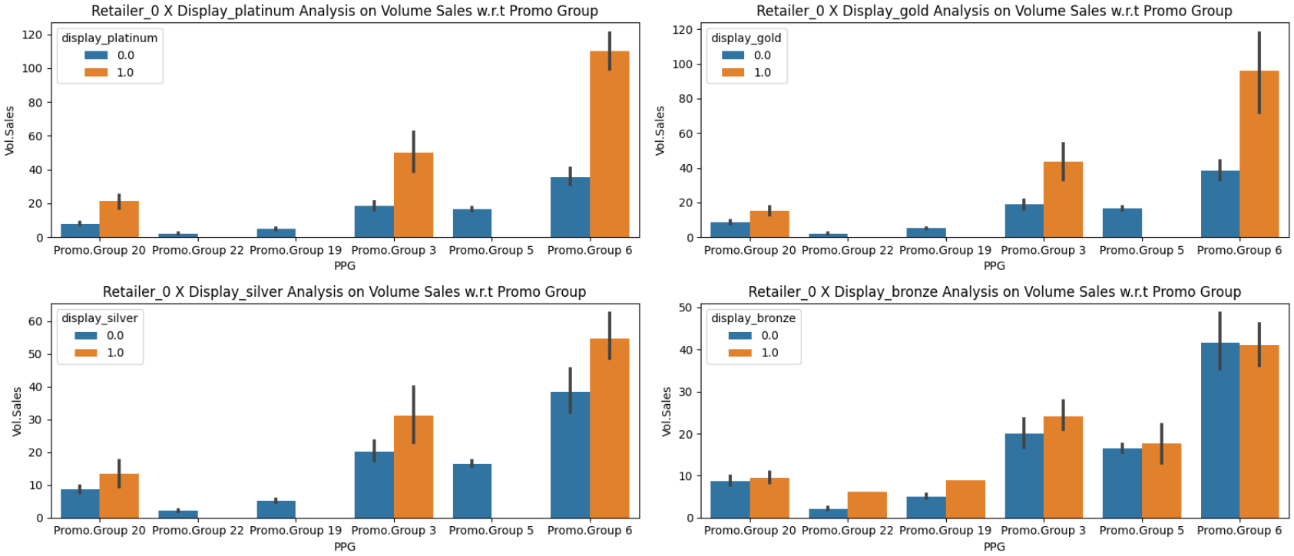
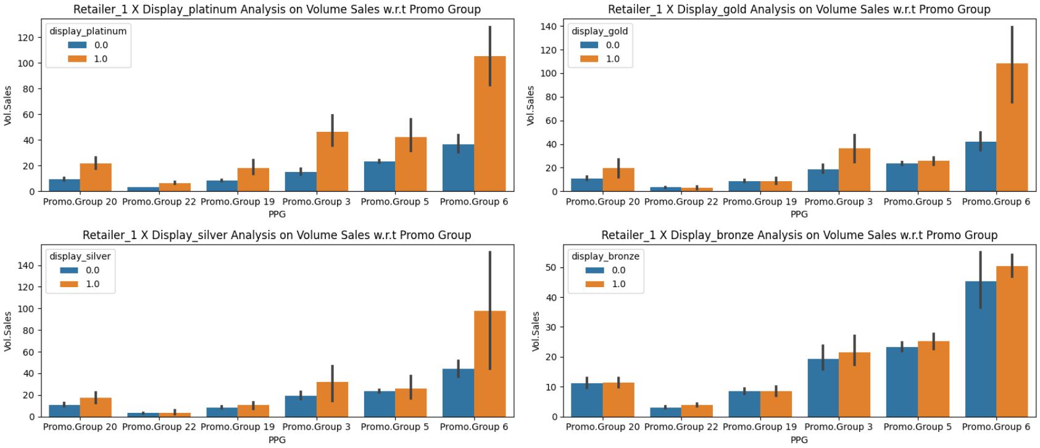
Exploratory Data Analysis
Retailer 0 - Volume Sales w.r.t Display Promotion
Retailer 1 - Volume Sales w.r.t Display Promotion
Observation: Observation: Among the promotions observed for Retailer 0, Display Platinum, Display Gold, and Display Silver showcase similar volume sales trends, demonstrating substantial impact.Conversely, while Display Bronze manages to cover sales across all promo groups, it achieves comparatively lower volume sales and impact than the other three.
Observation: Across Retailer 1, the majority of promo groups exhibit a positive response to the applied display promotions. Notably, Platinum, Gold, and Silver promotions have a significant impact specifically on Promo Group 6.

Slide 10
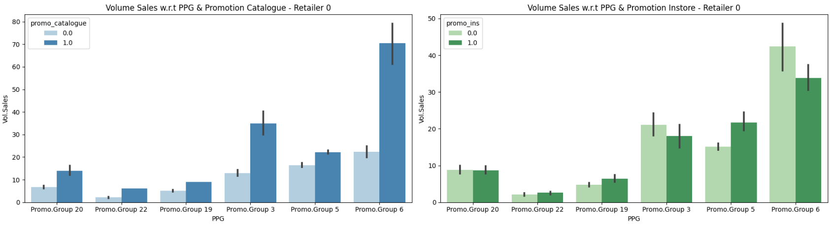
Exploratory Data Analysis
Retailer 0 - Volume Sales w.r.t PPG & Promotion Catalogue and Instore
Observation: The impact of catalogue promotions on volume sales is evidently substantial across all promotion groups, surpassing the influence of Instore promotions. Notably, Promo Groups 20, 3, and 6 for Retailer 0 depict higher sales in the absence of promotions under the Instore category.

Slide 11
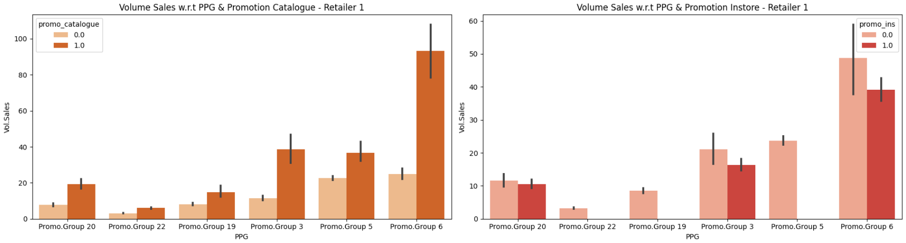
Exploratory Data Analysis
Retailer 1 - Volume Sales w.r.t PPG & Promotion Catalogue and Instore
Observation: Similar to Retailer 0, Instore Promotion does not hold impact on volume sales since without instore promotion itself sales are good, whereas catalogue hold positive impact on sales.

Slide 12
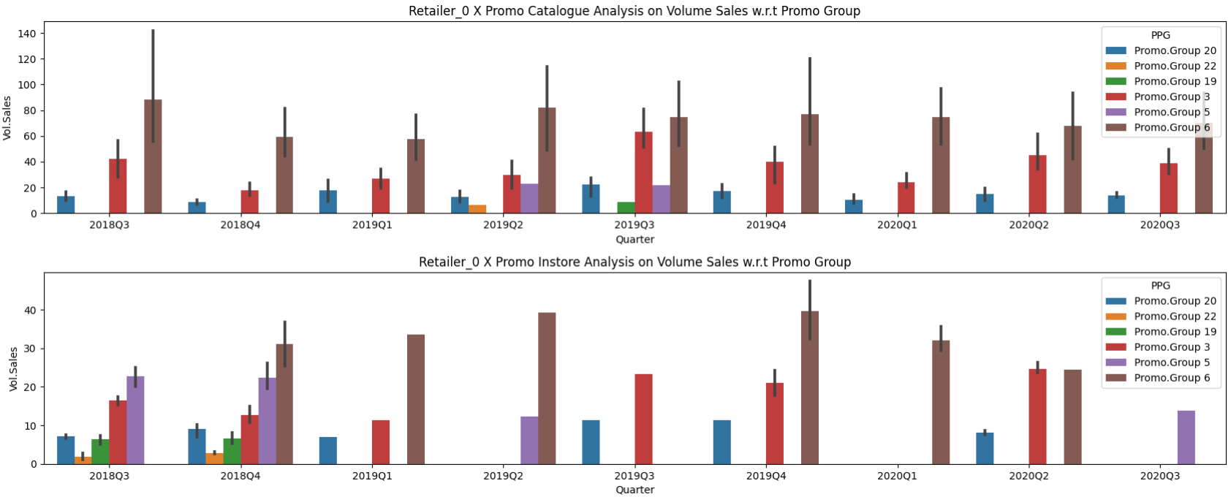
Exploratory Data Analysis
Retailer 0 → Comparing Catalogue and Instore Promotion on Volume Sales
Observation: Within Retailer 0, catalogue promotions notably drive sales in Promo Groups 6, 20, and 3, contributing significantly to their collective volume sales. In contrast, Promo Groups 3, 5, 6, and 19 show heightened sales specifically in response to instore promotions.

Slide 13
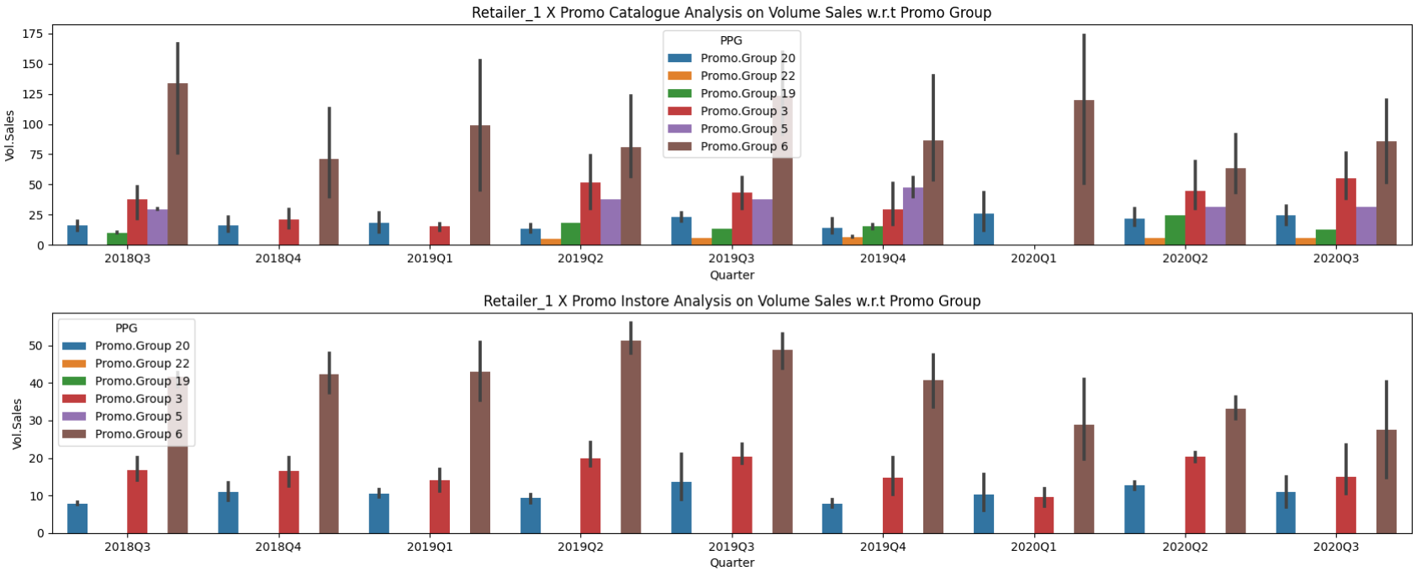
Exploratory Data Analysis
Retailer 1 → Comparing Catalogue and Instore Promotion on Volume Sales
Observation: Observation: The plotted data indicates that implementing catalogue promotions for retailer 1 appears to generate sales across nearly all promo groups. Conversely, instore promotions seem to have no impact on the sales of promo groups 5, 19, and 22.

Slide 14
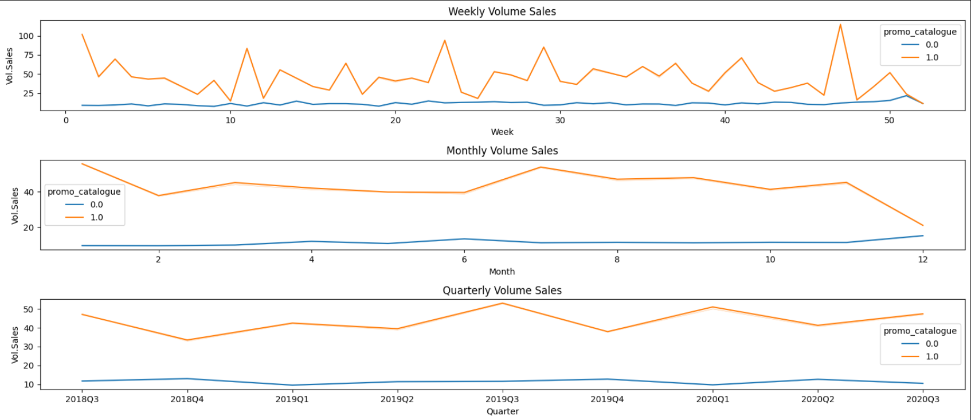
Exploratory Data Analysis
Time Series Analysis on Volume Sales w.r.t Promo Catalogue
Observation: The plotted data clearly indicates a positive influence of the Promo catalogue on volume sales. Quarterly analysis reveals a noticeable seasonality in volume sales for the Promo catalogue, marked by periodic spikes. Moreover, there appears to be a declining trend in sales towards the year's end.
Actionable Insight: Implementing catalogue promotions towards the year-end seems to have a lesser impact on volume sales.

Slide 15
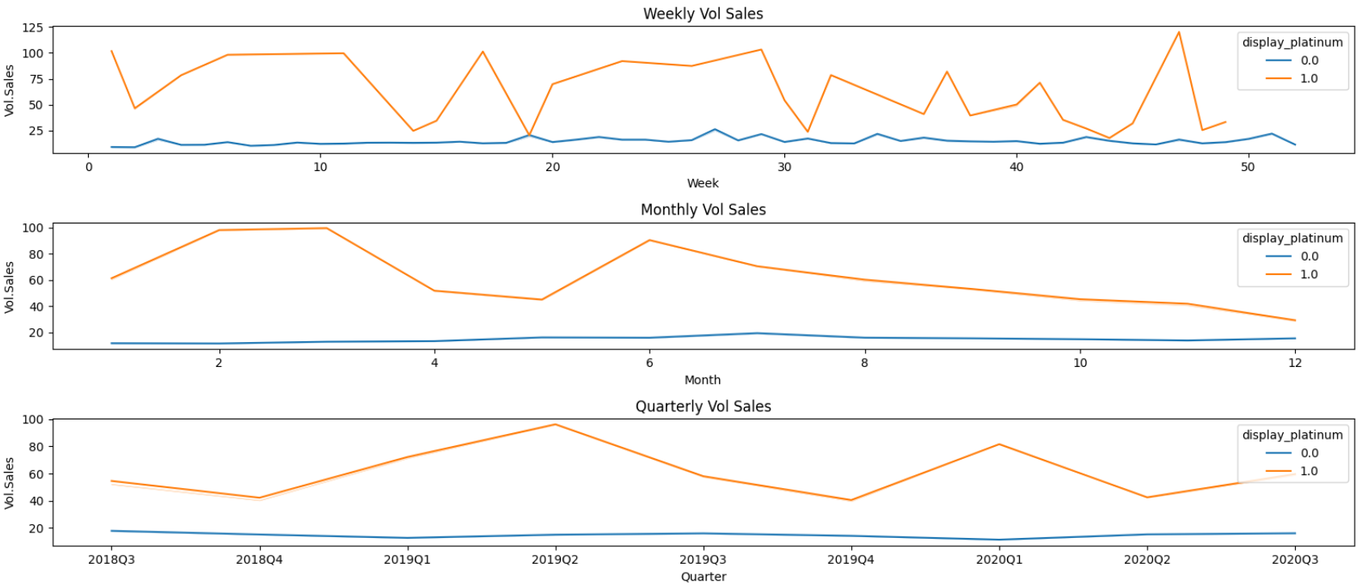
Exploratory Data Analysis
Time Series Analysis on Volume Sales w.r.t Display Platinum
Observation: The Display Platinum promotion stands out for its substantial impact on volume sales, consistently leading to noticeable spikes in sales whenever implemented.
Actionable Insights: Rather than prioritizing Instore Promotions during the latter half of the year, I suggest shifting focus towards conducting Display Promotions to anticipate a surge in sales.

Slide 16
Hypothesis
Modelling:
12 models will be built on the data separately for both the retailers at PPG level to understand the effect of Promotion Variables on the Volume Sales, which is our main objective.
We have made certain observations based on our EDA which we will be using for feature selection. Apart from these we will establish certain hypothesis and look to validate these hypothesis using the models.
Approach:
We are interested in analyzing the impact of Promotional Variables on Volume Sales, i.e., "Vol.Sales." Therefore, "Vol.Sales" will be our dependent variable.
IDV → x : ['promo_catalogue', 'promo_ins', 'display_platinum', 'display_gold', 'display_silver', 'display_bronze’, ’ Wtd.Selling.Dist’,’Seasonal Index’]
DV → y : Vol.Sales
Hypothesis:
The promotion campaigns have significant impact on the Vol sales for each PPG.
Implementing better promotion strategies must result in better Sales. eg Platinum Display must accelerate more sale than Bronze display or other displays.

Slide 17
Feature Engineering & Model Building
Feature Engineering
Seasonal Index
Competitor Data
Model Selection
OLS (Regression)
Feature Selection & Modelling
VIF for feature Selection
P-value based selection
Driver Based Model
Seasonal index based on weekly sales volume is calculated.
Data frame for each PPG is created, and competitor features added for each PPG.
Driver based model is selected for model building as it provides contribution of each variable & better explanation.
OLS model (Regression) is selected as it is simple for comprehension & understanding.
For feature selection VIF & p-value based methods are used

Slide 18
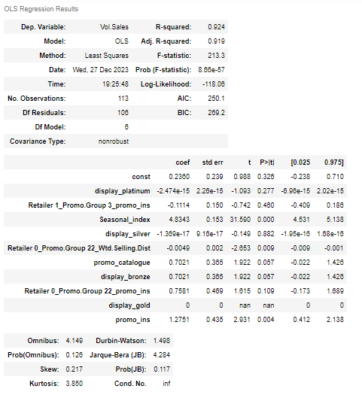
Model Results
PPG 19 Retailer 0:
General Observation:
The model explains around 92% of the variability in data.
Promotions:
Promos_ins, promo_catalogue, display_bronze, seasonal_index are significant features.
Display types Platinum, Silver has minimal influence on sales of PPG 19 for retailer 0.
Promotion Groups:
Retailer.1_Promo.Group3, Retailer.0_Promo.Group22 are competitors for given PPG.
.
Wt.Selling.Dist have no impact on vol sales.
Vol.Sales ~ const + coeff_platinum_display * Platinum_Display + coeff_Retailer_1_Promo.Group.3_promo_ins * Retailer_1_Promo.Group.3_promo_ins + coeff_seasonal_index * seasonal_index + coeff_silver_display * Silver_Display + coeff_Retailer_0_Promo.Group.22_wd * Retailer_0_Promo.Group.22_wd + coeff_promo_catalogue * promo_catalogue + coeff_bronze_display * bronze_Display + coeff_gold_display * gold_Display +
Coeff_Promo_ins * Promo_ins + coeff_Retailer_0_Promo.Group.22_promo_ins * retailer_0_Promo.Group.22_promo_ins
PPG | const | Seasonal index | promo catalogue | promo_ins | display platinum | display gold | display silver | display bronze | Retailer 1_Promo.Group 3_promo_ins | Retailer 0_Promo.Group 22_Wtd.Selling.Dist | Retailer 0_Promo.Group 22_promo_ins
ppg19_0 | 0.2360 | 4.8343 | 0.7021 | 1.2751 | 0.0000 | 0.0000 | 0.0000 | 0.7021 | -0.1114 | -0.0049 | 0.7581

Slide 19
Model Results : Monthly percentage contribution
PPG 19 Retailer 0:
Year | Month | perc Seasonal_index | perc const | perc promo catalogue | perc promo_ins | perc display platinum | perc display gold | perc display silver | perc display bronze | perc Retailer 1_Promo.Group 3_promo_ins | perc Retailer 0_Promo.Group 22_Wtd.Selling.Dist | perc Retailer 0_Promo.Group 22_promo_ins | Vol.Sales
2018 | 8 | 78.0 | 3.5 | 0.0 | 18.9 | 0.0 | 0.0 | 0.0 | 0.0 | -0.4 | -0.5 | 2.8 | 27.5
2018 | 9 | 73.4 | 3.9 | 0.0 | 21.2 | 0.0 | 0.0 | 0.0 | 0.0 | -0.7 | -6.7 | 12.6 | 31.2
2018 | 10 | 75.1 | 4.5 | 0.0 | 24.3 | 0.0 | 0.0 | 0.0 | 0.0 | -0.5 | -9.3 | 14.5 | 22.8
2018 | 11 | 70.6 | 4.5 | 0.0 | 24.5 | 0.0 | 0.0 | 0.0 | 0.0 | -0.5 | -9.4 | 14.6 | 21.7
2018 | 12 | 69.6 | 2.7 | 0.0 | 14.9 | 0.0 | 0.0 | 0.0 | 0.0 | -0.8 | -5.6 | 8.8 | 38.5
2019 | 1 | 84.9 | 7.6 | 0.0 | 0.0 | 0.0 | 0.0 | 0.0 | 0.0 | -0.9 | -15.2 | 0.0 | 9.5
2019 | 2 | 88.6 | 8.3 | 0.0 | 0.0 | 0.0 | 0.0 | 0.0 | 0.0 | 0.0 | -16.4 | 0.0 | 9.2
2019 | 3 | 103.6 | 6.7 | 0.0 | 0.0 | 0.0 | 0.0 | 0.0 | 0.0 | -0.6 | -13.1 | 0.0 | 17.1
2019 | 4 | 105.0 | 5.0 | 0.0 | 0.0 | 0.0 | 0.0 | 0.0 | 0.0 | -0.6 | -9.9 | 0.0 | 18.7
2019 | 5 | 106.9 | 3.7 | 0.0 | 0.0 | 0.0 | 0.0 | 0.0 | 0.0 | -0.4 | -7.3 | 0.0 | 26.2
2019 | 6 | 109.2 | 3.3 | 0.0 | 0.0 | 0.0 | 0.0 | 0.0 | 0.0 | -0.3 | -6.6 | 0.0 | 37.6
2019 | 7 | 114.9 | 4.6 | 0.0 | 0.0 | 0.0 | 0.0 | 0.0 | 0.0 | -0.5 | -9.2 | 0.0 | 22.4
2019 | 8 | 96.3 | 4.3 | 3.2 | 0.0 | 0.0 | 0.0 | 0.0 | 3.2 | -1.0 | -8.6 | 0.0 | 21.2
2019 | 9 | 104.9 | 5.6 | 0.0 | 0.0 | 0.0 | 0.0 | 0.0 | 0.0 | 0.0 | -11.2 | 0.0 | 20.9
2019 | 10 | 105.2 | 6.3 | 0.0 | 0.0 | 0.0 | 0.0 | 0.0 | 0.0 | 0.0 | -12.6 | 0.0 | 14.8
2019 | 11 | 112.3 | 7.2 | 0.0 | 0.0 | 0.0 | 0.0 | 0.0 | 0.0 | -1.7 | -14.5 | 0.0 | 13.5
2019 | 12 | 114.2 | 4.5 | 0.0 | 0.0 | 0.0 | 0.0 | 0.0 | 0.0 | -1.3 | -9.0 | 0.0 | 28.4
2020 | 1 | 128.8 | 11.6 | 0.0 | 0.0 | 0.0 | 0.0 | 0.0 | 0.0 | -1.4 | -23.1 | 0.0 | 9.5
2020 | 2 | 120.7 | 11.3 | 0.0 | 0.0 | 0.0 | 0.0 | 0.0 | 0.0 | -2.7 | -22.5 | 0.0 | 8.9
2020 | 3 | 99.6 | 6.4 | 0.0 | 0.0 | 0.0 | 0.0 | 0.0 | 0.0 | -0.6 | -12.7 | 0.0 | 17.1
2020 | 4 | 98.2 | 4.7 | 0.0 | 0.0 | 0.0 | 0.0 | 0.0 | 0.0 | -0.6 | -5.2 | 0.0 | 19.5
2020 | 5 | 96.6 | 3.6 | 0.0 | 0.0 | 0.0 | 0.0 | 0.0 | 0.0 | -0.7 | -0.2 | 0.0 | 33.0
2020 | 6 | 94.1 | 2.6 | 0.0 | 0.0 | 0.0 | 0.0 | 0.0 | 0.0 | -0.6 | -0.1 | 0.0 | 34.6
2020 | 7 | 90.3 | 3.6 | 0.0 | 0.0 | 0.0 | 0.0 | 0.0 | 0.0 | -0.4 | 0.0 | 0.0 | 24.3
2020 | 8 | 102.9 | 4.5 | 0.0 | 0.0 | 0.0 | 0.0 | 0.0 | 0.0 | -0.4 | 0.0 | 0.0 | 28.2
2020 | 9 | 100.7 | 6.0 | 0.0 | 0.0 | 0.0 | 0.0 | 0.0 | 0.0 | -0.7 | 0.0 | 0.0 | 16.7
Seasonal Index is having maximum percentage contribution for given ppg across all other features.
Weighted Distribution of retailer 0 ppg 22 is having inverse relation with Vol sales of PPG19_0.
Instore promotion is the only promotion ran for the given PPG, which shows around 20%-25% contribution for PPG19_0.

Slide 20
Model Results : Predictions
PPG 19 Retailer 0:
Model performs well in terms of prediction as it can be seen from the graph.

Slide 21
Model Results : Performance
PPG | R2-Value | Adj R2-Value
ppg19_0 | 0.924 | 0.919
ppg19_1 | 0.853 | 0.838
ppg20_0 | 0.855 | 0.845
ppg20_1 | 0.754 | 0.733
ppg22_0 | 0.731 | 0.716
ppg22_1 | 0.708 | 0.68
ppg3_0 | 0.91 | 0.902
ppg3_1 | 0.91 | 0.902
ppg5_0 | 0.72 | 0.701
ppg5_1 | 0.753 | 0.734
ppg6_0 | 0.937 | 0.932
ppg6_1 | 0.828 | 0.811
Model performs well for ppg19_0, ppg19_1, ppg20_0, ppg3_0, ppg3_1, ppg6_0, ppg6_1 with r2 value & adjusted r2-value more than 80%.
For ppg20_1, ppg22_1, ppg22_0, ppg5_0, ppg5_1, r2 value & adjusted r2 value is in the range of 70-80%
Using model Coefficients, contribution of each feature in the model is calculated to understand the impact of promotions discounts.
The results of the model are in line with the EDA.

Slide 22
Model Results: Promotion Discounts Results
PPG | const | Seasonal index | promo catalogue | promo_ins | display platinum | display gold | display silver | display bronze
ppg19_0 | 0.2360 | 4.8343 | 0.7021 | 1.2751 | 0.0000 | 0.0000 | 0.0000 | 0.7021
ppg19_1 | 1.5054 | 7.7124 | 2.2536 | 0.0000 | 3.3764 | 0.2763 | 1.5751 | 1.0110
ppg20_0 | 1.0620 | 6.9073 | 0.5056 | 0.4976 | 6.3136 | 2.3513 | 1.4828 | 0.6115
ppg20_1 | -5.6251 | 6.0338 | 3.9176 | 3.4577 | 4.6222 | 4.0180 | 1.2219 | 0.2314
ppg22_0 | -2.2200 | 0.4114 | 0.7217 | 0.2435 | 0.0000 | 0.0000 | 0.0000 | 0.7217
ppg22_1 | 0.1819 | 2.1703 | 1.7569 | 0.0000 | -0.1045 | 0.1069 | 0.6690 | 0.6865
ppg3_0 | 2.1276 | 16.0823 | -0.7844 | -0.3580 | 14.9336 | 12.9124 | 5.3210 | 3.5618
ppg3_1 | 2.1276 | 16.0823 | -0.7844 | -0.3580 | 14.9336 | 12.9124 | 5.3210 | 3.5618
ppg5_0 | 0.8519 | 16.2538 | 5.9532 | 5.2359 | 0.0000 | 0.0000 | 0.0000 | -6.9536
ppg5_1 | -2.0316 | 24.3626 | 7.3783 | 0.0000 | 5.0490 | 1.6254 | 3.3891 | 1.5955
ppg6_0 | 5.3689 | 27.4407 | 14.7845 | 8.3021 | 26.6061 | 10.6327 | -1.3596 | -4.0334
ppg6_1 | 0.2702 | 21.7494 | 16.2659 | 11.2491 | 35.0656 | 36.3816 | -0.6287 | 12.2089
Seasonal index is major feature.
Promo catalogue has good share in ppg20_1, ppg22_0, ppg22_1 & average share in ppg5_0, ppg5_1, pp6_0, ppg_1.
Instore promotions performs well for ppg20_1, ppg22_0, ppg22_1.
Display platinum performs well for ppg3_0, ppg3_1, ppg6_0 & ppg6_1.
Display gold performs well for ppg6_1, ppg3_0, ppg3_1 & ppg6_0 & ppg20_1.
Display silver has average performance while it has negative impact for ppg6_0 & ppg6_1.
Display bronze has negative impact for ppg5_0 & ppg6_0 while it has average contribution in other models except ppg22_0.

Slide 23
Model Results - Interaction Metrics
PPG | ppg19_0 | ppg19_1 | ppg20_0 | ppg20_1 | ppg22_0 | ppg22_1 | ppg3_0 | ppg3_1 | ppg5_0 | ppg5_1 | ppg6_0 | ppg6_1
ppg19_0 | 1 | 0 | 0 | 0 | 1 | 0 | 0 | 1 | 0 | 0 | 0 | 0
ppg19_1 | 0 | 1 | 0 | 0 | 1 | 0 | 0 | 1 | 0 | 0 | 0 | 1
ppg20_0 | 0 | 0 | 1 | 0 | 0 | 0 | 0 | 0 | 0 | 0 | 0 | 0
ppg20_1 | 0 | 0 | 0 | 1 | 0 | 0 | 1 | 0 | 0 | 0 | 1 | 1
ppg22_0 | 0 | 0 | 0 | 0 | 1 | 0 | 1 | 0 | 1 | 0 | 0 | 0
ppg22_1 | 0 | 1 | 0 | 1 | 0 | 1 | 1 | 0 | 0 | 0 | 0 | 1
ppg3_0 | 0 | 0 | 1 | 0 | 0 | 1 | 1 | 0 | 0 | 0 | 0 | 0
ppg3_1 | 0 | 0 | 1 | 0 | 0 | 1 | 0 | 1 | 0 | 0 | 0 | 0
ppg5_0 | 1 | 0 | 0 | 0 | 1 | 0 | 0 | 0 | 1 | 0 | 0 | 0
ppg5_1 | 0 | 0 | 1 | 0 | 0 | 0 | 1 | 0 | 0 | 1 | 0 | 0
ppg6_0 | 0 | 0 | 0 | 0 | 1 | 0 | 0 | 1 | 0 | 0 | 1 | 0
ppg6_1 | 0 | 0 | 0 | 1 | 0 | 1 | 0 | 1 | 0 | 0 | 0 | 1
Interaction metrics is significant to understand the interaction of given ppg with other ppgs’ for different retailers.
For ppg20_0, no other ppg is interacting with the model.
Most of the ppgs’ interact with maximum 3 other ppgs’.

Slide 24
Conclusion
Based on the problem statement, we created 12 different models for each ppg at retailer level.
As objective is to find the drivers of the sales OLS model is used at it provides comprehensive understanding of coefficients.
Most model performs well having more than 80% adjusted r2 value while it is in the range of 70%-80% for a few.
Display platinum performs significantly well for most the promo groups.
Display gold campaign have significant impact
Display bronze & display silver have an average impact on volume sales.
Promo instore & promo catalogue also have contribution in Vol sales, but it is different for different Promo groups.
Interaction metrics shows that the model promo group has an interaction with another promo groups.
Increase in weighted distribution of competitor has an inverse relation with Vol sales for given promo group.
For few promo groups some of the discount campaigns are having negative impact which is against our hypothesis.
This negative coefficients can be removed by using Bayesian regression technique.

Slide 25
Thank You
Do you have any questions?
Contributors:
Mangesh Shinde → mangesh.shinde@tigeranalytics.com
Raghul Singh → Raghul.singh@tigeranalytics.com
Geet Desai → Geet.desai@tigeranalytics.com

