Slide 1
Image Generation using GAN
SUBMITTED BY
RAGHUL VISHAL T
NM ID: au711721243074
KGiSL INSTITUTE OF TECHNOLOGY
3/21/2024 Annual Review

Slide 2
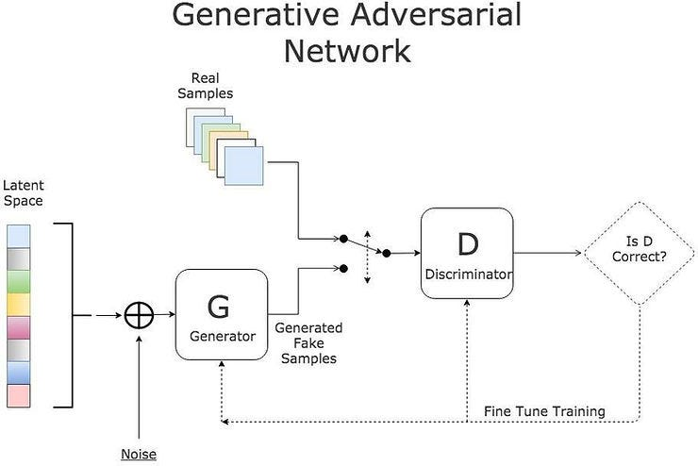
Image Generation using GAN
3/21/2024 Annual Review

Slide 3


AGENDA
PROBLEM STATEMENT
PROJECT OVERVIEW
END USERS
SOLUTION AND PROPOSITION
KEY FEATURES
MODELLING APPROACH
RESULT
3/21/2024 Annual Review

Slide 4

PROBLEM STATEMENT
The task involves generating artificial images that bear a strong resemblance to authentic images from the CIFAR-10 dataset. CIFAR-10, a standard dataset in computer vision, comprises 60,000 32x32 RGB images distributed among 10 categories. The objective is to devise a generative model capable of producing images that are virtually indistinguishable from genuine CIFAR-10 samples.
3/21/2024 Annual Review

Slide 5

PROJECT OVERVIEW
The project aims to implement a Generative Adversarial Network (GAN) architecture using Keras and TensorFlow to generate synthetic images resembling real images from the CIFAR-10 dataset. CIFAR-10 is a widely-used benchmark dataset in computer vision, containing 60,000 32x32 color images across 10 classes.
3/21/2024 Annual Review

Slide 6

WHO ARE THE END USERS?
Computer vision researchers, as well as those delving into deep learning and generative modeling, can employ the developed GAN model to delve into novel methodologies, pushing the boundaries of image synthesis, and experimenting with diverse image generation tasks.
Data scientists and practitioners in machine learning have the opportunity to utilize the trained GAN model across various domains, including but not limited to data augmentation, synthetic data creation, and priming models for downstream tasks such as image classification, object detection, and image segmentation.
3/21/2024 Annual Review

Slide 7
YOUR SOLUTION AND ITS VALUE PROPOSITION
Solution: Our GAN model excels in generating images that closely mimic those from the CIFAR-10 dataset.
Value:
Authentic Image Synthesis: Creates synthetic images with high fidelity to reality.
Model Robustness Enhancement: Strengthens model resilience by diversifying synthetic data.
Creative Potential: Enables experimentation and artistic exploration in image generation.
Cost-Efficiency: Reduces expenses associated with acquiring real-world data.
.
3/21/2024 Annual Review

Slide 8
THE WOW IN YOUR SOLUTION
Hyper-realistic Images: Our GAN generates images that blur the line between synthetic and real.
Boundless Creativity: Empowers users to unleash artistic expression and visionary concepts effortlessly.
Instant Data Amplification: Expands dataset diversity instantly, enhancing model robustness and insights.
Resource Efficiency: Saves time and costs by eliminating exhaustive data collection processes.
Revolutionizes Design: Transforms prototyping and visualization, elevating product innovation to new heights.
Educational Powerhouse: Sparks curiosity and fosters experimentation in AI and generative modeling.
Innovation Catalyst: Inspires bold exploration and propels groundbreaking discoveries in AI.
3/21/2024 Annual Review

Slide 9
MODELLING
Data Preprocessing:
1.Pixel Value Normalization: Adjust pixel values to a range between 0 and 1 for numerical stability.
Data Partitioning: Divide the CIFAR-10 dataset into training and validation subsets for evaluating model performance.
2.Neural Network Architecture: Develop a deep neural network structure to synthesize images from random noise vectors (latent space).
Utilization of Convolutional Layers: Employ convolutional layers to extract hierarchical features from input noise vectors.
Transpose Convolutional Layers: Utilize transpose convolutional layers to increase the dimensionality of noise representations and generate image-like outputs.
Activation Function Application: Incorporate activation functions like LeakyReLU to introduce non-linearity and enable the model to capture intricate patterns.
3/21/2024 Annual Review

Slide 10
3.Discriminator Setup:
Binary Classifier Configuration: Develop a binary classifier that can discern real CIFAR-10 images from those generated by the generator.
Convolutional Layers Usage: Employ convolutional layers to extract features from input images and learn distinctive representations.
Activation Function Selection: Choose LeakyReLU activation functions to introduce complexities, aiding the discriminator in recognizing subtle differences.
Output Layer Arrangement: Utilize a single sigmoid activation neuron in the output layer to determine the probability of an image being real (1) or synthetic (0).
4.Training Methodology:
Adversarial Training Approach: Engage in adversarial training where the generator competes with the discriminator. The generator aims to produce convincing images, while the discriminator aims to correctly classify real and synthetic images.
Loss Function Application: Use binary cross-entropy loss functions to guide both the generator and discriminator towards their respective objectives.
Optimization Technique: Implement the Adam optimizer with appropriate learning rates to fine-tune model parameters effectively.
Mini-Batch Training Strategy: Train the model in mini-batches to maximize computational efficiency and hasten convergence.
Hyperparameter Tuning: Experiment with hyperparameters such as learning rates, batch sizes, and network architectures to optimize model performance.
5.Performance Evaluation:
Inception Score Assessment: Evaluate image quality and diversity using the Inception Score, which utilizes predictions from an Inception-v3 model.
Frechet Inception Distance (FID) Measurement: Calculate the FID to quantify the similarity between real and synthetic image feature distributions.
Visual Inspection: Qualitatively assess generated images through visual examination to gauge their realism, diversity, and overall quality.
6.Deployment Procedure:
Model Persistence: Save the trained generator and discriminator models for future usage and deployment.
Documentation Provision: Provide comprehensive documentation and usage instructions to facilitate seamless integration and deployment of the GAN model.

Slide 11
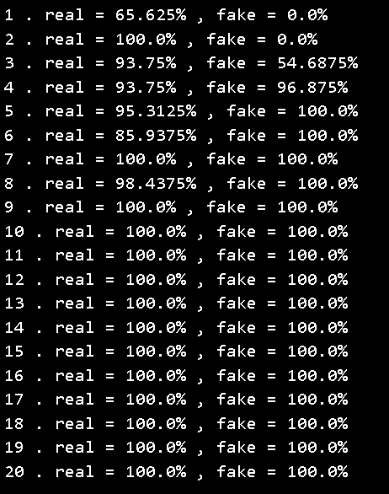
RESULTS
High Fidelity: Images closely mirror authentic CIFAR-10 images.
Diverse Outputs: Model yields diverse outputs spanning different classes.
Quality Validation: Metrics verify exceptional image quality and authenticity.
Steady Training: Training demonstrates stability and continual enhancement.
Effective Utilization: Users acknowledge effective data augmentation and creative applications.
Educational Contribution: Model facilitates learning and experimental endeavors.
Potential for Innovation: Findings ignite further exploration and innovation in AI.
3/21/2024 Annual Review

