Slide 1

Stock Price Prediction

Slide 2
Scope of Analysis
Predicting stock prices using machine learning. This project analyzes trends, patterns, and correlations. It uses historical market data to forecast stock closing prices.

Slide 3
Approach of Analysis
1
Data Preprocessing
2
EDA
Cleaning and preparing data for analysis.
Exploring data to find key insights.
3
Model Building
4
Dashboard
Creating a predictive model.
Visualizing results in Power BI.

Slide 4
Dataset Overview
Key Attributes
Data Insights
Open
Provides insights into stock price movements. Suitable for predictive modeling.
No Categorical Variable, Standardized Numerical Columns, Date’s Data typed format
High
Low
Close
Volume

Slide 5
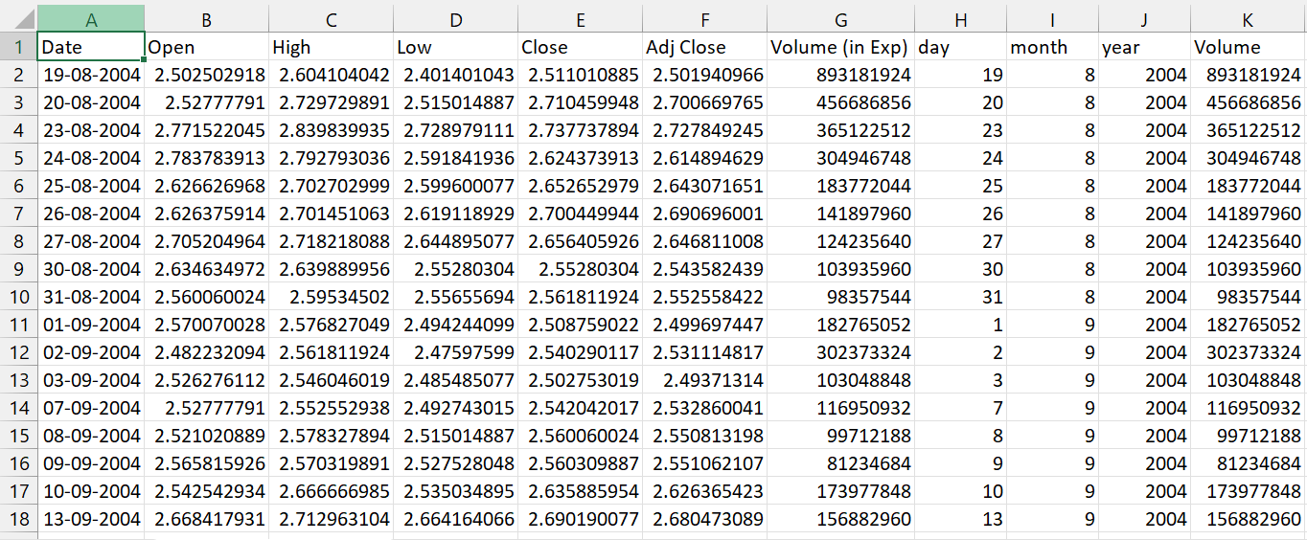
Dataset Overview
Dataset Overview
Key Attributes
Data Insights
Open
Provides insights into stock price movements. Suitable for predictive modeling.
High
Low
Close
Volume

Slide 6
Addressing Real-Time Issues
Informed Decisions
Risk Reduction
Portfolio Optimization
Helps investors make informed trading decisions.
Anticipates stock trends based on past data.
Optimizes portfolio strategies.

Slide 7
Exploratory Data Analysis
1
Missing Values
Checked and handled missing data.
2
Correlation
Analyzed feature relationships with heatmaps.
3
Distribution
Visualized stock price distribution.
4
Trend Analysis
Used time series plots for insights.

Slide 8
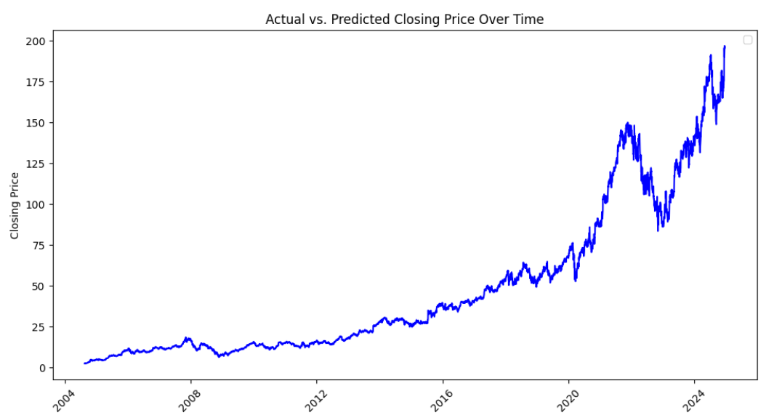

Slide 9
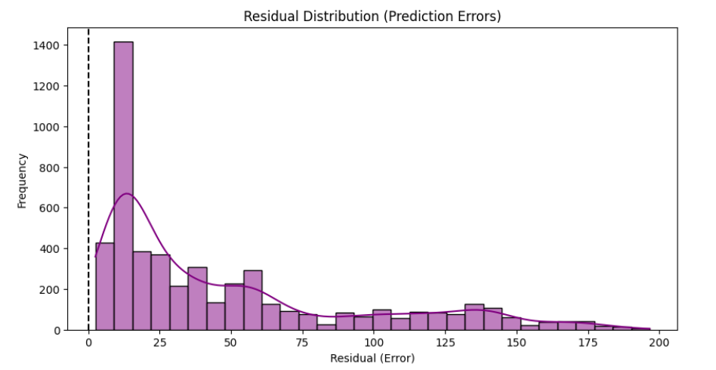

Slide 10
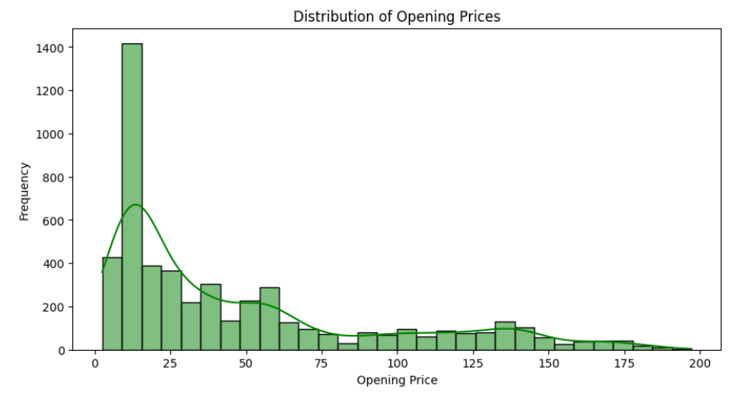

Slide 11
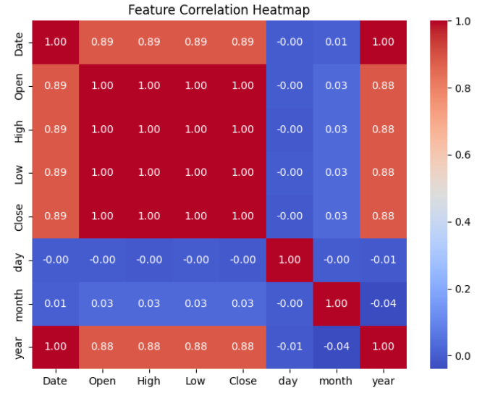

Slide 12




Model Building & Evaluation
Algorithm
Random Forest Regressor (Python).
Preprocessing
Standardized numeric features.
MAE
0.29
R² Score
0.9998 (Highly accurate).

Slide 13
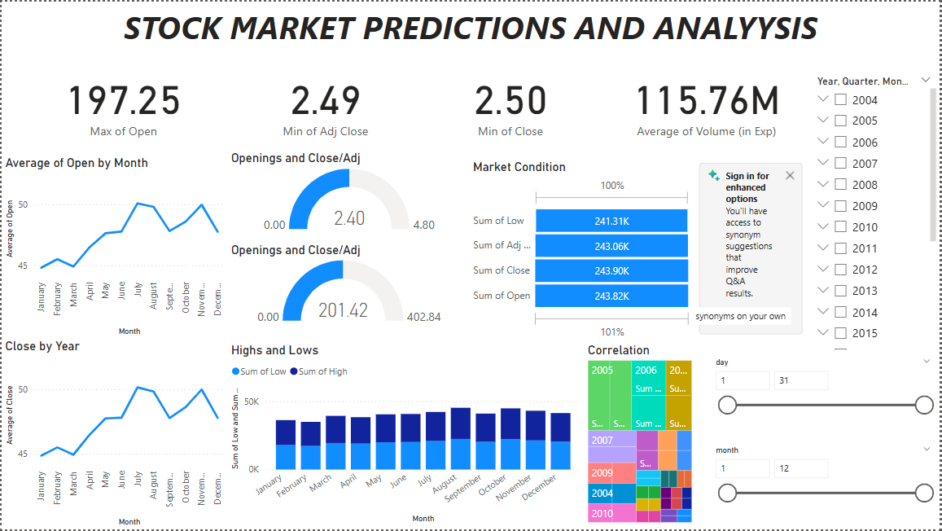
Dashboard

Slide 14
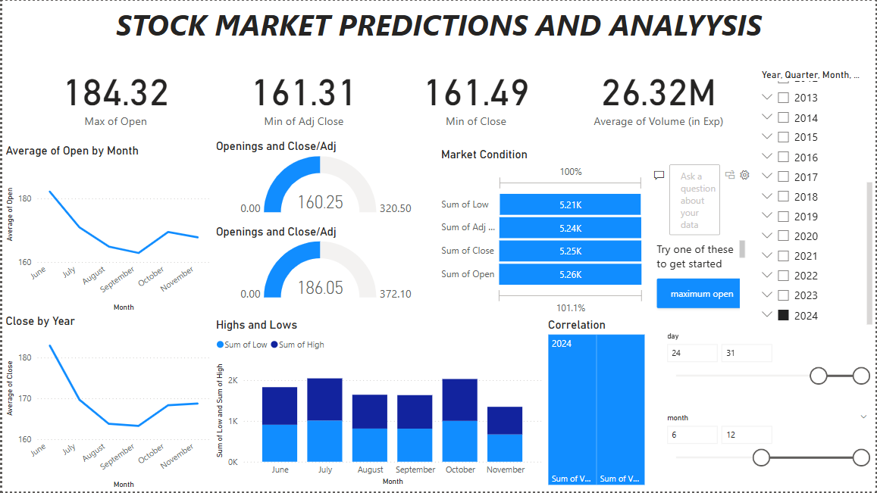
Result

Slide 15
Conclusion
The model provides highly accurate stock price predictions. The dashboard enhances real-time monitoring. It offers a user-friendly way to analyze stock trends effectively.

