Slide 2
ClicBank – Clinical Content Bank

Slide 3
About ClicBank
ClicBank is a web application developed by ZeOmega for clinical content designers and Jiva configuration engineers.
Used to create, modify and analyze sets of configuration entities such as Assessments, Care plans, Code tables and Sentinel Rules.
Import and export configurations, for deployment in the field and sharing with other collaborators.
Designed to run independently of Jiva, as it is for the smaller audience of content creators while Jiva in production is for members, providers and caseworkers.

Slide 4
About ClicBank (cont…)
The goal of ClicBank project is to enhance Jiva’s ability to manage complex, inter-related configurations in a distributed and collaborative environment, full audit trail at a semantic level and automatic change log generation.
Entities supported
Current - Assessments, Care plans, ACE dependent Code tables
Future - Sentinel Rules, Reference tables, Decision tables and additional code tables

Slide 5
ClicBank Objectives
Configuration and Managing Content
Import/Export between ClicBank and Jiva
Backward Compatibility with all Jiva versions
Reporting
Migration of Content
Versioning of Content

Slide 6
ClicBank Entities
Jiva file types POC, ACE and Code tables – categorized as Domains
Domains include Entity types and they are
POC includes Problem Categories, POC templates, Goal Classes, Interventions, Problems, Priorities, Goals and Barriers
ACE includes Attribute Values, Questions, Groups, Attributes, Assessment titles and Assessments
Code tables includes Priority, Encounter Types, Goal Classes, Activity Names, Attachment File types, Assessment type. Code tables are read-only, cannot be edited except for Goal Classes and Interventions.
General includes Keywords, Code billing rows, Activities
Entity is an item of specific Entity type.

Slide 7
Managing Entities
Create Entity
View Entity
Edit Entity
Copy Entity
Lock and Unlock Feature
References/Callers
Managing Duplicate entity titles

Slide 8
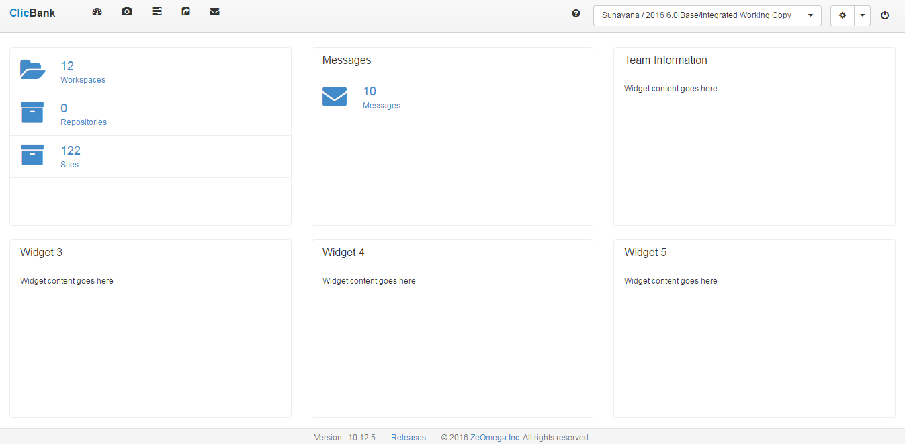
ClicBank Dashboard

Slide 9
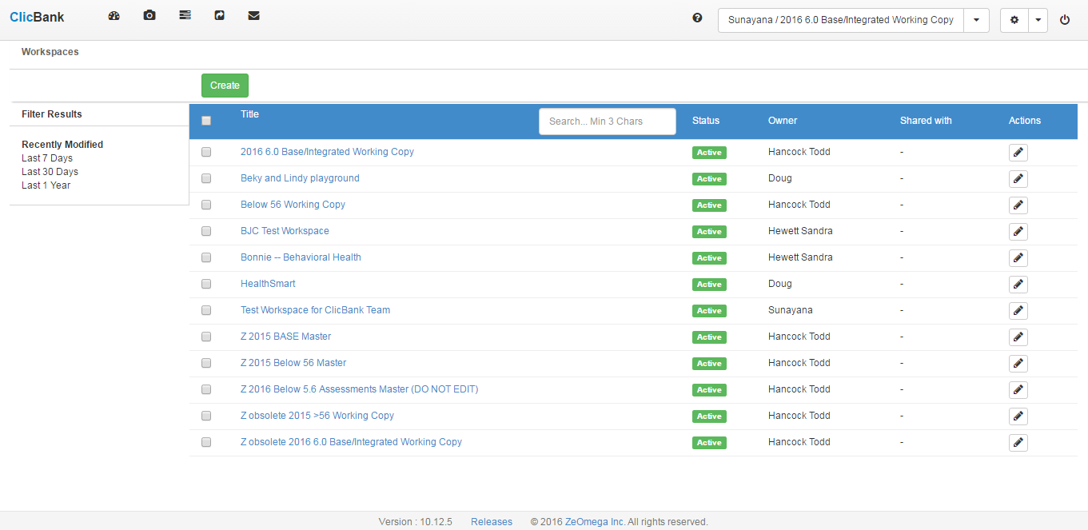
Workspace listing

Slide 10
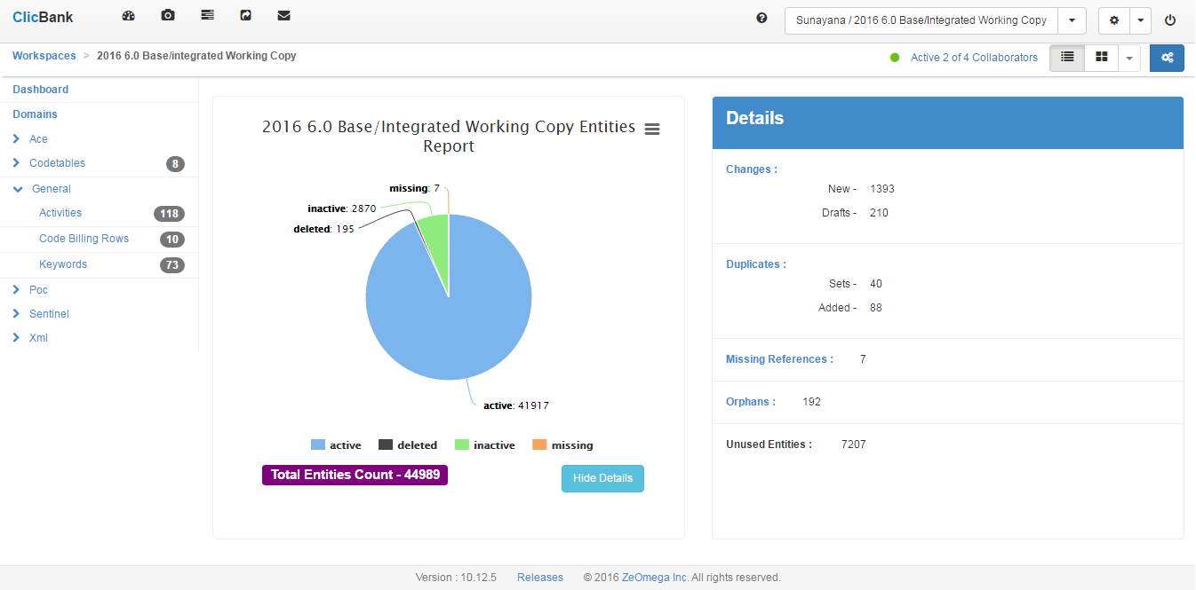
Workspace Dashboard

Slide 11
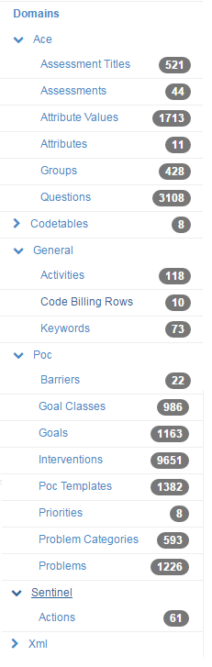
Workspace Left Navigation Panel
Jiva Entities under ACE and POC

Slide 12
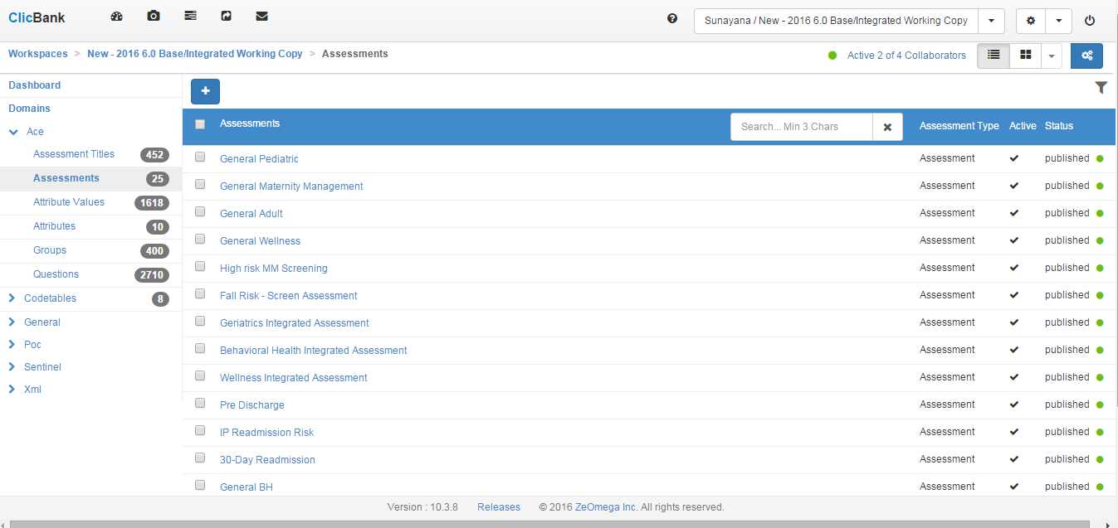
Managing Content – List View

Slide 13
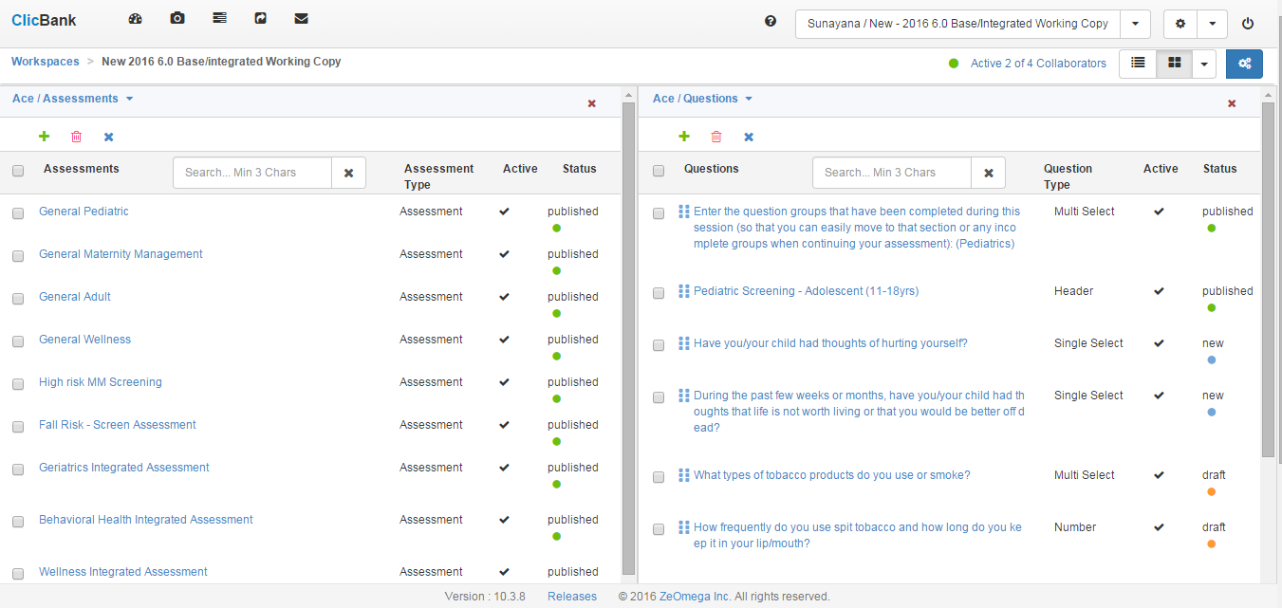
Managing Content – Tile View

Slide 14
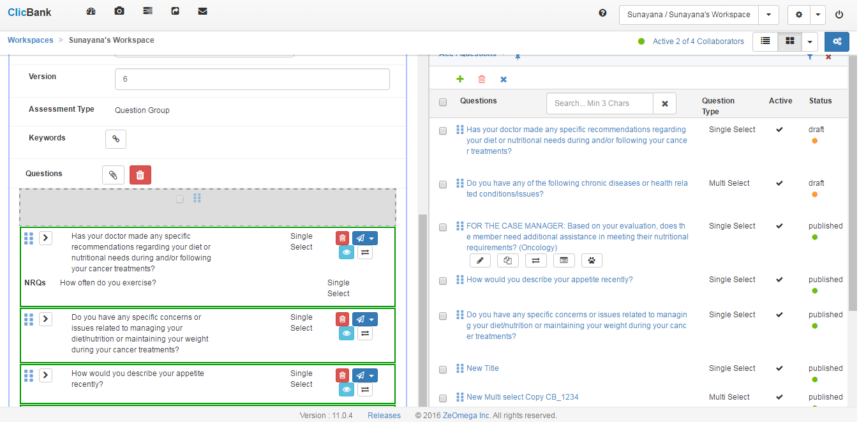
Tile View – Drag and Drop

Slide 15
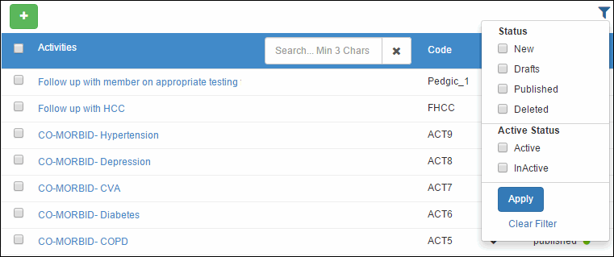
Filter Entities
Filtering Entities in the Entity listing screen based on Status and Active Flag

Slide 16
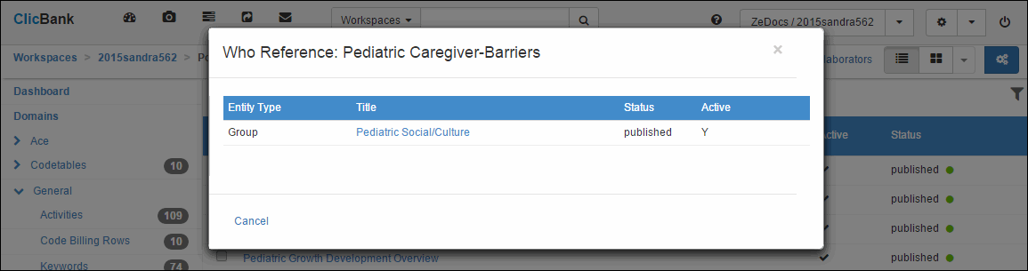
Who Reference Me
Who references me option for every entity to view dependencies

Slide 17
Common Fields for all Entities
Title – Title of the entity
Active – Entity active flag
Owner – Jiva or Client
Portals – Jiva portals (Nurse, Member and Provider)

Slide 18
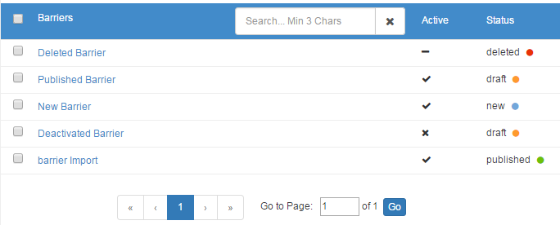
Entity Statuses
Status
New
Draft
Published
Deleted
Active Flag
Active
Inactive

Slide 19
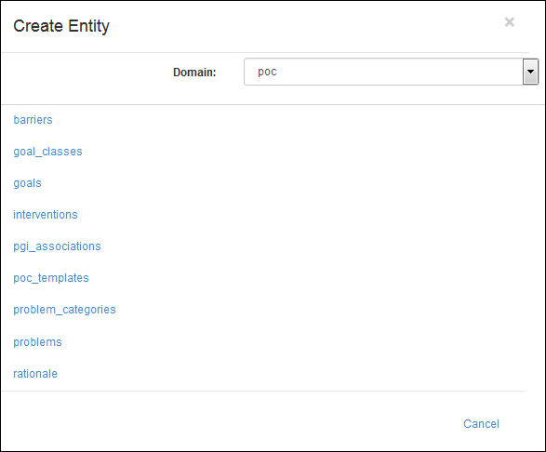
Adding Entities
Adding Entities from the Add Entity menu

Slide 20
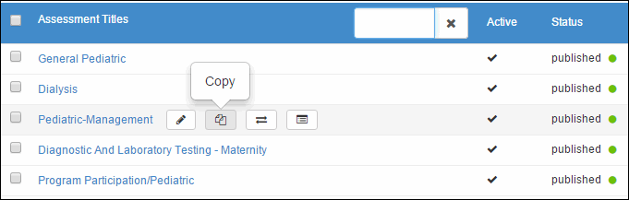
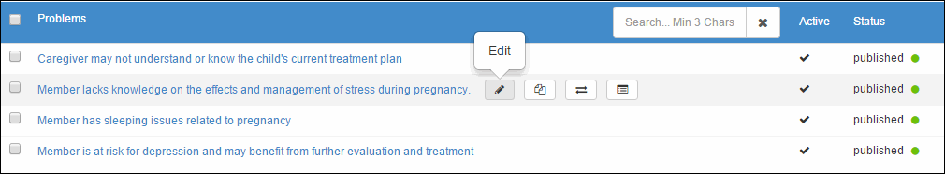
Editing Entities
Copying Entities from the Entity listing screen
Editing Entities from the Entity listing screen

Slide 21
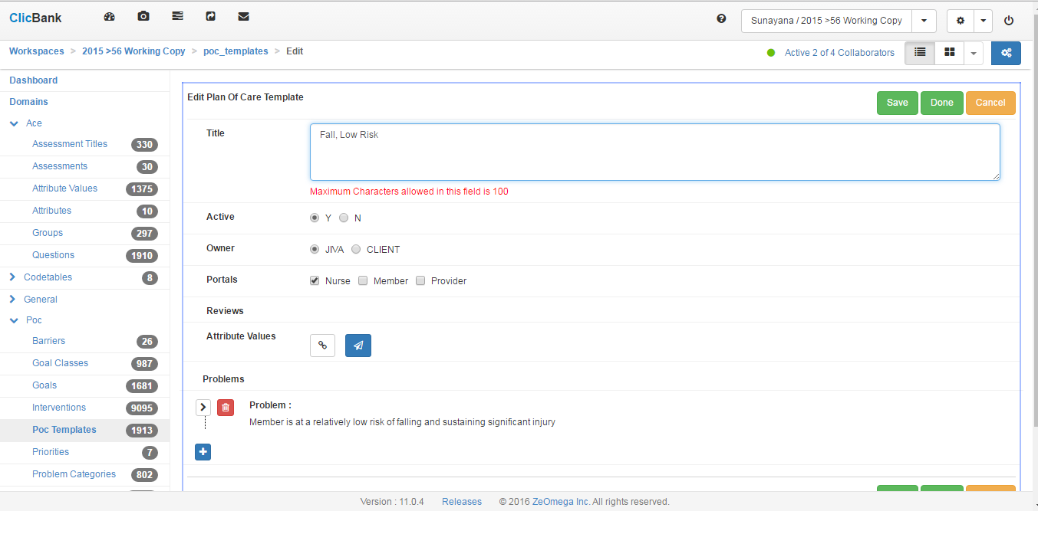
Editing Careplan example

Slide 22
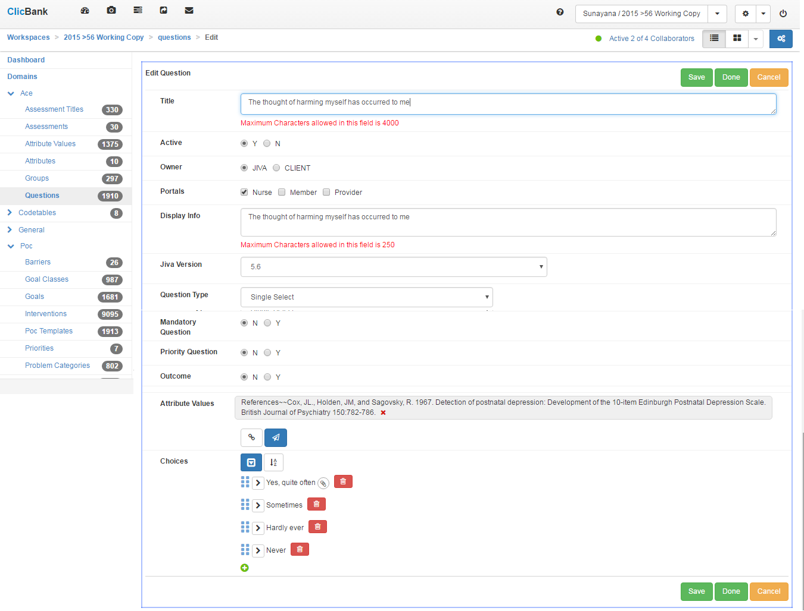
Editing Question example

Slide 23
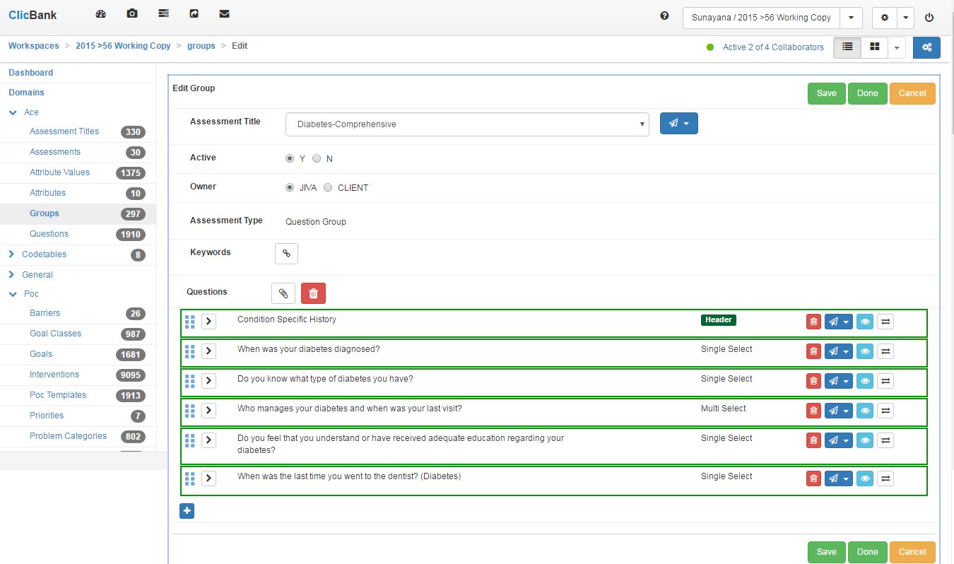
Editing Group Example

Slide 24
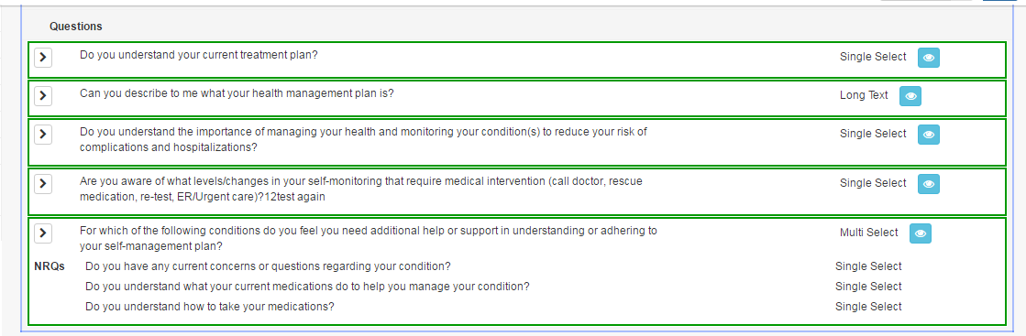
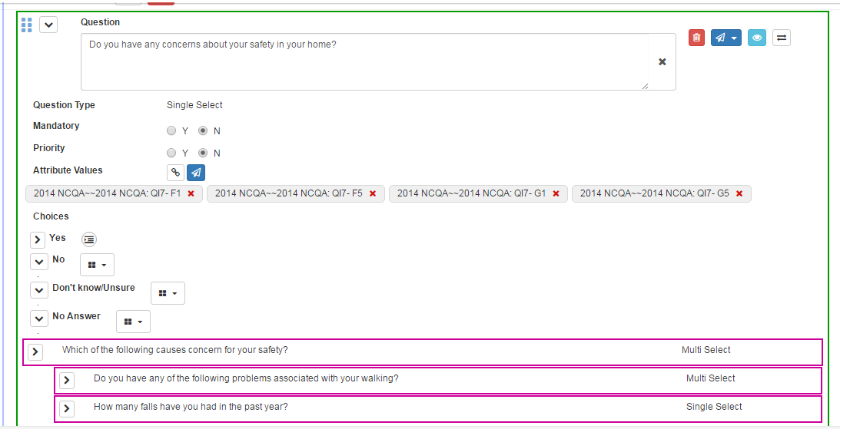
Next Reference Questions in Question Groups and Assessments

Slide 25
Lock Feature
Different kinds of locks – Edit, Virtual, New and Workspace
When a user is editing an entity in a Workspace, the entity will be locked for other users.
When questions are being edited by a user, all Groups/ Assessments associated with the question will be simultaneously locked for other users because of the mirror data structure.
When a group is being edited by a user, all questions in the group will not be available for editing for other users. (Per 2)

Slide 26
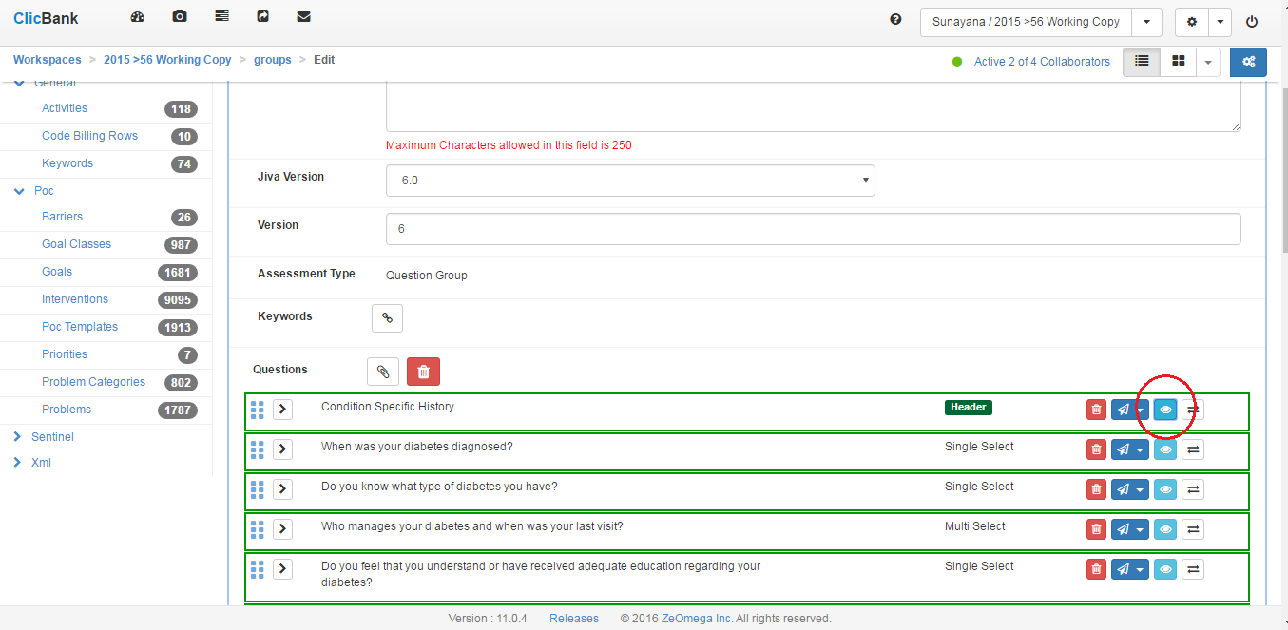
Advanced Viewing – Eye in the sky

Slide 27
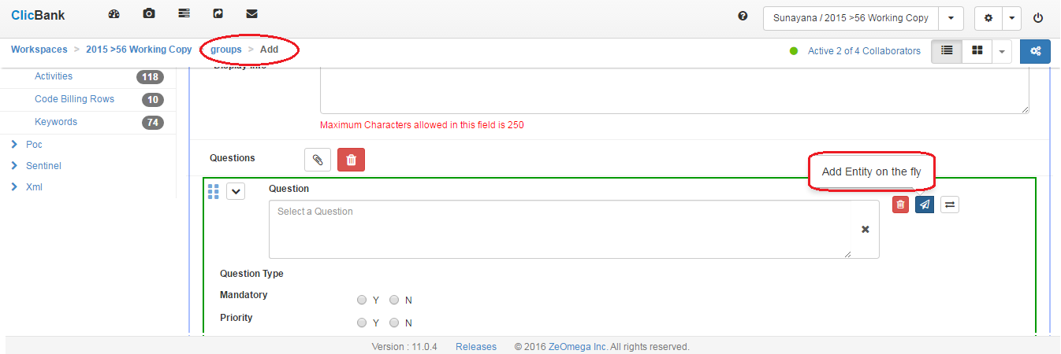
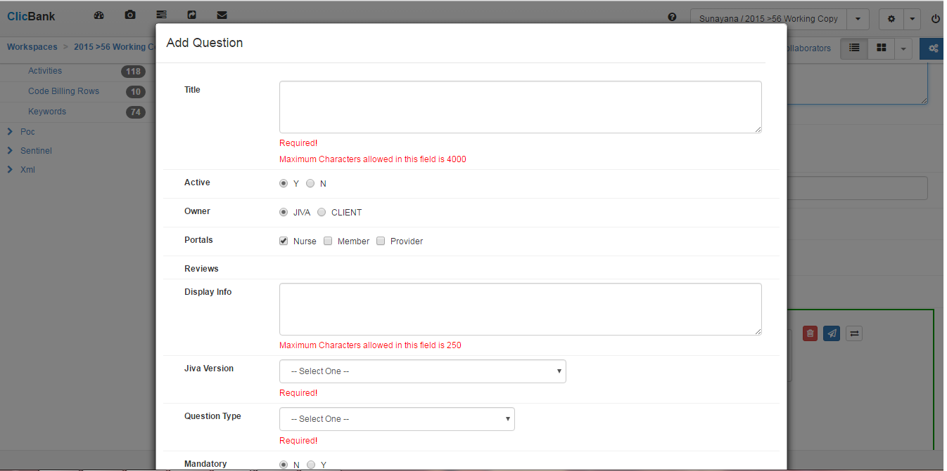
Advanced Editing – Add on the fly

Slide 28
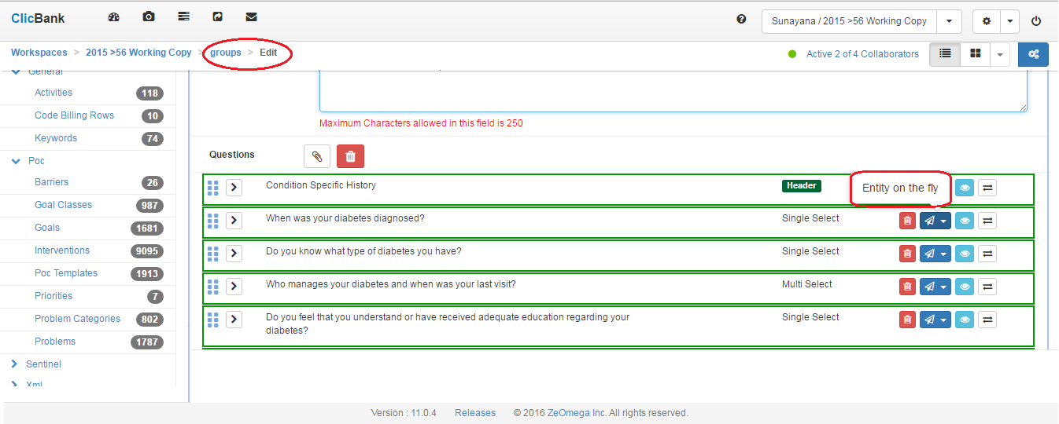
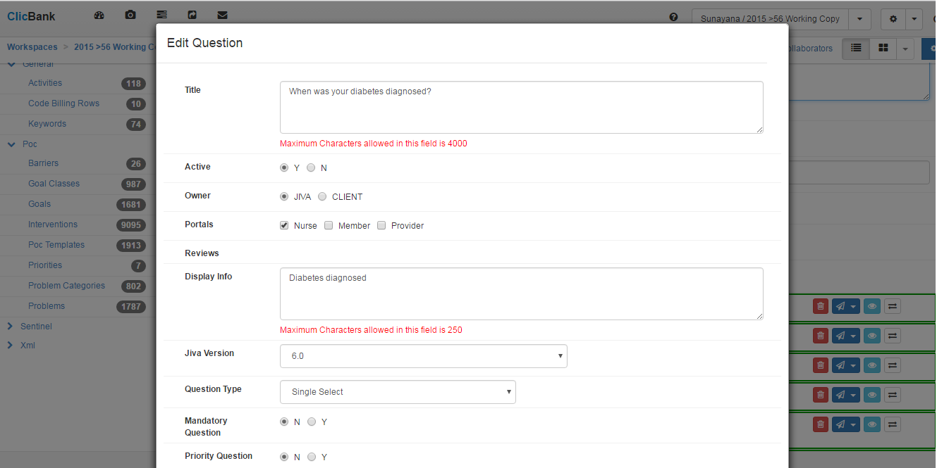
Advanced Editing – Edit on the fly

Slide 29
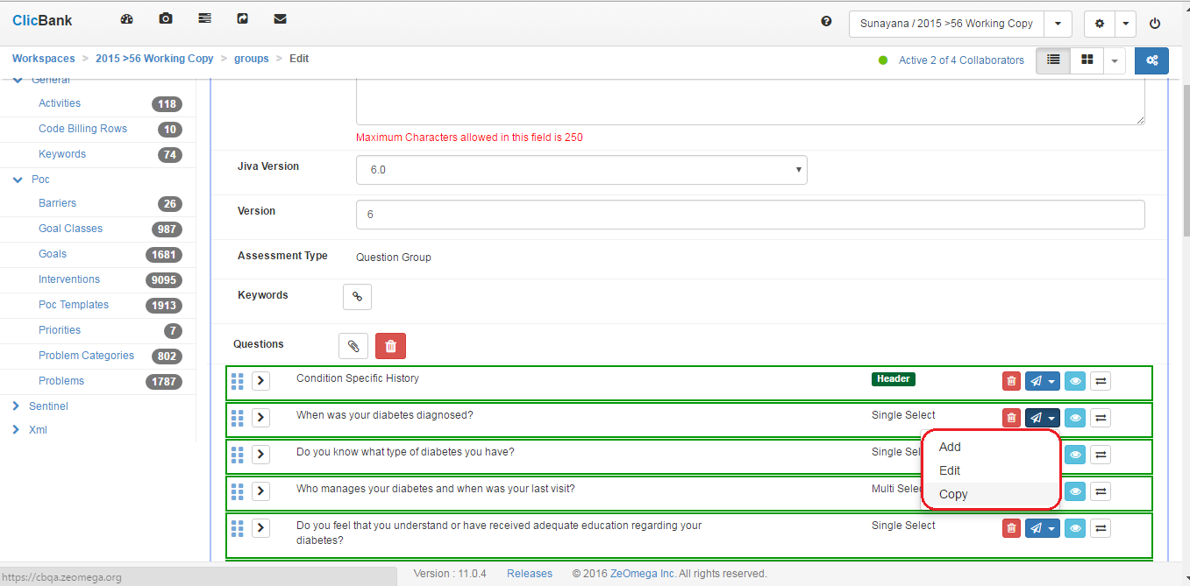
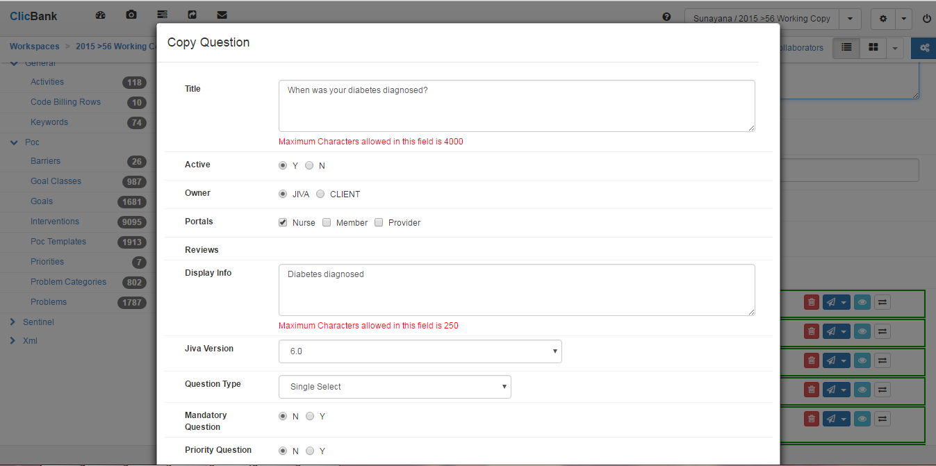
Advanced Editing - Copy on the fly

Slide 30


Saving and Cancelling Edits
Simple Case
Cancelling new
Cancelling edits
Advanced Case
Cancelling Edits of edit on the fly questions when Assessment/Question group edit is cancelled.

Slide 31
Advanced Editing – Removing Choices
Consistency rules for removing choices-
Anytime a choice is removed then the NRQs may also be removed if that choice is the last one to trigger the NRQ.
System warns the users in this situation and displays a message with the Assessment/Group that would be impacted when a choice is removed.
The goal is to move the effected NRQ’s to top level so they can be reconfigured later.
Any other configuration information such as Trigger POC, Assessment or Group will be lost without warning.
When LOV choice is removed, any POC configuration information will also be lost without warning.

Slide 32
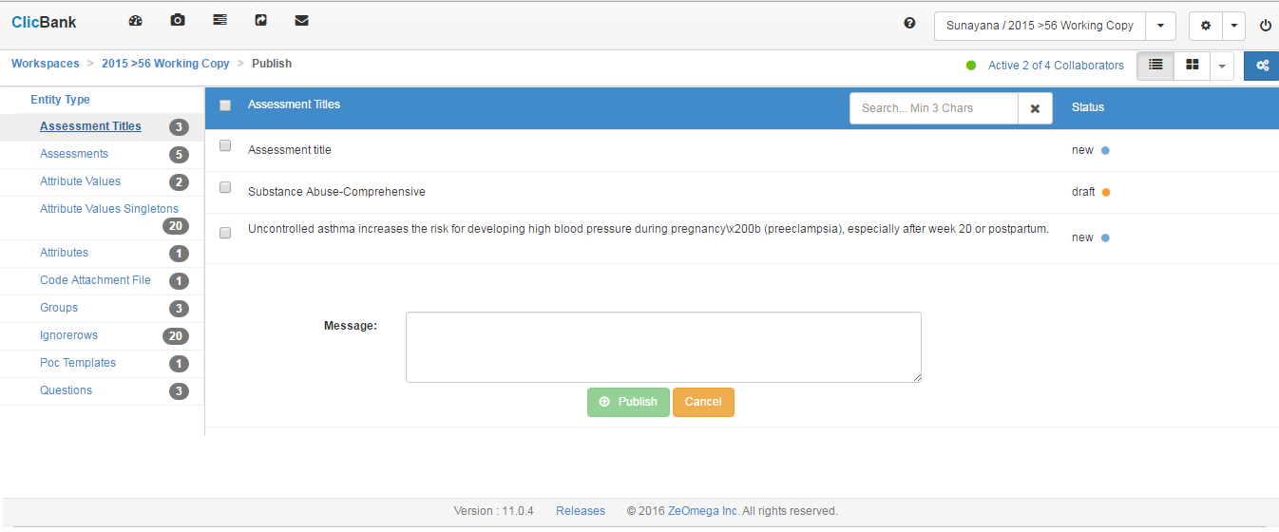
Publishing Entities without dependencies
Publish changes – Categorized but no dependencies selected.

Slide 33
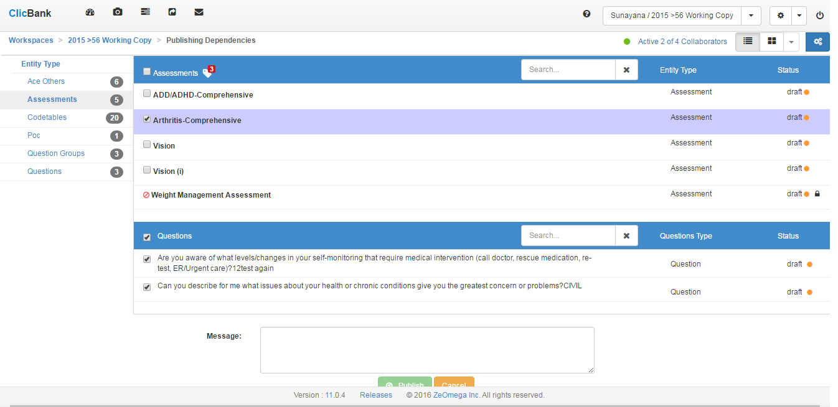
Publishing Entities with dependencies
Publish Dependencies – Categorized with dependent entities selected automatically when a parent entity is selected.

Slide 34
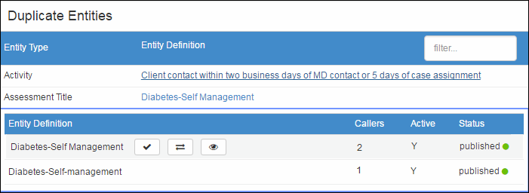
Duplicates
The Duplicates menu on the workspace dashboard displays the number of entities that are duplicated, along with the number of sets that are duplicated.

Slide 35
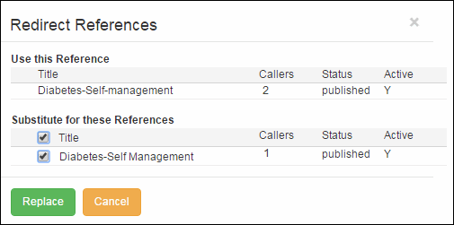
Duplicates
Replacing duplicate references - resolves duplicate entities by batch replacing a duplicate reference with desired entity and allows deactivating the duplicate.

Slide 36
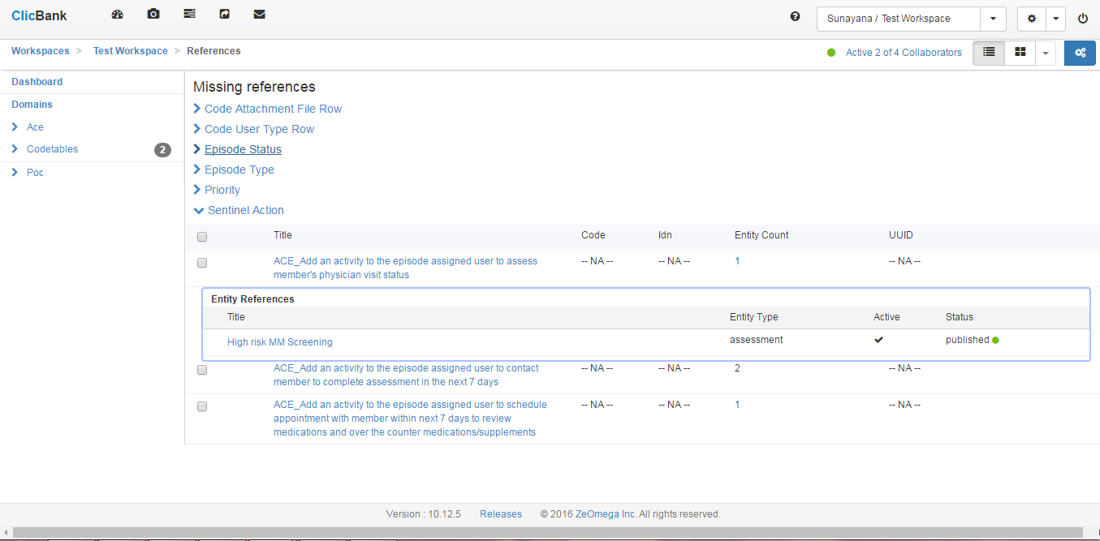
Missing References
The missing references menu displays the number of entities referenced but the entity definition is not imported/defined.

Slide 37
Importing into ClicBank
Import xls/xml configuration files from Jiva into a Workspace.
Files can be imported in any order.
File naming convention is required. Example
ACE_YYYY_MM_DD_Jiva_5_6_1.xls xls
ACE_groups_YYYY_MM_DD_Jiva_5_6_1.xls
POC_YYYY_MM_DD_Jiva_5_6_1.xls
Trigger_YYYY_MM_DD_Jiva_5_6_1.xls
action_YYYY_MM_DD_Jiva_5_6_1.xls
activity_names_codetable_YYYY_MM_DD_Jiva_5_6_1.xls
Downloadable Import logs are available for every file imported.

Slide 38
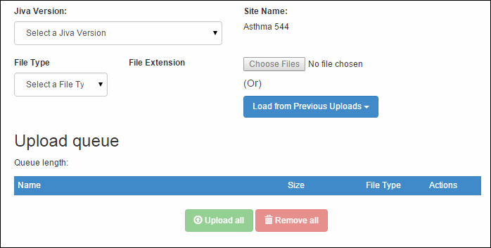
Importing into ClicBank

Slide 39
Reporting
List of Reports available (Complete or Partial)
Assessment Catalog Report
EBG Crosswalk Report
Questions Matrix Report
Questions Catalog Report
CAPs Report
Duplicates Report
Jiva Comparison Report
ClicBank Jiva Comparison
Fix Codetable owners
Examples from ACFC content.

Slide 40
Exporting from ClicBank
The configurations from ClicBank can be exported as Jiva compatible files.
Snapshots are required in the export screen to generate IDNs compatible with the targeted Jiva system.
All dependent entities are selected automatically and exported.

Slide 41
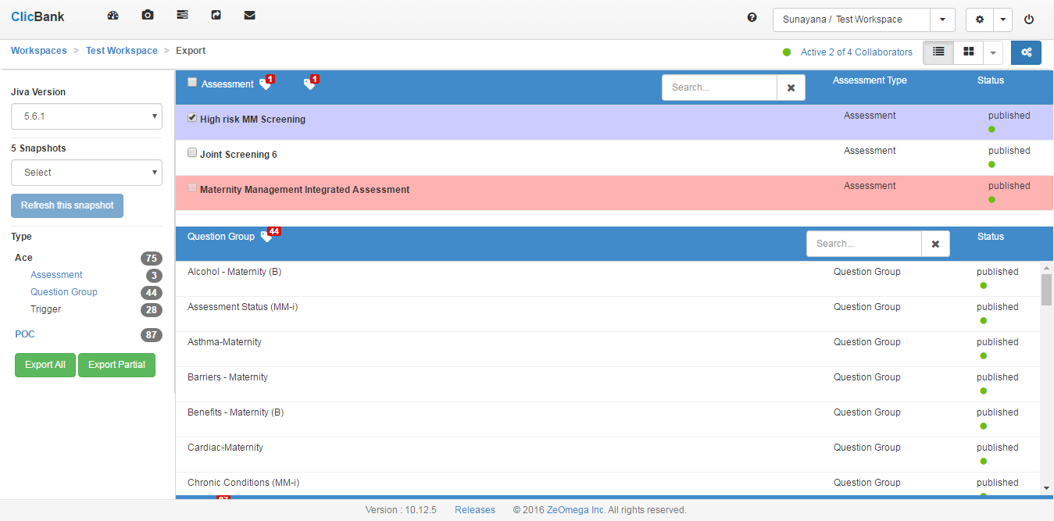
Exporting from ClicBank for Jiva

Slide 42
Snapshots
Snapshot is a read-only static view of the selected Jiva database generated as an XML identities. Snapshot identities include Title, IDN, Active Flag, Code (if any) and few additional fields for other entities (parent).
Using snapshot, ClicBank Exporter generates IDNs for the entities in ClicBank during the export.
Snapshot XML files can be moved between ClicBank instances when DB connection could not be established.

Slide 43
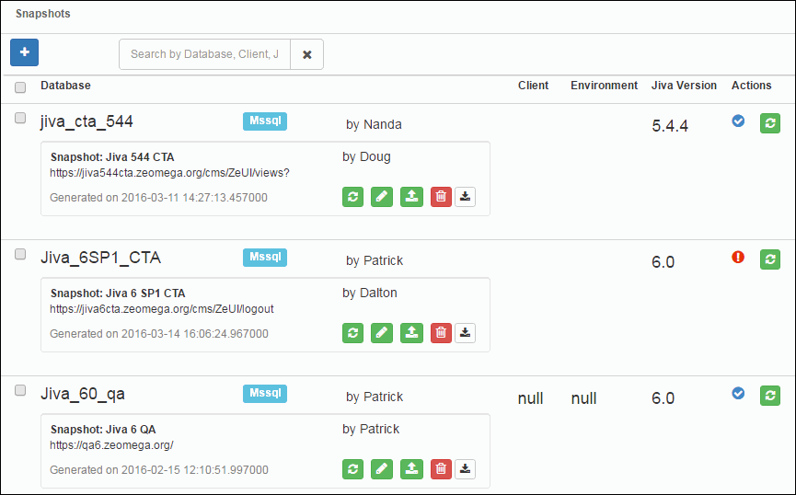
Snapshots

Slide 44
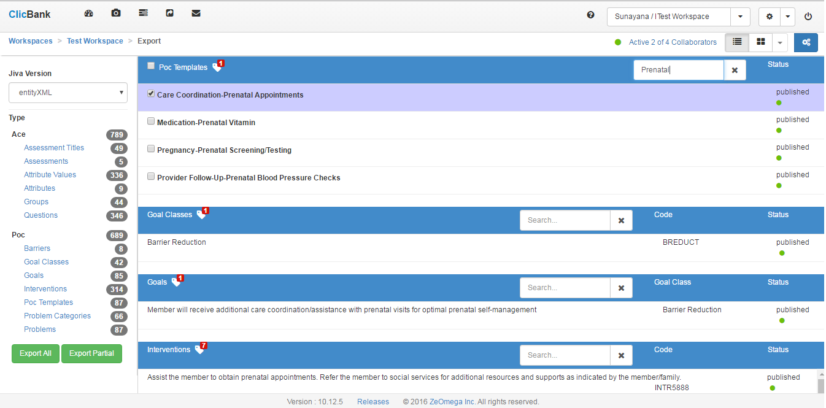
Advanced Export using Entity XMLs for CB

Slide 45
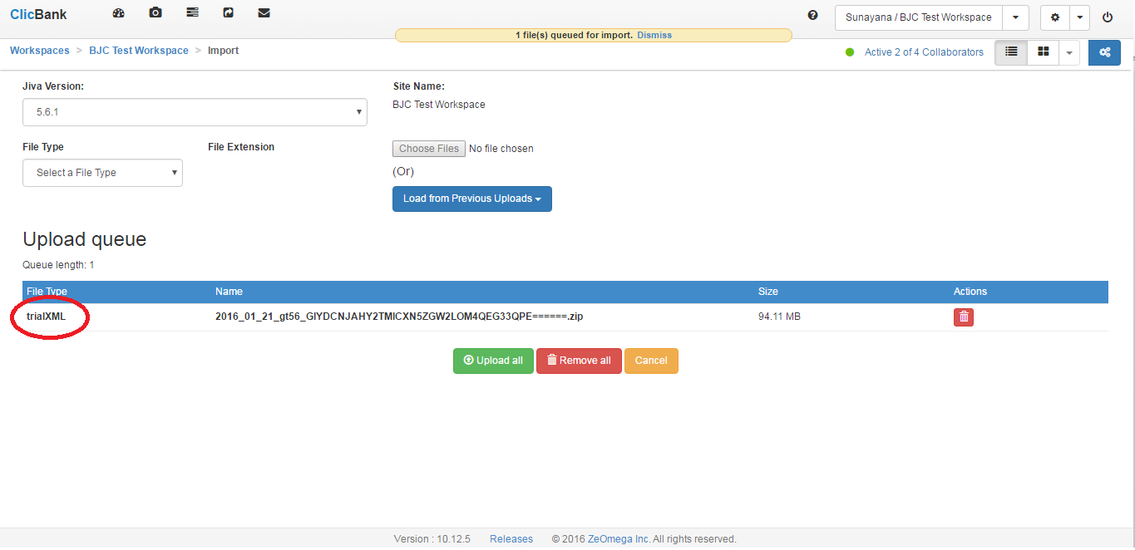
Advanced CB Import using Trial XMLs

Slide 46
Other Advanced Topics
Refresh Workspace
Manage Locks
Users and Roles
Site Objects
XML

Slide 47
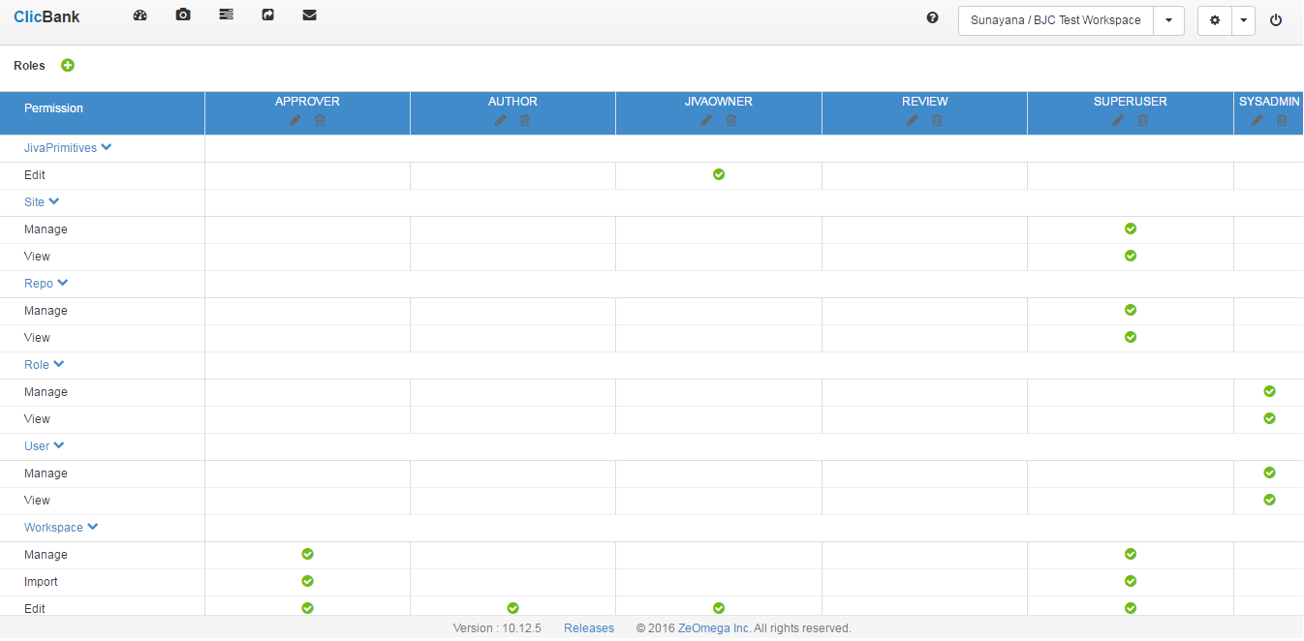
Roles and Permissions

Slide 48
Keeping ClicBank Updated
Puppet Installation (independent of Jiva Installation)
Agile process – New capabilities released every month
Releasing copy workspace and download workspace in our next release
Schema Evolution
Keeps file based schemas up-to-date.

Slide 49
Review ACFC Content

