Slide 1
User Defined Fields
Presented By –
Sangamesh T

Slide 2
User Defined Fields
User defined fields is a module in Jiva that provide functionality and allows user to define custom fields through Jiva UI without need of build/code updates.
Avoid code customizations.
Support client business workflows/requirements with ease.
Easy to manage and maintain.
Client configurable

Slide 3
Dependent Modules –
Interface
Sentinel
Reports
DB
Application

Slide 4
Step to configure UDF
Step 1 – Add Screen Title
Step 2 – Add Field
Step 3 – Add Screen Title to Configure
Step 4 – Configure Screen Title
Step 5 – Add field to Configured Screen
Step 6 – Publish Screen

Slide 5
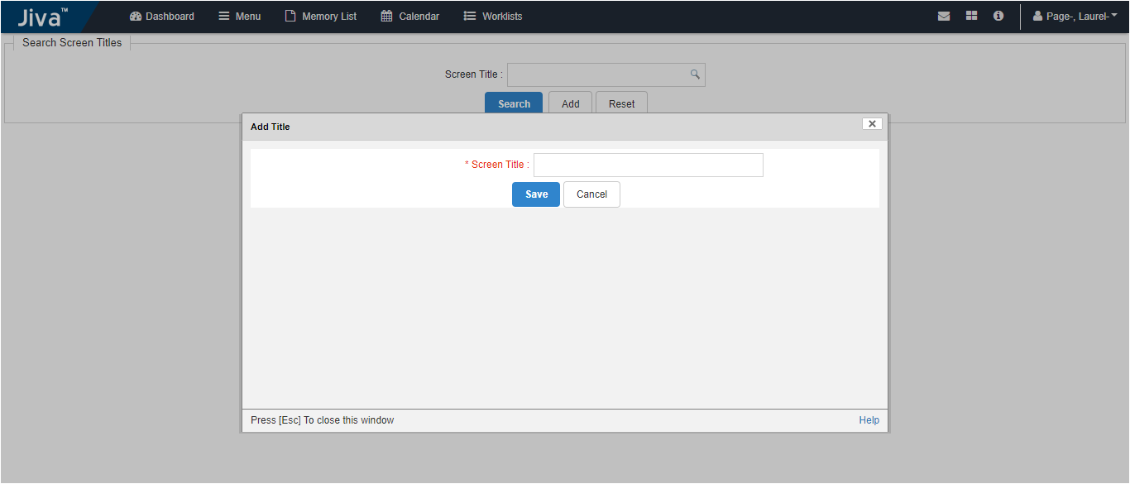
Add Screen

Slide 6
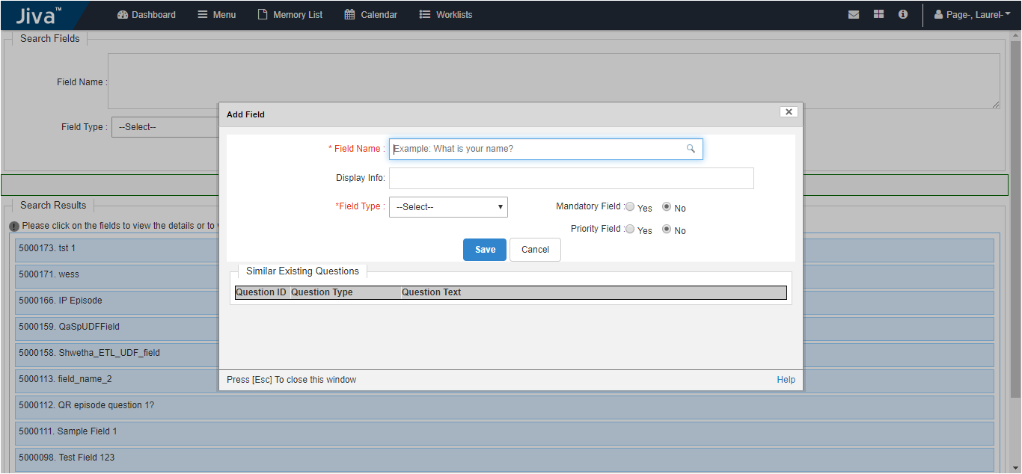
Add Field

Slide 7
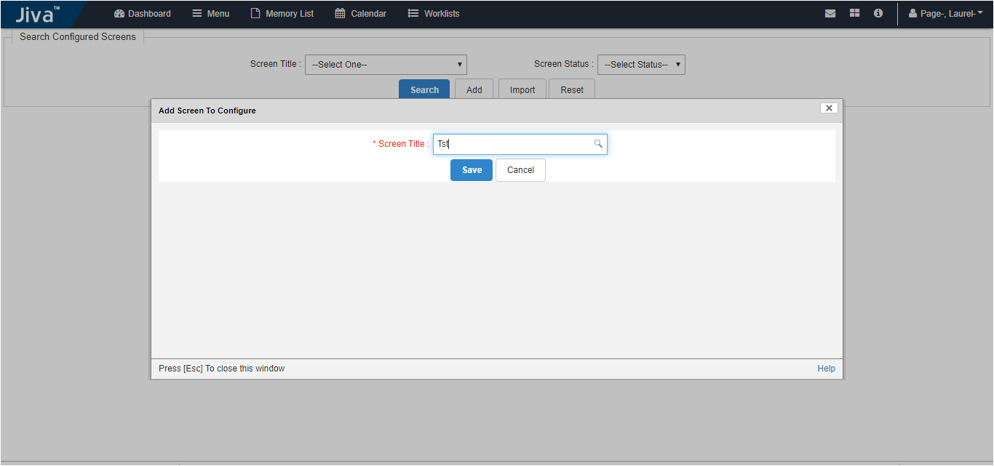
Add Screen To Configure

Slide 8
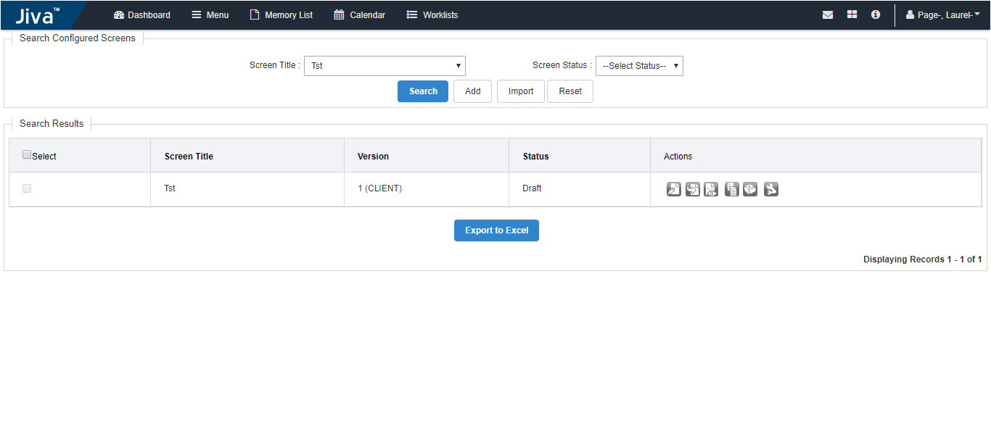
Search Configured Screen

Slide 9
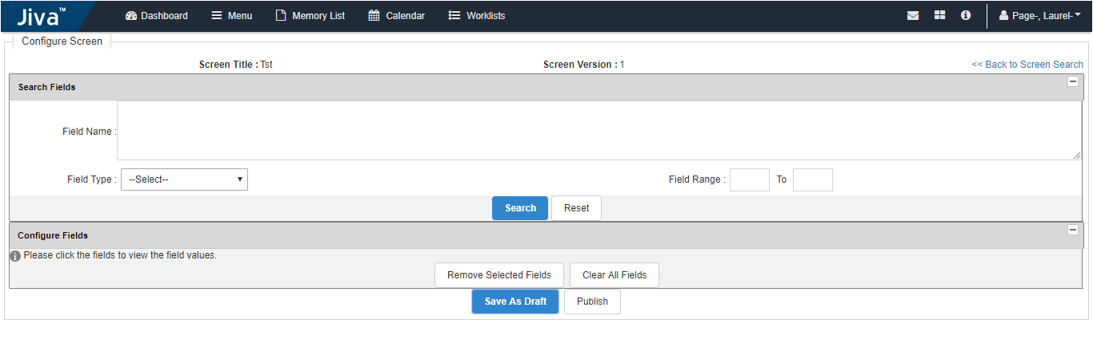
Configure Screen

Slide 10
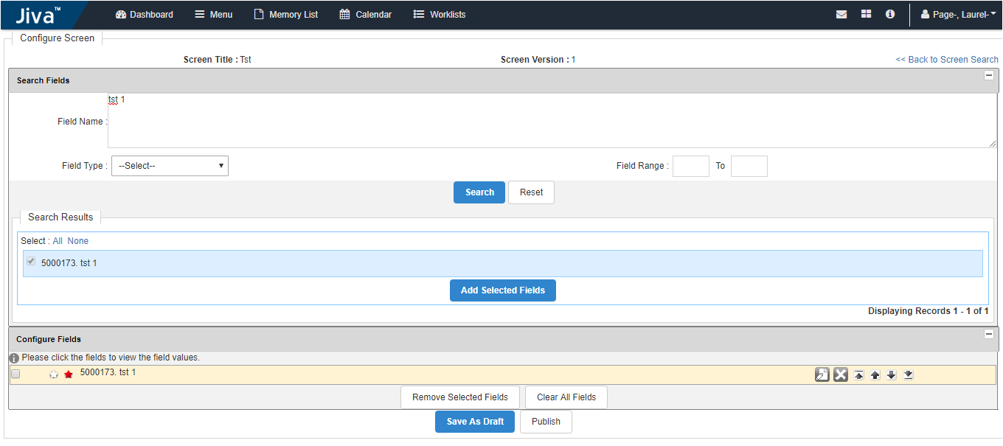
Add field to configured screen

Slide 11
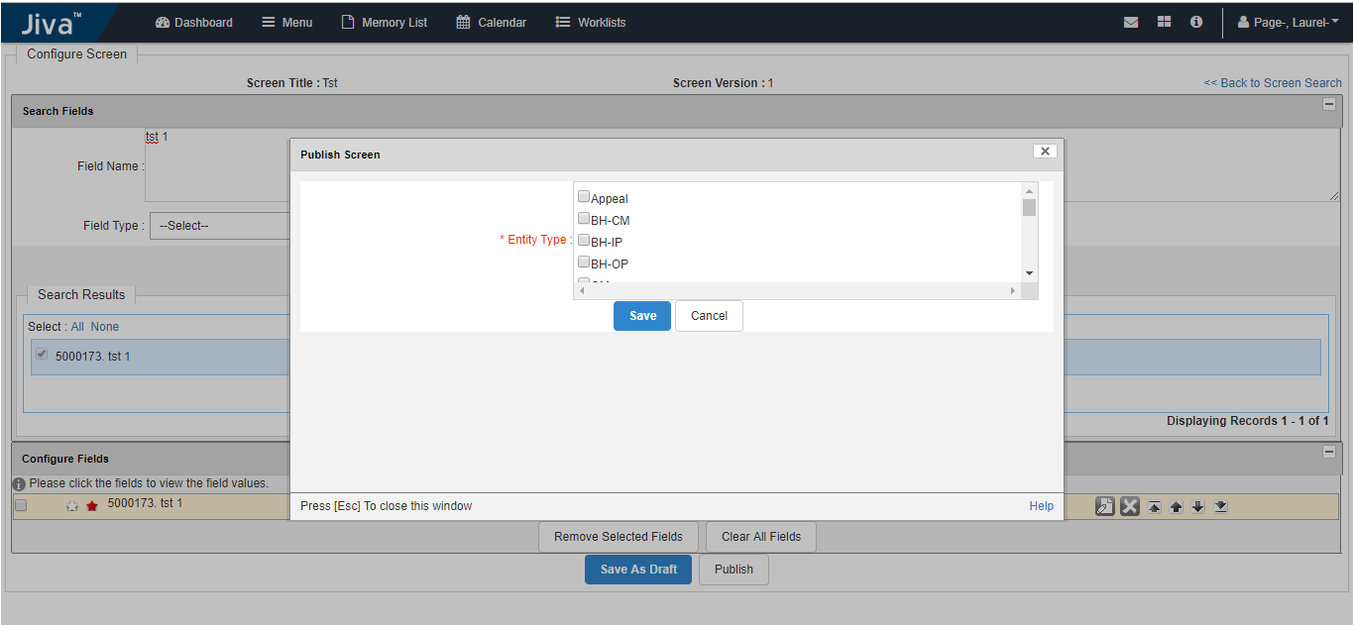
Publish Screen

