Slide 1
VIRTUAL RULER THAT SHOWS SIZE OF AN OBJECT
Computer Vision
Department Of Computer Science
Dr. Ashwin Ashok
RAGHUNANDAN GARDAS

Slide 2
AGENDA
Problem statement
Proposed solution
Stereo Vision
Disparity Map
Demo
Outputs
Results analysis
How to improve Accuracy?

Slide 3
PROBLEM STATEMENT
To find a better alternative to the existing technique of measuring object size using ruler.
Develop an application that can capture an image and give out its dimensions in real time.

Slide 4
PROPOSED SOLUTION
IMAGE PREPROCESSING
CALCULATING DEPTH
ESTIMATING DIMENSIONS

Slide 5
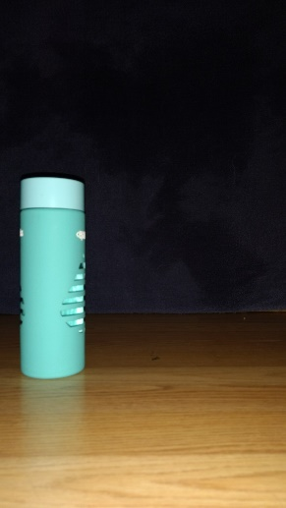
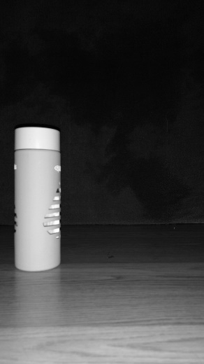

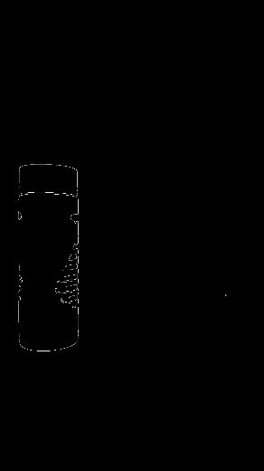
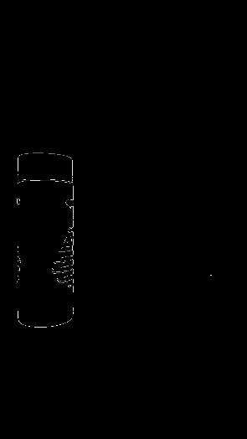
IMAGE PREPROCESSING
Original Image
Grey-Scaling
Gaussian Blur
Edge Detection
Erosion

Slide 6
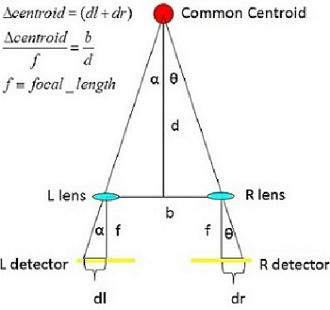
CALCULATING DEPTH
STEREO TRIANGULATION
Stereo setup consists of two cameras with known distance where both the cameras are pointed towards the object and images taken from these cameras are used for calculating the depth from camera lens to object.

Slide 7
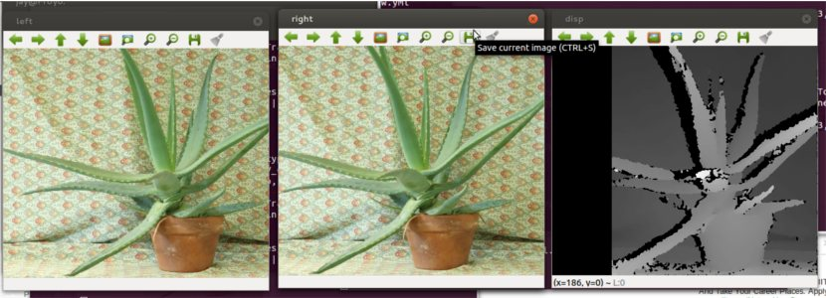

CALCULATING DEPTH
DISPARITY & DISPARITY MAP
Disparity refers to the difference in coordinates of similar features within two stereo images. A common point from both the images is considered and the coordinates of the point is noted and the depth is calculated from the disparity of the coordinates of the images from the below formula.
B is distance between two cameras.
f is focal length of camera.

Slide 8

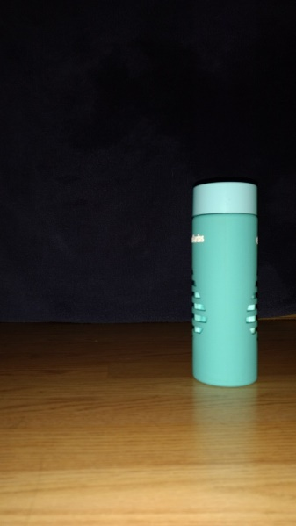
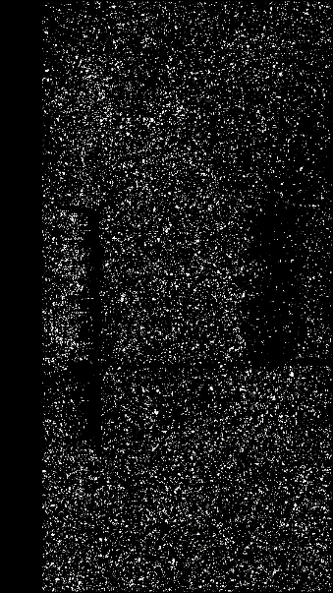
DISPARITY MAP using STEREO BLOCK MATCHING ALGORITHM

Slide 9
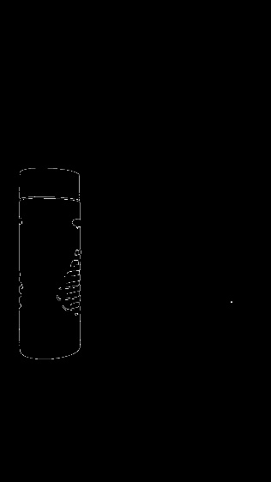
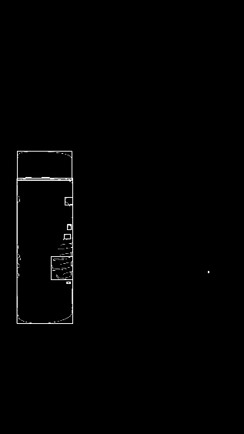
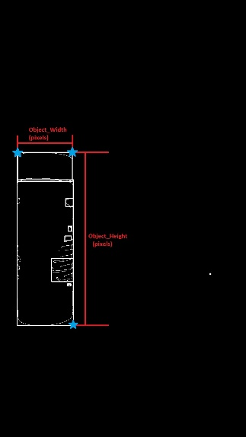
DRAWING CONTOURS
Contour is a line joining all the continuous points along the boundaries of an object in an image. Contours analyse the shape of object and helps in recognition and detection of objects.
Eroded Image
Contours Drawn
Edge Points Selected

Slide 10
ESTIMATING DIMENSIONS
By knowing the depth from lens to object, we can calculate the dimensions of the object by using the following formula.
DEMO

Slide 11
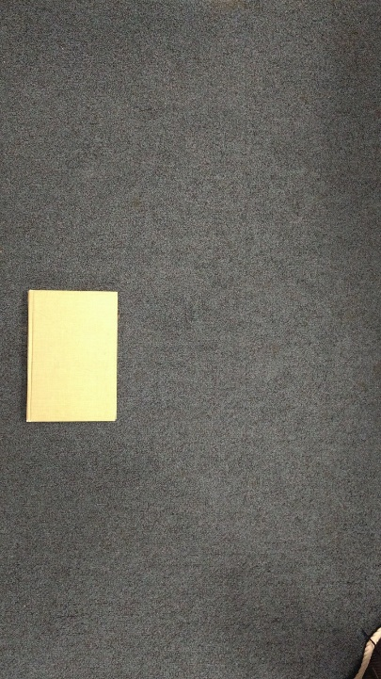
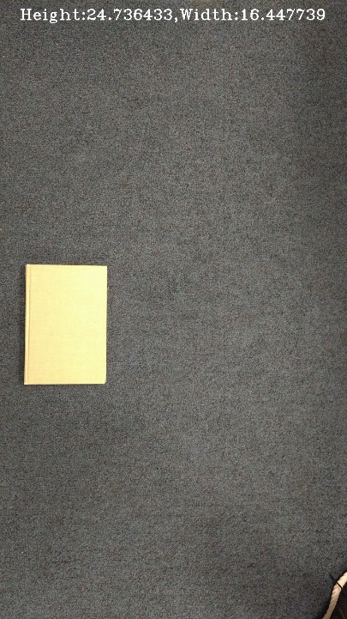

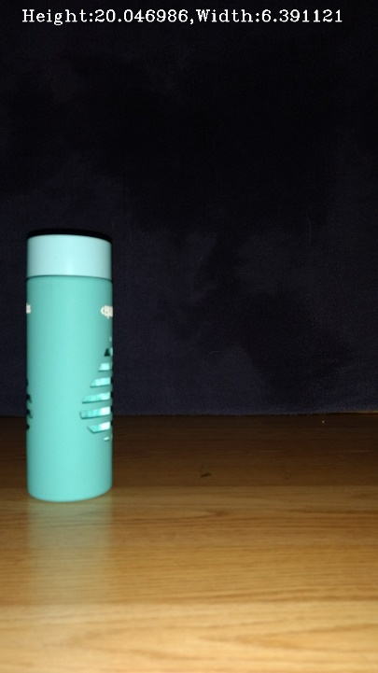
OUTPUTS

Slide 12
Result Analysis
 | Disparity Method | Known Depth Method | Original Values
Depth | 55.9 cm | 40.0 cm | 40 cm
Height | 30 cm | 20.11 cm | 20 cm
Width | 9 cm | 6.3 cm | 6.5 cm
Error % | 35%-50% | 2% | -

Slide 13
How to improve Accuracy?
Calculate exact depth using Stereo Vision.
Capture Stereo Images using proper Stereo Setup.
For Disparity Method, It’s mandatory to have the camera and object on the same horizontal plane. Plane of camera and object plays an important role for Disparity Calculation.

Slide 14
Conclusion
Stereo Vision can be our solution to various problem’s related to images in real life. We’ve used it to find an object’s dimensions here but the same project can further be developed and extended to fulfill many more needs such as
Real time traffic vehicle analyzer based on dimensions
Real time ticket issue based on height.

Slide 15
THANK YOU!!!

