Slide 1
PS 2024
3rd Year 1st Sem
Sireesha Puppala

Slide 2
Project Title: Path Gen
A GenAI based LearningPath Generator.

Slide 3
Problem Statement
Develop a hybrid Generative AI-based app that creates and dynamically adjusts personalized learning paths for students based on their individual learning styles, goals, performance, and feedback.
This app should offer a tailored educational experience, helping students progress efficiently through their courses and achieve their academic objectives

Slide 4
Key Components:
Data Collection and Integration:
Gather data on students' learning styles, goals, performance, and feedback
Ensure data is cleaned and preprocessed for analysis.
Generative AI Model Development:
Develop and train AI model to create customized learning paths based on user data.
Build or fine-tune model to suggest relevant educational materials and resources.
Frontend Development:
Create a responsive and interactive user interface for displaying learning paths
Develop forms and interfaces for users to provide feedback and interact with the application.
Middleware and Database Mgmt.:
Create RESTful APIs to manage user data, learning paths, and interactions between the frontend and backend.
Implement secure authentication and authorization processes for user access and data protection.
Store and manage user profiles, learning preferences, and performance data. Save and retrieve generated learning paths and associated educational resources.
Testing and Validation:
Test the app with real user data to validate the accuracy and usefulness of analytics, predictions, and recommendations.
Deployment:
Deploy the app on a suitable platform or web service.

Slide 5
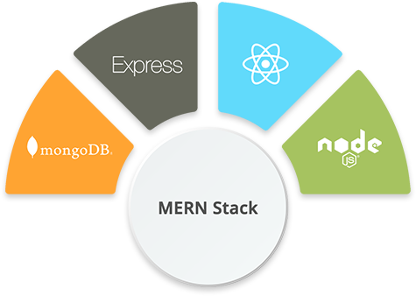
Tech Stack
Gen AI

Slide 6
Expected Outcome
By offering targeted content and resources, the app helps students progress more efficiently through their courses and achieve their academic objectives.
Interactive and user-friendly interfaces encourage active participation and feedback, making the learning process more engaging and responsive to students' needs.
.

Slide 7
All the best!

