Slide 1


Forest Fire Detection Using
Deep Learning
Raghunath Rout
STU678bcd0cdd1ca1737215244

Slide 2

Learning Objectives
Understand the concept of convolutional neural network and its practical working for forest fire detection.
Understand the real purpose and importance of different layers or filters in the CNN.
i.e which patterns or features needs to be extracted and can be used to predict the accurate result or output.
To build the model and train it for 2 class for the real time detection of fire in the forest at. (immediately)
Analyse & accuracy of the model.
GOAL
Source :
www.freepik.com/

Slide 3
Tools and Technology used
Programming Language : Python
Library : Numpy
FrameWorks : Tensorflow & Keras
Model : CNN (Convolutional Neural Network)
Development Enviroment : Google Colab (https://colab.research.google.com)
Data Set : Kaggle’s pre classified data set
Other : Matplotlib

Slide 4
Methodology
Data collection : Collected the data sets from kaggle using kaggle’s api.
Data Pre-processing : It includes 2 processes i.e image processing and augmentation. In image processing rescale, resize, and normalize the images, in augmentation the different orientation of the images are generated.
Model Selection & Building : CNN, used 3 Conv3D filters, then 1 dense layer with 512 neurons(256 random dropped), 1 output layer with function sigmoid.
Model Training : Trained the model using the data & Ran 12 epochs
Model Evaluation : It is evaluated using its accuracy, it’s accuracy is 81%.

Slide 5
Problem Statement:
Forest is the huge colletion of trees.It has the huge source of natual resources for the human being or any living organisms.
So if fire caught in the forest for how much long time that much resources we’ll loss.
Fire caught in the forest is very common. So it is better to detect the in real time or as soon as possible.
Since most forest are huge in geo-graphical area it is very difficult & also expensive to detecy it manually.
Using Green Skills or A.I we can do it easily and potentially the cost would be minimized.

Slide 6
Solution:
Deep Learning : Using deep learning i tried to solve this problem, by classify the data i.e images received into 2 classes one is fire and another is no fire.
The Deep Learning model called CNN decides on the the basis of trained data that the image is received now is a fire situation or not in the forest.
I achieved 81% accuracy on test of the model.
This is a generalized model, it can be used in any region or all regions.
Once deployed this model can be used for real-time and real world application.

Slide 7
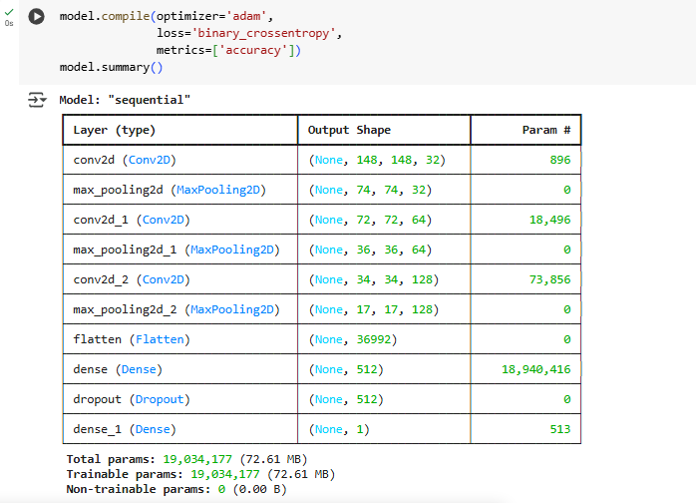
Screenshot of Output:

Slide 8
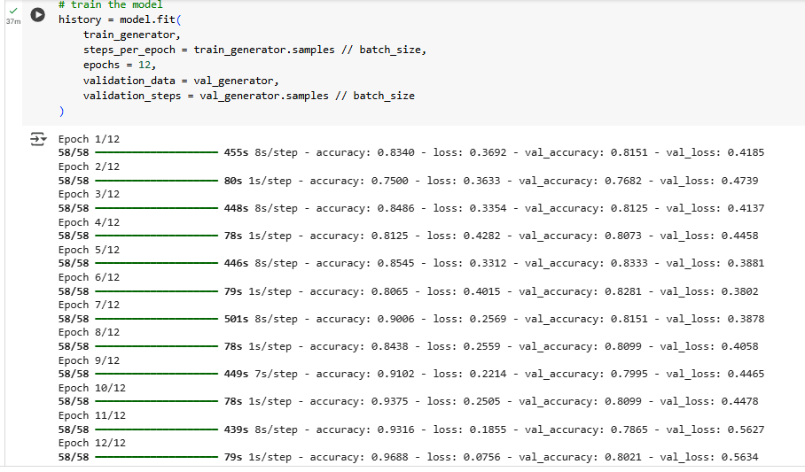
Screenshot of Output:

Slide 9
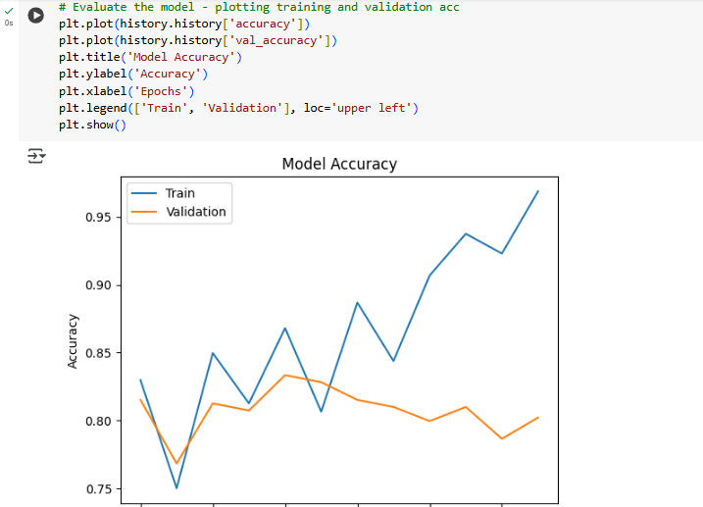
Screenshot of Output:

Slide 10
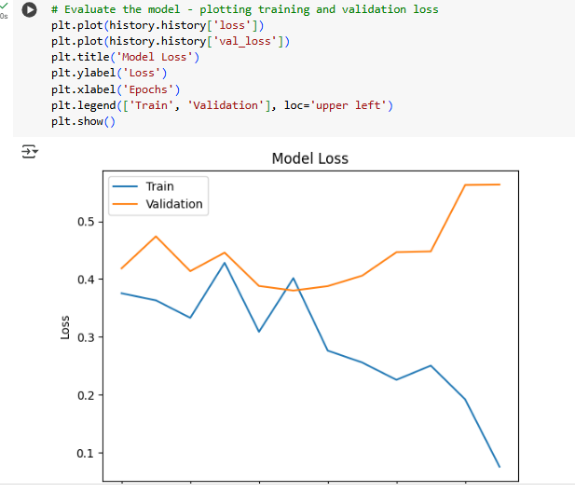
Screenshot of Output:

Slide 11
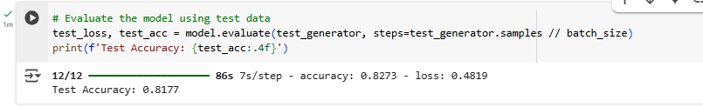
Screenshot of Output:

Slide 12
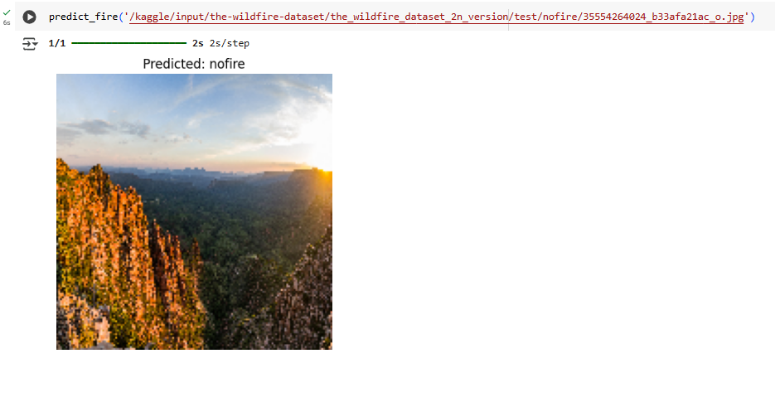
Screenshot of Output:

Slide 13
Conclusion:
Imported the data set from the kaggle which has 2 classes i.e fire and nofire.
Build the CNN model and train the model using this data set. I run for 12 epochs.
It gave the accuracy score of 81%.
In future we can use regularization techniques like learning rates or early stopping, model check points.
We can also use pre-trained model with it in future like vgg16/19, mobileNet V2, by freezing the weights.

