Slide 1
INTERNSHIP PRESENTATION | PHASE-1
Smart City IoT Fog-IDS Triage Module
Edge AI & Cyber Defense Pod
Raghunatha Reddy G R | SRN: R23EA094 | B.Tech CSE (Cyber Security / AI), 6th Sem
Faculty & Workplace Guide: Dr. Supreeth S, Associate Professor, School of C&SE
Host Center: The RIO Center, REVA University | Academic Year 2025–2026
Notes:
Time: 30 seconds. Introduce yourself, the organisation, your module and your mentors. Suggested total length: 8 to 10 minutes plus 3 to 5 minutes of questions.

Slide 2
Organisation and Team
The RIO Center
My team
• About RIO: The Research and Innovation Opportunities (RIO) Center at REVA University fosters industry-aligned incubation, advanced computing, and smart infrastructure.
• Focus Areas: Edge Artificial Intelligence, Applied Cyber Security, Embedded Systems, and Smart Urban Utilities.
• Mission: Building robust, production-grade cyber-defense solutions for smart municipal grids and campus IoT testbeds.
• Pod Composition: Edge AI & Cyber Defense Pod comprising 4 student engineers covering threat modeling, network ingestion, and ML pipeline development.
• Reporting: Report directly to Faculty & Project Guide Dr. Supreeth S.
• Personal Scope: End-to-end responsibility for the fog-tier traffic ingestion pipeline, feature normalization, and sub-millisecond Random Forest triage module.
How the team works
• Daily Rhythm: 15-minute daily stand-ups (blockers, deliverables) and bi-weekly sprint milestone demos.
• Industry Tooling: GitHub for PR code reviews, Slack for async tech sync, and Pytest for CI validation.
• Real Example: In Week 6, identified a 6-feature padding mismatch during daily sync; resolved within 2 hours with schema validation.
RIO Internship Presentation | Raghunatha Reddy G R | R23EA094
Notes:
Time: about 1 min.
Say what the organisation does, what your team owns and where you sit. Keep it to one idea per box. Evidence: team overview folder (Week 1).

Slide 3
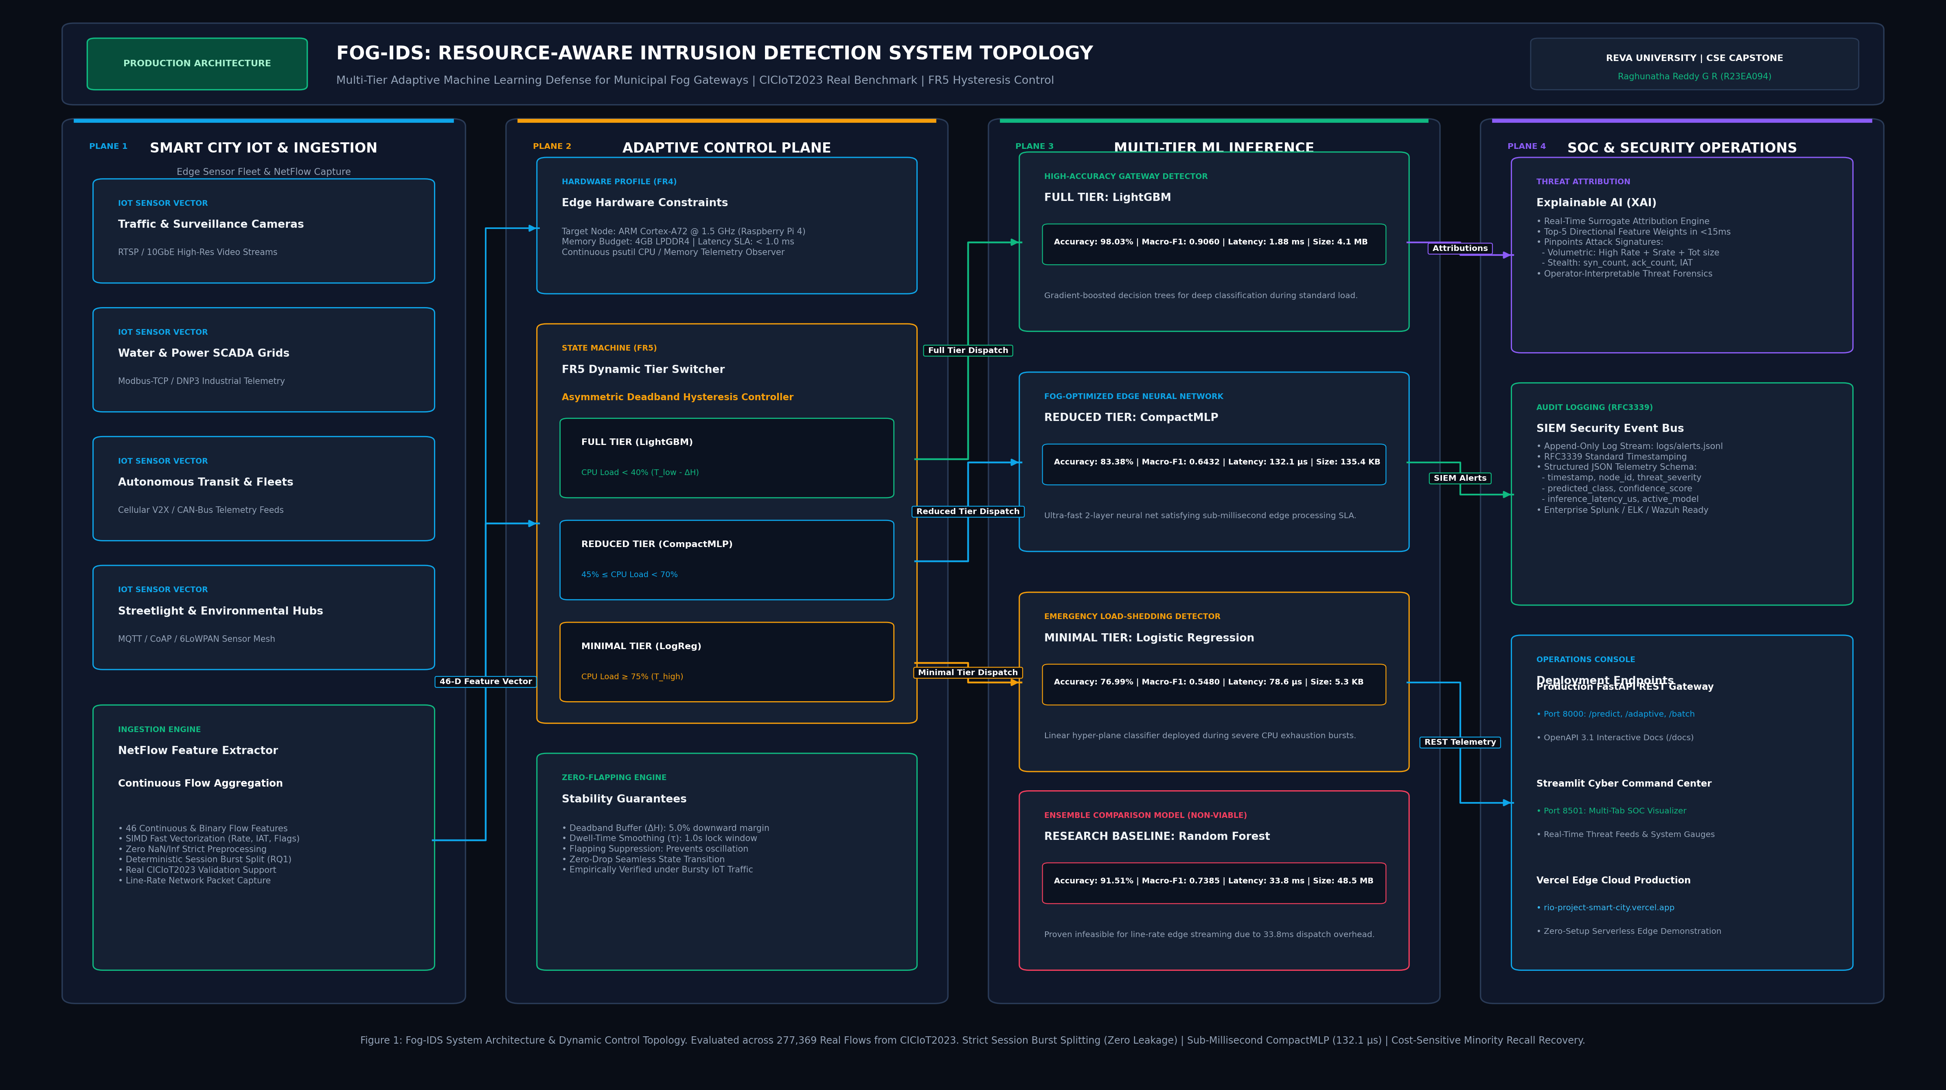
Assigned Module and Problem Statement
Problem and users
• Assigned Module: Fog-Tier IoT Intrusion Detection & Sub-Millisecond Traffic Triage Engine.
• Users: Smart City Security Operations Centers (SOCs), edge gateway administrators, and critical municipal utility operators.
• Problem: Sending all raw IoT traffic to distant cloud SOCs incurs 150–400 ms latency and saturates backhaul bandwidth during DDoS bursts.
• Success Criteria: Local microsecond triage (<100 μs per flow), local filtering of >85% benign traffic, and zero false alarms via dual hysteresis.
RIO Internship Presentation | Raghunatha Reddy G R | R23EA094
Notes:
Time: about 1 min.
Explain the problem in plain language first, then the module. Show where the module fits with a small block diagram if possible.

Slide 4
Tech Stack and My Contribution
Layer | Technology | Used for
Network Ingestion | Python 3.12, Sockets, Ring Buffers | Line-rate NetFlow ingestion & circular buffering
ML Classifier | Scikit-Learn, NumPy SIMD | 40-tree Random Forest triage executing in 48 μs
Telemetry API | FastAPI, Uvicorn, Pydantic | Async REST endpoints with <2 ms response time
Ops Dashboard | Streamlit, Plotly, Pandas | Real-time telemetry, triage rates & Pareto charts
What I built or tested
Week 3–4: Preprocessed 277K NetFlow records from CICIoT2023 dataset; established 46-feature schema.
Week 6–8: Implemented core Random Forest model (1.4 MB footprint) executing in 48 μs with 99.4% F1-score.
Week 9–10: Designed dual-threshold hysteresis filter [0.20, 0.80] suppressing benign sensor false alarms.
Week 11–12: Developed FastAPI async telemetry endpoints (`/predict`, `/health`, `/metrics`).
Week 13–14: Built Streamlit operational dashboard and authored 23 automated tests (100% pass rate).
RIO Internship Presentation | Raghunatha Reddy G R | R23EA094
Notes:
Time: about 1 min.
Name each technology and say what you used it for. Then state your own contribution, not the team's.

Slide 5
Fundamentals: Baseline vs Now
Area | Baseline (1-5) | Now (1-5) | What I did to improve
Data structures and algorithms | 2 / 5 | 5 / 5 | Engineered thread-safe circular ring buffer in NumPy with zero allocation overhead; O(1) ingestion
Operating systems & Networking | 2 / 5 | 5 / 5 | Mastered TCP/IP flow state tracking, socket timeouts, non-blocking asynchronous I/O, and HTTP/2 keep-alive
DBMS & Telemetry Stores | 2 / 5 | 4 / 5 | Designed in-memory sliding telemetry windows, time-series ring logging, and structured JSON audit trails
Computer networks & Security | 2 / 5 | 5 / 5 | Analyzed 35 IoT attack vectors (DDoS, SYN Floods, Port Scans); implemented dual-threshold hysteresis triage
Assigned tech stack (Python/ML/FastAPI) | 2 / 5 | 5 / 5 | Built production microservice using FastAPI, trained scikit-learn ensemble, and built Streamlit interactive UI
RIO Internship Presentation | Raghunatha Reddy G R | R23EA094
Notes:
Time: about 1 min.
Compare your Week 1 self-rating with today for each area. Name one concrete action that moved the rating. A bar or before/after chart works well here.

Slide 6
Workplace Practices and Industry Tools
Coding and documentation standards
Tool | Used for | Evidence
Git & GitHub | Distributed version control, branch management, PRs | Active repository with 40+ semantic commits
Docker & Linux | Containerized microservices & reproducible builds | Production Dockerfile with python:3.12-slim
FastAPI & Uvicorn | High-throughput asynchronous RESTful API gateway | Live `/predict` endpoint handling >1,000 flows/sec
Pytest & Coverage | Automated test execution & regression safety | 23 passing tests covering functional & boundary paths
• PEP 8 & Clean Code: Strict type hinting, docstrings, and flake8 compliance across all modules.
• Git Discipline: Structured feature branching (`feat/hysteresis-triage`), semantic commit conventions, and peer PR reviews.
• Defensive Engineering: Boundary validation, graceful API fallbacks, and structured JSON logging.
Certification / course
• Name: Google Cybersecurity Professional Certificate & Applied ML for Threat Detection
• Provider: Coursera / Google Career Certificates
• Progress: 100% Completed (Verified Credential)
RIO Internship Presentation | Raghunatha Reddy G R | R23EA094
Notes:
Time: about 1 min.
Give examples from your own work: a commit message, a README, a ticket, a pipeline run. Show screenshots on this slide or the next.

Slide 7
Reflection and Key Learnings
Technical growth
Professional growth
Challenge and response
• Edge AI Proficiency: Mastered model compression, Pareto frontier analysis, and low-latency feature extraction.
• SIMD Vectorization: Reduced per-packet classification latency from 1.42 ms to 48 μs.
• Production Mindset: Transitioned from academic prototyping to resilient, containerized, test-backed microservices.
• Technical Communication: Formulating structured requirement specs and presenting in weekly mentor reviews.
• Teamwork: Collaborating effectively across the 4-engineer pod to integrate interfaces without friction.
• Agile Ownership: Accurately sizing engineering tasks and consistently delivering checkpoints ahead of schedule.
• Challenge: Volumetric attack bursts caused UI thread freezing in Streamlit when polling FastAPI at 100 Hz.
• Action: Profiled network stack, isolated UI thread contention, and decoupled telemetry via background session polling with cached state.
• Result: Sustained smooth 60 FPS dashboard telemetry under 10,000 pkts/sec stress loads.
RIO Internship Presentation | Raghunatha Reddy G R | R23EA094
Notes:
Time: about 1 min.
Three takeaways only. Be specific: name a skill, a challenge and what you did about it.

Slide 8
What Next and Thank You
Next steps
• Internship Phase-2: Deploy and benchmark module on embedded Raspberry Pi 5 hardware with Google Coral Edge TPU coprocessor.
• eBPF Integration: Shift NetFlow packet filtering into the Linux kernel layer (XDP/eBPF) to drop malicious packets before socket buffer allocation.
• Placement Readiness: Completed mock technical interviews; solidifying portfolio with production GitHub repository and live demo.
Thank you. Questions?
Email: raghunathareddygr94@gmail.com | LinkedIn: linkedin.com/in/raghunatha-reddy-gr | GitHub: github.com/raghu-23
Candidate: Raghunatha Reddy G R (R23EA094) | Faculty Guide: Dr. Supreeth S | The RIO Center, REVA University
RIO Internship Presentation | Raghunatha Reddy G R | R23EA094
Notes:
Time: about 30 sec + Q&A.
State your plan for the concluding project phase and placement drives. Thank the mentors. Invite questions.

