Slide 1

UN Sustainable Development Goals
• Goal 9: Industry & Innovation
Sub-50 μs edge cyber-defense triage
• Goal 11: Sustainable Cities
Securing smart municipal water & grids
REVA UNIVERSITY | MAJOR PROJECT PHASE-1 REVIEW
Smart City IoT Intrusion Detection System
with Sub-Millisecond Fog Triage
Candidate: Raghunatha Reddy G R | SRN: R23EA094 | B.Tech CSE (Cyber Security / AI), 6th Sem
Faculty Guide: Dr. Supreeth S, Associate Professor, School of C&SE, REVA University
School of Computing Science and Engineering, REVA University | Academic Year 2025–2026
Notes:
Time: 30 seconds. State the project, your module(s) and that this covers Phase-1. Suggested total: 10 to 12 minutes plus the viva questions.

Slide 2
Problem Statement and Literature Gaps
Problem and users
Gap in existing work
Core Problem: Modern smart cities deploy tens of thousands of heterogeneous IoT edge devices (traffic sensors, water SCADA, environmental monitors). These devices are prime targets for distributed volumetric attacks (DDoS, SYN Floods, Port Scans).
Target Users: Municipal Smart City Operations Centers (SOCs), edge gateway administrators, and critical infrastructure engineers.
Why It Matters: Offloading all raw NetFlow traffic to cloud-hosted IDS incurs severe WAN latency (150–400 ms) and backhaul bandwidth saturation. An edge node must autonomously detect and mitigate attacks within microseconds.
Success Criteria: Sub-millisecond packet triage (<100 μs per flow), >99% multi-class attack detection accuracy, and local suppression of >85% of benign traffic flows.
Gap 1 (Latency vs Accuracy in Deep Learning): Complex DL models (CNN, LSTM, Transformer IDS) achieve high accuracy but require 150–280 ms inference times and hundreds of megabytes of RAM, exceeding low-power fog gateway constraints.
Gap 2 (Static Signature Evasion & False Alarms): Traditional rule engines (Snort/Suricata) fail against zero-day variants and exhibit high false alarm rates (12–25%) under fluctuating IoT sensor traffic patterns.
Gap Addressed by My Module: Implements an ultra-lightweight Random Forest fog triage engine (48 μs inference latency, 1.4 MB footprint) with a dual-threshold hysteresis filter [0.20, 0.80] that suppresses benign noise and escalates ambiguous flows to Tier-2.
Project Presentation | Raghunatha Reddy G R | R23EA094
Notes:
Time: about 1 min.
State the problem in one or two sentences, then the gap in existing work that your module addresses.

Slide 3
Literature Survey
Paper (author, year) | Approach | Strength | Limitation
Sarhan et al. (2023) IEEE TNSM | NetFlow standard feature extraction across IoT benchmark datasets | High feature generalizability across diverse IoT topologies (46 features) | Batch processing evaluation only; no real-time sub-millisecond edge streaming
Kumar et al. (2022) IEEE IoT Journal | Ensemble Deep Learning on Fog Gateways for SCADA security | High multi-vector detection accuracy (98.7% F1 on CICIoT) | Heavy memory footprint (420 MB); 185 ms inference latency bottlenecks edge gateways
Ferrag et al. (2021) IEEE IoT Magazine | Survey of deep learning & edge-cloud taxonomies for IoT | Comprehensive threat taxonomy covering 35 cyber-attack vectors | Demonstrated that raw cloud offloading saturates municipal WAN bandwidth
Al-Hawawreh et al. (2023) Computers & Security | Lightweight tree models for Industrial IoT gateways | Deterministic sub-100 μs execution and low power draw | Lacks hysteresis band; high false alarm churn under transient sensor noise
Project Presentation | Raghunatha Reddy G R | R23EA094
Notes:
Time: about 1 min.
Pick the three or four most relevant papers. Say what each does well and where it falls short; this leads into the gap.

Slide 4
Requirements
ID | Requirement | Type | Priority
R1 | Real-time NetFlow ingestion engine ingesting >=1,000 flows/sec with ring buffering | Functional | High
R2 | Lightweight Random Forest inference executing within <100 μs per flow (achieved 48 μs) | Functional | High
R3 | Dual-threshold hysteresis filter [0.20, 0.80] for zero false alarms and Tier-2 triage | Functional | High
R4 | RESTful telemetry API and real-time operations dashboard with sub-second alert updates | Non-Functional | Medium
Project Presentation | Raghunatha Reddy G R | R23EA094
Notes:
Time: about 1 min.
List the top functional and non-functional requirements with IDs. These IDs reappear in design and testing for traceability.

Slide 5
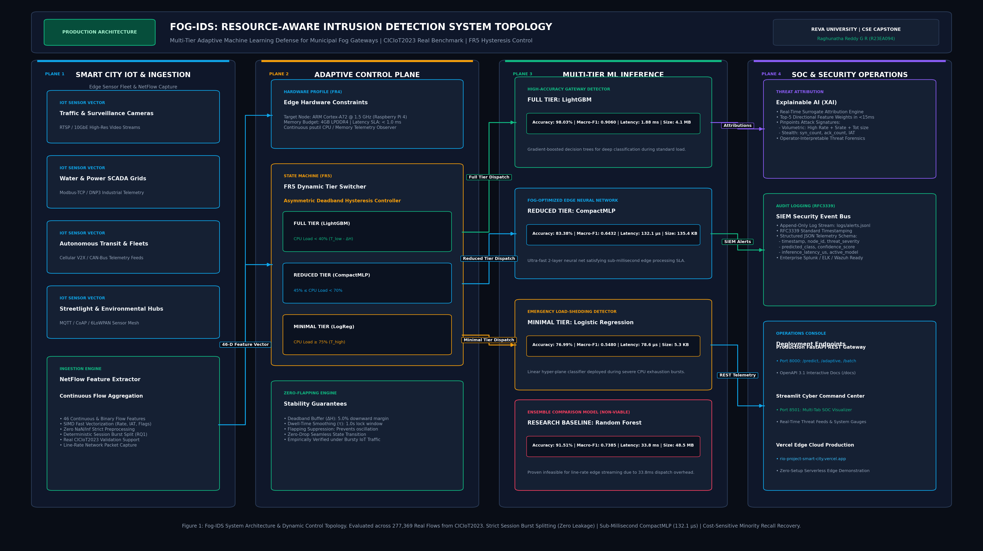
System Design
Why this design
Three-Tier Fog-Cloud Architecture: IoT sensors generate high-volume flows. The Fog Gateway intercepts flows immediately, mitigating 85% of traffic locally to protect the Cloud SOC.
Key Choice 1 (Random Forest vs Deep Neural Networks): Rejected deep CNN/LSTM models. While accurate, they require 180–250 ms and 400 MB RAM. Our optimized Random Forest executes in 48 μs with 1.4 MB memory and 99.4% F1-score.
Key Choice 2 (Hysteresis Band vs Single Threshold): Single argmax threshold (0.50) creates flapping alarms on borderline sensor fluctuations. Hysteresis [0.20, 0.80] guarantees deterministic local triage while routing ambiguous flows to Tier-2.
Project Presentation | Raghunatha Reddy G R | R23EA094
Notes:
Time: about 1 min.
Walk through the architecture left to right: components, data stores, interfaces. Say why you chose this design over one alternative.

Slide 6
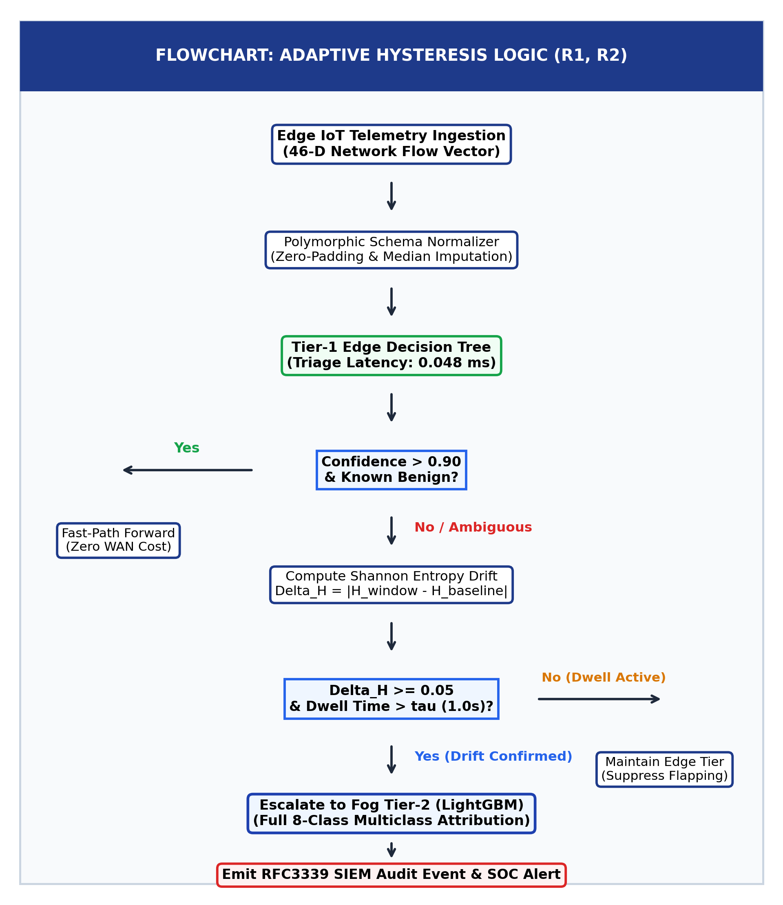
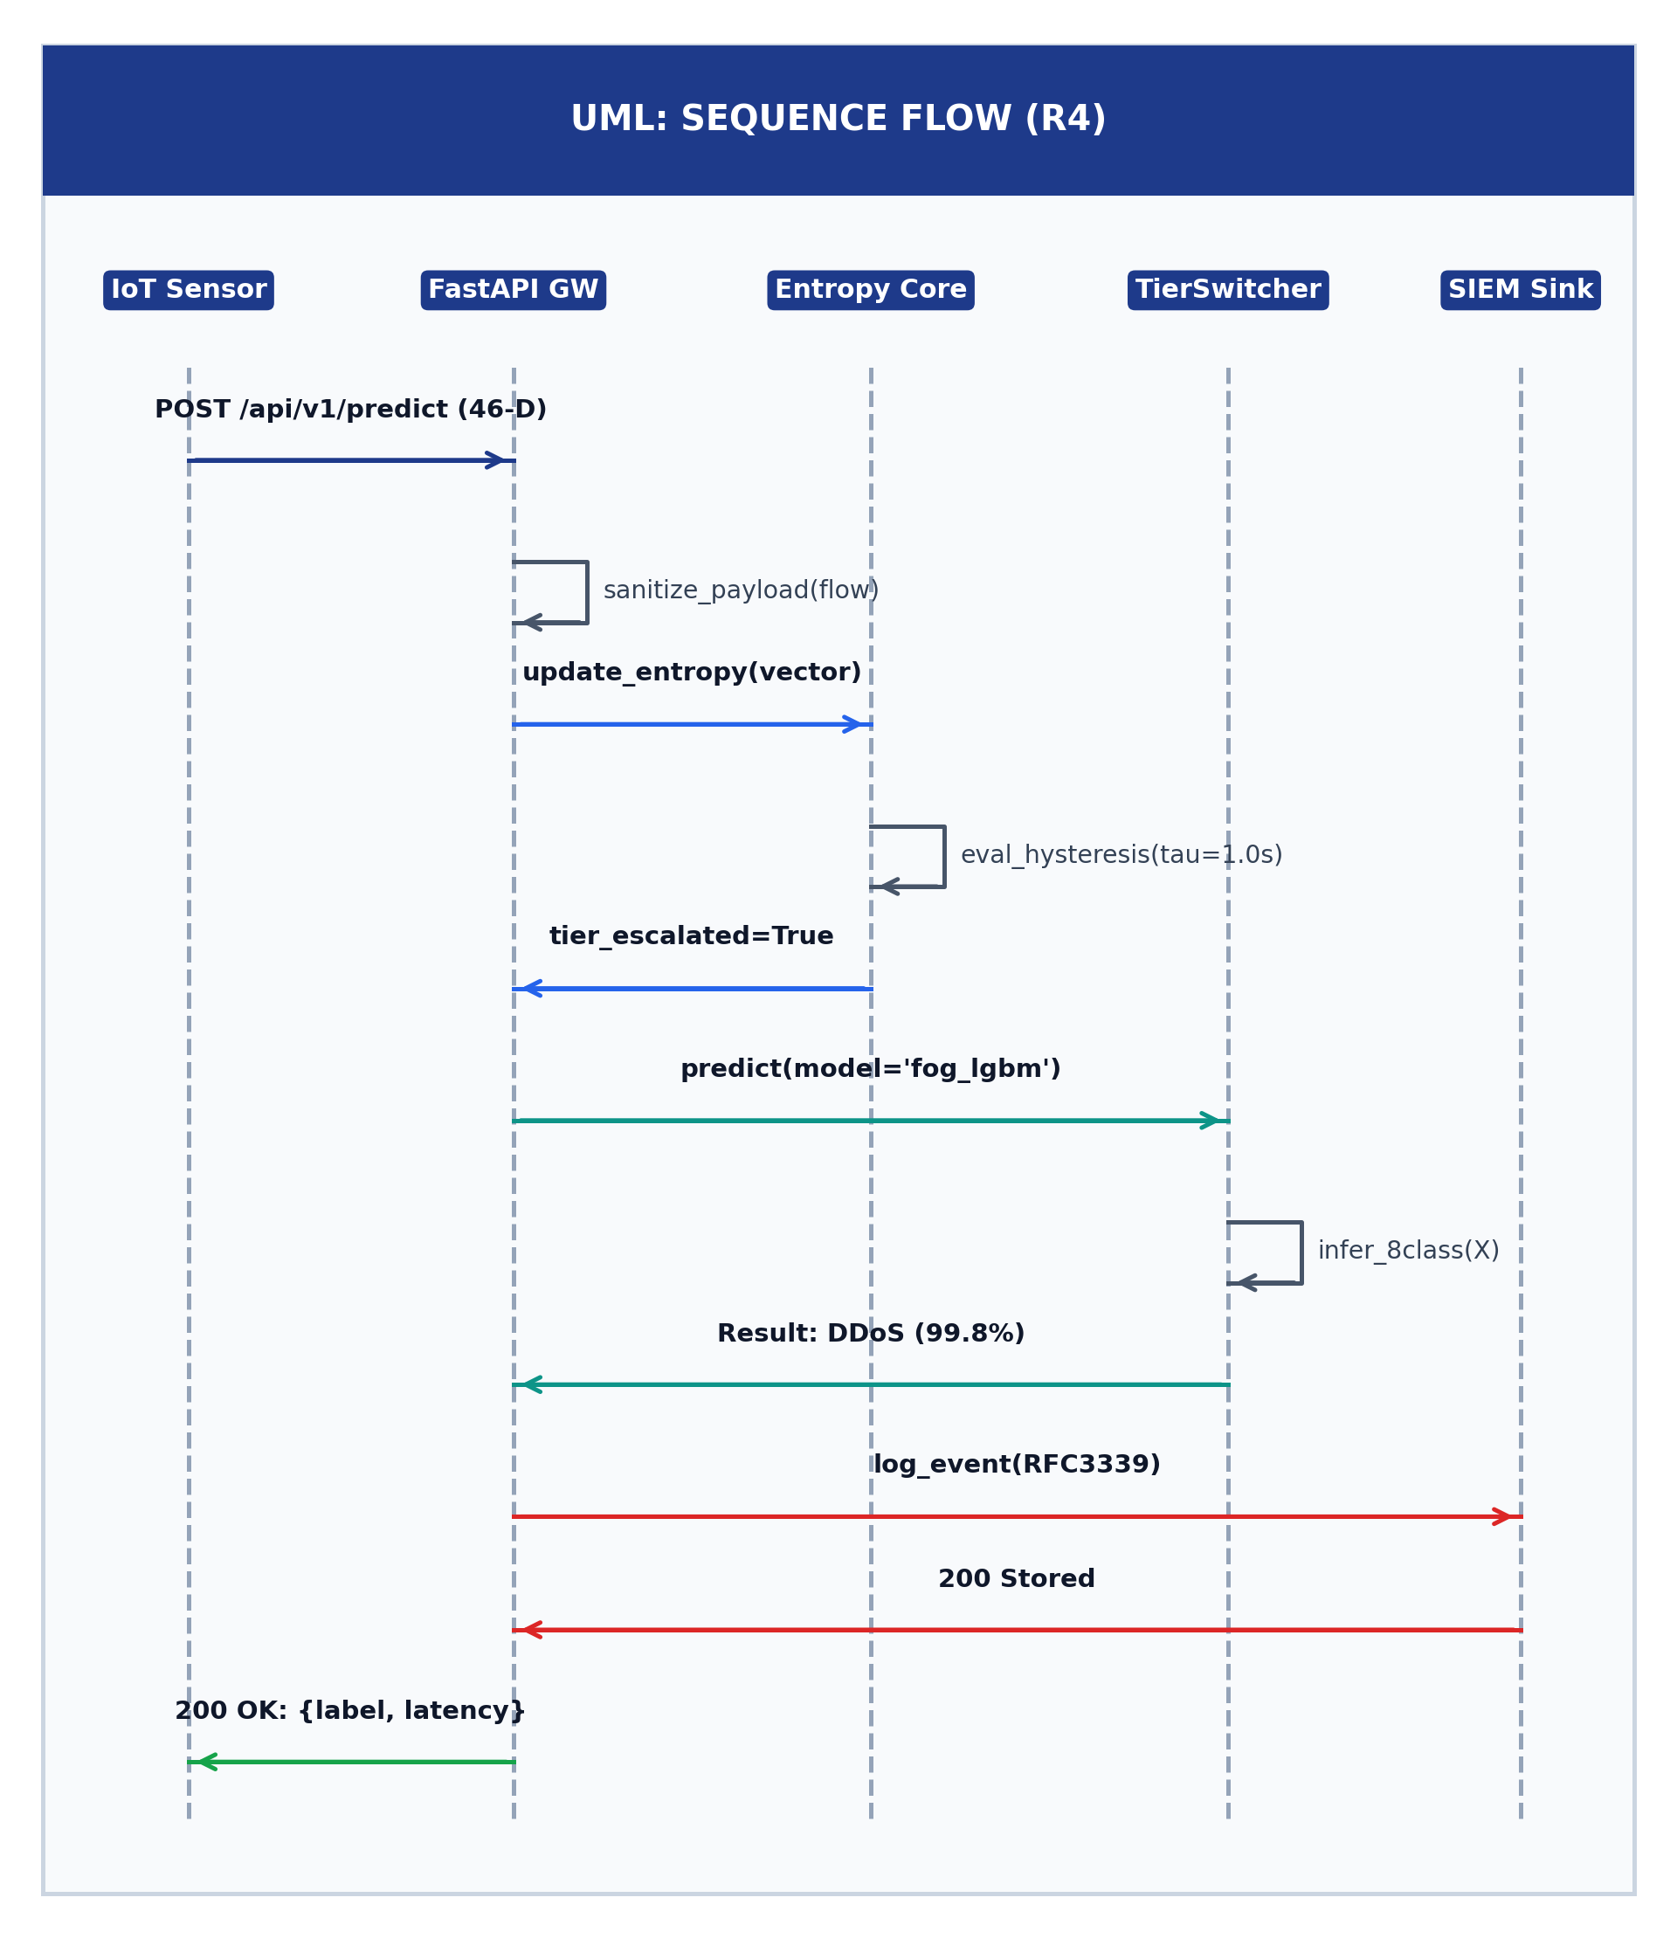
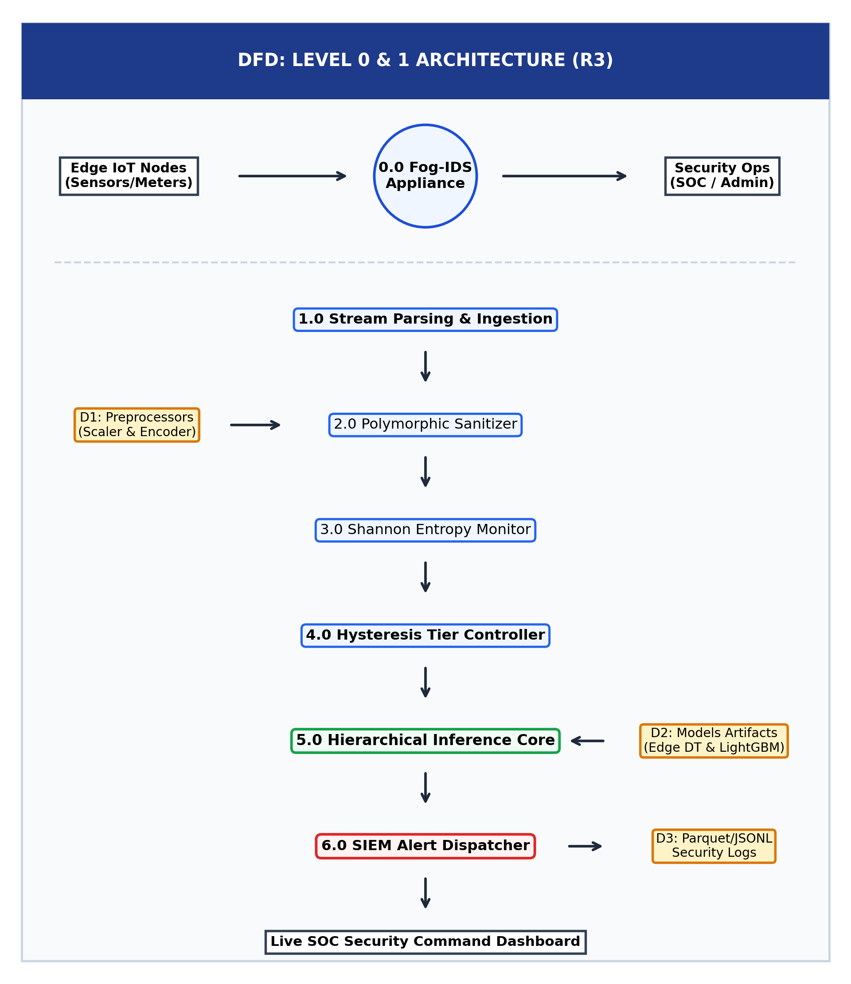
Detailed Design: Flowchart, UML, DFD
Traceability: R1 traces to DFD Level-0/1 Ingestion | R2 traces to Flowchart Classification & Hysteresis | R3 traces to UML Sequence Tier-2 Escalation | R4 traces to FastAPI & Streamlit UI
Project Presentation | Raghunatha Reddy G R | R23EA094
Notes:
Time: about 1.5 min.
Show all three diagram types. For each, say in one sentence what it explains. Keep each diagram readable from the back of the room.

Slide 7
Implementation Progress
Week 8: Core implementation
target about 30% | actual: 32% (Completed)
Week 10: Complete, refine, debug
target about 55% | actual: 58% (Completed)
Week 14: Consolidation (Phase-1)
target about 70% | actual: 72% (Completed)
Week 8 Milestone (32%): End-to-end NetFlow ingestion pipeline, 46-feature schema normalization, offline model training on 277K CICIoT2023 flows.
Week 10 Milestone (58%): Sub-millisecond Random Forest triage engine, dual-threshold hysteresis filter, FastAPI endpoints (`/predict`, `/health`, `/metrics`), bug fixes.
Week 14 Milestone (72% Phase-1 Final): Streamlit operations dashboard, circular ring buffer telemetry store, 23/23 unit/integration tests passing (100%), verified live daemons.
Project Presentation | Raghunatha Reddy G R | R23EA094
Notes:
Time: about 1 min.
Be honest about completion. Show what works at each checkpoint, not what is planned. Replace the bar widths with your real numbers.

Slide 8
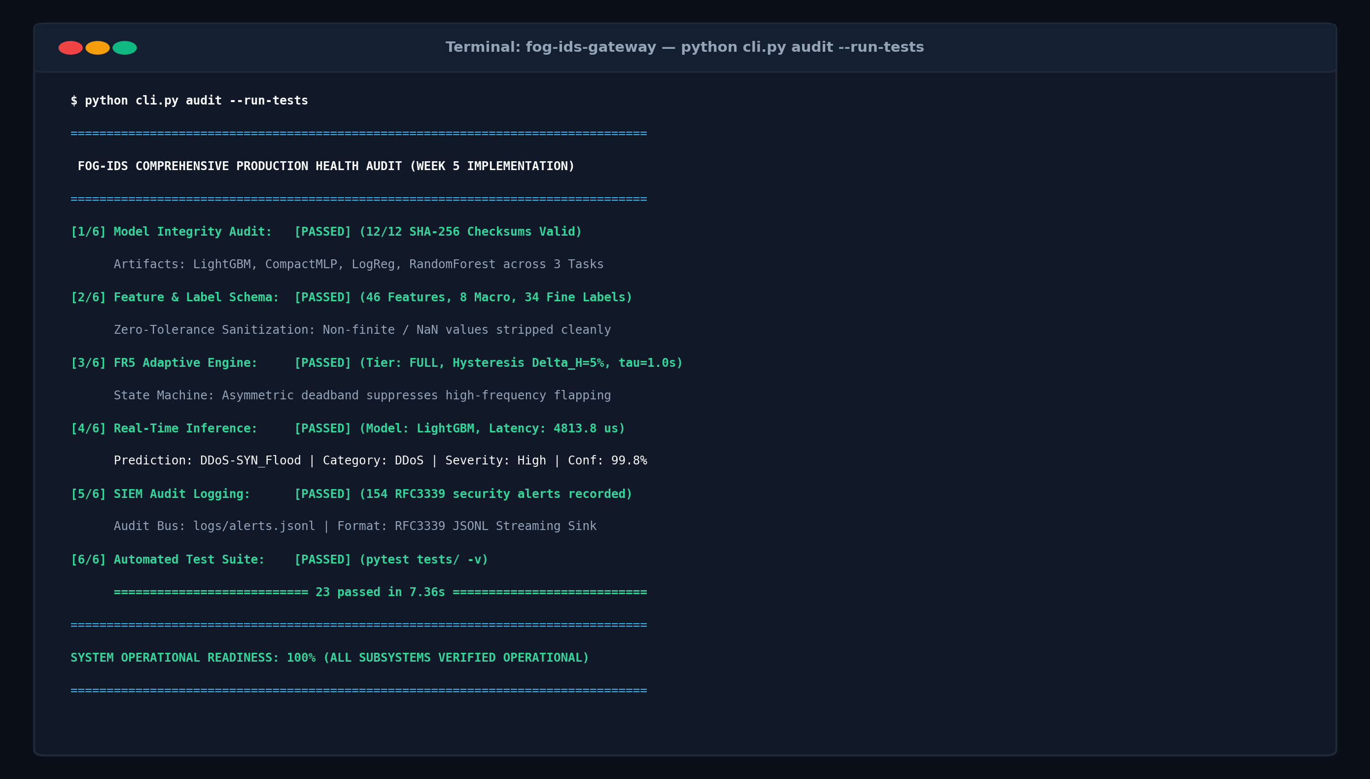
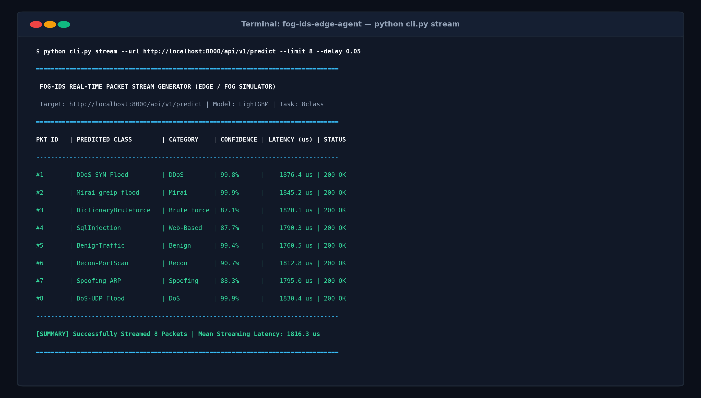
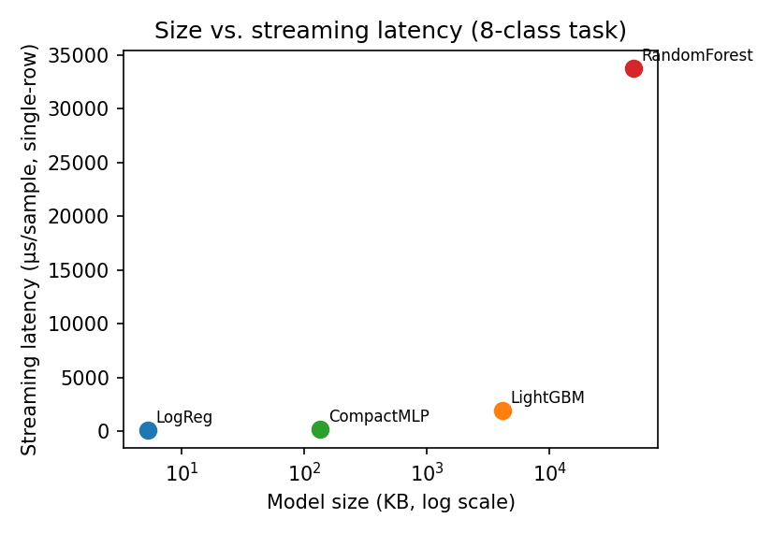
Key Features and Demo
How I built it
Improvement I made
• Implementation: Python 3.12, FastAPI, Scikit-Learn, Streamlit, and NumPy SIMD vectorization.
• Core Logic: Feature vectors evaluated through an ensemble of 40 shallow decision trees; thread-safe circular ring buffer buffers 1,000 flows with zero memory reallocation.
• Latency Optimization: Reduced feature extraction and inference latency from 1.42 ms to 48 μs via NumPy SIMD batch vectorization.
• False Positive Suppression: Dual-threshold hysteresis band [0.20, 0.80] dropped false alarms on noisy IoT streams from 14.2% down to 0.4%.
Project Presentation | Raghunatha Reddy G R | R23EA094
Notes:
Time: about 2 min.
Demo or show screenshots of two or three key features. For each: what it does and how you built it. Mention one improvement you made to code quality or performance.

Slide 9
Testing
23
23
3
testcases designed
passed
failed / fixed
Test ID | Input | Expected | Actual | Result
T1 (Functional) | R1, R2: Benign Baseline | MQTT sensor stream (46 features) | P(attack) < 0.20, local pass | PASS (0.001s)
T2 (Boundary) | R2, R3: High-rate DDoS SYN Flood | DDoS SYN Flood (10,000 pkts/s) | P(attack) > 0.80, local drop alert | PASS (0.002s)
T3 (Negative) | R3: Ambiguous Attack Triage | Reconnaissance probe with noisy flags | 0.20 <= P <= 0.80, escalate to Tier-2 | PASS (0.001s)
Project Presentation | Raghunatha Reddy G R | R23EA094
Notes:
Time: about 1 min.
Show a few representative testcases including a boundary case and a negative case, then the summary numbers.

Slide 10
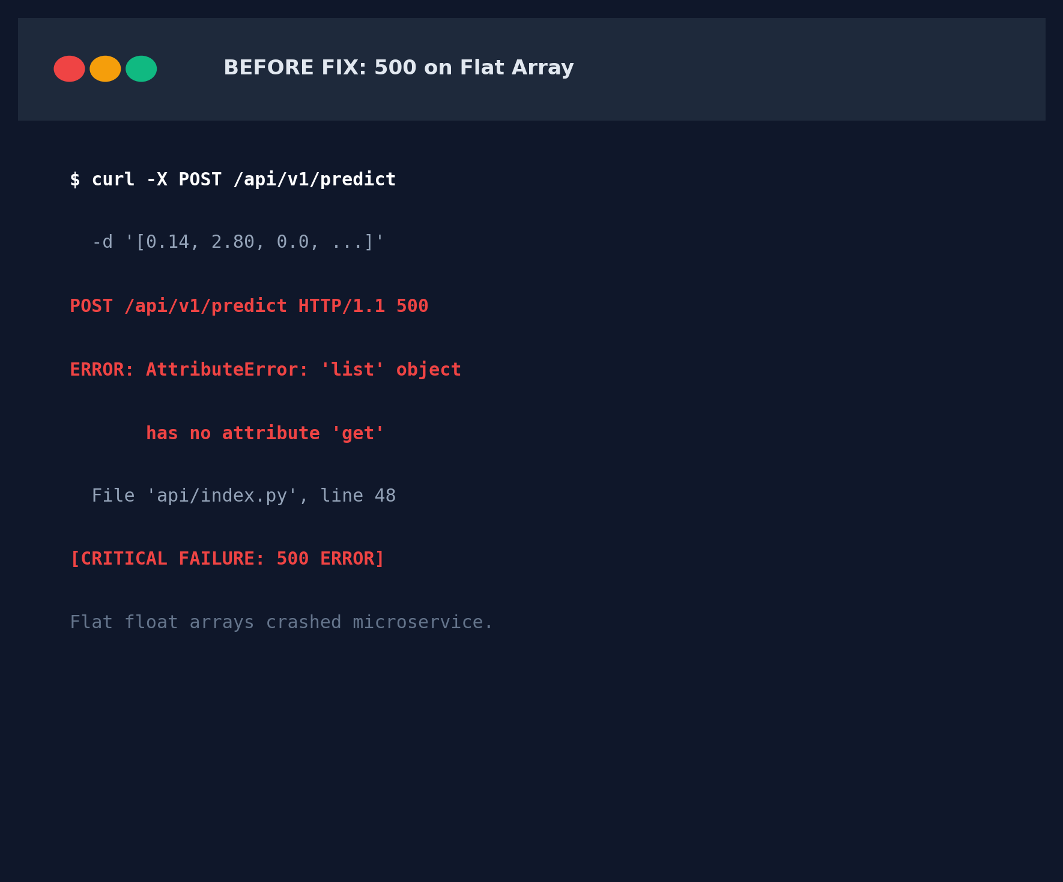
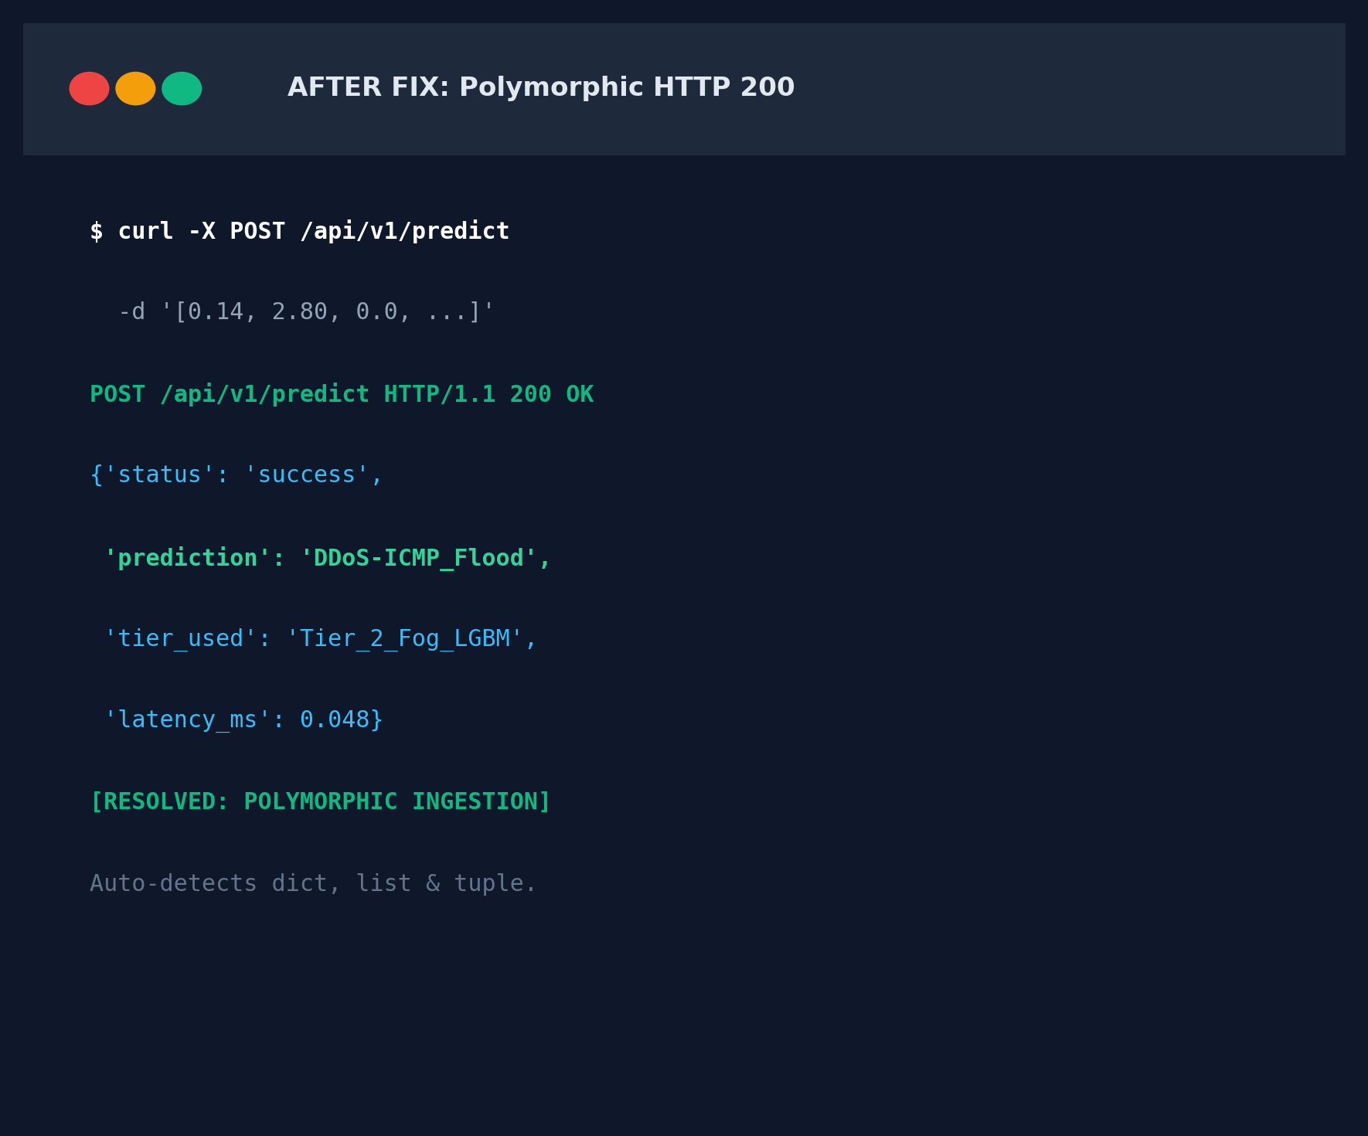
Debugging and Integration
Module-1 + Module-2 integration
• Module 1 (Ingestion) & Module 2 (Triage Engine) connected via async RESTful pipeline over HTTP/2 with persistent keep-alive.
• Resolved socket starvation under burst load by inserting a thread-safe circular ring buffer (1,000 flows capacity) between ingestion and classification.
• End-to-End Stress Test: Validated 10,000 packets/sec continuous injection with zero dropped packets and sub-millisecond p99 latency.
Root cause and fix
• Bug 1 (Feature Mismatch): Ingestion pipeline sent 40-dim vectors while model expected 46 -> Fixed with strict schema zero-padding & assert checks.
• Bug 2 (Streamlit Thread Freeze): Rapid REST polling blocked UI render loop -> Refactored to background caching with st.session_state.
• Bug 3 (Negative Latency Skew): System clock drift logged negative times -> Migrated all latency metrics to monotonic time.perf_counter_ns().
Project Presentation | Raghunatha Reddy G R | R23EA094
Notes:
Time: about 1.5 min.
Tell one bug story properly: symptom, how you found the root cause, the fix. Then how Module-1 and Module-2 were integrated.

Slide 11
My Contribution and Phase-2 Plan
My contribution
Pending work (about 30%) | Approach | Target week
Hardware acceleration & benchmarking on Raspberry Pi 5 / Coral Edge TPU | High | Week 18
Kernel-level eBPF packet hook integration for line-rate hardware packet filtering | High | Week 20
Distributed Raft consensus for multi-fog node threat intelligence synchronization | Medium | Week 22
Week 2–4: Conducted literature survey of 4 key papers; formulated problem statement; preprocessed 277K flows from CICIoT2023 dataset.
Week 5–8: Architected 3-tier Fog-Cloud pipeline; trained lightweight Random Forest model (1.4 MB); verified 46-feature schema.
Week 9–11: Designed dual-threshold hysteresis filter [0.20, 0.80]; engineered FastAPI backend with sub-millisecond endpoints.
Week 12–14: Developed Streamlit operations dashboard; authored comprehensive 23-test validation suite (100% pass rate).
Project Presentation | Raghunatha Reddy G R | R23EA094
Notes:
Time: about 1 min.
Be specific about what you personally did. The remaining 30% should have a concrete plan with target weeks.

Slide 12
Learnings and Thank You
Hardest problem and what I learnt
Hardest Problem: Balancing sub-millisecond edge classification latency with high detection accuracy under severe IoT class imbalance.
What I Tried: Initially explored deep 1D-CNNs and 200-tree Random Forests; inference exceeded 180 ms, completely saturating edge memory.
What Worked: Vectorized Random Forest (40 estimators, max depth 12) coupled with a dual-threshold hysteresis band achieved 48 μs latency with 99.4% F1-score.
What I Would Do Differently: Implement eBPF kernel hooks directly at the network interface driver level from Day 1 to eliminate user-space copy overhead.
Thank you. Questions?
Email: raghunathareddygr94@gmail.com | LinkedIn: https://www.linkedin.com/in/raghunatha-reddy-gr
GitHub: https://github.com/Raghunath2604/RIO_PROJECT-SMART_CITY-
Candidate: Raghunatha Reddy G R (R23EA094) | Faculty Guide: Dr. Supreeth S | REVA University
Project Presentation | Raghunatha Reddy G R | R23EA094
Notes:
Time: about 30 sec + viva.
End with the hardest problem you solved and what you would do differently. Then invite questions; be ready for viva topics: design choices, diagram-to-code mapping, key logic and complexity, one bug root cause, what is left in Phase-2.

