Slide 1
WEEK 3 ASSIGNMENT · DETAILED DESIGN OF THE MODULE
Fog-IDS: Flowchart, DFD and UML Design
Lightweight Multi-Class Intrusion Detection for Fog Nodes in Smart City IoT Networks
RAGHUNATHAREDDY GR · SRN R23EA094
School of Computing Science and Engineering, REVA University, Bengaluru
Faculty Guide: Dr. Supreeth S
Notes:
This is my Week 3 deliverable: the detailed design of the module. It covers the process flowchart, the data flow diagrams at level 0 and level 1, and the UML class, sequence and use-case diagrams. Importantly, the design describes the system I have already built and run, not a planned one, and every name in the diagrams matches the real code.

Slide 2
SYSTEM OVERVIEW
A Six-Stage Pipeline, Built and Run End to End
1
2
3
4
5
6
Load
Leakage
Benchmark
Profile
Fog
Report
Chunked CSV load, sanitize features
Random vs session-aware split
Four models at 2, 8 and 34 classes
Size, memory, latency
Centralized vs per-node vs federated
REPORT.md, CSVs, figures
Simulation disclosure
This project uses software simulation only. “Fog nodes” are data partitions processed inside one Python process (src/fog_emulation.py). Deployability is model size and latency measured on the development machine, scaled by a documented estimate for Raspberry-Pi-class hardware. No physical device or real network is used.
Week 3 · Detailed Design · Fog-IDS
2 / 16
Notes:
The system is a six-stage pipeline run by one orchestrator, run_pipeline.py. Stage one loads and cleans the data in chunks. Two compares random against session-aware splitting to test for leakage. Three benchmarks the models at 2, 8 and 34 classes. Four profiles model size, memory and latency. Five emulates multiple fog nodes. Six writes the report. Each stage is checkpointed, so it can be re-run independently. Important disclosure: this is a software simulation. No physical fog node or IoT device is used; fog nodes are data partitions in one Python process and hardware numbers are measured on the dev machine and scaled using a documented estimate.

Slide 3
MODULE DESIGN
Eight Modules, Each Tied to a Research Question
Module | Responsibility | Supports
schema.py | Feature list, class groupings (2/8/34) | Foundation
data_gen.py | Synthetic generator for the leakage control test | RQ2
loader.py | Chunked loading of the real CICIoT2023 CSVs | FR1
splits.py | Random vs session-aware split strategies | RQ2
train_eval.py | Model factory, training, per-class metrics | RQ1, RQ4
profile_model.py | Model size, memory, per-sample latency | RQ3
fog_emulation.py | Centralized / per-node / federated comparison | RQ5
run_pipeline.py | Orchestrator: CLI, stages, checkpoint cache, report | All
Week 3 · Detailed Design · Fog-IDS
3 / 16
Notes:
Each module has one responsibility. schema defines features and class groupings. data_gen is the synthetic generator used for the leakage test. loader reads the real CSVs in chunks. splits holds the random and session-aware strategies, answering RQ2. train_eval trains models and computes macro-F1 and per-class recall, answering RQ1 and RQ4. profile_model measures size and latency, RQ3. fog_emulation compares centralized, per-node and federated training, RQ5. run_pipeline orchestrates it all.

Slide 4
MODULE DESIGN
Module Interfaces: Inputs, Outputs and Key Functions
Module | Key functions | Input | Output
schema.py | category_shares(), fine_label_shares(), sanitize_feature_matrix() | Raw feature matrix | Cleaned matrix; 46 features and 34/8/2-class label maps
data_gen.py | generate(scale, seed) | Scale and random seed | Synthetic DataFrame in the real schema
loader.py | load_dataset(), load_real_presplit() | Data folder (optional), per-class cap | One labeled DataFrame (real or synthetic)
splits.py | random_split(), session_split() | DataFrame, test size, seed | Train and test DataFrames
train_eval.py | prepare_xy(), train_one_model(), run_experiment() | Train/test DataFrames, task, model names | Metrics, per-class results, confusion matrix
profile_model.py | model_size_bytes(), streaming_latency_us(), profile_all() | Trained model results | Size, memory and latency table
fog_emulation.py | partition_nodes(), run_centralized(), run_per_node(), run_federated_avg() | Train/test DataFrames, node count | Three-strategy comparison table
run_pipeline.py | main(), stage_load() to stage_report(), write_report() | Command-line arguments | REPORT.md, CSVs, figures, checkpoint cache
Week 3 · Detailed Design · Fog-IDS
4 / 16
Notes:
This table shows each module's interface: the key functions, what goes in and what comes out. The flow is easy to follow. The loader returns one labeled DataFrame, whether real or synthetic. The splits module turns it into train and test sets. train_eval trains and scores models, profile_model measures their cost, and fog_emulation repeats the comparison across simulated nodes. run_pipeline wires these together through stage functions and caches each result, so any stage can be re-run on its own.

Slide 5
PROCESS FLOWCHART · PART A
Control Flow, Part A: Start to Benchmark
Cache
exists?
Real data
provided?
START
run_pipeline.py
Parse CLI
arguments
no
no
Legend
yes
yes
Start / end / connector
Load cached
result
Load real data
(loader.py)
Generate
synthetic data
Process step
Decision
Cache step
To
Part B
STAGE: Benchmark
(train_eval.py)
STAGE: Leakage
(splits.py)
Sanitize features
(schema.py)
Week 3 · Detailed Design · Fog-IDS
5 / 16
Notes:
This is the process flowchart, split in two parts so every label stays readable. It starts when the pipeline is run. The first step parses the command-line arguments. Then a decision: does a checkpoint cache already exist? If so, it loads the cached result. If not, a second decision asks whether real data was provided. If yes, it loads the real data with the loader. If not, it generates synthetic data. Both paths join at the sanitize step, then the leakage stage and the benchmark stage run. The circle at the end is an off-page connector to part B.

Slide 6
PROCESS FLOWCHART · PART B
Control Flow, Part B: Profile to Report
From
Part A
STAGE: Profile
(profile_model.py)
STAGE: Fog
(fog_emulation.py)
STAGE: Report
(write_report)
Save result to
checkpoint cache
Legend
Start / end / connector
More stages
requested?
Process step
Back to Parse CLI
arguments (Part A)
yes
Decision
Cache step
no
END
report, CSVs, figures
Week 3 · Detailed Design · Fog-IDS
6 / 16
Notes:
Part B continues from the connector. It runs the profile stage, then the fog stage, then the report stage. The result is saved to the checkpoint cache. The decision diamond asks whether more stages were requested. If yes, control loops back to parsing the command-line arguments. If no, the run ends with the report, CSVs and figures delivered.

Slide 7
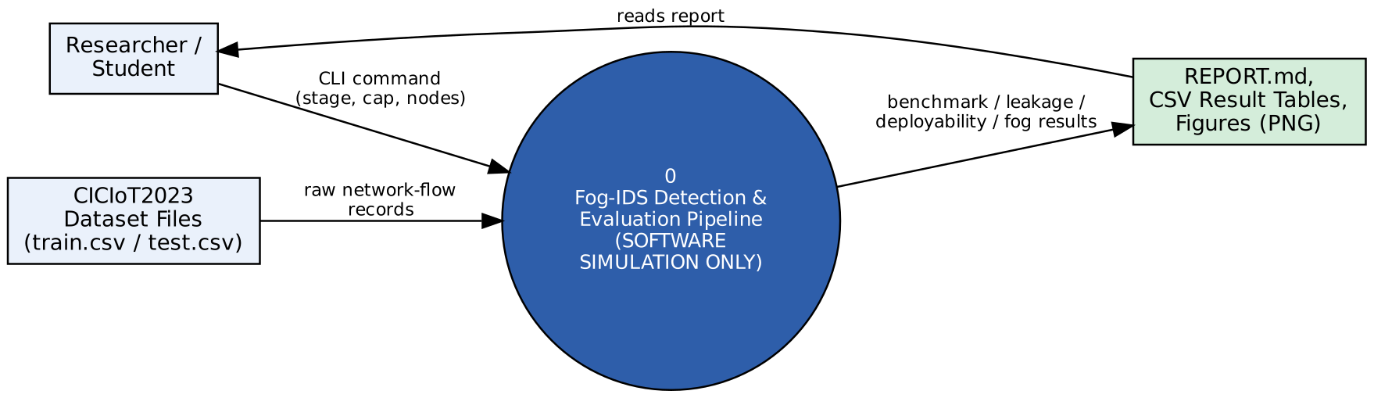
DATA FLOW DIAGRAM
DFD Level 0: Context Diagram
Single process: the Fog-IDS detection and evaluation pipeline (software simulation only)
Inputs: CICIoT2023 CSV data and researcher run settings
Outputs: results report, metric tables, figures for the researcher
Week 3 · Detailed Design · Fog-IDS
7 / 16
Notes:
The context diagram treats the whole system as one process. Data comes in from the CICIoT2023 files and the researcher's command line settings. Data goes out as the results report, tables and figures that the researcher reads. Everything inside is shown at level 1.

Slide 8
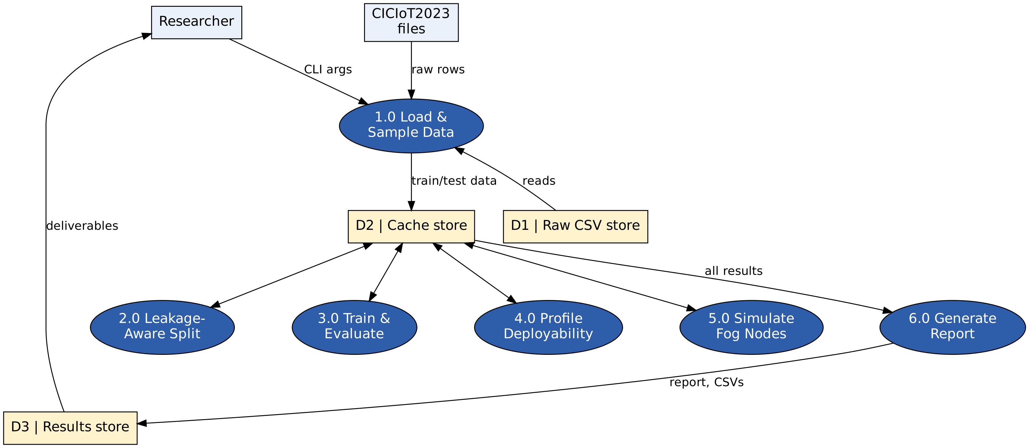
DATA FLOW DIAGRAM
DFD Level 1: Six Processes, Three Data Stores
Week 3 · Detailed Design · Fog-IDS
8 / 16
Notes:
Level 1 breaks the single process into six: load, leakage test, benchmark, profile, fog emulation and report. There are three data stores: D1 the raw CSV files, D2 the checkpoint cache, and D3 the results folder. The double arrows show that processes both read from and write to the cache. That is what lets any stage be re-run on its own without repeating earlier work.

Slide 9
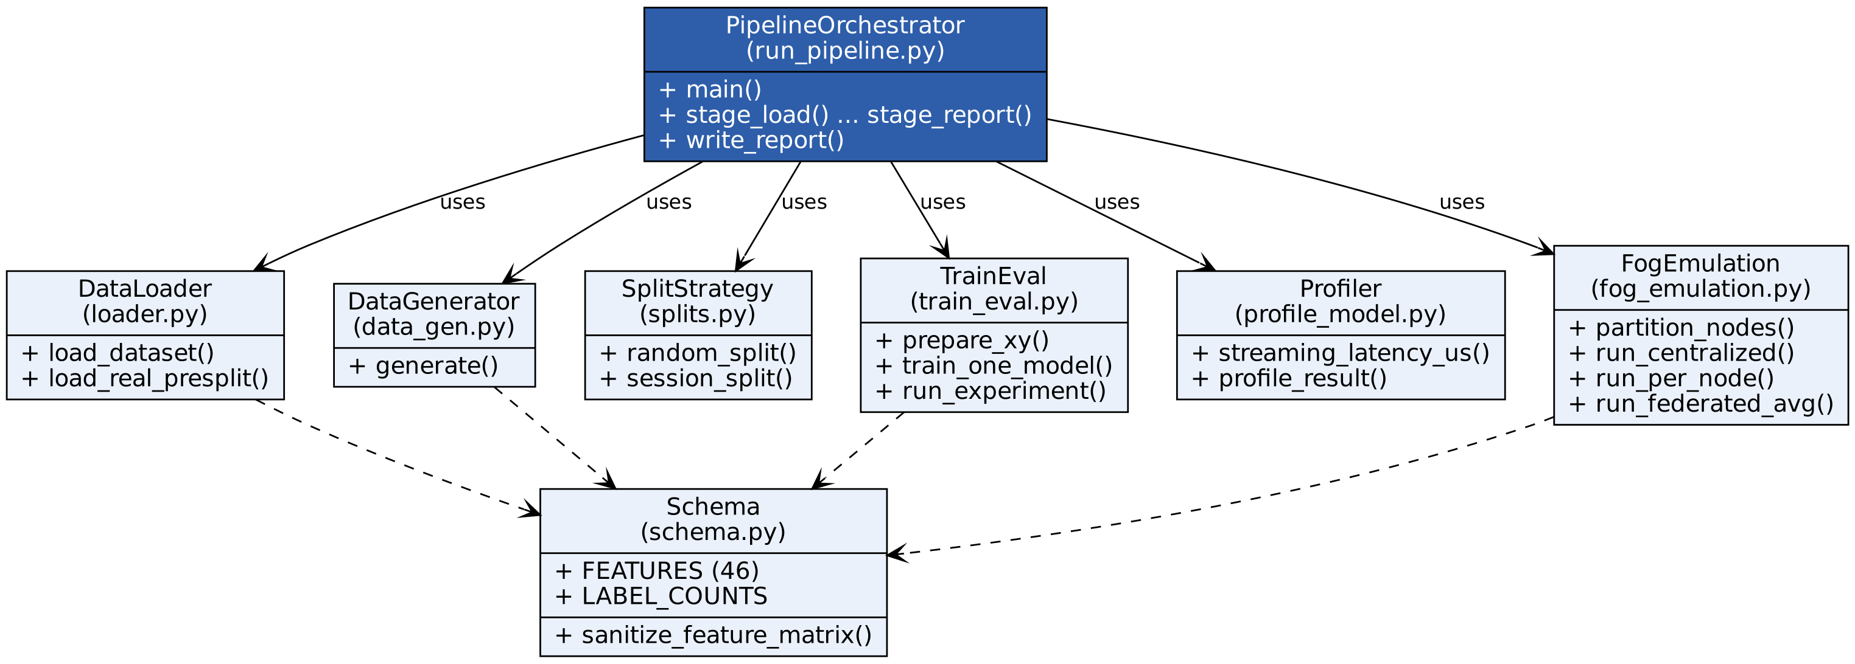
UML CLASS DIAGRAM
Eight Classes Mirror the Code Modules
Each box lists the class, its source file and its key operations
Solid arrows: uses. Dashed arrows: imports
PipelineOrchestrator coordinates all other classes; most import Schema
Week 3 · Detailed Design · Fog-IDS
9 / 16
Notes:
The class diagram has one class per module in the code: Schema, DataLoader, DataGenerator, SplitStrategy, TrainEval, Profiler, FogEmulation, and PipelineOrchestrator. Each box lists its key operations. Solid arrows mean uses, dashed arrows mean imports. The orchestrator at the top coordinates the other classes, and most of the lower-level classes import Schema for the shared feature and label definitions.

Slide 10
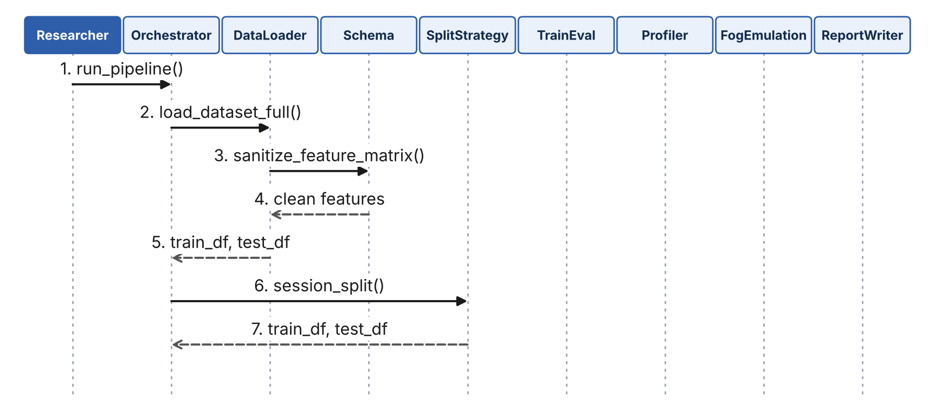
UML SEQUENCE DIAGRAM · SOLID = CALL, DASHED = RETURN
One Full Run, Part 1: Setup to Splitting
Week 3 · Detailed Design · Fog-IDS
10 / 16
Notes:
The sequence diagram follows one complete run across nine participants: the researcher, orchestrator, loader, schema, split strategy, train-eval, profiler, fog emulation and report writer. Part 1: the researcher starts the run, the orchestrator asks the loader for the dataset, the loader asks the schema to sanitize the features, and the orchestrator runs the session split. Solid arrows are calls, dashed arrows are returns.

Slide 11
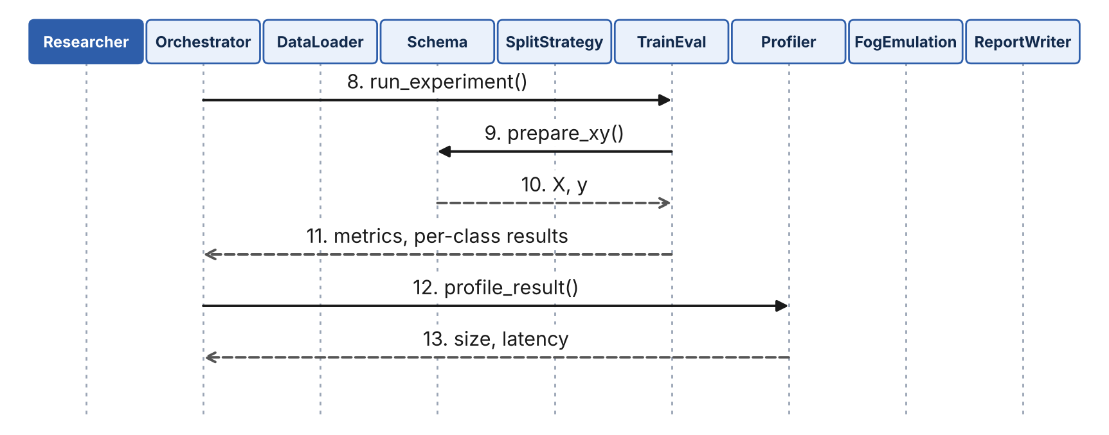
UML SEQUENCE DIAGRAM · SOLID = CALL, DASHED = RETURN
One Full Run, Part 2: Benchmark and Profile
Week 3 · Detailed Design · Fog-IDS
11 / 16
Notes:
Part 2 continues the same run. The orchestrator runs the experiment through train-eval, which asks the schema to prepare X and y. The metrics come back to the orchestrator, which then calls the profiler for size and latency.

Slide 12
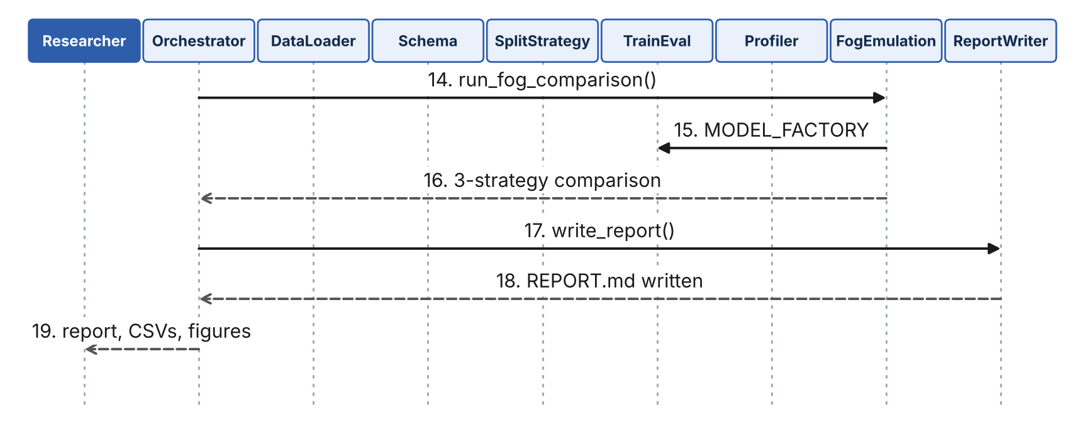
UML SEQUENCE DIAGRAM · SOLID = CALL, DASHED = RETURN
One Full Run, Part 3: Fog Emulation to Report
Week 3 · Detailed Design · Fog-IDS
12 / 16
Notes:
Part 3 finishes the run. The orchestrator calls fog emulation, which uses the model factory from train-eval and returns a three-strategy comparison. Finally the orchestrator calls the report writer, and the report, CSVs and figures return to the researcher as message 19.

Slide 13
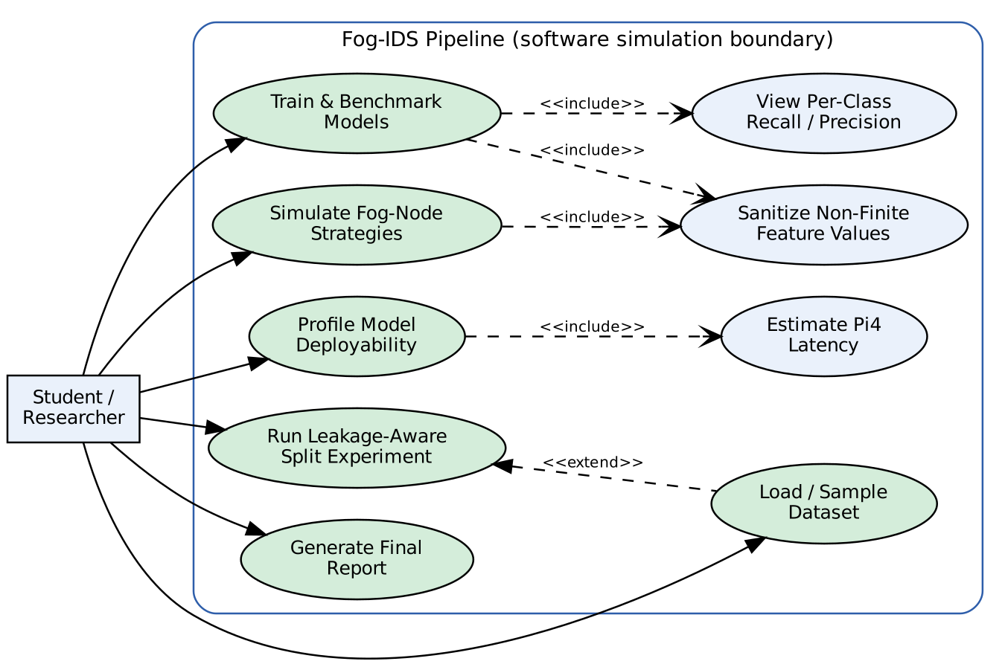
UML USE-CASE DIAGRAM
One Actor, Six Primary Use Cases
Scope
Actor: Student / Researcher
6 primary use cases, one per pipeline stage
3 included use cases reused by the primary ones
System boundary: the software simulation
Week 3 · Detailed Design · Fog-IDS
13 / 16
Notes:
The single actor is the student researcher. There are six primary use cases, one per pipeline stage, and three included use cases that the primary ones reuse. The system boundary shows what is inside the software simulation.

Slide 14
REQUIREMENTS TRACEABILITY
Requirements Traced to Modules and Status
ID | Requirement | Module | Status
FR1 | Chunked loading of real CSVs | loader.py | Built
FR2 | Clean, scale, encode features | train_eval.py | Built (feature selection pending)
FR3 | Session-aware split with random control | splits.py | Built (leakage shown on synthetic data)
FR4 | Three model tiers benchmarked | train_eval.py, profile_model.py | Built
FR5 | Tier switching on CPU/RAM headroom | None yet | Not yet built
FR6 | Class-imbalance handling | train_eval.py | Built
FR7 | Full metric set and confusion matrices | train_eval.py | Built
FR8 | Size, memory, latency profiling | profile_model.py | Built (hardware numbers estimated)
FR9 | Multi-fog-node comparison | fog_emulation.py | Built
Week 3 · Detailed Design · Fog-IDS
14 / 16
Notes:
Each functional requirement from the literature review maps to a module in the design and to an honest status. FR1, FR4, FR6, FR7, FR8 and FR9 are built and run on real data. FR2 is built, with the feature-selection hook still to add. FR3 is built but the leakage effect is validated on synthetic data only. FR5, the resource-aware tier switcher, is not yet built.

Slide 15
HONEST REPORTING
What the Design Does Not Claim
1
2
3
FR5 not built
Leakage test is synthetic
Hardware numbers are estimates
The resource-aware tier switcher needs a real fog device or an OS-level resource monitor.
The real data was already row-shuffled (mean run-length about 1.1), so session boundaries are not recoverable.
Fog-class latency is an estimated range scaled from dev-machine measurements, not measured on a device.
Week 3 · Detailed Design · Fog-IDS
15 / 16
Notes:
I want to be upfront about limits. FR5, the tier switcher, needs a real device or OS-level monitor, so it's future work. The real redistribution of CICIoT2023 was already row-shuffled, so true session boundaries can't be recovered, which is why the leakage test uses synthetic data. And the fog hardware numbers are an estimated range, not a measurement on a device. Stating these openly is part of the design.

Slide 16
SUMMARY
Design Complete, Matched to the Built System
✓
Process flowchart of the pipeline and checkpoint logic
Thank You
✓
DFD Level 0 and Level 1 with three data stores
Questions welcome
✓
UML class, sequence (19 messages) and use-case diagrams
RAGHUNATHAREDDY GR · R23EA094
School of Computing Science & Engineering, REVA University
Guide: Dr. Supreeth S
✓
FR1–FR9 traced to modules, with honest status
✓
Next: tier switcher (FR5) and feature-selection hook
16 / 16
Notes:
To summarize: the design is complete and matches the built system. It has a process flowchart, DFD at two levels, and UML class, sequence and use-case diagrams, all traced to real functions in the code, with requirements mapped to modules and honest statuses. Next steps are the tier switcher and feature selection. Thank you, happy to take questions.

