Slide 1
WEEK 2
FinTech Domain & Software
Development Fundamentals
Stock markets • APIs & JSON • Git/GitHub • Data flow • Analytics
Prepared by: RAGHUNATHAREDDY GR
FinTech internship prerequisite | 15 October 2026
Education only. Not investment or trading advice.

Slide 2
1. Stock Market Fundamentals
The vocabulary behind market and financial datasets
Exchanges & indices
NSE and BSE are venues. Nifty 50 covers 50 large/liquid names; Sensex tracks 30 BSE companies.
Primary vs secondary
IPO issues/listings bring a company to public markets. SME IPOs are for eligible smaller enterprises under current rules.
Valuation vocabulary
Market cap = price × shares. P/E = price/EPS. P/B = price/book value per share. Volume measures shares traded.
Shareholder returns
EPS, dividends, bonus issues and splits need corporate-action context. Dividends are not guaranteed.
Three statements
P&L: period performance. Balance Sheet: assets/liabilities/equity at a date. Cash Flow: operating, investing and financing cash movements.
Market plumbing
Broker, demat account, DP, NSDL/CDSL, clearing corporation and SEBI. Standard equity rolling settlement is generally T+1.
Analyst rule: verify units, reporting period, consolidated vs standalone basis, corporate actions and data freshness.
Week 2 | FinTech Domain & Software Development Fundamentals
2

Slide 3
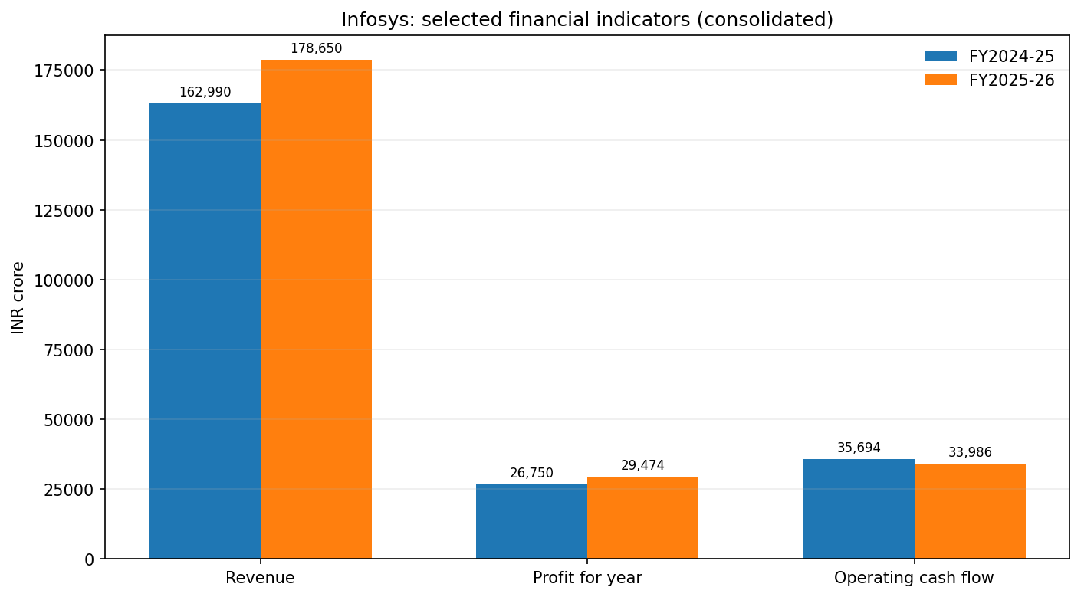
2. Listed Company Financial Analysis
Infosys Limited | FY2025-26 vs FY2024-25 | Consolidated Ind AS
Revenue
₹178,650 crore
+9.6% year on year
Profit for year
₹29,474 crore
+10.2% year on year
Basic EPS
₹71.58
+11.0% year on year
What to investigate
Current ratio: 2.27x → 1.98x
Trade receivables: +13.1% YoY
Operating cash flow: -4.8% YoY
Compare profit with cash conversion and working capital
Week 2 | FinTech Domain & Software Development Fundamentals
3

Slide 4
3. Reading Financial Statements
Interpret signals together; ratios alone rarely tell the whole story
Profit & Loss
Revenue growth +9.6%
Profit for year +10.2%
Profit margin roughly stable to slightly higher
Balance Sheet
Assets +4.7%
Current liabilities +22.1%
Current ratio down to 1.98x
Cash Flow
Operating cash flow -4.8%
Simple FCF (CFO - capex) down
Financing outflow larger
Ratios in the report
Net profit margin = net profit / revenue • Current ratio = current assets / current liabilities
EPS = profit attributable to ordinary shareholders / weighted-average shares • FCF (simple) = operating cash flow - capex
Historical comparison, not a forecast or investment recommendation.
Week 2 | FinTech Domain & Software Development Fundamentals
4

Slide 5
4. REST API & JSON: Public Data to CSV
Hands-on exercise using Frankfurter exchange-rate reference data
1. GET request
/v2/rates?base=USD&quotes=INR,EUR,GBP,JPY
2. Inspect JSON
Check HTTP status, data type, fields and missing records.
3. Export CSV
Python requests + Pandas writes normalized rows.
Run from project root:
Command
python "Source Code/api_extract.py"
No API key required. A live request must run on an internet-connected machine; the included CSV is an example row from the API docs, not a full live extraction.
Week 2 | FinTech Domain & Software Development Fundamentals
5

Slide 6
5. Git & GitHub
Track assignments with meaningful version history
Working tree
Edit files
Staging
git add
Local history
git commit
Remote repo
git push
Publish after authentication and review
git init
git add .
git commit -m "Add Week 2 assignments"
gh repo create week-2-fintech-fundamentals --public --source=. --remote=origin --push
Check for secrets, personal data and confidential files before every push.
Week 2 | FinTech Domain & Software Development Fundamentals
6

Slide 7
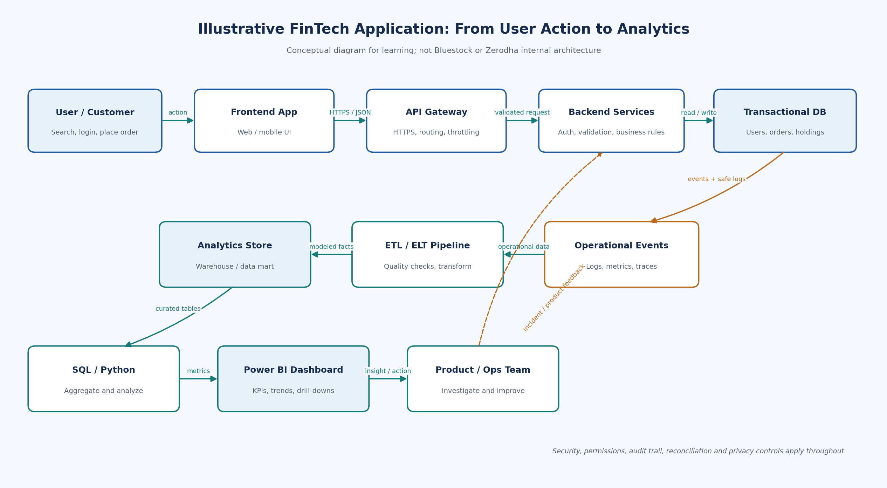
6. How Application Data Reaches Analytics
Client, backend, database, pipeline and dashboard
Week 2 | FinTech Domain & Software Development Fundamentals
7

Slide 8
7. FinTech Case Study: Zerodha
Public engineering sources suggest opportunities for observable, data-informed operations
Reliability
Availability, p95 latency, API errors, incident minutes
Customer journey
KYC conversion, completion time, order rejection reasons
Data quality
Event lag, missing events, duplicates and reconciliations
Public technical references
Zerodha Tech documents logging, monitoring and large PostgreSQL workloads.
Analytics can connect system health to onboarding friction, order lifecycle and support outcomes.
Suggested KPIs are analyst proposals, not claims about Zerodha’s private internal metrics.
Week 2 | FinTech Domain & Software Development Fundamentals
8

Slide 9
Submission Checklist & Key Sources
Week 2 deliverables
Stock market summary + Infosys FY2025-26 statement analysis
API extraction script + example JSON/CSV + Postman steps
Git/GitHub workflow guide and secure publishing checklist
Software architecture / data-flow diagram
Zerodha FinTech research report
PowerPoint slides and source references
Sources: Infosys official FY26 reports • NSE • SEBI Investor • CDSL • Zerodha Tech / Varsity • Frankfurter API docs
Week 2 | FinTech Domain & Software Development Fundamentals
9

