Slide 1
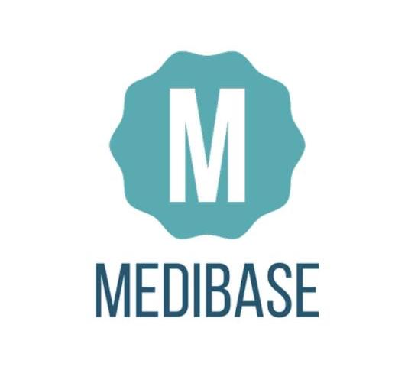
Hari Sai Raghuram V Akhilesh Pothuri Rithvik Sallaram
1610110145 1610110049 1610110285

Slide 2
Overview
Our main objective is to provide population around a region with a common platform to store all the medical records which can be accessed from anywhere.
As these records consists of sensitive information of the patients, we want to keep these records safe and not fall in the wrong hands.
For maintaining up to date information, we plan to keep the privileges of editing these records only to recognised and certified doctors and medical institutions.
Although our focus is on rural population, we also need to track the needs of other people. For this purpose we plan to provide a mobile application for patients to check their records from time to time.

Slide 3
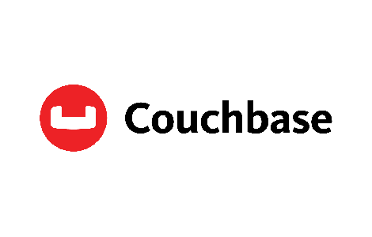
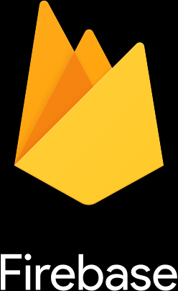
A Hybrid Storage Model
Medibase uses the Couchbase distributed NoSQL data storage model as well as the firebase cloud service reaping the benefits of both the models.

Slide 4
Data Model
Firebase provides useful and handy features.
i) Simple User Authentication
ii) A fast data retrieval.
For the above reasons Medibase uses Firebase’s secure Authentication for logging in users and it’s database to store personal user information.

Slide 5
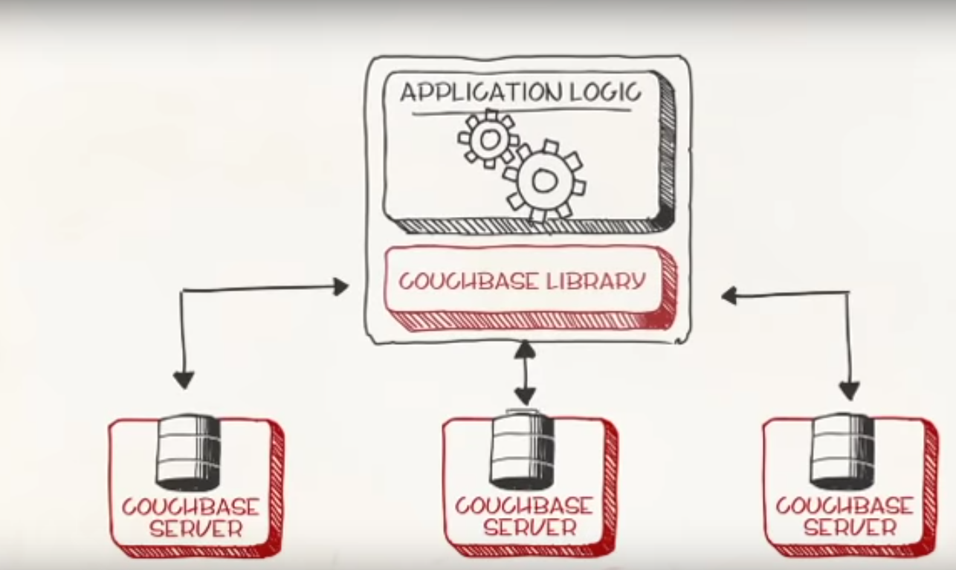
Data Model
Couchbase is where the medical records of the users are stored.
MEDIBASE
Node maintained by hospital

Slide 6
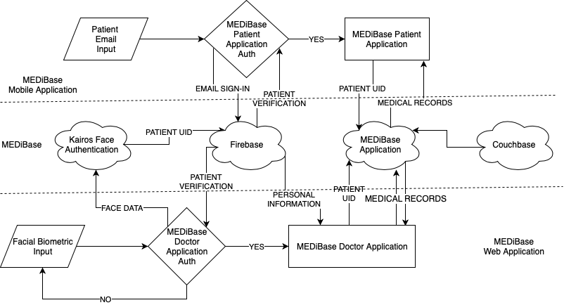
Architecture

Slide 7
Motivation for this architecture
Storing all the patient records of all the hospitals in one centralised data storage is infeasible.
Patient records are highly sensitive data and hospitals will be reluctant to share them to another storage out of their control.
Each hospital will be a node in the couchbase architecture, hosting their own database with patient records
Only on patient authentication will the data be retrieved from the nodes.

Slide 8
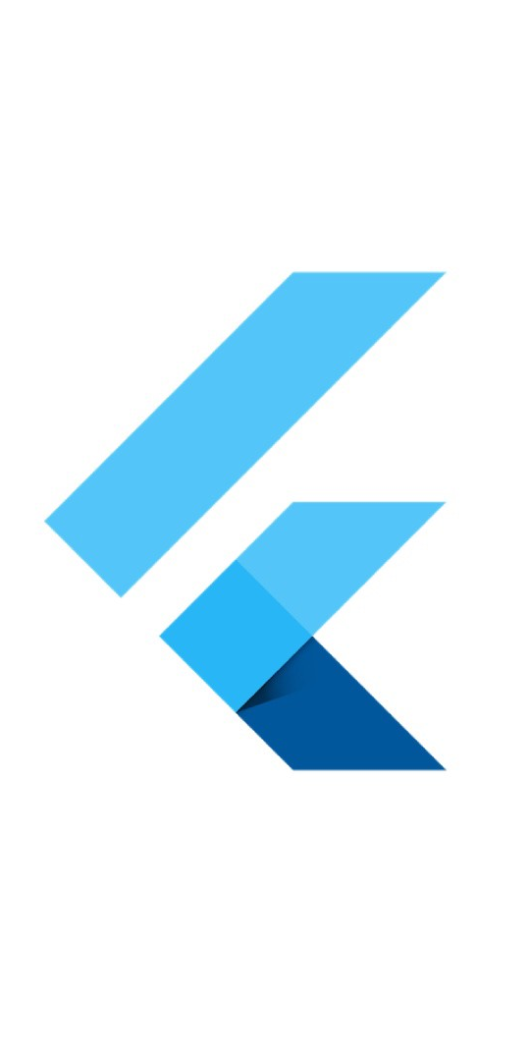
Mobile Application
The Mobile application is made with flutter. A cross platform mobile application framework.
Designed only for patient use.
Provides useful information to patient about their past medical records
Primarily built for patient convenience and ease of access of records.

Slide 9
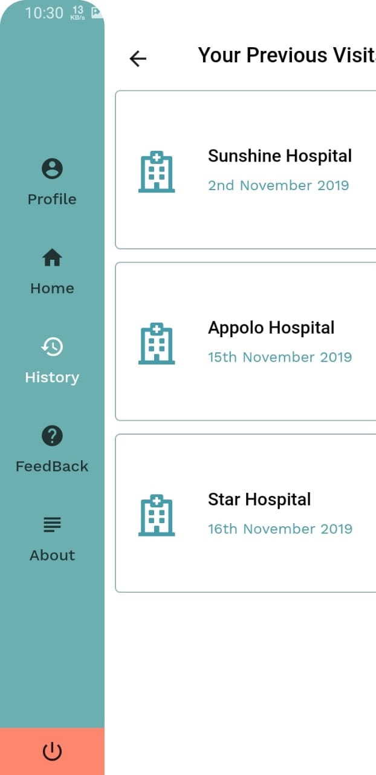
Medical History
The patients can access their entire medical records since the time they started using Medibase.
Allows for a clear view of all the hospitals they visited and the displays the diagnosis given at each instant.

Slide 10
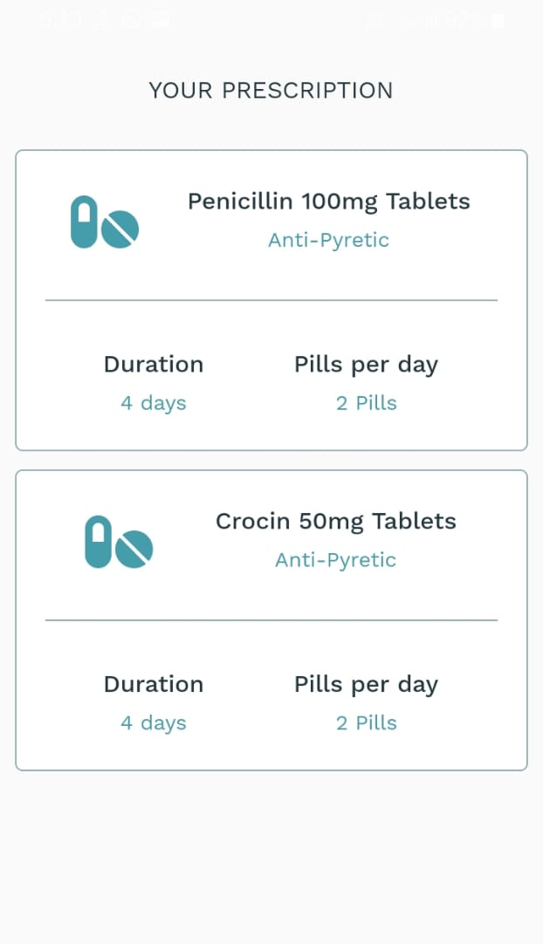
Prescriptions
It further provides a useful interface for patients to check their current and past prescription in an instant .
A clear Interface for information about important medication.

Slide 11

Web Application
The website was built using Angular.
Designed only for institutes use.
Provides all the historical medical records of the patient to the institute.
Primarily built for institute’s convenience to add or read the records.

Slide 12
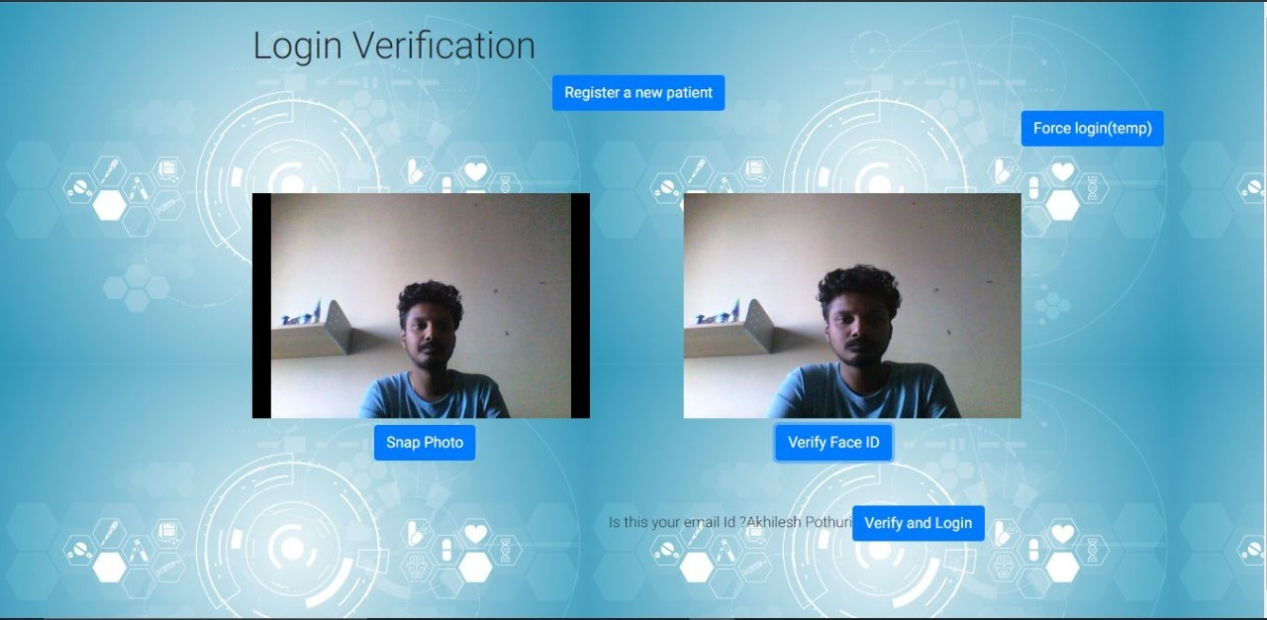
Face Authentication
The patients are logged in using a biometric authorisation service.
We have used Kairos to perform this task.

Slide 13
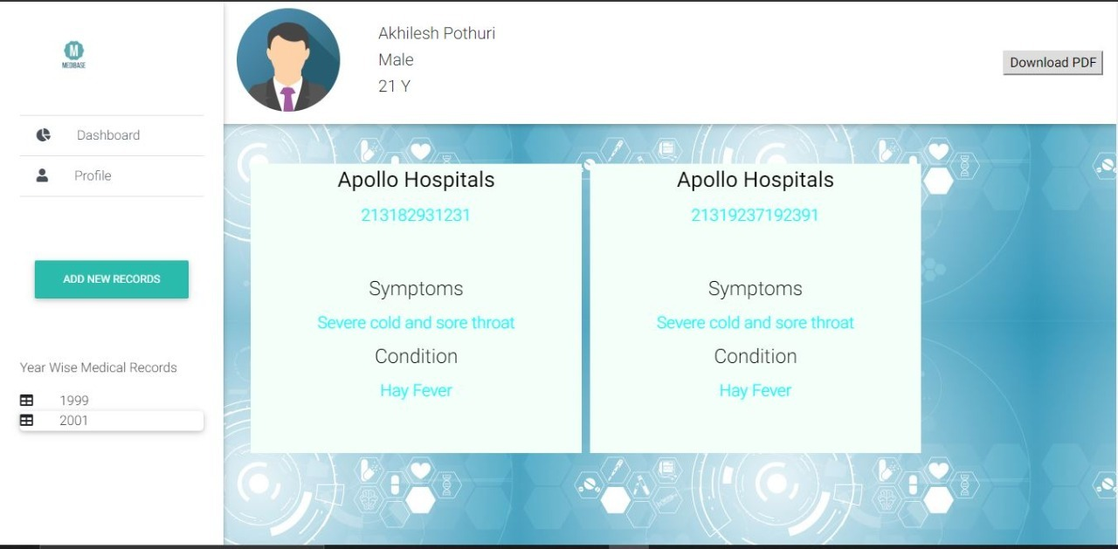
A Doctor’s View
Once the patient gives access to his/her records the doctors can view and access their records.
Once the diagnosis is completed the doctor will update the details of the diagnosis

Slide 14
WEBSITE VS MOBILE APPLICATION
The website application is built for the doctors to access patient’s medical records when required, with the consent of the patient. Verification of both the doctor and the patient will be required to access the medical records. Doctors will be able to print the patient’s medical history for a better understanding of the patient’s condition and new medical records, prescriptions for the patient. New Patient registration can only be done in the website application.
The android application is specifically designed for the patient usage. This may only cater the needs of the population who have a smartphone, but is very useful for patients who do have this facility. Patients can login using their email id mentioned during registration.

Slide 15
Summing Up

Slide 16
LOGIN AND AUTHENTICATION TECHNIQUES
Website:
Two factor authentication.
The login privileges for the web application are only provided to certified medical institutes and doctors.
The doctor can access the website only when the patient verification is done.
Flutter:
We have used google sign in for a quick login.
If the user is not registered, the mobile app will prompt a null screen and request the user to register through the institute for integrity in the details section.

Slide 17
2. DATA STORAGE TECHNIQUES
Hybrid data storage technique used.
Centralised storage system: Firebase-
Cannot store all medical data at a single place as it leads to bottleneck issues and issues related to the security of the data.
Chosen Firebase to store personal information and low sensitive data
Distributed storage system: Couchbase-
Couchbase is a distributed document based NoSQL database.
The records and other medical details of the patients are stored in couchbase.
We have separated the personal information, and the medical data in two different databases so as to ensure data security.

Slide 18
Novelty
MEDiBase is the first of a kind application focused for all categories and kinds of people in the world. This application is mainly focused for people who are living outside the cities where the technological knowledge among people is mediocre or even less. This application even stands out among its competitors based on the fact that it uses both centralised and decentralised database for storage of the data, thus taking advantage of both kinds of storage. This application even ensures the uniqueness of data by employing biometrics which is unique for each patient.

Slide 19
Future Scope
Use Two-phase biometric authentication
Appointments and Reminders
SMS System for patients with keypad phone
Website application for patients
Blockchain Technology for Safe Transactions

Slide 20
Work distribution
Hari Sai Raghuram Backend
Rithvik Sallaram Mobile Application
Akhilesh Pothuri Web Application

