Slide 1
DRIVER DROWSINESS DETECTION
By:
K. Samuel - 17BD1A054R Ande Yashwanth - 17BD1A0544
Ketan Jain - 17BD1A054T
K. Anirudh - 17BD1A054J
Mentor:V. Archana Reddy

Slide 2
CONTENTS
Abstract
Introduction
Existing System
Proposed System
System Requirements
Flow Diagram
Literature Survey

Slide 3
ABSTRACT
Nowadays, more and more professions require long-term concentration. Drivers must keep a close eye on the road, so they can react to sudden events immediately.
Drowsiness and Fatigue of drivers are amongst the significant causes of road accidents. Every year, they increase the amounts of deaths and fatalities injuries globally.
So we design a system that deals with automatic driver drowsiness detection based on visual information and Artificial Intelligence which locate, track, and analyze both the drivers face and eyes .
The system measures the drowsiness associated with extended eye closure and alerts the driver with a beep sound if he closes the eyes for a long time and also start recording the video and send it to the an emergency contact as email in order to notify about the situation ..

Slide 4
INTRODUCTION
Drowsiness is simply defined as “a state of near sleep due to fatigue”.
It is technically distinct from fatigue, which has been defined as a “disinclination to continue performing the task at hand”.
The effects of sleepiness and fatigue are very much the same.
Sleepiness slows reaction time, decreases awareness, and impairs judgment.
In both conditions, driver can’t focus on primary task of driving which may enhance the likelihood of crash occurrence.
With the ever-growing traffic conditions, this problem will further deteriorate.
For this reason, it is necessary to develop driver alertness system for accident prevention due to Driver Drowsiness.

Slide 5
Methods Used for Detecting Drowsiness
One solution to this serious problem is the development of an intelligent vehicle that can predict driver drowsiness and prevent drowsy driving.
When drowsiness is detected while driving, audible sound , vibrations, or warning messages on a display are generally used to warn the driver to concentrate on driving or to take a rest.
These methods help the drowsy driver to prevent drowsiness-related crashes in a moment, but it is hard to get rid of drowsiness by just being aware of it.

Slide 6
Computer vision techniques to detect the changes in driver’s facial expressions .
Computer vision method to detect driver drowsiness based on detecting eyelid closing and opening using artificial neural networks as classification algorithm.
Here we generally have two techniques, which are:
Face tracking system must be robust to head movement, rotation, pose variation and illumination changes.
Eye detection which locates the position of eye is difficult task due to many factors such as lighting condition, expression, facial shadowing, etc.

Slide 7
EXISTING SYSTEM
Existing systems uses iris sensor for the drowsiness of the driving force.
A complex distributed sensors model that's particularly suitable for measuring blink of the driving force , accident and hand position on a wheel .
These sensors are often utilized in automotive active safety systems that aim at detecting driver’s fatigue, a serious issue to stop road accidents.
The key point of this approach is to style a prototype of sensor units, in order that it can function platform for integrating different sorts of sensors into the wheel .

Slide 8
Drawbacks
The hardware required here is more.
Installation and maintenance is expensive.
The system if fails in one way, there is no other alternate to alert the driver and this may worsen the situation even more.

Slide 9
PROPOSED SYSTEM
The proposed system uses deep learning for the analysis of whether eye is open or closed.
The algorithm used for the analysis of this is Convolution Neural Network (CNN).
The dataset is taken for the analysis of whether the eye is closed or open.
The dataset is used for the training of the machine.
The webcam takes the images of the driver.
The taken images are compared with the already trained images for the alerting purpose.
If the driver is in a drowsy state, a beep sound is a used to alert the driver and also the drowsy state of the driver is recorded and send to an emergency contact and legal authorities through email .

Slide 10
Advantages
Hardware required is less.
Cost effective.
The notification alert system will help reduce the accident cases that are caused due to drowsiness.

Slide 11
SYSTEM REQUIREMENTS
Hardware Requirements
Webcam
Speaker
Raspberry Pi
Software Requirements
Windows 10- Operating System (8gb RAM , 2TB hard disk).
Python - High level programming language.
OpenCV - Used for face and eye detection.
Keras - Used to build our classification model.
Pygame - This module is used to play alarm sound.

Slide 12
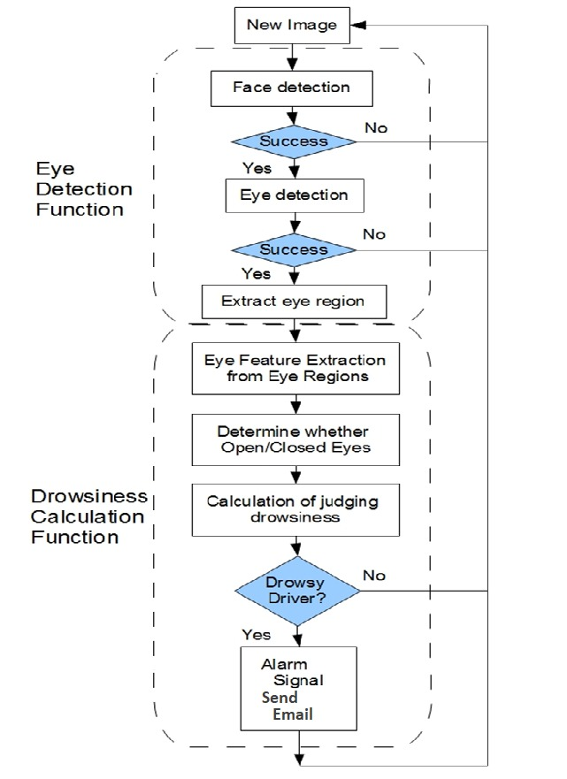
FLOW DIAGRAM

Slide 13
LITERATURE SURVEY
In Jan, 2019, Wisaroot Tipprasert , Theekapun charoenpong, chamaporn sukjamsri , Charoenpong , Chamaporn proposed a complex distributed sensors model that's particularly suitable for measuring blink of the driving force , accident and hand position on a wheel .
These sensors are often utilized in automotive active safety systems that aim at detecting driver’s fatigue, a serious issue to stop road accidents.
The key point of this approach is to style a prototype of sensor units, in order that it can function platform for integrating different sorts of sensors into the wheel .
The wheel is slowed or stopped counting on the condition.

Slide 14
In November, 2019, Anirban Dasgupta , Daleef Rahman , Aurobin da Routray described a smartphone- based drowsiness detection and warning system for automotive drivers.
They proposed that measures of the driver’s eyes are capable to detect drowsiness under simulator or experiment conditions.
Here the problem with this system is that,it is a mobile based application and if the driver doesn’t have a mobile or if it is switched off then system will be of no use .

Slide 15
THANK YOU

