Slide 1
DRIVER DROWSINESS DETECTION
Mentor: V. Archana Reddy
By:
K. Samuel - 17BD1A054R
Ande Yashwanth - 17BD1A0544
Ketan Jain - 17BD1A054T
K. Anirudh - 17BD1A054J

Slide 2
CONTENTS
USE CASE DIAGRAM
CLASS DIAGRAM
SEQUENCE DIAGRAM
COLLABORATION DIAGRAM
OBJECT DIAGRAM
COMPONENT DIAGRAM
FINAL OUTPUT

Slide 3
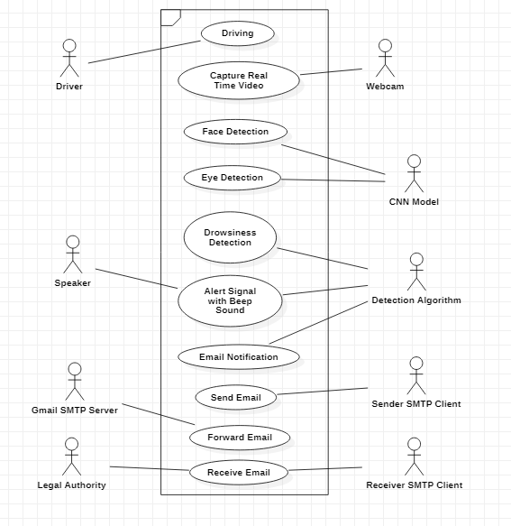
USE CASE DIAGRAM

Slide 4
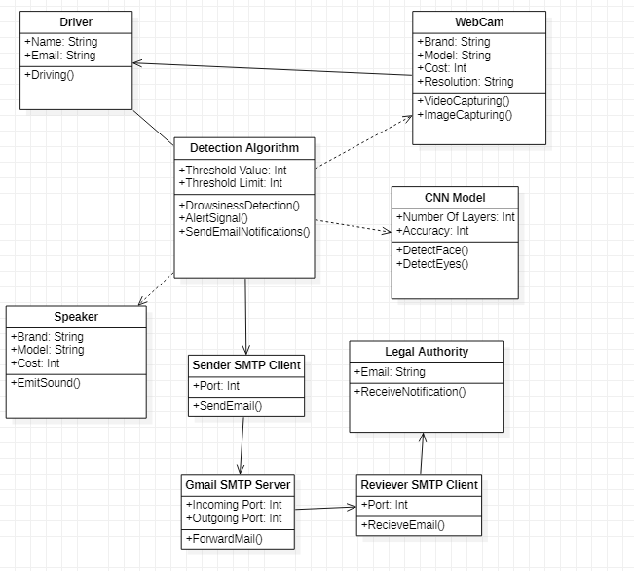
CLASS DIAGRAM

Slide 5
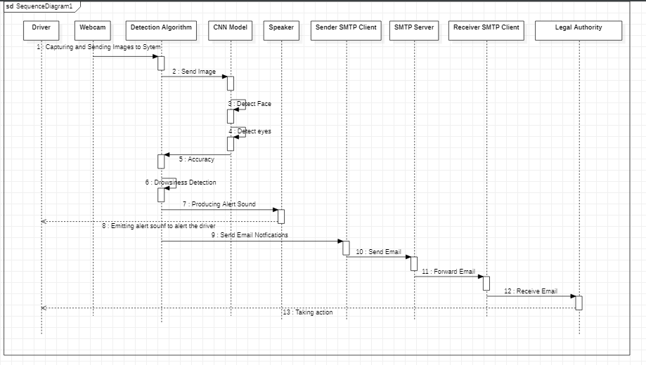
SEQUENCE DIAGRAM

Slide 6
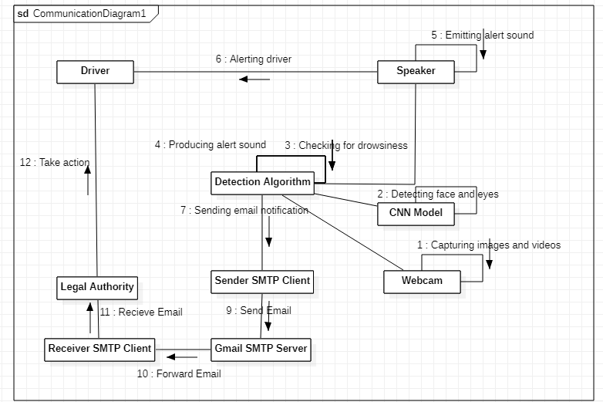
COLLABORATION DIAGRAM

Slide 7
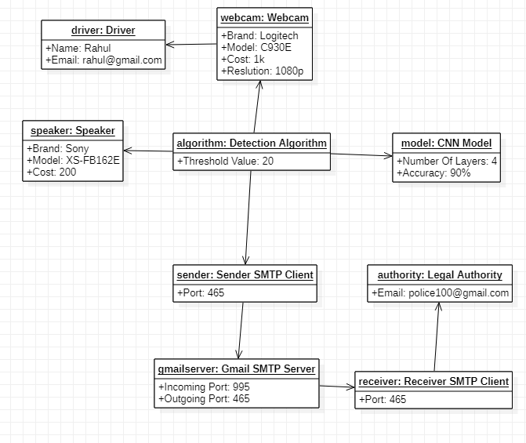
OBJECT DIAGRAM

Slide 8
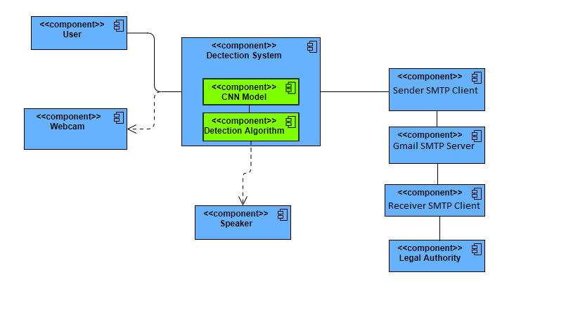
COMPONENT DIAGRAM

Slide 9
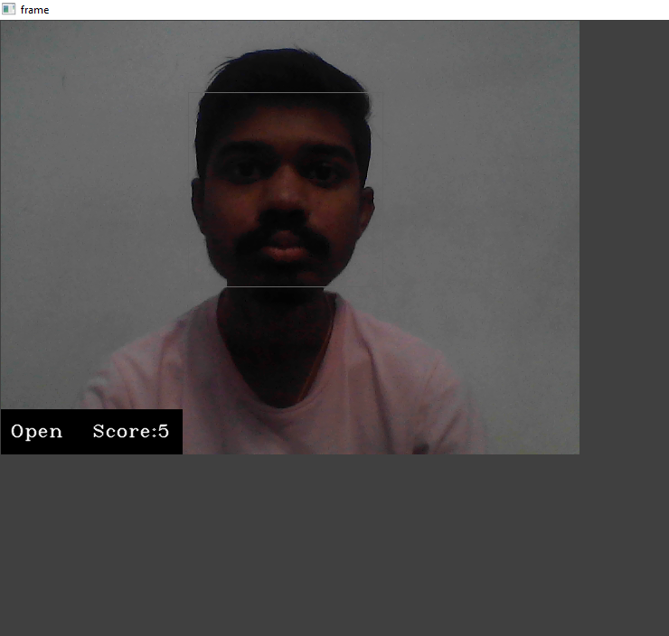
FINAL OUTPUT
Normal State

Slide 10
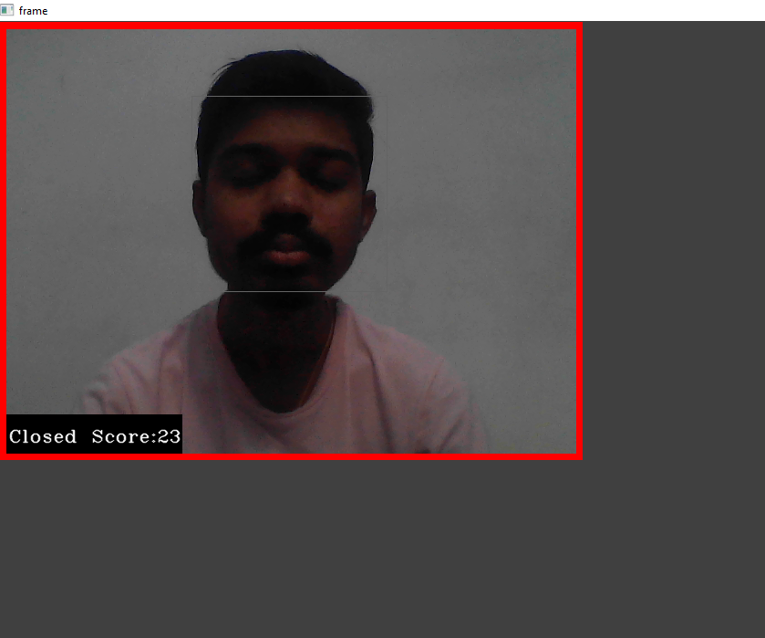
Drowsy State

Slide 11
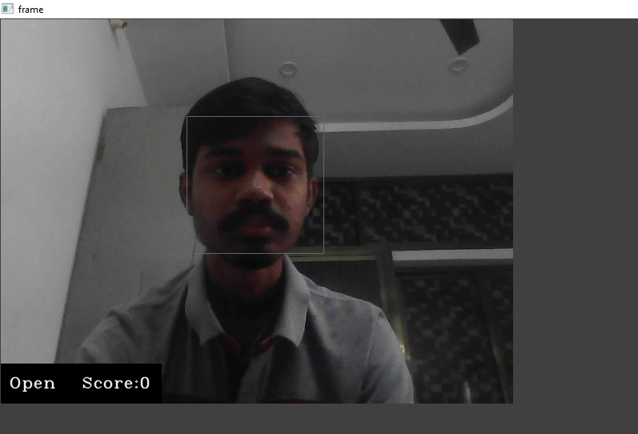

Slide 12
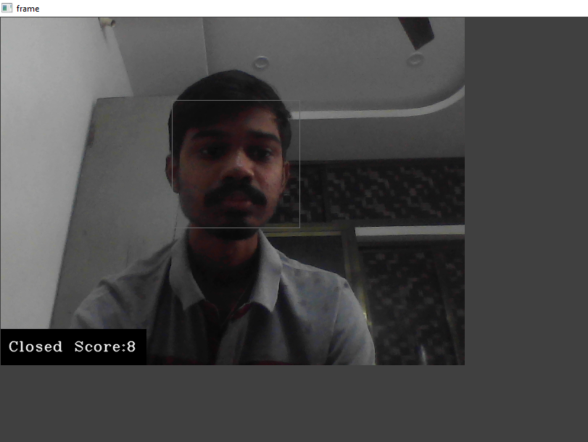

Slide 13
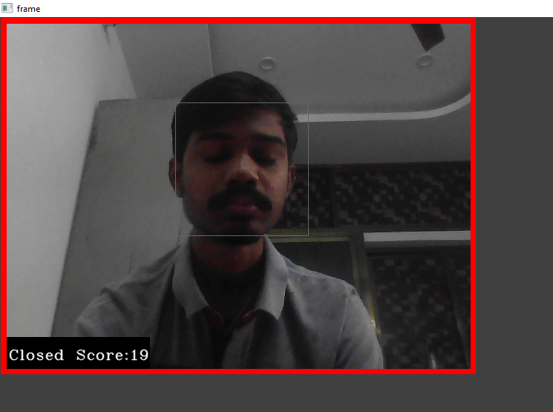

Slide 14
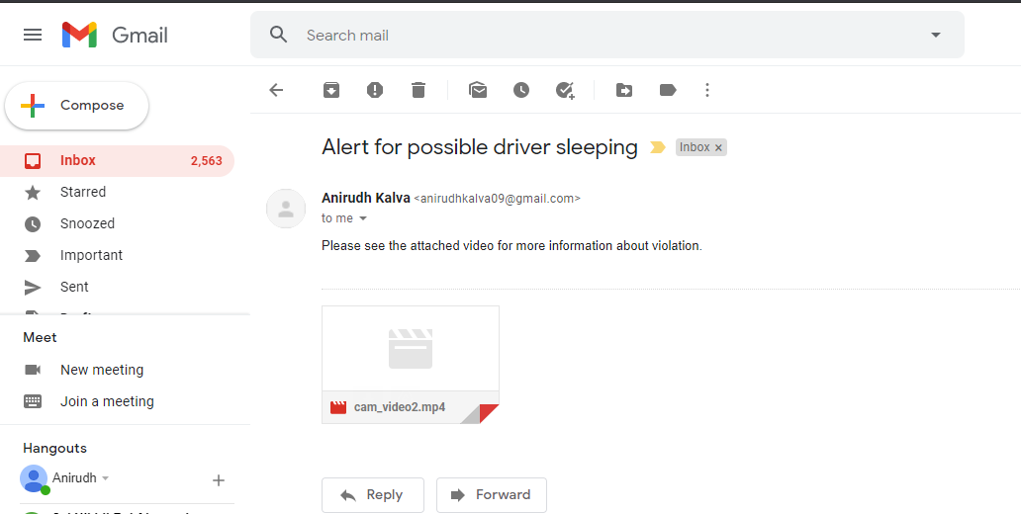
Email Notification

Slide 15
THANK YOU

