Slide 1
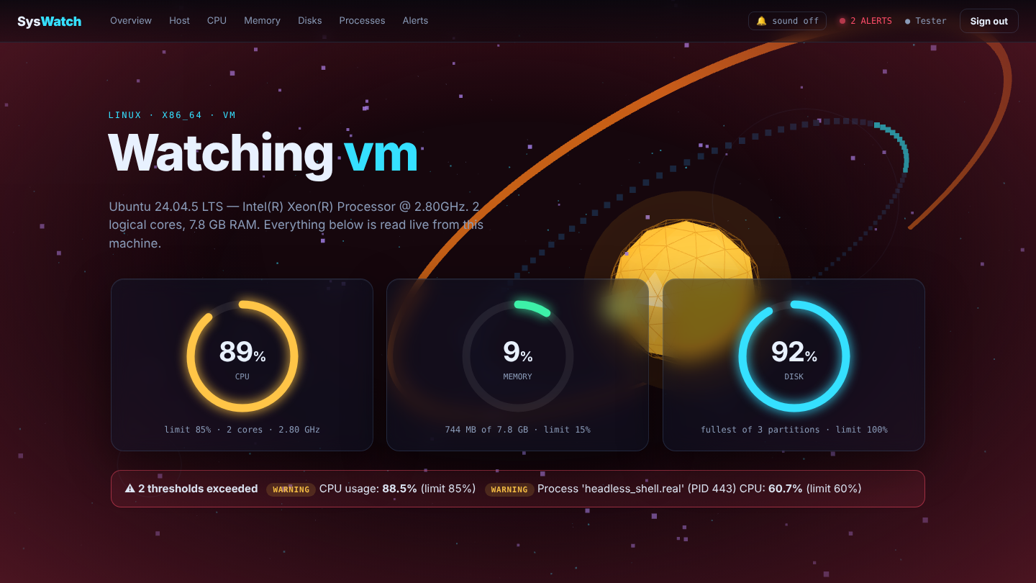
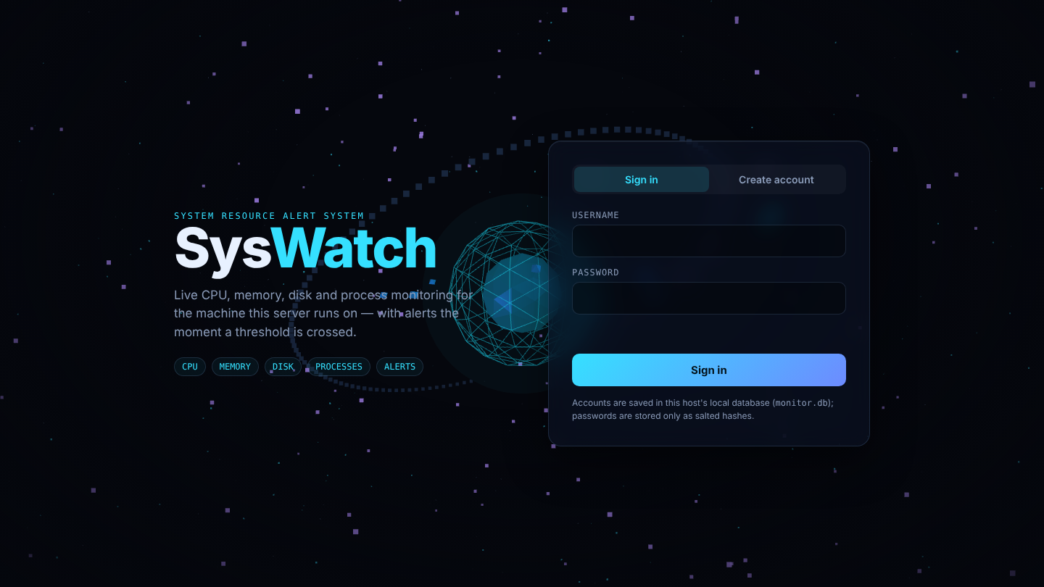
SysWatch
System Resource Alert & Notification System: a 3D interactive monitor for CPU, memory, disk and process usage
TEAM
FACULTY GUIDE
2520090024 S. Raghuram Reddy
2520090045 M. Prem Manikanta Reddy
2520090025 D. Nikhil Krishna
D Alekhya
Notes:
Introduce the team and faculty guide. SysWatch is a web-based system resource monitor that raises alerts when CPU, memory, disk or process usage crosses a threshold. It runs on the host machine and adapts to whatever system it is installed on.

Slide 2




Problem statement
Resource exhaustion rarely announces itself. By the time a server freezes or a disk fills, users are already affected.
Nobody is watching
No early warning
Tied to one OS
Heavy alternatives
Built-in tools such as Task Manager or top only help while someone has them open. Overload at 3 AM goes unnoticed.
Raw numbers are shown without limits. There is no alert when CPU, memory or disk crosses a safe level.
Each operating system has different tools and different views, so monitoring is inconsistent across machines.
Enterprise monitoring suites need agents, servers and licences. That is too much for a lab, a lab PC or a small team.
Our answer: a lightweight monitor that watches the host continuously, alerts the moment a threshold is crossed, and works on any machine it is installed on.
Notes:
Systems fail slowly and silently. Task Manager / top only show numbers if someone is looking. We want the system to tell the administrator, not the other way round.

Slide 3




Objectives and scope
Monitor
Alert
Track CPU (total and per core), memory and swap, every disk partition, and running processes in real time.
Generate warning and critical alerts when user-defined thresholds are exceeded, then log them and notify instantly.
Adapt to the host
Secure access
When deployed on another machine, show that machine's own OS, hardware, cores, disks and sensors automatically.
A login page protects the dashboard. Accounts are stored in the host's own database with salted password hashes.
Plus: an interactive 3D parallax interface so the machine's health can be felt at a glance, not just read.
Notes:
Four goals taken straight from the project brief: track the four resource types, alert on thresholds, adapt to the host, and require login with credentials stored on the host database.

Slide 4
System design: architecture
1 Host machine
2 Sampler thread
3 Alert engine
Any OS: Windows, macOS, Linux. CPU, RAM, disks, processes, network, sensors read through psutil.
Background thread takes a snapshot every 2 seconds and keeps the last 60 points for the live chart.
Compares each metric with its threshold, sets severity, applies a 60 s cooldown, logs recovery.
alerts stored
6 Browser UI
5 Flask REST API
4 SQLite database
Login page, Three.js 3D scene, live dashboard, toasts, optional sound and desktop notifications.
Session-cookie login. /api/system, /api/metrics, /api/thresholds and more. All data routes need login.
monitor.db on the host: users (hashed passwords), alerts log, threshold settings.
JSON over HTTP, polled every 2 s
live snapshot is read from memory, history from the DB
Notes:
Walk the diagram as a loop. Top row: the host is sampled every two seconds and evaluated against thresholds. Bottom row, right to left: alerts and settings live in SQLite, Flask serves them over an authenticated REST API, and the browser renders them as gauges, charts and a 3D scene.

Slide 5
System design: data model and alert logic
DATABASE TABLES
ALERT PIPELINE
users
1
Sample
psutil snapshot every 2 s
id, username (unique), password_hash, created_at, last_login
2
Compare
value >= threshold ?
alerts
id, ts, level, metric, value, threshold, message (latest 500 kept)
3
Severity
warning, or critical past the midpoint to 100%
settings
4
Cooldown
same alert at most once per 60 s
key, value: six thresholds and the session secret key
5
Notify and log
DB row, banner, toast, 3D scene turns red
WHAT IS CHECKED
Total CPU | Memory | every disk partition | process count | busiest process by CPU | busiest process by memory
6
Recover
info entry when value drops back below
Example: with CPU limit 85%, a reading of 89% is a warning; 93% or higher is critical.
Notes:
Three small tables. The alert engine is the core idea: severity is based on how far past the threshold a value is, and the cooldown stops the log from flooding while a problem persists.

Slide 6




Implementation approach
STEP 1
STEP 2
STEP 3
STEP 4
STEP 5
Collect
Evaluate
Authenticate
Serve
Visualize
psutil sampler thread reads CPU, memory, disks, processes and network, then primes counters so the first reading is accurate.
Alert engine applies thresholds, severity and cooldown. Alerts are written to SQLite.
Register and login routes. Passwords hashed with PBKDF2-SHA256 and salt. Sessions via signed cookie.
Flask JSON API. Input is validated, thresholds range-checked, data routes locked behind login.
Three.js scene plus dashboard. Mouse and scroll drive the parallax; metrics drive the 3D objects.
Key decisions: a single Python file for the backend, one self-contained HTML page for the UI, and Three.js bundled locally so it runs even without internet.
Notes:
We built bottom-up: first the data collection, then alerting, then accounts, then the API, and finally the interface. Each stage was testable on its own before the next was added.

Slide 7
Adapts to whichever system it runs on
DETECTED ON STARTUP
Hostname, OS name and version, kernel, architecture
CPU model, physical and logical cores, max clock
RAM size, swap or page file
Every mounted disk partition
IP addresses and network traffic
Signed-in users, uptime
Feature | Linux | macOS | Windows
CPU, memory, disk, processes | Yes | Yes | Yes
Load average | Yes | Yes | Hidden
Temperature sensors | If exposed | Hidden | Hidden
Battery | If present | If present | If present
Swap label | Swap | Swap | Page file
Each logical CPU core becomes one orbiting node in the 3D scene, so an 8-core laptop and a 64-core server look different.
The UI shows or hides each panel automatically. Tested on Ubuntu 24.04.
Notes:
This is the 'runs on another system' requirement. Nothing about the machine is hard-coded. On startup the server asks the OS what it has, and the interface only shows what exists. Verified on Linux; the Windows and macOS branches follow psutil and Python platform support.

Slide 8



The 3D parallax interface
Glowing core
CPU load: spins faster and shifts cyan to amber to red
Orbiting nodes
One per CPU core, sized by that core's usage
Dotted ring
Memory: fraction of dots lit equals RAM used
Outer arc
Disk: arc length equals fullest partition
Whole scene tints red while any alert is active. Mouse, scroll and card tilt create the depth effect.
Notes:
Every 3D object is bound to a real metric, so the scene is a live visualization, not decoration. Parallax comes from three star layers moving at different speeds with the mouse, plus a camera that flies through the scene as you scroll.

Slide 9








Technologies used
Python 3
Flask
psutil
SQLite
Backend language, threads for sampling
Web server, REST API, sessions
Cross-platform CPU, RAM, disk, process data
Embedded database for users, alerts, settings
Werkzeug security
Three.js (WebGL)
HTML, CSS, JS
Playwright
PBKDF2-SHA256 salted password hashing
3D scene, particles, parallax camera
Canvas charts, SVG gauges, glass UI
Browser and API test automation (with requests)
Notes:
Everything is open source and installs with pip. The only runtime dependencies are Flask and psutil.

Slide 10





Testing
Authentication
Short or invalid usernames, weak passwords, duplicate accounts, wrong password, session persistence, logout
8 checks
TEST BED
Ubuntu 24.04 LTS
2 vCPU, 7.8 GB RAM
Python 3, Flask, psutil
Headless Chromium (Playwright)
Method
Black-box HTTP tests plus real CPU and memory load, then a full UI walk-through with screenshots.
Security
Hashed password in DB, data routes return 401 when signed out, bad thresholds rejected
6 checks
Accuracy
Memory, process count and host info compared with psutil read independently
3 checks
Alerting
Real CPU stress, real memory allocation, cooldown, recovery, DB persistence
7 checks
Performance
100 consecutive API calls timed, server CPU and RAM sampled
3 checks
Notes:
27 automated checks plus a browser run. Importantly, alerts were tested with real load: busy-loop processes for CPU and a real memory allocation, not mocked values.

Slide 11
Results: measured performance
27/27
2.3 ms
3.6 s
2.5 s
automated checks passed
average API response (p95 2.9 ms)
CPU overload to alert, 100% load
memory breach to alert
Footprint of the monitor itself
0.2% CPU while sampling every 2 s
38 MB of RAM for the whole server
All alerts persisted to the DB and cleared on recovery
Memory and process counts matched psutil exactly
Notes:
All numbers measured on the test bed. 27 of 27 checks pass. The first full run had two failing checks which were caused by the test itself: memory was 6 percent and the lowest allowed threshold is 10 percent. After allocating real memory in the test, both passed. Alerts arrive within about one sampling interval plus network time.

Slide 12
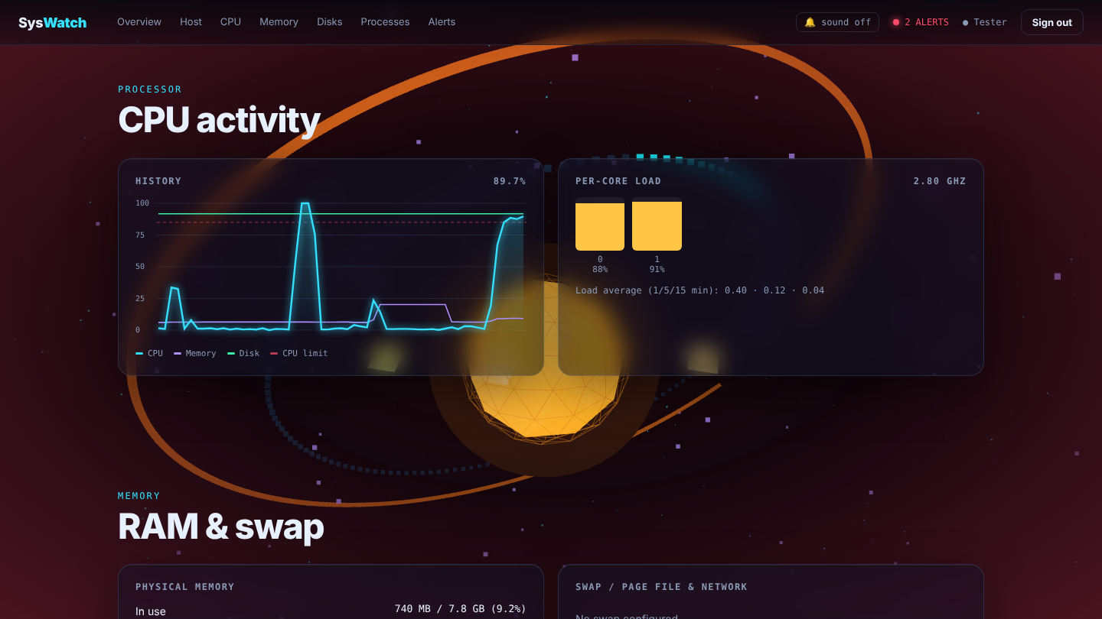
Results: live system view
Alert banner and 3D scene react at once
History, per-core load and load average
Gauges turn amber past the limit, the banner names the metric, value and threshold, and the core glows with load.
The spike from our stress test is visible, both cores hit 88 to 91 percent, and alerts fell back after the load stopped.
Notes:
Left: live gauges and the alert banner during a CPU stress run. The core glows amber and the scene tints red. Right: the CPU history chart shows the spike we generated and the dashed line is the CPU threshold. Bottom: alert log and editable thresholds.

Slide 13




Impact
From reactive to proactive
One tool, any machine
Problems are flagged within seconds of crossing a limit, before users notice slowdowns or crashes.
The same code reports the real hardware and OS of whichever Windows, macOS or Linux host it runs on.
Light and low-cost
Clear and engaging
0.2% CPU and 38 MB of RAM. No agents, cloud account or licence: pip install and run.
The 3D view makes system health intuitive, which helps students and non-experts understand resources.
Fits labs, small servers, home PCs and classrooms where a full monitoring suite is overkill.
Notes:
Frame impact for three audiences: the person running the machine, the team or institution, and learners. Be honest that this is a lightweight tool, not a replacement for enterprise monitoring.

Slide 14
Conclusion and future scope
WHAT WE DELIVERED
WHAT COMES NEXT
Live monitoring of CPU, memory, disk and processes
Threshold alerts with severity, cooldown and recovery
Login with accounts stored in the host database
Interface that adapts to the host and shows real 3D health
27 of 27 tests passed, alerts in under 4 seconds
Email, SMS and Telegram alert delivery
Monitor many machines from one dashboard
Predict trends, such as when a disk will fill
HTTPS, production server and role-based access
Verify on Windows and macOS hosts
Docker image for one-command install
Notes:
Summarize: all requirements met. Then be upfront about limits: it was verified on Linux, runs on Flask's development server, and needs HTTPS and a production server for internet exposure. Future scope is realistic next steps.

Slide 15

Thank you
Questions and live demo
2520090024 S. Raghuram Reddy
2520090045 M. Prem Manikanta Reddy
2520090025 D. Nikhil Krishna
Faculty guide: D Alekhya
Notes:
Invite questions. Offer to run the live demo: open the app, register, show the dashboard and trigger an alert by lowering a threshold.

