Slide 1
Context-free grammars

Slide 2
Roadmap
Last time
Regex == DFA
JLex for generating Lexers
This time
CFGs, the underlying abstraction for Parsers

Slide 3
RegExs Are Great!
Perfect for tokenizing a language
They do have some limitations
Limited class of language that cannot specify all programming constructs we need
No notion of structure
Let’s explore both of these issues

Slide 4
Limitations of RegExs
Cannot handle “matching”
Eg: language of balanced parentheses
L = { (^{x})^{x} where x > 1}
cannot be matched
Intuition:
An FSM can only handle a finite depth of
parentheses that we can handle
let’s see a diagram…

Slide 5
Limitations of RegExs: Balanced Parens
Assume F is an FSM that recognized L. Let N be the number of states in F’.
Feed N+1 left parens into N
By the pigeonhole principle, we must have revisited some state s on two input characters i and j.
By the definition of F, there must be a path from s to a final state. But this means that it accepts some suffix of closed parens at input i and j, but both cannot be correct
(
(
(
(
…

Slide 6
Limitations of RegEx: Structure
Our Enhanced-RegEx scanner can emit a stream of tokens:
X = Y + Z
… but this doesn’t really enforce any order of operations
ID
ASSIGN
ID
PLUS
ID

Slide 7
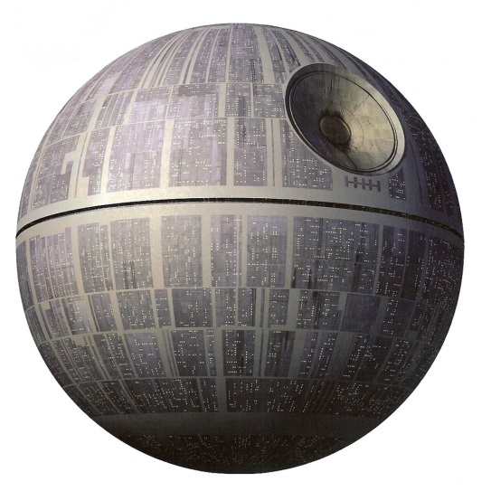
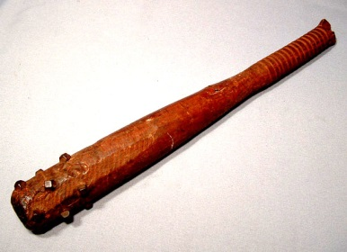
The Chomsky Hierarchy
LANGUAGE CLASS:
power
efficiency
Recursively enumerable
Context-Sensitive
Turing machine
Context-Free
Happy medium?
Regular
FSM
Noam
Chomsky

Slide 8
Context Free Grammars (CFGs)
A set of (recursive) rewriting rules to generate patterns of strings
Can envision a “parse tree” that keeps structure

Slide 9
CFG: Intuition
S → ( S )
A rule that says that you
can rewrite S to be an S surrounded by
a single set of parens
Before applying rule
After applying rule
S
S
CFGs recognize the language of
trees where all the leaves are terminals
(
S
)

Slide 10
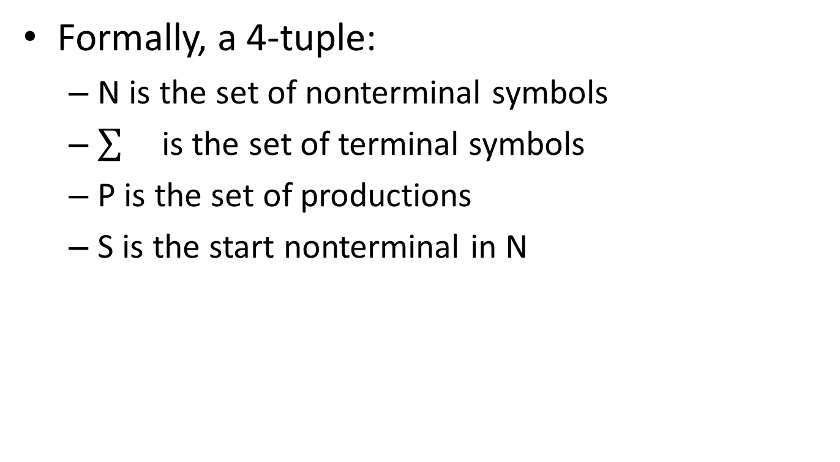
Context Free Grammars (CFGs)
Formally, a 4-tuple:
N is the set of nonterminal symbols
is the set of terminal symbols
P is the set of productions
S is the start nonterminal in N

Slide 11
Context Free Grammars (CFGs)
Placeholder / interior nodes
in the parse tree
Formally, a 4-tuple:
N is the set of nonterminal symbols
is the set of terminal symbols
P is the set of productions
S is the start nonterminal in N

Slide 12
Context Free Grammars (CFGs)
Placeholder / interior nodes
in the parse tree
Formally, a 4-tuple:
N is the set of nonterminal symbols
is the set of terminal symbols
P is the set of productions
S is the start nonterminal in N
Tokens from
scanner

Slide 13
Context Free Grammars (CFGs)
Placeholder / interior nodes
in the parse tree
Formally, a 4-tuple:
N is the set of nonterminal symbols
is the set of terminal symbols
P is the set of productions
S is the start nonterminal in N
Tokens from
scanner
Rules for deriving strings

Slide 14
Context Free Grammars (CFGs)
Placeholder / interior nodes
in the parse tree
Formally, a 4-tuple:
N is the set of nonterminal symbols
is the set of terminal symbols
P is the set of productions
S is the start nonterminal in N
Tokens from
scanner
Rules for deriving strings
If not otherwise specified, use the
non-terminal that appears on the LHS
of the first production as the start

Slide 15
Production Syntax
LHS → RHS
Expression: Sequence of
terminals and nonterminals
Single nonterminal symbol

Slide 16
Production Shorthand
Nonterm → expression
Nonterm→ ε
equivalently:
Nonterm → expression
| ε
equivalently:
Nonterm → expression | ε
Sequence of terms and nonterms

Slide 17
Derivations
To derive a string:
Start by setting “Current Sequence” to the start symbol
Repeat:
Find a Nonterminal X in the Current Sequence
Find a production of the form X→α
“Apply” the production: create a new “current sequence” in which α replaces X
Stop when there are no more nonterminals

Slide 18
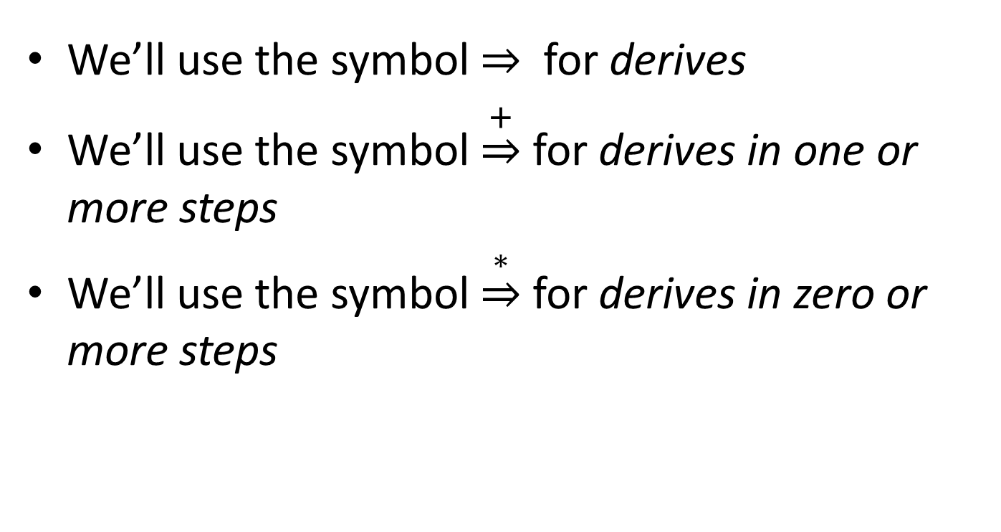
Derivation Syntax
We’ll use the symbol for derives
We’ll use the symbol $\underset{⇒}{+}$ for derives in one or more steps
We’ll use the symbol $\underset{⇒}{∗}$ for derives in zero or more steps

Slide 19
An Example Grammar

Slide 20
An Example Grammar
Terminals
begin
end
semicolon
assign
id
plus

Slide 21
An Example Grammar
For readability, bold and lowercase
Terminals
begin
end
semicolon
assign
id
plus

Slide 22
An Example Grammar
For readability, bold and lowercase
Terminals
begin
end
semicolon
assign
id
plus
Program
boundary

Slide 23
An Example Grammar
For readability, bold and lowercase
Terminals
begin
end
semicolon
assign
id
plus
Program
boundary
Represents “;”
Separates statements

Slide 24
An Example Grammar
For readability, bold and lowercase
Terminals
begin
end
semicolon
assign
id
plus
Program
boundary
Represents “;”
Separates statements
Represents “=“ statement

Slide 25
An Example Grammar
For readability, bold and lowercase
Terminals
begin
end
semicolon
assign
id
plus
Program
boundary
Represents “;”
Separates statements
Represents “=“ statement
Identifier / variable name

Slide 26
An Example Grammar
For readability, bold and lowercase
Terminals
begin
end
semicolon
assign
id
plus
Program
boundary
Represents “;”
Separates statements
Represents “=“ statement
Identifier / variable name
Represents “+“ expression

Slide 27
An Example Grammar
For readability, bold and lowercase
Terminals
begin
end
semicolon
assign
id
plus
Nonterminals
Prog
Stmts
Stmt
Expr

Slide 28
An Example Grammar
For readability, bold and lowercase
Terminals
begin
end
semicolon
assign
id
plus
For readability, Italics and UpperCamelCase
Nonterminals
Prog
Stmts
Stmt
Expr

Slide 29
An Example Grammar
For readability, bold and lowercase
Terminals
begin
end
semicolon
assign
id
plus
For readability, Italics and UpperCamelCase
Nonterminals
Prog
Stmts
Stmt
Expr
Root of the parse tree

Slide 30
An Example Grammar
For readability, bold and lowercase
Terminals
begin
end
semicolon
assign
id
plus
For readability, Italics and UpperCamelCase
Nonterminals
Prog
Stmts
Stmt
Expr
Root of the parse tree
List of statements

Slide 31
An Example Grammar
For readability, bold and lowercase
Terminals
begin
end
semicolon
assign
id
plus
For readability, Italics and UpperCamelCase
Nonterminals
Prog
Stmts
Stmt
Expr
Root of the parse tree
List of statements
A single statement

Slide 32
An Example Grammar
For readability, bold and lowercase
Terminals
begin
end
semicolon
assign
id
plus
For readability, Italics and UpperCamelCase
Nonterminals
Prog
Stmts
Stmt
Expr
Root of the parse tree
List of statements
A single statement
A mathematical expression

Slide 33
An Example Grammar
For readability, bold and lowercase
Terminals
begin
end
semicolon
assign
id
plus
Defines the syntax of legal programs
Productions
Prog → begin Stmts end
Stmts → Stmts semicolon Stmt
| Stmt
Stmt → id assign Expr
Expr → id
| Expr plus id
For readability, Italics and UpperCamelCase
Nonterminals
Prog
Stmts
Stmt
Expr

Slide 34
An Example Grammar
For readability, bold and lowercase
Terminals
begin
end
semicolon
assign
id
plus
Program
boundary
Defines the syntax of legal programs
Represents “;”
Separates statements
Productions
Prog → begin Stmts end
Stmts → Stmts semicolon Stmt
| Stmt
Stmt → id assign Expr
Expr → id
| Expr plus id
Represents “=“ statement
Identifier / variable name
Represents “+“ expression
For readability, Italics and UpperCamelCase
Nonterminals
Prog
Stmts
Stmt
Expr
Root of the parse tree
List of statements
A single statement
A mathematical expression

Slide 35
Productions
Prog → begin Stmts end
Stmts → Stmts semicolon Stmt
| Stmt
Stmt → id assign Expr
Expr → id
| Expr plus id

Slide 36
Productions
Prog → begin Stmts end
Stmts → Stmts semicolon Stmt
| Stmt
Stmt → id assign Expr
Expr → id
| Expr plus id
Derivation Sequence

Slide 37
Productions
Prog → begin Stmts end
Stmts → Stmts semicolon Stmt
| Stmt
Stmt → id assign Expr
Expr → id
| Expr plus id
Parse Tree
Derivation Sequence

Slide 38
Productions
Prog → begin Stmts end
Stmts → Stmts semicolon Stmt
| Stmt
Stmt → id assign Expr
Expr → id
| Expr plus id
Parse Tree
Derivation Sequence
Key
terminal
Nonterminal
Rule used

Slide 39
Productions
Prog → begin Stmts end
Stmts → Stmts semicolon Stmt
| Stmt
Stmt → id assign Expr
Expr → id
| Expr plus id
Parse Tree
Prog
Derivation Sequence
Prog
Key
terminal
Nonterminal
Rule used

Slide 40

Productions
Prog → begin Stmts end
Stmts → Stmts semicolon Stmt
| Stmt
Stmt → id assign Expr
Expr → id
| Expr plus id
Parse Tree
Prog
Derivation Sequence
Prog begin Stmts end
1
Key
terminal
Nonterminal
Rule used

Slide 41
Productions
Prog → begin Stmts end
Stmts → Stmts semicolon Stmt
| Stmt
Stmt → id assign Expr
Expr → id
| Expr plus id
Parse Tree
Prog
begin
Stmts
end
Derivation Sequence
Prog begin Stmts end
1
Key
terminal
Nonterminal
Rule used

Slide 42
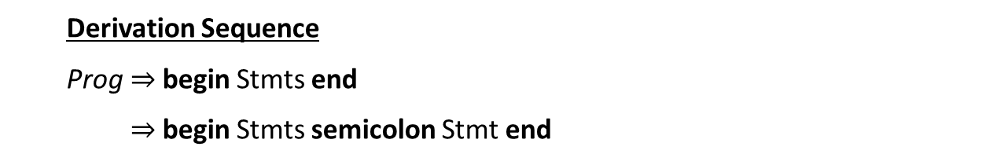
Productions
Prog → begin Stmts end
Stmts → Stmts semicolon Stmt
| Stmt
Stmt → id assign Expr
Expr → id
| Expr plus id
Parse Tree
Prog
begin
Stmts
end
Stmts
semicolon
Stmt
Derivation Sequence
Prog begin Stmts end
begin Stmts semicolon Stmt end
1
2
Key
terminal
Nonterminal
Rule used

Slide 43
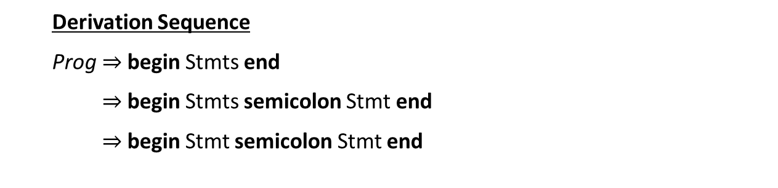
Productions
Prog → begin Stmts end
Stmts → Stmts semicolon Stmt
| Stmt
Stmt → id assign Expr
Expr → id
| Expr plus id
Parse Tree
Prog
begin
Stmts
end
Stmts
semicolon
Stmt
Stmt
Derivation Sequence
Prog begin Stmts end
begin Stmts semicolon Stmt end
begin Stmt semicolon Stmt end
1
2
Key
3
terminal
Nonterminal
Rule used

Slide 44
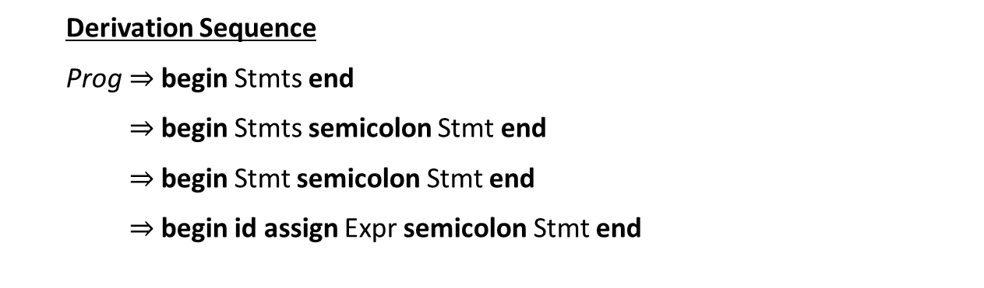
Productions
Prog → begin Stmts end
Stmts → Stmts semicolon Stmt
| Stmt
Stmt → id assign Expr
Expr → id
| Expr plus id
Parse Tree
Prog
begin
Stmts
end
Stmts
semicolon
Stmt
Stmt
Derivation Sequence
Prog begin Stmts end
begin Stmts semicolon Stmt end
begin Stmt semicolon Stmt end
begin id assign Expr semicolon Stmt end
id
assign
Expr
1
2
Key
3
4
terminal
Nonterminal
Rule used

Slide 45
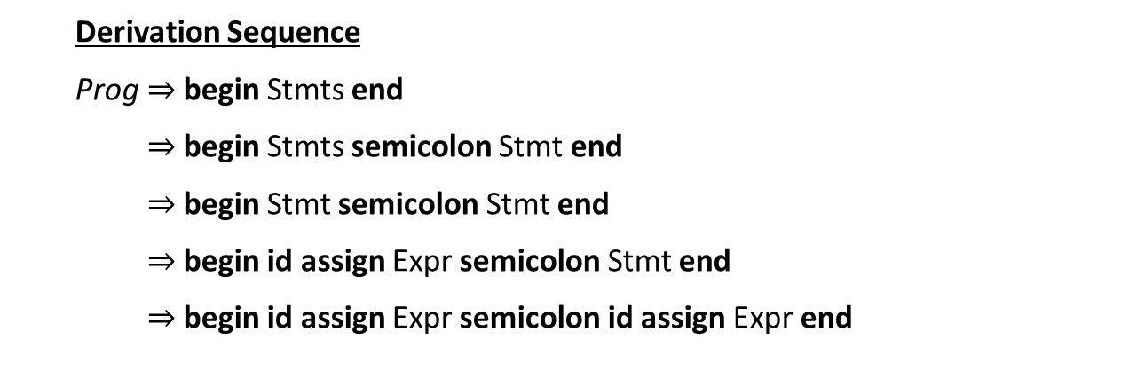
Productions
Prog → begin Stmts end
Stmts → Stmts semicolon Stmt
| Stmt
Stmt → id assign Expr
Expr → id
| Expr plus id
Parse Tree
Prog
begin
Stmts
end
Stmts
semicolon
Stmt
Stmt
id
assign
Expr
Derivation Sequence
Prog begin Stmts end
begin Stmts semicolon Stmt end
begin Stmt semicolon Stmt end
begin id assign Expr semicolon Stmt end
begin id assign Expr semicolon id assign Expr end
id
assign
Expr
1
2
Key
3
4
terminal
4
Nonterminal
Rule used

Slide 46
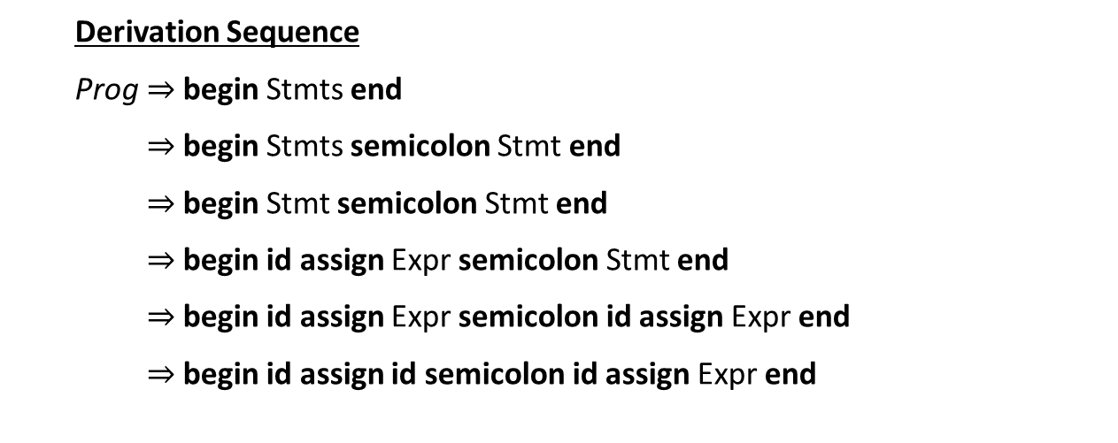
Productions
Prog → begin Stmts end
Stmts → Stmts semicolon Stmt
| Stmt
Stmt → id assign Expr
Expr → id
| Expr plus id
Parse Tree
Prog
begin
Stmts
end
Stmts
semicolon
Stmt
Stmt
id
assign
Expr
Derivation Sequence
Prog begin Stmts end
begin Stmts semicolon Stmt end
begin Stmt semicolon Stmt end
begin id assign Expr semicolon Stmt end
begin id assign Expr semicolon id assign Expr end
begin id assign id semicolon id assign Expr end
id
assign
Expr
1
2
id
Key
3
4
terminal
4
Nonterminal
5
Rule used

Slide 47
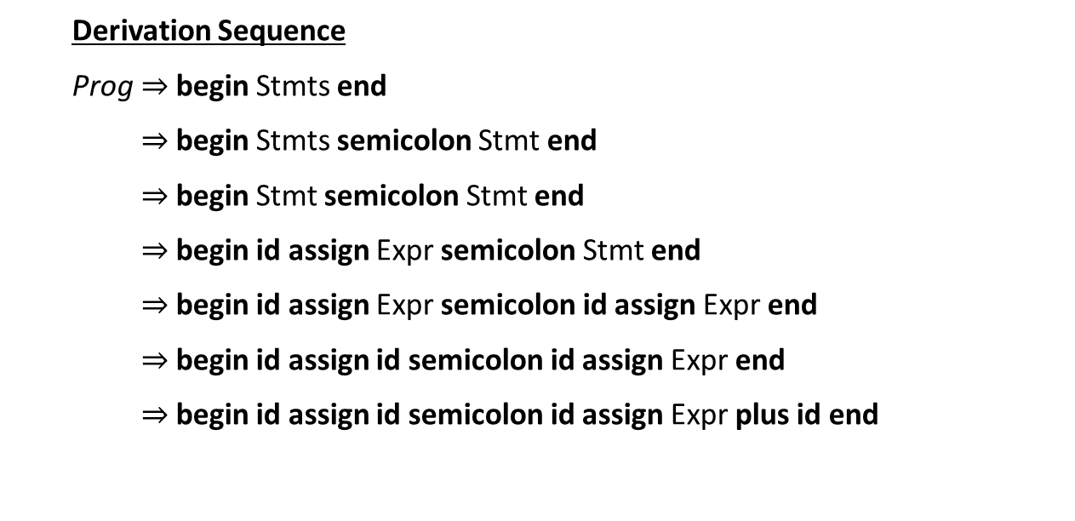
Productions
Prog → begin Stmts end
Stmts → Stmts semicolon Stmt
| Stmt
Stmt → id assign Expr
Expr → id
| Expr plus id
Parse Tree
Prog
begin
Stmts
end
Stmts
semicolon
Stmt
Stmt
id
assign
Expr
Derivation Sequence
Prog begin Stmts end
begin Stmts semicolon Stmt end
begin Stmt semicolon Stmt end
begin id assign Expr semicolon Stmt end
begin id assign Expr semicolon id assign Expr end
begin id assign id semicolon id assign Expr end
begin id assign id semicolon id assign Expr plus id end
id
assign
Expr
Expr
plus
id
1
2
id
Key
3
4
terminal
4
Nonterminal
5
Rule used
6

Slide 48
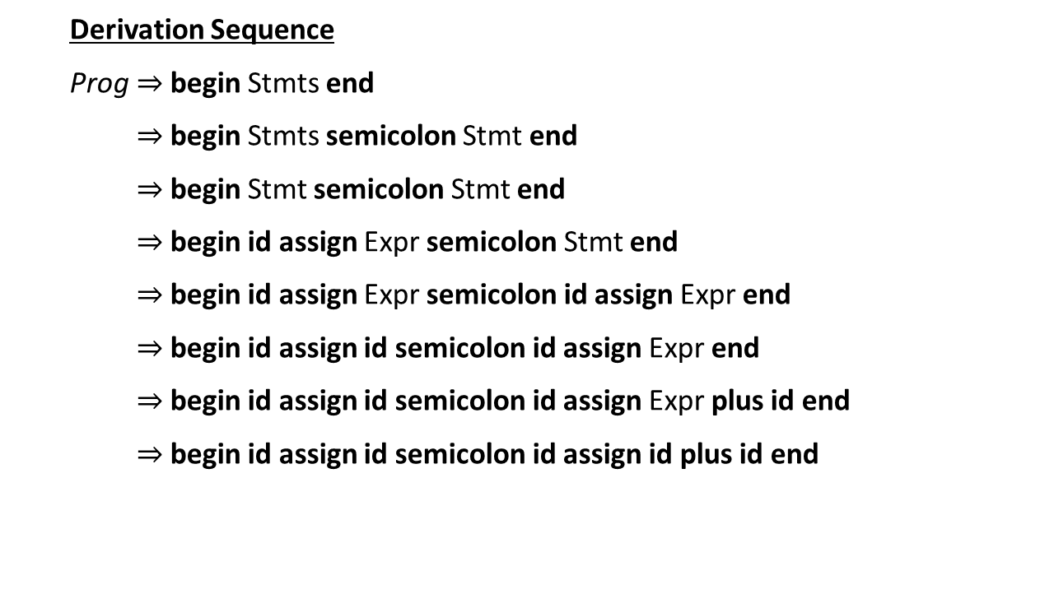
Productions
Prog → begin Stmts end
Stmts → Stmts semicolon Stmt
| Stmt
Stmt → id assign Expr
Expr → id
| Expr plus id
Parse Tree
Prog
begin
Stmts
end
Stmts
semicolon
Stmt
Stmt
id
assign
Expr
Derivation Sequence
Prog begin Stmts end
begin Stmts semicolon Stmt end
begin Stmt semicolon Stmt end
begin id assign Expr semicolon Stmt end
begin id assign Expr semicolon id assign Expr end
begin id assign id semicolon id assign Expr end
begin id assign id semicolon id assign Expr plus id end
begin id assign id semicolon id assign id plus id end
id
assign
Expr
Expr
plus
id
1
2
id
id
Key
3
4
terminal
4
Nonterminal
5
Rule used
6
5

Slide 49
Makefiles: Motivation
Typing the series of commands to generate our code can be tedious
Multiple steps that depend on each other
Somewhat complicated commands
May not need to rebuild everything
Makefiles solve these issues
Record a series of commands in a script-like DSL
Specify dependency rules and Make generates the results

Slide 50
Makefiles: Basic Structure
<target>: <dependency list>
<command to satisfy target>
Example
Example.class: Example.java IO.class
javac Example.java
IO.class: IO.java
javac IO.java
(tab)

Slide 51
Makefiles: Basic Structure
<target>: <dependency list>
<command to satisfy target>
Example
Example.class: Example.java IO.class
javac Example.java
IO.class: IO.java
javac IO.java
(tab)

Slide 52
Makefiles: Basic Structure
<target>: <dependency list>
<command to satisfy target>
Example
Example.class: Example.java IO.class
javac Example.java
IO.class: IO.java
javac IO.java
(tab)
Example.class depends on example.java and IO.class

Slide 53
Makefiles: Basic Structure
<target>: <dependency list>
<command to satisfy target>
Example
Example.class: Example.java IO.class
javac Example.java
IO.class: IO.java
javac IO.java
(tab)
Example.class depends on example.java and IO.class
Example.class is generated by
javac Example.java

Slide 54
Makefiles: Dependencies
Example.class
Example
Example.class: Example.java IO.class
javac Example.java
IO.class: IO.java
javac IO.java
Example.java
IO.class
IO.java

Slide 55
Makefiles: Dependencies
Internal Dependency graph
Example.class
Example
Example.class: Example.java IO.class
javac Example.java
IO.class: IO.java
javac IO.java
Example.java
IO.class
IO.java

Slide 56
Makefiles: Dependencies
Internal Dependency graph
Example.class
Example
Example.class: Example.java IO.class
javac Example.java
IO.class: IO.java
javac IO.java
Example.java
IO.class
A file is rebuilt if one of it’s
dependencies changes
IO.java

Slide 57
Makefiles: Variables
You can thread common configuration values through your makefile

Slide 58
Makefiles: Variables
You can thread common configuration values through your makefile
Example
JC = /s/std/bin/javac
JFLAGS = -g

Slide 59
Makefiles: Variables
You can thread common configuration values through your makefile
Example
JC = /s/std/bin/javac
JFLAGS = -g
Build for debug

Slide 60
Makefiles: Variables
You can thread common configuration values through your makefile
Example
JC = /s/std/bin/javac
JFLAGS = -g
Example.class: Example.java IO.class
$(JC) $(JFLAGS) Example.java
IO.class: IO.java
$(JC) $(JFLAGS) IO.java
Build for debug

Slide 61

Makefiles: Phony Targets
You can run commands through make.
Write a target with no dependencies (called phony)
Will cause it to execute the command every time
Example
clean:
rm –f *.class
test:
java –cp . Test.class

Slide 62
Makefiles: Phony Targets
You can run commands through make.
Write a target with no dependencies (called phony)
Will cause it to execute the command every time
Example
clean:
rm –f *.class
test:
java –cp . Test.class

Slide 63
Makefiles: Phony Targets
You can run commands through make.
Write a target with no dependencies (called phony)
Will cause it to execute the command every time
Example
clean:
rm –f *.class
test:
java –cp . Test.class

Slide 64
Recap
We’ve defined context-free grammars
More powerful than regular grammars
Submit P1
P2 will come out tonight
Next time we’ll look at grammars in more detail

