Slide 1
CS536
Building a Predictive Parser

Slide 2

Last Time: Intro LL(1) Predictive Parser
“predict” the parse tree top-down
Parser structure
1 token of lookahead
A stack tracking parse tree frontier
Selector/parse table
Necessary conditions
Left-factored
Free of left-recursion

Slide 3
Today: Building the Parse Table
Review Grammar transformations
Why they are necessary
How they work
Build the selector table
FIRST(X): Set of terminals that can begin at a subtree rooted at X
FOLLOW(X): Set of terminals that can appear after X

Slide 4
Review LL(1) Grammar Transformations
Necessary (but not sufficient conditions) for LL(1) Parsing:
Left factored
No rules with common prefix
Why? We’d need to look past the prefix to pick rule
Free of left recursion
No nonterminal loops for a production
Why? Need to look past list to know when to cap it

Slide 5
Why Left Recursion is a Problem (Blackbox View)
CFG snippet:
XList ⟶ XList x | x
Current parse tree:
XList
Current token:
x
How should we grow the tree top-down?
XList
(OR)
XList
x
XList
x
Correct if there are no more xs
Correct if there are more xs
We don’t know which without more lookahead

Slide 6
Why Left Recursion is a Problem (Whitebox View)
CFG snippet:
XList ⟶ XList x | x
Current parse tree:
XList
x
eof
Current token:
x
Parse table:
XList
XList x
ε
XList
x
XList
XList
x
x
(Stack overflow)
XList
x
eof
Stack
Current

Slide 7
Left Recursion Elimination: Review
Replace
A ⟶ A α | β
Head of the list
With
A ⟶ β A’
A’ ⟶ α A’ | ε
Where β does not start with A and may not be present
Preserve order (a list of α starting with β) but use right recursion

Slide 8
Left Recursion Elimination: Ex1
A ⟶ β A’
A’ ⟶ α A’ | ε
A ⟶ A α | β
β
E ⟶ id E’
E’ ⟶ cross id E’ | ε
E ⟶ E cross id | id
α
β
α

Slide 9
Left Recursion Elimination: Ex2
A ⟶ β A’
A’ ⟶ α A’ | ε
A ⟶ A α | β
E ⟶ TE’
E’ ⟶ + TE’ | ε
E ⟶ E + T | T
T ⟶ T * F | F
F ⟶ ( E ) | id
T ⟶ FT’
T’ ⟶ *FT’ | ε
F ⟶ ( E ) | id

Slide 10
Left Recursion Elimination: Ex3
A ⟶ β A’
A’ ⟶ α A’ | ε
A ⟶ A α | β
SList ⟶ SList D | ε
D ⟶ Type id semi
Type ⟶ bool | int
SList ⟶ ε SList’
SList’ ⟶ D Slist’ | ε
D ⟶ Type id semi
Type ⟶ bool | int
SList ⟶ D Slist | ε
D ⟶ Type id semi
Type ⟶ bool | int

Slide 11
Left Factoring: Review
Removing common prefix from grammar
Replace
A ⟶ α β₁ | … | α β_{m} | y₁ | … | y_{n}
With
A ⟶ α A’ | y₁ | … | y_{n}
A’ ⟶ β₁ | … | β_{m}
Where β_{i} and y_{i} are sequence of symbols with no common prefix
y_{i} May not be present, one of the β may be ε
Squash all “problem” rules starting with α together into one rule α A’
Now A’ represents the suffix of the “problem” rules

Slide 12
Left Factoring: Example 1
A ⟶ α A’ | y₁ | … | y_{n}
A’ ⟶ β₁ | … | β_{m}
A ⟶ α β₁ | … | α β_{m} | y₁ | … | y_{n}
α
β₁
α
β₂
α
β₃
γ₁
X ⟶ < a > | < b > | < c > | d
α
γ₁
X ⟶ < X’ | d
X’ ⟶ a > | b > | c >
β ₁
β ₂
β ₃

Slide 13
Left Factoring: Example 2
A ⟶ α A’ | y₁ | … | y_{n}
A’ ⟶ β₁ | … | β_{m}
A ⟶ α β₁ | … | α β_{m} | y₁ | … | y_{n}
β₁
β₂
Stmt⟶ id assign E | id ( EList ) | return
E ⟶ intlit | id
Elist ⟶ E | E comma EList
Stmt ⟶ id Stmt’ | return
Stmt’ ⟶ assign E | ( EList )
E ⟶ intlit | id
Elist ⟶ E | E comma EList

Slide 14
Left Factoring: Example 3
A ⟶ α A’ | y₁ | … | y_{n}
A’ ⟶ β₁ | … | β_{m}
A ⟶ α β₁ | … | α β_{m} | y₁ | … | y_{n}
α
Β₁ = ε
α
β₂
S ⟶ if E then S | if E then S else S | semi
E ⟶ boollit
S ⟶ if E then S S’ | semi
S’ ⟶ else S | ε
E ⟶ boollit

Slide 15
Left Factoring: Not Always Immediate
A ⟶ α A’ | y₁ | … | y_{n}
A’ ⟶ β₁ | … | β_{m}
A ⟶ α β₁ | … | α β_{m} | y₁ | … | y_{n}
This snippet yearns for left-factoring
S ⟶ A | C | return
A ⟶ id assign E
C ⟶ id ( EList )
but we cannot! At least without inlining
S ⟶ id assign E | id ( Elist ) | return

Slide 16
Let’s be more constructive
So far, we’ve only talked about what precludes us from building a predictive parser
It’s time to actually build the parse table

Slide 17
Building the Parse Table
What do we actually need to ensure arbitrary production A ⟶ α is the correct one to apply?
(assume α is an arbitrary symbol string)
What terminals could possibly start α (we call this the FIRST set)
What terminal could possibly come after A (we call this the FOLLOW set)

Slide 18
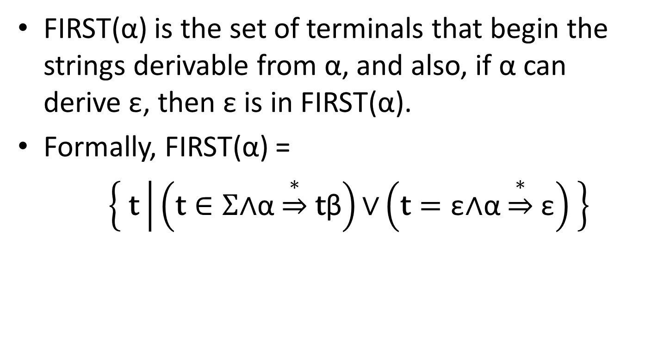
FIRST Sets
FIRST(α) is the set of terminals that begin the strings derivable from α, and also, if α can derive ε, then ε is in FIRST(α).
Formally, FIRST(α) =
$\left\{ \text{t} | \left(\text{t}∈Σ\text{∧}\text{α}\underset{⇒}{∗}\text{t}\text{β}\right)\text{∨}\left(\text{t}=\text{ε}\text{∧}\text{α}\underset{⇒}{∗}\text{ε}\right) \right\}$

Slide 19
Why is FIRST Important?
Assume the top-of-stack symbol is A and current token is a
Production 1: A ⟶ α
Production 2: A ⟶ β
FIRST let us disambiguate:
If a is in FIRST(α), it tells us that Production 1 is a viable choice
If a is in FIRST(β), it tells us that Production 2 is a viable choice
If a is in only FIRST(α) xor FIRST(β) , we can predict the rule we need.

Slide 20
FIRST Construction: Single Symbol
We begin by doing FIRST sets for a single, arbitrary symbol X
If X is a terminal: FIRST(X) = { X }
If X is ε: FIRST(ε) = { ε }
If X is a nonterminal, for each X ⟶ Y₁ Y₂ … Y_{k}
Put FIRST(Y₁) - {ε} into FIRST(X)
If ε is in FIRST(Y₁) , put FIRST(Y₂) - {ε} into FIRST(X)
If ε is also in FIRST(Y₂), put FIRST(Y₃) - {ε} into FIRST(X)
…
If ε is in FIRST of all Y_{i} symbols, put ε into FIRST(X)

Slide 21
FIRST(X) Example
Building FIRST(X) for nonterm X
for each X ⟶ Y₁ Y₂ … Y_{k}
Add FIRST(Y₁) - {ε}
If ε is in FIRST(Y_{1 to i-1}): add FIRST(Y_{i}) - {ε}
If ε is in all RHS symbols, add ε
FIRST(Factor)
= { intlit, lparens }
Exp | ⟶ | Term Exp'
Exp' | ⟶ | minus Term Exp' | ε
Term | ⟶ | Factor Term'
Term' | ⟶ | divide Factor Term' | ε
Factor | ⟶ | intlit | lparens Exp rparens
FIRST(Term’)
= { divide, ε }
FIRST(Term)
= { intlit, lparens }
FIRST(Exp’)
= { minus, ε}
FIRST(Exp)
= { intlit, lparens}

Slide 22
FIRST(α)
We now extend FIRST to strings of symbols α
We want to define FIRST for all RHS
Looks very similar to the procedure for single symbols
Let α =Y₁ Y₂ … Y_{k}
Put FIRST(Y₁) - {ε} in FIRST(α)
If ε is in FIRST(Y₁): add FIRST(Y₂) – {ε} to FIRST(α)
If ε is in FIRST(Y₂): add FIRST(Y₃) – {ε} to FIRST(α)
…
If ε is in FIRST of all Y_{i} symbols, put ε into FIRST(α)

Slide 23
Building FIRST(α) from FIRST(X)
Building FIRST(X) for nonterm X
for each X ⟶ Y₁ Y₂ … Y_{k}
Add FIRST(Y₁) - {ε}
If ε is in FIRST(Y_{1 to i-1}): add FIRST(Y_{i}) - {ε}
If ε is in all RHS symbols, add ε
Building FIRST(α)
Let α = Y₁ Y₂ … Y_{k}
Add FIRST(Y₁) - {ε}
If ε is in FIRST(Y_{1 to i-1}): add FIRST(Y_{i}) – {ε}
If ε is in all RHS symbols, add ε

Slide 24
FIRST(α) Example
Building FIRST(α)
Let α = Y₁ Y₂ … Y_{k}
Add FIRST(Y₁) - {ε}
If ε is in FIRST(Y_{1 to i-1}): add FIRST(Y_{i}) – {ε}
If ε is in all RHS symbols, add ε
E → TX
X → +TX | ε
T → FY
Y → *FY | ε
F → (E) | id
FIRST(E) = {(, id}
FIRST(T) = {(, id}
FIRST(F) = {(, id}
FIRST(X) = {+, ε}
FIRST(Y) = {*, ε}
FIRST(TX) = {(, id}
FIRST(+TX) = { + }
FIRST(FY) = { (, id }
FIRST (*FY) = { * }
FIRST( ( E ) ) = { ( }
FIRST( id ) = { id }

Slide 25
FIRST Sets aren’t enough for Parse Tables
If a rule can derive ε, we need to know what comes next
Obviously, some productions won’t work

Slide 26
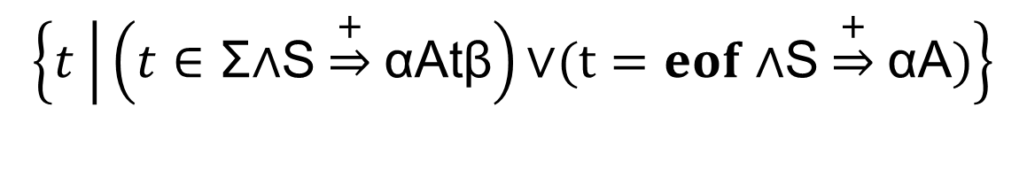
FOLLOW Sets
For nonterminal A, FOLLOW(A) is the set of terminals that can appear immediately to the right of A
Formally, FOLLOW(A) =
$$\left\{t | \left(t∈\text{Σ}\text{∧}\text{S}\underset{⇒}{+}\text{αA}\text{t}\text{β}\right)\text{∨}(t=eof \text{∧}\text{S}\underset{⇒}{+}\text{αA})\right\}$$

Slide 27
FOLLOW Sets: Pictorially
For nonterminal A, FOLLOW(A) is the set of terminals that can appear immediately to the right of A
X
S
A
B
X
Y
???
+
-
A
B
-
???
ε

Slide 28
FOLLOW Sets: Construction
To build FOLLOW(A)
If A is the start nonterminal, add eof
For rules X ⟶ α A β
Add FIRST(β) – {ε}
If ε is in FIRST(β) or β is empty, add FOLLOW(X)
Continue building FOLLOW sets until saturation
S
X
Y
Where α, β may be empty
A
B
-
???
ε
X
A
B
???
+
-

Slide 29
FOLLOW Sets Example
FOLLOW(A) for X ⟶ α A β
If A is the start, add eof
Add FIRST(β) – {ε}
Add FOLLOW(X) if ε in FIRST(β) or β is empty
S | ⟶ | B c | D B
B | ⟶ | a b | c S
D | ⟶ | d | ε
FIRST (S)
=
{ a, c, d }
FOLLOW (S)
=
{ eof }
FIRST (B)
=
{ a, c }
FOLLOW (B)
=
{ c, eof }
FIRST (D)
=
{ d, ε }
FOLLOW (D)
=
{ a, c }
FIRST (B c)
=
{ a, c }
FOLLOW (S)
=
{ eof, c }
FIRST (D B)
=
{ d, a, c }
FOLLOW (B)
=
{ c, eof }
FIRST (a b)
=
{ a }
FOLLOW (D)
=
{ a, c }
FIRST (c S)
=
{ c }
FOLLOW (S)
=
{ eof, c }
FOLLOW (B)
=
{ c, eof }
FOLLOW (D)
=
{ a, c }

Slide 30
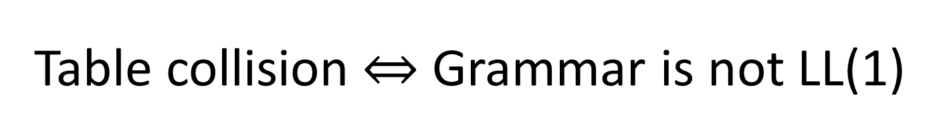
Building the Parse Table
for each production X ⟶ α {
for each terminal t in FIRST(α){
put α in Table[X][t]
}
if ε is in FIRST(α){
for each terminal t in FOLLOW(X){
put α in Table[X][t]
}
}
}
Table collision Grammar is not LL(1)

Slide 31
Putting it all together
Build FIRST sets for each nonterminal
Build FIRST sets for each production’s RHS
Build FOLLOW sets for each nonterminal
Use FIRST and FOLLOW to fill parse table for each production

Slide 32
Tips n’ Tricks
FIRST sets
Only contain alphabet terminals and ε
Defined for arbitrary RHS and nonterminals
Constructed by starting at the beginning of a production
FOLLOW sets
Only contain alphabet terminals and eof
Defined for nonterminals only
Constructed by jumping into production

Slide 33
FIRST(α) for α = Y₁ Y₂ … Y_{k}
Add FIRST(Y₁) - {ε}
If ε is in FIRST(Y_{1 to i-1}): add FIRST(Y_{i}) – {ε}
If ε is in all RHS symbols, add ε
FOLLOW(A) for X ⟶ α A β
If A is the start, add eof
Add FIRST(β) – {ε}
Add FOLLOW(X) if ε in FIRST(β) or β empty
Table[X][t]
CFG
for each production X ⟶ α
for each terminal t in FIRST(α)
put α in Table[X][t]
if ε is in FIRST(α){
for each terminal t in FOLLOW(X){
put α in Table[X][t]
S | ⟶ | B c | D B
B | ⟶ | a b | c S
D | ⟶ | d | ε
Not LL(1)
a
b
c
d
eof
FIRST (S)
=
{ a, c, d }
S
B c
B c
D B
FIRST (B)
=
{ a, c }
FOLLOW (S)
=
{ eof, c }
D B
D B
FIRST (D)
=
{ d, ε }
FOLLOW (B)
=
{ c, eof }
B
a b
c S
FIRST (B c)
=
{ a, c }
FOLLOW (D)
=
{ a, c }
FIRST (D B)
=
{ d, a, c }
ε
D
ε
FIRST (a b)
=
{ a }
FIRST (c S)
=
{ c }

