Slide 1
CS536
Semantic Analysis Introduction with Emphasis on Name Analysis

Slide 2
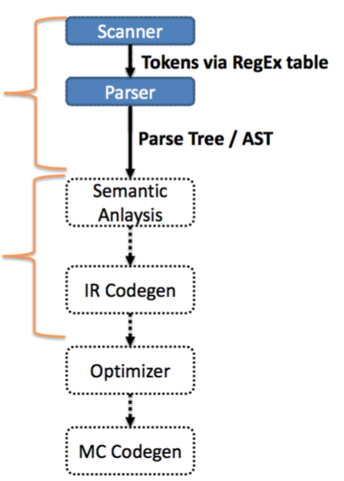
Where we are at
So far, we’ve only defined the structure of a program—aka the syntax
We are now diving into the semantics of the program

Slide 3
Semantics: The Meaning of a Program
The parser can guarantee that the program is structurally correct
The parser does not guarantee that the program makes sense:
void var;
Undeclared variables
Ill-typed statements
int doubleRainbow;
doubleRainbow = true;

Slide 4
Static Semantic Analysis
Two phases
Name analysis (aka name resolution)
For each scope
Process declarations, add them to symbol table
Process statements, update IDs to point to their entry
Type analysis
Process statements
Use symbol table info to determine the type of each expression

Slide 5
Why do we need this phase?
Code generation
Different operations use different instructions:
Consistent variable access
Integer addition vs floating point addition
Operator overloading
Optimization
Symbol table knows where a variable is used
Can remove dead code
Can weaken the type (e.g., int -> bool)
NOTE: pointers can make this occasionally impossible
Error checking

Slide 6
Semantic Error Analysis
For non-trivial programming languages, we run into fundamental undecidability problems
– Halting?
– Crashes?
Sometimes practical feasibility as well
– Thread interleavings – Interprocedural dataflow

Slide 7
Catch Obvious Errors
We may not be able to guarantee the absence of errors
We can at least catch some, though
Undeclared identifiers
Multiply declared identifiers
Ill-typedness

Slide 8
Name analysis
Associating ids with their uses
Need to bind names before we can type uses
What definitions do we need about identifiers?
Symbol table
How do we bind definitions and uses together?
scope

Slide 9
Symbol table entries
A table that binds a name to information we need
Information typically needed in an entry
– Kind (struct, variable, function, class)
– Type (int, int × string → bool, struct)
– Nesting level – Runtime location (where it’s stored in memory)

Slide 10
Symbol table operations
Insert entry
– Lookup – Add new table – Remove/forget a table
When should we use these operations?

Slide 11
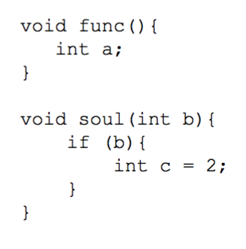
Scope: the lifetime of a name
Block of code in which a name is visible/valid
– No scope
Assembly / FORTRAN
– static / most deeply nested scope
Should be familiar – C / Java / C++

Slide 12
Many decisions related to scope!!

Slide 13
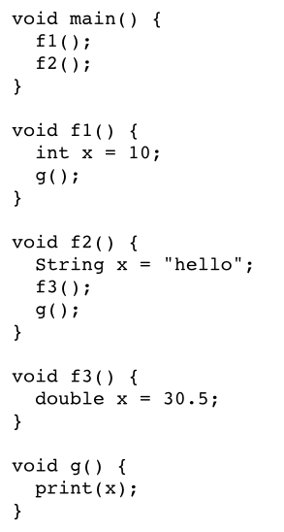
Static vs Dynamic Scope
Static
Correspondence between a variable use / decl is known at compile time
Dynamic
Correspondence determined at runtime

Slide 14
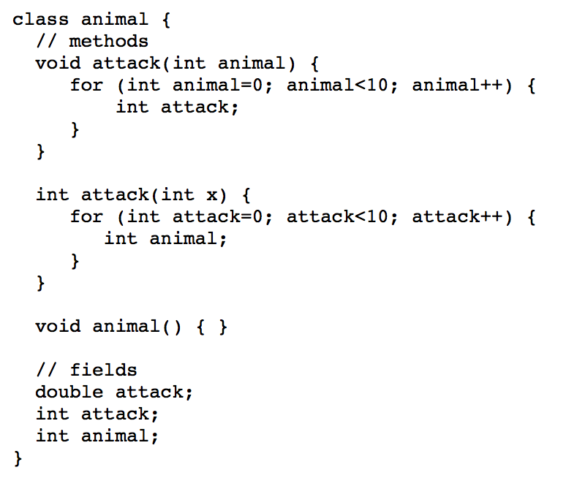
Exercises
What uses/decl are OK in this Java code?

Slide 15
Exercises
void main() {
int x = 0;
f1();
g();
f2();
}
void f1() {
int x = 10;
g();
}
void f2() {
int x = 20;
f1();
g();
}
void g() {
print(x);
}
What does this return, assuming dynamic scoping?

Slide 16
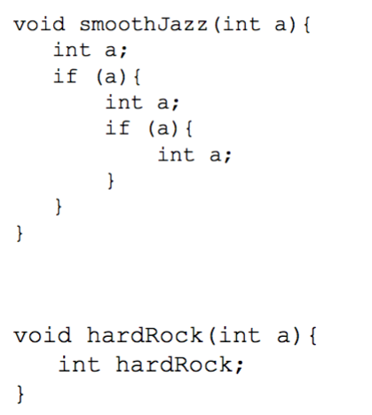
Variable shadowing
Do we allow names to be reused in nesting relations?
What about when the kinds are different?

Slide 17
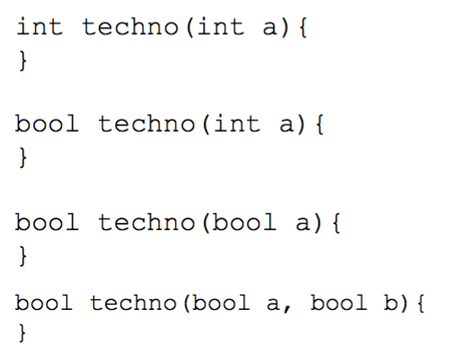
Overloading
Same name different type

Slide 18
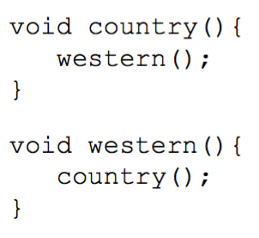
Forward references
Use of a name before it is filled out in the symbol table
Requires two passes over the program
1 to fill symbol table, 1 to use it

Slide 19
Example
int k=10, x=20;
void foo(int k) {
int a = x;
int x = k;
int b = x;
while (...) {
int x;
if (x == k) {
int k, y;
k = y = x;
}
if (x == k) {
int x = y;
}
}
}
Determine which uses correspond to which decl

Slide 20
Example
int (1)k=10, (2)x=20;
void (3)foo(int (4)k) {
int (5)a = x(2);
int (6)x = k(4);
int (7)b = x(6);
while (...) {
int (8)x;
if (x(8) == k(4)) {
int (9)k, (10)y;
k(9) = y(10) = x(8);
}
if (x(8) == k(4)) {
int (11)x = y(ERROR);
}
}
}
Determine which uses correspond to which decl

Slide 21
Name analysis for YES
Time to make some decisions
What scoping rules will we allow?
What info does a YES compiler need in its symbol table?
Relevant for P4

Slide 22
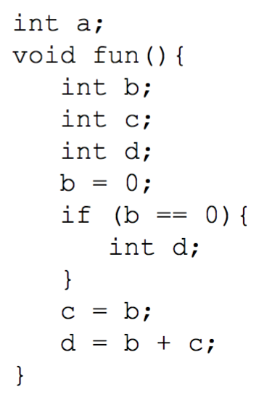
YES: A statically scoped language
YES is designed for ease of symbol table use
global scope + nested scopes
All declarations are made at the top of a scope
Declarations can always be removed from table at end of scope

Slide 23
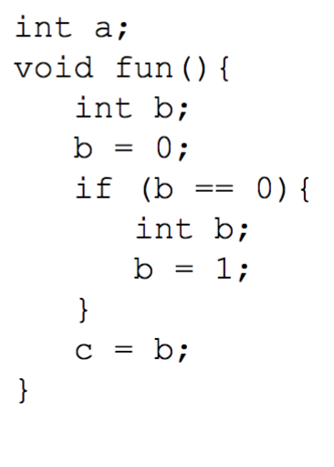
YES: Nesting
Like Java or C, we’ll use most deeply nested scope to determine binding
Shadowing
Variable shadowing allowed
Struct definition shadowing allowed

Slide 24
YES: Symbol table implementation
We want the symbol table to efficiently add an entry when we need it, remove it when we’re done with it
We’ll go with a list of hashmaps
This makes sense since we expect to remove a lot of names from scope at once

Slide 25
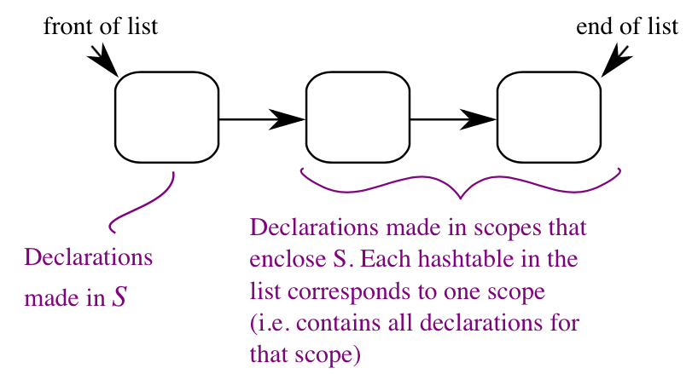
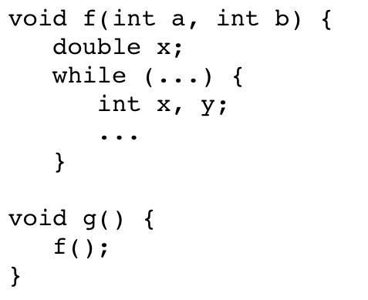
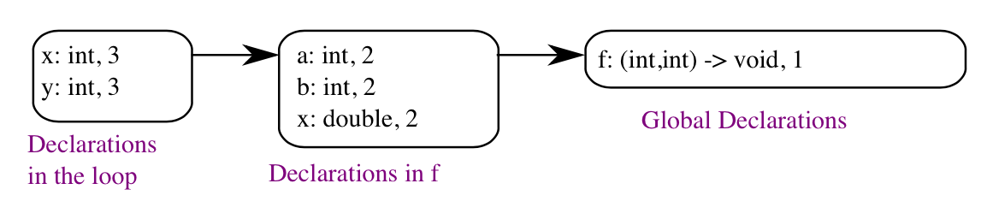
Example

Slide 26
YES: Symbol kinds
Identifier types
Variables
Carries a name, primitive type
Function declarations
Carries a name, return type, list of param types
Struct definitions
Carries a name, list of fields (types with names), size

Slide 27
YES: Sym class implementation
There are many ways to implement your symbols
Here’s one suggestion
Sym class for variable definitions
FnSym subclass for function declarations
StructDefSym for struct type definitions
Contains it’s OWN symbol table for it’s field definitions
StructSym for when you want an instance of a struct

Slide 28
Implementing name analysis with an AST
At this point, we’re basically done with the Parse Tree
Walk the AST, much like the unparse() method
Augment AST nodes with a link to the relevant name in the symbol table
Build new entries into the symbol table when a declaration is encountered

Slide 29
