Slide 1
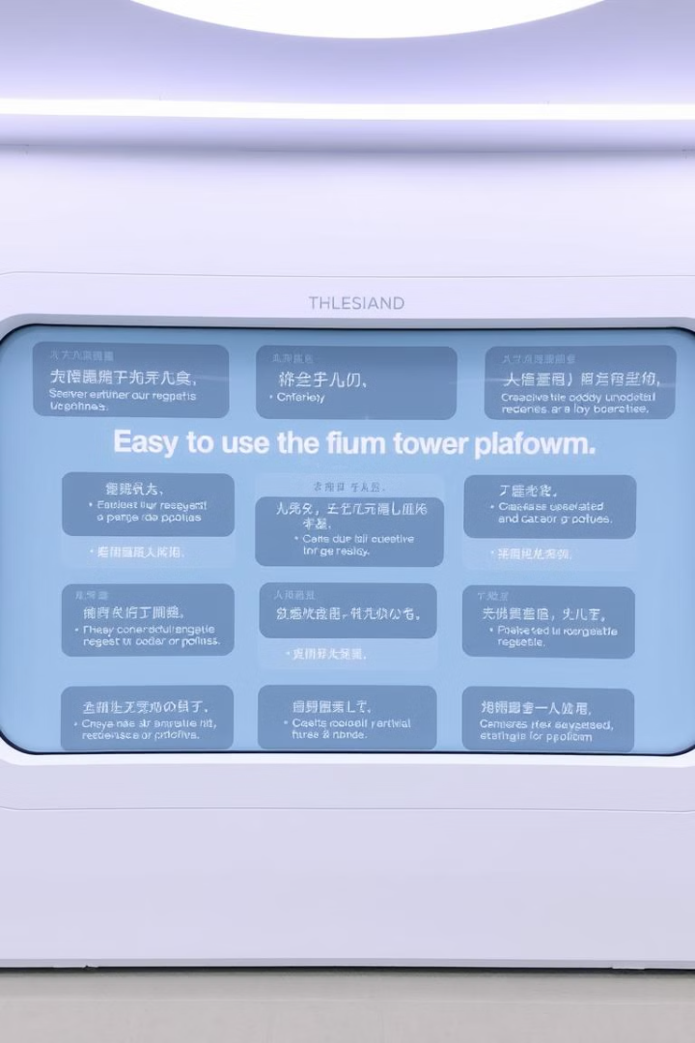
Translangua: Your Global Communication Solution
Translangua empowers you to break down language barriers and connect with audiences worldwide.

Slide 2
The Challenges of Language Barriers
Limited reach: Businesses struggle to connect with diverse audiences.
Missed opportunities: Lost potential for growth and expansion.
Inefficient communication: Misunderstandings and delays hinder collaboration.

Slide 3
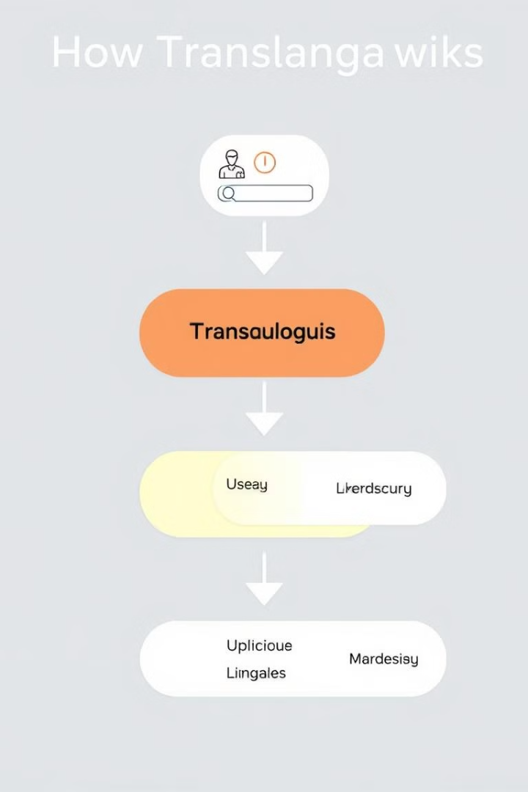
How Translangua Works
Input text in your preferred language.
Translangua's AI engine translates the text into multiple languages.
Receive translated text that maintains the original meaning and tone.

Slide 4

Leveraging Cutting-Edge AI Technology
1
Neural Machine Translation (NMT): Translangua utilizes advanced NMT for high-quality translations.
2
Contextual Understanding: Translangua goes beyond word-for-word translation, capturing nuances and cultural context.
3
Continuous Learning: Translangua's AI engine constantly learns and improves its translation accuracy.

Slide 5
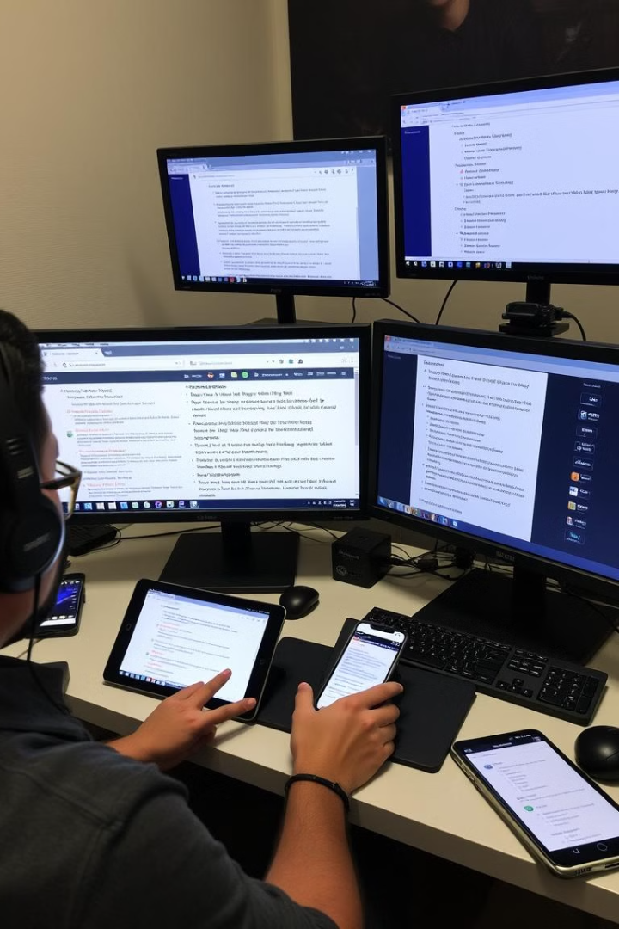



Seamless Integration Across Platforms
Web-based platform for convenient access from any device.
Mobile app for on-the-go translation needs.
Integrations with popular business software for streamlined workflows.

Slide 6

Accurate and Contextual Translation
High-quality translations for various purposes.
Accurate translations for business communications, documents, and websites.
Contextual understanding that ensures clear and natural translations.

Slide 7

Ensuring Data Privacy and Security
1
Data encryption for secure transmission and storage.
2
Compliance with industry-standard security protocols.
3
Commitment to protecting user data and privacy.

Slide 8




Unlocking the Power of Multilingual Collaboration
Expand your reach to new markets and audiences.
Collaborate seamlessly with international teams and partners.
Unlock the power of diversity and global perspectives.

