Slide 1
ABALONE
- A fishy creature.
- Raghu Teja Dhulipala

Slide 2
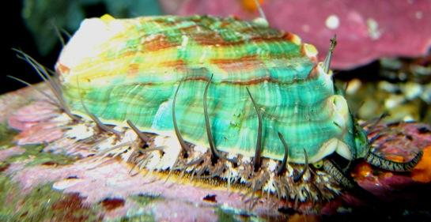

Slide 3
Domain and Problem Understanding
Abalone being a sea shell it has different physical measurements and its age varies by number of “Rings” it have.
So, predicting the age of abalone from physical measurements we have as a dataset.
Considering this as a Regression problem.

Slide 4
Dataset Information.
The number of rings is the value to “Predict.” When given
Sex
Length
Diameter
Height
Whole weight
Shucked weight
Viscera weight
Shell weight

Slide 5

Data Exploration
Number of records: 4177
Number of attributes: 8
There are no missing values in the given data.
And there is no class imbalance.
Data is “HIGHLY COLLINEAR”

Slide 6
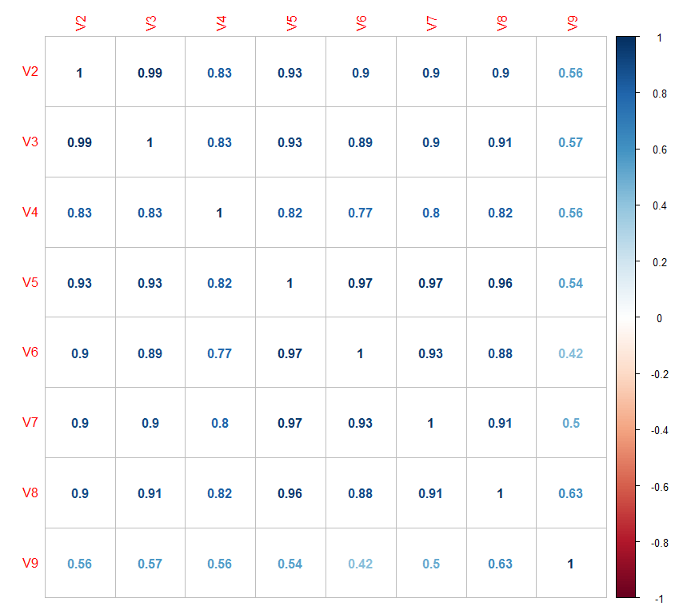
Correlation Plot

Slide 7
Structure of Data
All the attributes except V1-SEX are numeric.
V1 is a categorical attribute, so applied dummy technique and converted to numeric.
And then removed V1 so as to see the entire data is in a single datatype.
Target variable is also in numeric datatype.

Slide 8
Basic Preprocessing Steps
Standardizing using Scale Function.
Divide the data into Train and test (70/30) to run the models.

Slide 9
Model Building
Since this is a Regression problem we can use:
Linear Regression.
CART.
Random Forest.
SVM

Slide 10


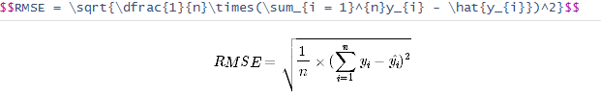
Evaluation Metric
MAE
MSE
RMSE

Slide 11
Linear Regression
 | MAE | MSE | RMSE
Linear regression | 1.56 | 4.67 | 2.16

Slide 12

Using VIF
With the help of VIF we can see that attributes V5 and V6 are having high VIF in the entire data.
By checking with the Correlation between these two attributes found that there are highly correlated so dropped V5 and then ran Linear model.

Slide 13
Linear model after feature reduction using VIF
 | MAE | MSE | RMSE
Linear regression- VIF | 1.58 | 4.8 | 2.19

Slide 14
Random Forest
By using random forest, importance of attributes are taken into consideration
So, V1F and V1M are dropped and then the model is built.
 | MAE | MSE | RMSE
Random Forest | 1.49 | 4.35 | 2.86

Slide 15
SVM
 | MAE | MSE | RMSE
Random Forest | 1.45 | 4.4 | 2.09

Slide 16
Decision Trees- CART
 | MAE | MSE | RMSE
CART | 1.72 | 5.83 | 2.41

Slide 17
Scope of Improvements
Check for the outliers, remove and then run the models.
As regression models vary a lot with presence of outliers.
And also built a metadata using the outputs of the models.

