Slide 1
CAPSTONE PROJECT
PROJECT TITLE
SECURE DATA HIDING IN IMAGES USING STEGANOGRAPHY
Presented By: Kuruva Raghu Vamshi Student Name : Kuruva Raghu Vamshi
College Name & Department : Vishwa Vishwani institute of
systems and management (BS-MS(computer science))

Slide 2

OUTLINE
Problem Statement Technology used Wow factor
End users Result Conclusion Git-hub Link Future scope

Slide 3
PROBLEM STATEMENT
Data security is crucial in today’s digital world. Traditional encryption methods protect data but reveal its existence. Steganography allows data to be hidden inside images, making it undetectable to unauthorized users.

Slide 4
TECHNOLOGY USED
Programming Language: Python
Libraries: OpenCV, Pillow, NumPy, Cryptography
Method: Least Significant Bit (LSB) for data embedding, encryption for security.

Slide 5
WOW FACTORS
Invisible Data: Data is hidden within images without noticeable quality change.
Double Security: Combines encryption and steganography.
User-Friendly: Easy for anyone to use without technical expertise.

Slide 6
END USERS
Government Agencies: Secure transmission of sensitive data.
Military: Hidden communication.
Businesses: Protection of proprietary data.
Personal Use: Secure personal files.

Slide 7
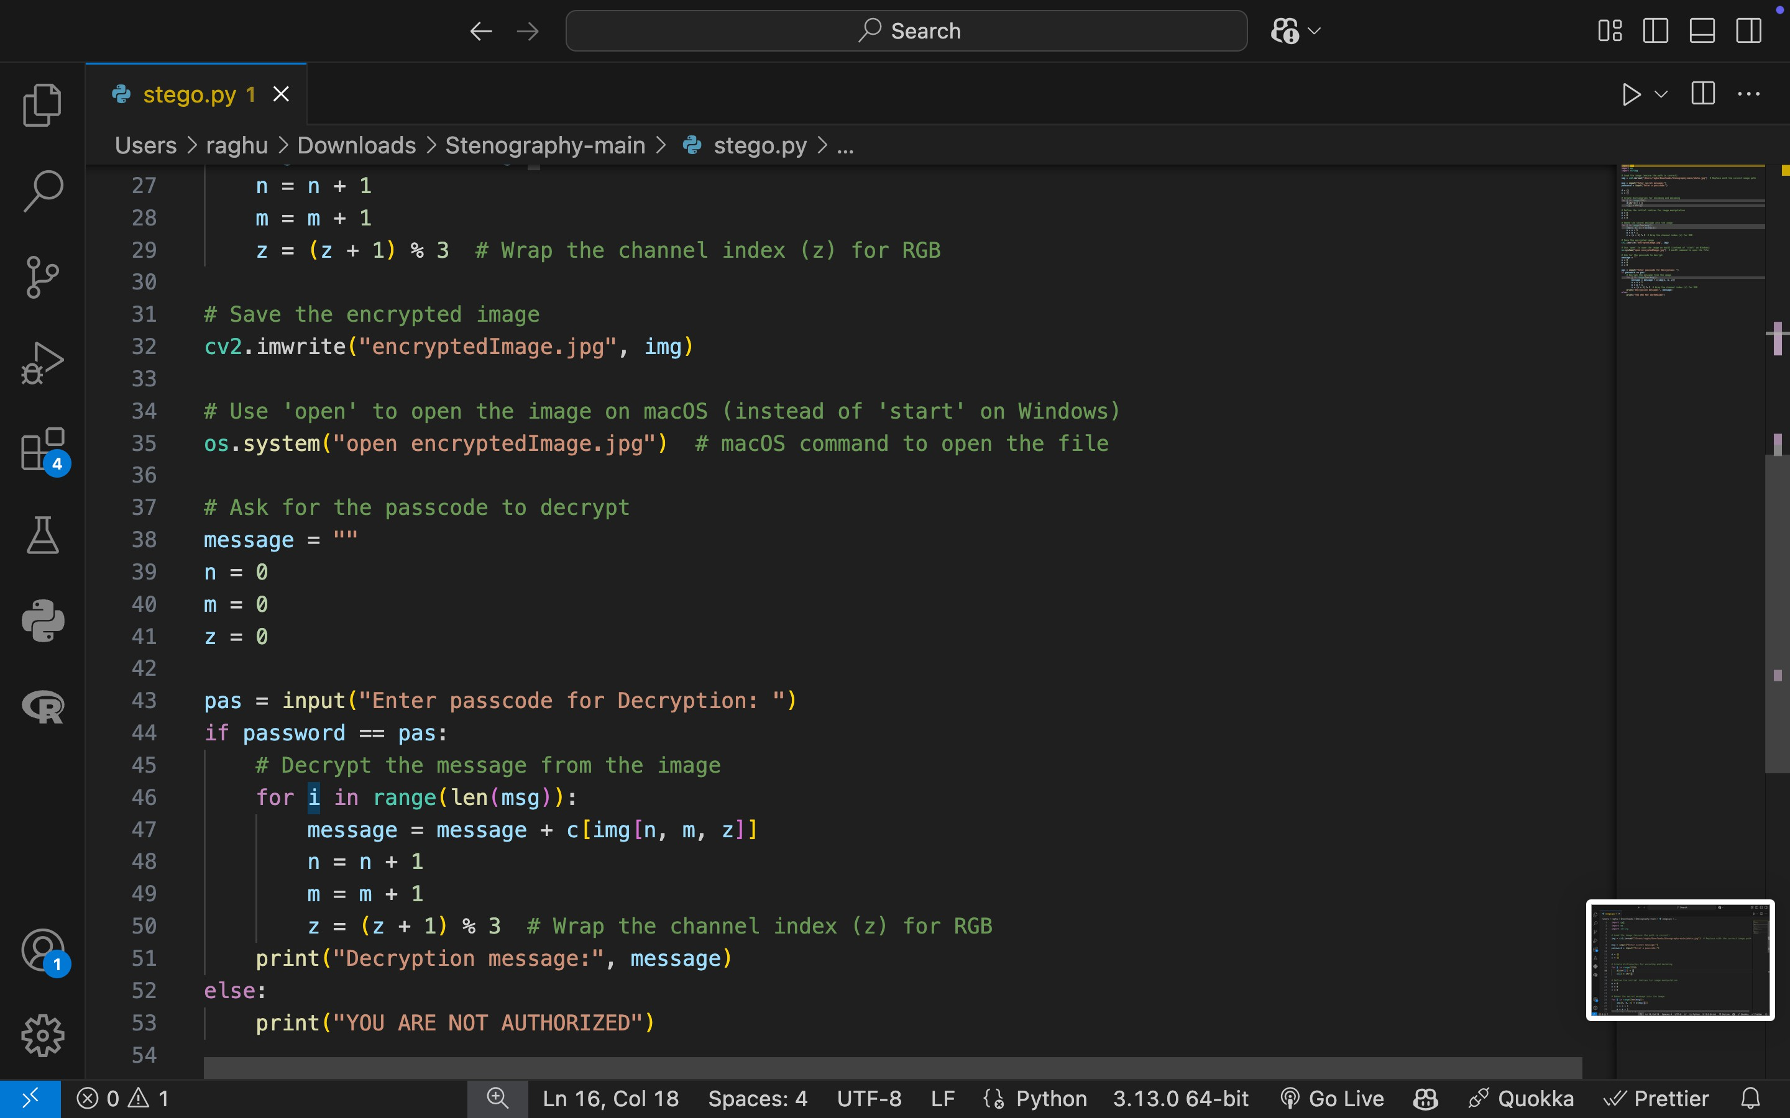
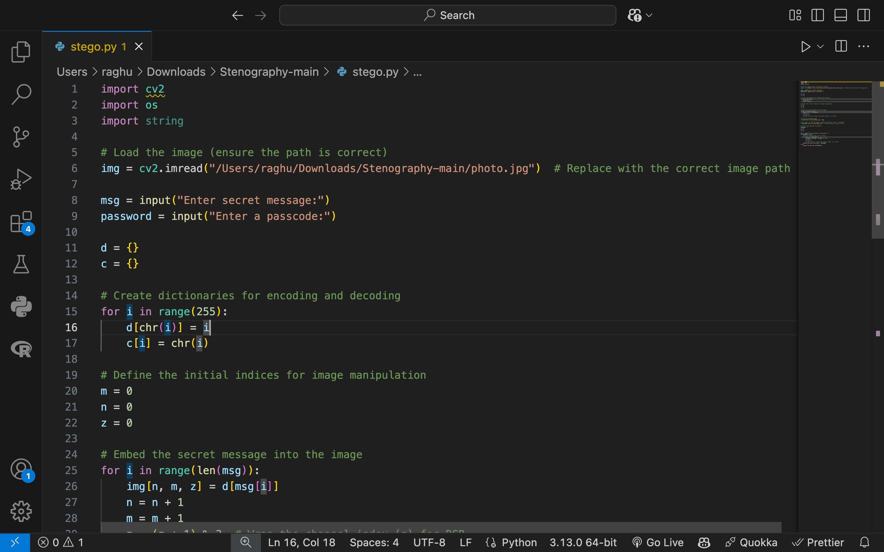
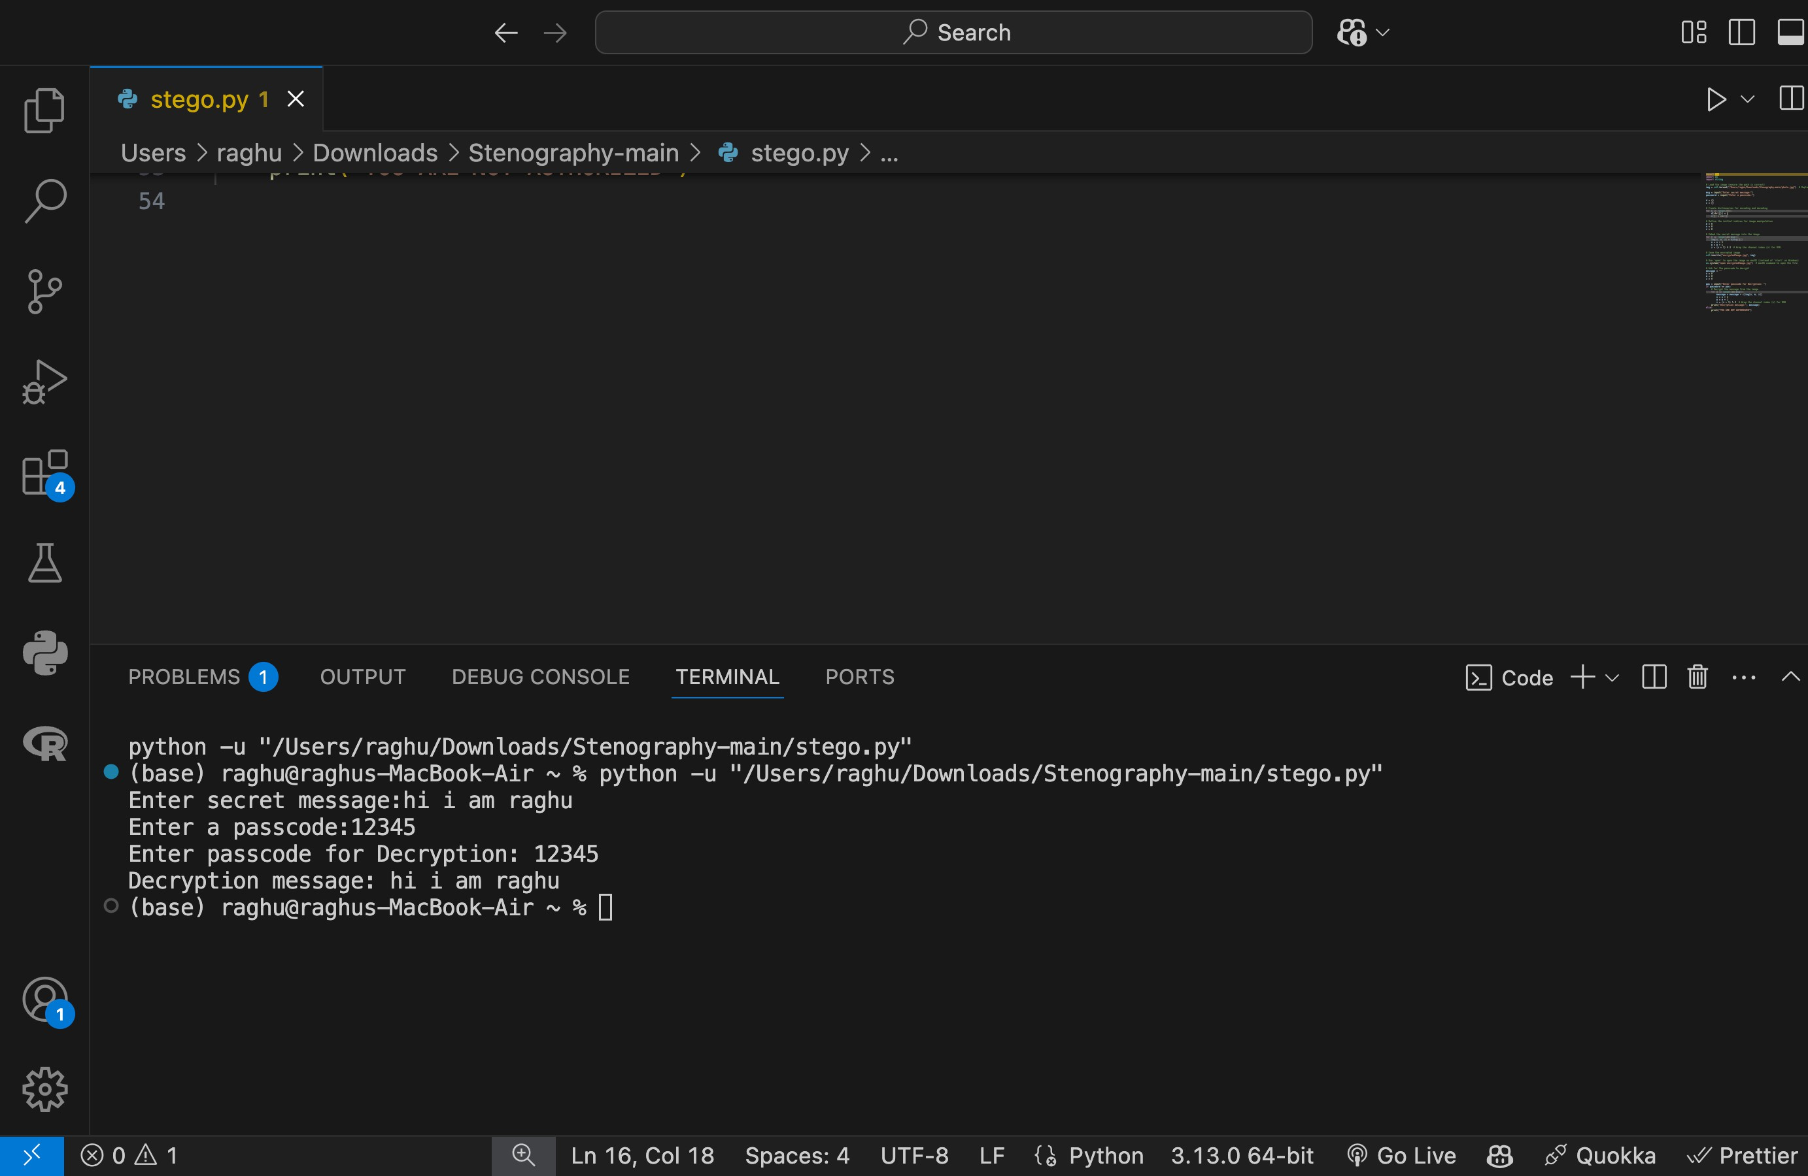
RESULTS
Screenshots of the outcome (min 3)

Slide 8
CONCLUSION
Steganography, combined with encryption, offers a secure, invisible way to hide data in images. This solution is practical for protecting sensitive data in various sectors.

Slide 9
GITHUB LINK
https://github.com/Raghuvamshi512/stegnography/blob/main/stego.py

Slide 10
FUTURE SCOPE(OPTIONAL)
Implement advanced steganography methods.
Improve security with stronger encryption.
Develop real-time embedding and cross-platform apps.

Slide 11
THANK YOU

