Slide 1
TCP Vs QUIC Under Wireless-like Random Packet Loss EE6750 - Transport Over Wireless Networks 3/6/2026
Team Members & Roles:
Raghuvamsi Lekkala: Implementation, experiments, data collection
Krishna Sri Mannam: Experiment design, analysis, report writing
Tools We Are Using:
WSL2 + tc netem: Simulating random wireless packet loss on Windows (craigloewen-msft, 2024).
aioquic: Running QUIC protocol (Python library) (Lainé, 2026).
Python sockets/iperf3: Running TCP for comparison (GUEANT, 2013)
Wireshark: Capturing and inspecting packets (Wireshark Foundation, n.d.)
Python (matplotlib): Plotting graphs and analyzing results (Python, 2025)

Slide 2
Problem Statement & Research Question
Problem:
Wireless networks drop packets due to interference, not congestion.
TCP misinterprets packet loss as congestion, slowing down unnecessarily (Arghavani, 2026).
QUIC was designed to handle loss more intelligently (Ghedini, 2018).
Research Question:
How does QUIC compare to TCP in throughput and flow completion time when transferring a 10MB file under random wireless-like packet loss rates of 0%, 1%, 3%, 5%, and 10%?

Slide 3
Why It Matters
Real-World Impact:
Most internet traffic runs over WiFi or mobile networks, yet TCP was designed for wired networks in the 1970s.
Users experience slow downloads and buffering on uncongested WiFi.
Who is Already Using QUIC?
Google, YouTube, HTTP/3: Faster page loads, reduced buffering, better mobile performance.
Meta/Facebook: Improved mobile network performance.
Why This Research Matters:
We need data: Exact figures on TCP degradation vs QUIC under real loss conditions.
QUIC is not always available: Some firewalls block UDP, forcing TCP use.
Network engineers need this: To make informed protocol decisions and justify infrastructure upgrades.

Slide 4
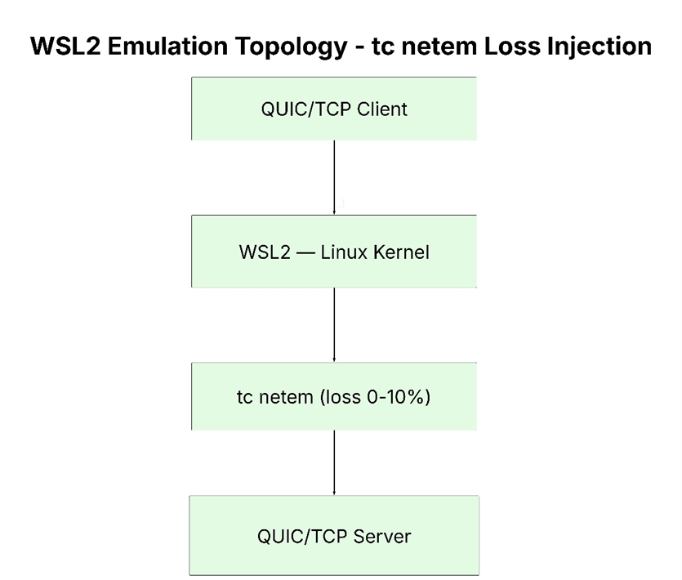
Wireless Mechanisms
What Actually Happens in a Wireless Network?
Physical Layer: Loss due to radio interference and noise.
Link Layer: WiFi MAC retries failed frames (4-7 attempts), then drops the frame.
Transport Layer: Both TCP and QUIC see packet loss, but react differently.
Simulating with tc netem:
tc qdisc add dev eth0 root netem loss 5% - Simulates random packet loss.

Slide 5
Layered Reasoning Map
What Happens at Each Layer:
Physical Layer: Random bit errors due to interference.
Link Layer: WiFi retries failed frames.
Network Layer: Both TCP and QUIC detect lost packets but react differently.
Transport Layer:
TCP: Assumes loss is due to congestion, halves CWND (Congestion Window).
QUIC: Selective retransmit, minimal CWND reduction.
Application Layer:
TCP: Slower file transfer.
QUIC: Faster, smoother file transfer.
Key Insight:
TCP misinterprets packet loss as congestion, slowing down unnecessarily.
QUIC handles loss more efficiently, maintaining better throughput.

Slide 6
Hypotheses
H1 - Throughput:
Hypothesis: QUIC will maintain higher throughput than TCP as packet loss increases.
Reasoning: TCP’s congestion window halves with each loss, while QUIC maintains a more consistent sending rate.
H2 - Flow Completion Time (FCT):
Hypothesis: QUIC will complete the file transfer faster and more consistently than TCP.
Reasoning: QUIC recovers faster, while TCP’s repeated slowdowns result in longer transfers.
H3 - Retransmissions:
Hypothesis: TCP’s retransmission count will increase faster than QUIC’s.
Reasoning: TCP retransmits more data unnecessarily, while QUIC only retransmits lost packets.

Slide 7
Experimental Design
Method: Emulation
Emulation allows for real protocol behavior in a controlled, repeatable environment.
tc netem is used for packet loss simulation on Windows using WSL2 (Kerrisk, n.d.).
Independent Variable:
Loss Rate: 0%, 1%, 3%, 5%, 10%.
Metrics Measured:
Goodput: Mbps
Flow Completion Time (FCT): ms
Retransmissions: Count
Latency CDF: ms
Baseline vs Comparison:
Baseline: TCP Cubic
Comparison: QUIC (aioquic)
Core Scenarios:
Scenario 1: No loss (0%)
Scenario 2: Medium loss (3%)
Scenario 3: High loss (10%)

Slide 8
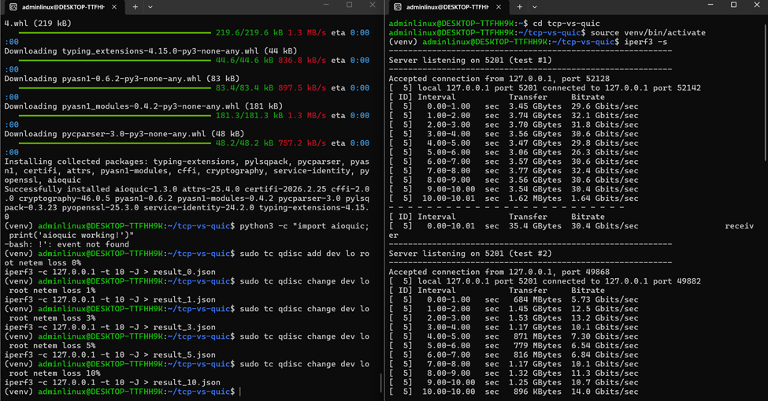
Implementation Progress
What We Have Done So Far:
WSL2 Environment Setup: Completed and tested with necessary tools installed (aioquic, iperf3, tc netem, python).
Loss Injection Ready: Tested packet loss injection with tc netem.
GitHub Repository: Set up with all scripts and experiment details documented.
Next Steps:
Week 1: Finalize aioquic server and client, collect first QUIC results.
Week 2: Full data collection (100 runs).
Week 3: Analysis, CDF plots, and comparison.
Week 4: Final report and presentation.

Slide 9
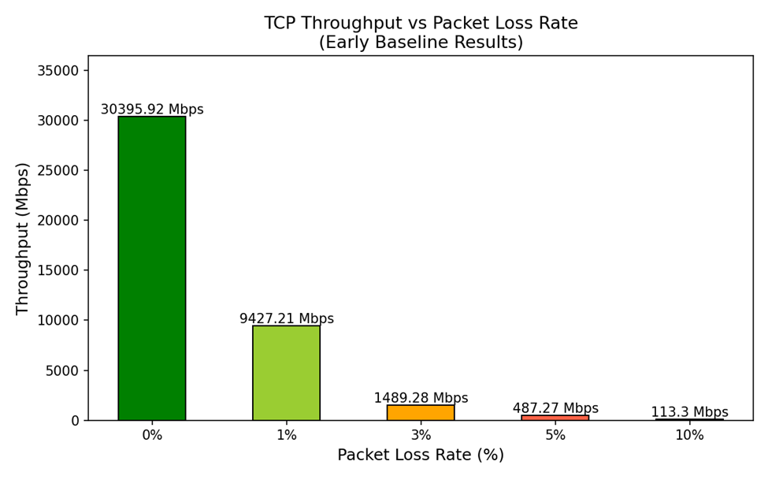
Early Results
TCP Baseline Results (with 5 loss rates):
0%: 30,395 Mbps (baseline)
1%: 9,427 Mbps (↓ 69%)
3%: 1,489 Mbps (↓ 95%)
5%: 487 Mbps (↓ 98%)
10%: 113 Mbps (↓ 99.6%)
Key Observations:
Exponential degradation: Even 1% packet loss causes a 70% drop in throughput.
TCP's vulnerability: Performance collapses as packet loss increases, especially at 10%.
Supports our hypothesis: TCP is highly sensitive to random packet loss.
Next Step:
To run QUIC side-by-side and compare performance.

Slide 10
Rubric Alignment And Schedule
Rubric Alignment:
Problem & Motivation: Clearly defined with real-world impact.
Course Concepts: Full 5-layer reasoning from Physical to Application layer.
Experimental Design: 5 loss rates, 10 trials each, 100 runs, CDFs and confidence intervals planned.
Implementation Status: WSL2 environment working, baseline experiments completed.
Results & Analysis: Early data collected and visualized.
Reproducibility: GitHub repo live, all scripts and commands documented.
Updated Schedule:
Week 1: Finalize QUIC setup, verify results.
Week 2: Full data collection (100 runs).
Week 3: Analysis, graphs, CDFs.
Week 4: Report, presentation, final submission.

Slide 11
References
Arghavani, M. (2026). Optimising TCP slow-start: in-depth analysis and enhanced designs. Otago.ac.nz. https://ourarchive.otago.ac.nz/esploro/outputs/doctoral/Optimising-TCP-slow-start-in-depth-analysis-and/9926545580001891?institution=64OTAGO_INST
craigloewen-msft. (2024). Install WSL. Learn.microsoft.com. https://learn.microsoft.com/en-us/windows/wsl/install
Ghedini, A. (2018). The Road to QUIC. The Cloudflare Blog. https://blog.cloudflare.com/the-road-to-quic/
GUEANT, V. (2013). iPerf - The TCP, UDP and SCTP network bandwidth measurement tool. Iperf.fr. https://iperf.fr/
Kerrisk, M. (n.d.). tc-netem(8) - Linux manual page. Man7.org. https://man7.org/linux/man-pages/man8/tc-netem.8.html
Lainé, J. (2026). aioquic — aioquic documentation. Readthedocs.io. https://aioquic.readthedocs.io/en/latest/
Python. (2025). Python. Python.org; Python.org. https://www.python.org/
Wireshark Foundtion. (n.d.). Wireshark. Wireshark.org. https://www.wireshark.org/

