Slide 1


Orreus: An Interactive Orrery Web App
2024
Visualizing the Solar System and Beyond
Team Name: The DOMIRA: THE GUARDIANS OF AURCTIA CHALLENGE: Create an Orrery Web App that Displays Near-Earth Objects TEAM MEMBERS: RAGHUVARAN D (TEAM LEADER) DOMINIC WALTER T SHARMILA L A

Slide 2
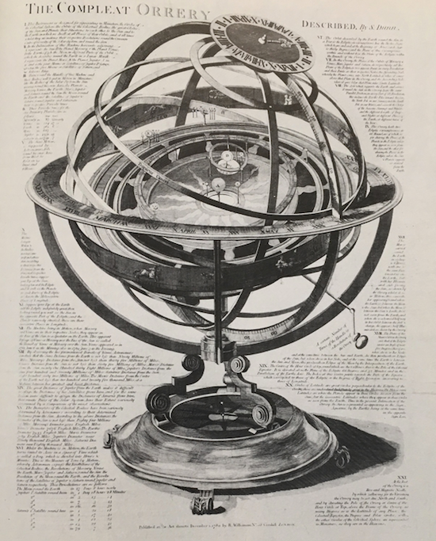
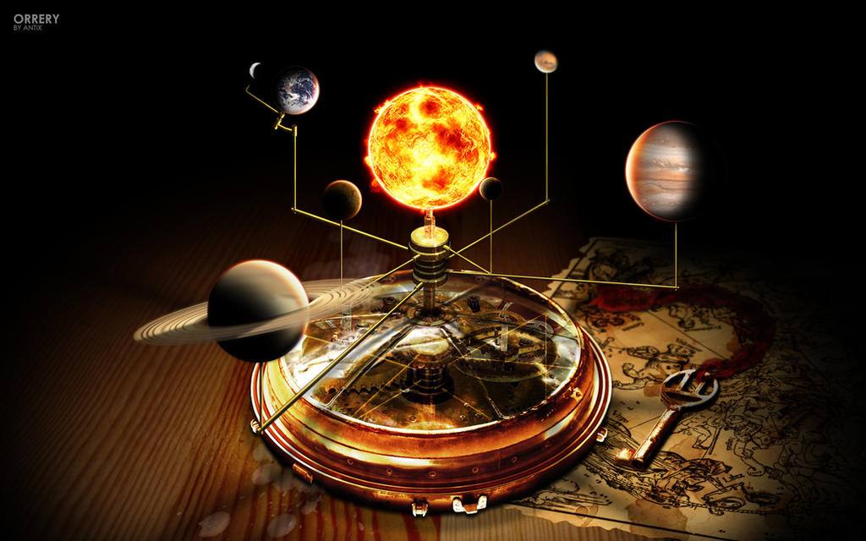
What is an Orrery?
2024
An orrery is a mechanical model of the solar system. The name originates from Charles Boyle, to whom a mechanical model was presented in 1713. Our goal was to modernize this concept with today’s technology

Slide 3
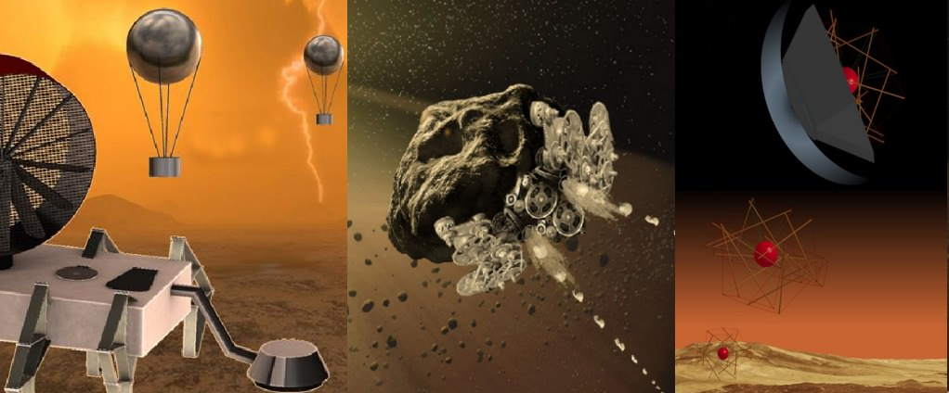
We Challenge The Subject
2024
The solar system is vast, and with increasing interest in space exploration, it’s crucial to create interactive tools to educate the public and provide detailed information about space, especially concerning Near-Earth objects like asteroids and comets

Slide 4
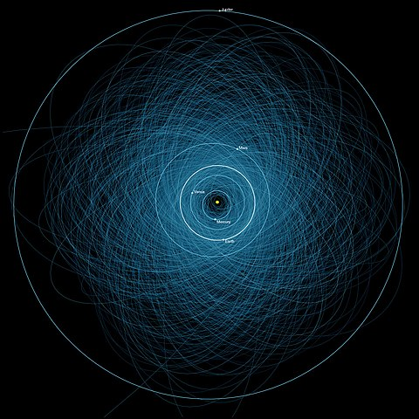
Introducing Orreus
2024
Orreus is a virtual orrery, designed to make learning about the solar system immersive. It displays celestial bodies, including planets, Near-Earth Asteroids, comets, and PHAs. The app enables users to interact with real-time data and explore missions.

Slide 5
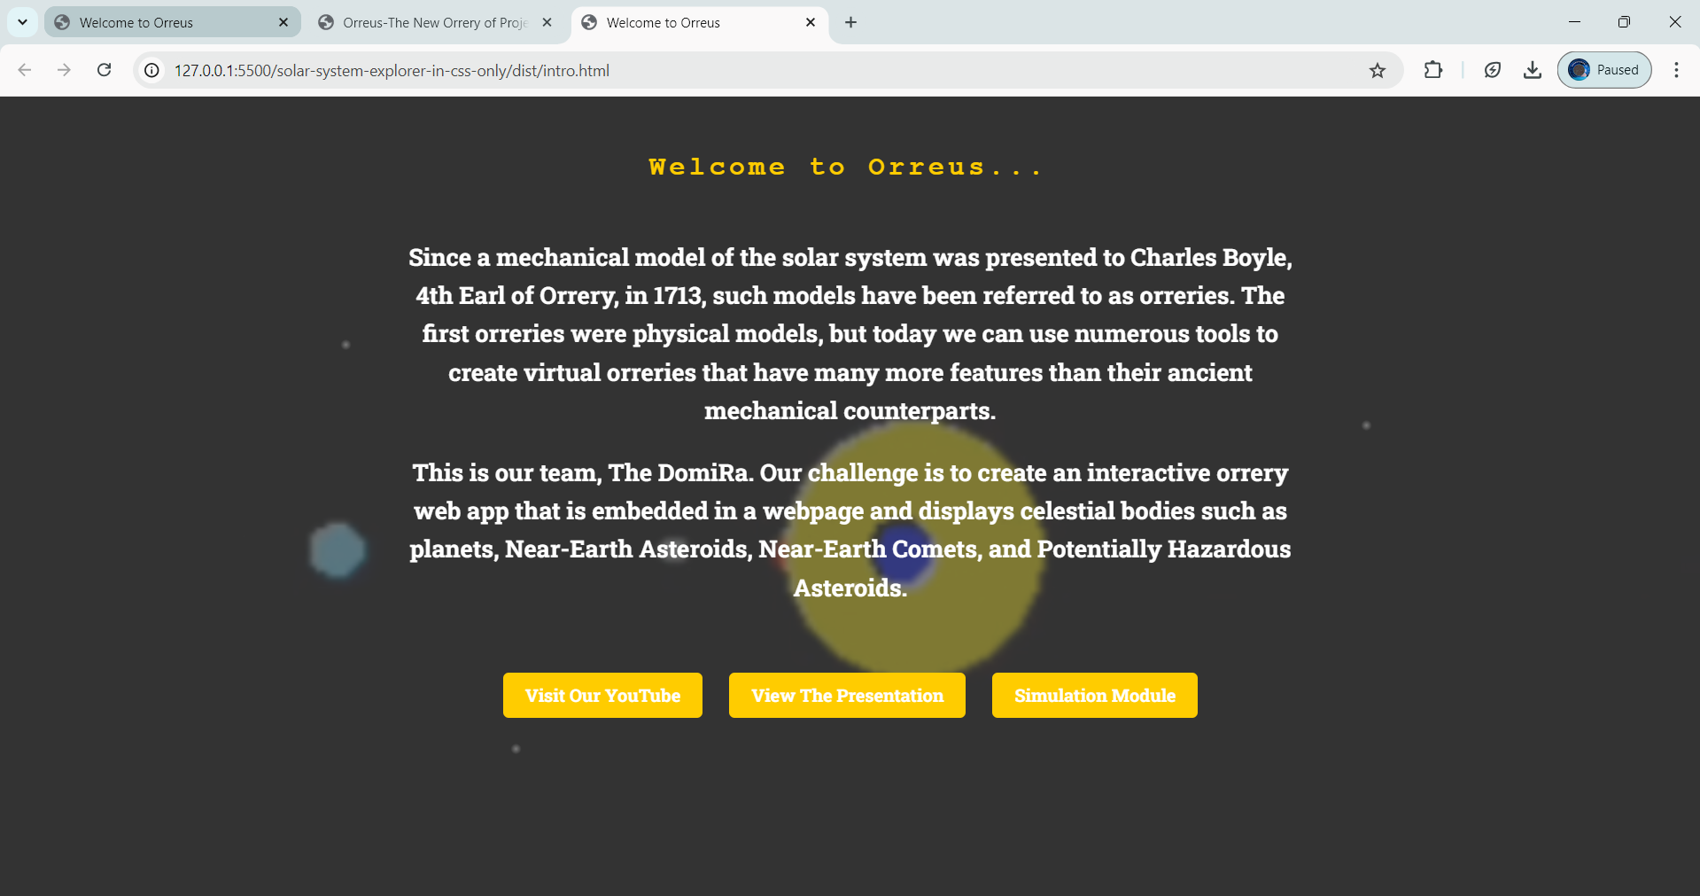
Our Application
2024
Front Page

Slide 6
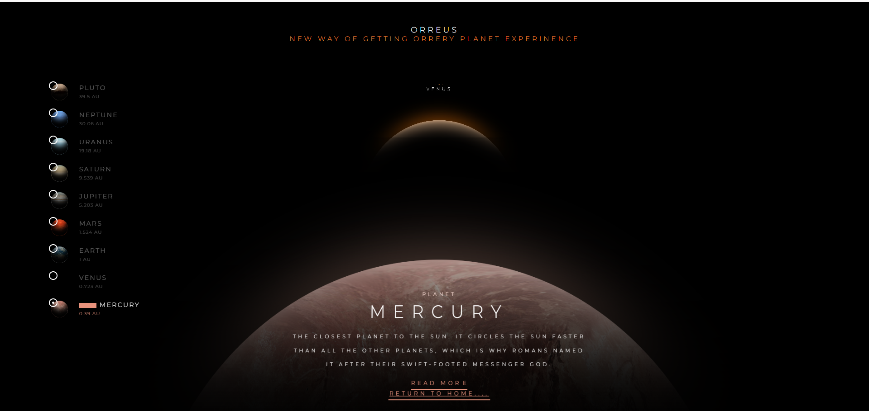
Our Application
2024
Simulation of Orrery

Slide 7

How Users Interact with Orreus?
2024
Orreus is a virtual orrery, designed to make learning about the solar system immersive. It displays celestial bodies, including planets, Near-Earth Asteroids, comets, and PHAs. The app enables users to interact with real-time data and explore missions.

Slide 8
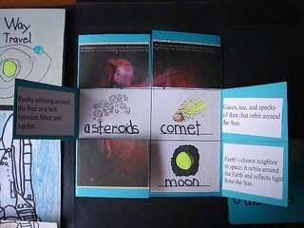
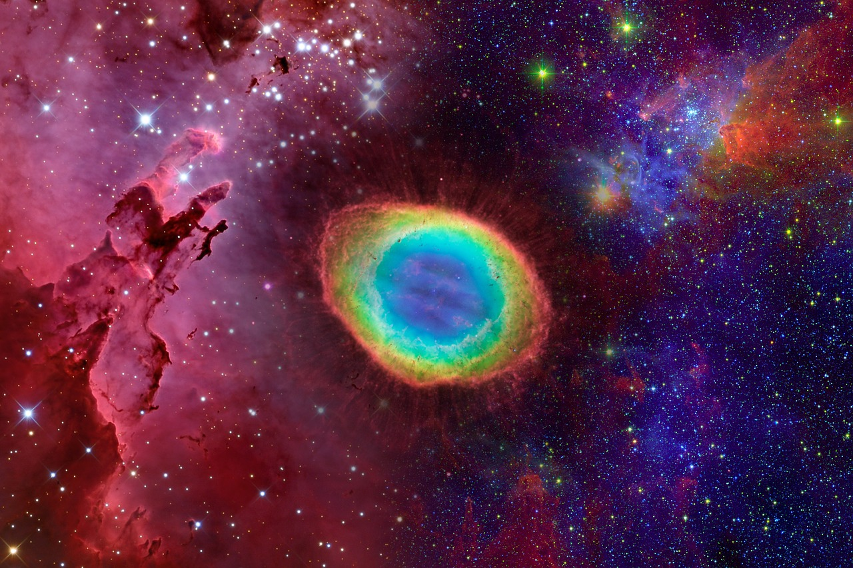
Orreus as an Educational Tool
2024
Orreus is more than just a tool for exploration—it’s a powerful educational platform that can be used in classrooms and museums to teach students about the solar system and space science.

Slide 9
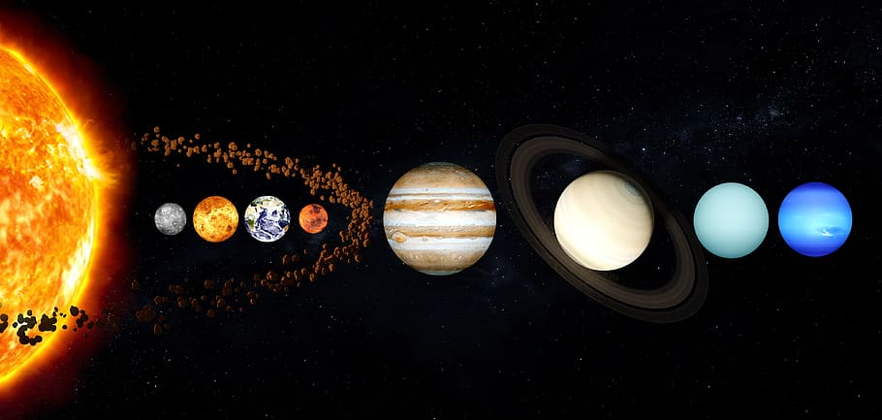
Looking Forward
2024
Looking ahead, we have plans to enhance Orreus further by integrating VR experiences, allowing users to participate in asteroid mining missions and explore exoplanetary systems.

Slide 10
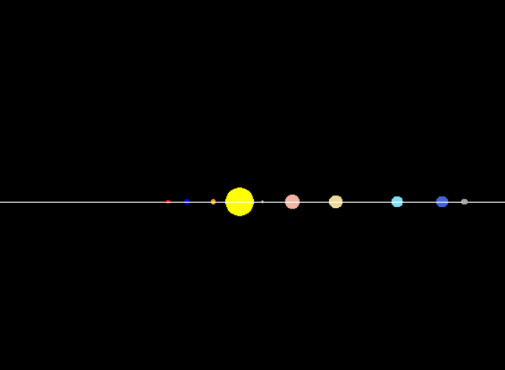
Try Orreus Today
2024
We invite you to explore Orreus today! Whether you’re a space enthusiast or an educator, our platform offers something exciting for everyone. Thank you for your time, and we’re happy to answer any questions.

Slide 11
Reference
2024
Models: https://codepen.io/jcoulterdesign/pen/ZxXbeP?editors=1111
https://codepen.io/WillemCrnlssn/pen/nabXoo
https://data.nasa.gov/Space-Science/Near-Earth-Comets-Orbital-Elements-API/ysqn-vd8v/about_data Theory:
Resources of our challenge https://www.spaceappschallenge.org/nasa-space-apps-2024/challenges/create-an-orrery-web-app-that-displays-near-earth-objects/?tab=resources

Slide 12

Project Codes and Videos
2024
Nasa Space App Challenge 2024 Project Link: https://github.com/RaghuvaranDBECse32/Orreus
PPT Link: https://onedrive.live.com/edit?id=1375A2F2B81AEE6F!sb9a3fb9a258344a6b13a49e1abbc5759&resid=1375A2F2B81AEE6F!sb9a3fb9a258344a6b13a49e1abbc5759&cid=1375a2f2b81aee6f&ithint=file%2cpptx&redeem=aHR0cHM6Ly8xZHJ2Lm1zL3AvYy8xMzc1YTJmMmI4MWFlZTZmL0VacjdvN21ESmFaRXNUcEo0YXU4VjFrQm5ZUjFSM0R3S2wyeUQ5T3M3NWF3M1E_ZT1taEdnWHM&migratedtospo=true&wdo=2

Slide 13
Thank You
2024

