Slide 1
Statics for Data Science Project Topic : Summer clothes Dataset Mentor : Prof Sreenath M V
SUDIPTA PAHARI PES2UG19CS411
SRIVATSAN N PES2UG19CS408
Y RAGHAVENDRA PES2UG19CS464
BILAL RIZVI PES2UG19CS423

Slide 2
About Dataset
We have selected Summer clothes e commerce dataset from kaggle website
This dataset contains the information about the clothes price,ratings,units sold,origin of clothes and much more
In our dataset we are having nearly 3% of the missing values
Our aim is to improve the sales using this dataset

Slide 3
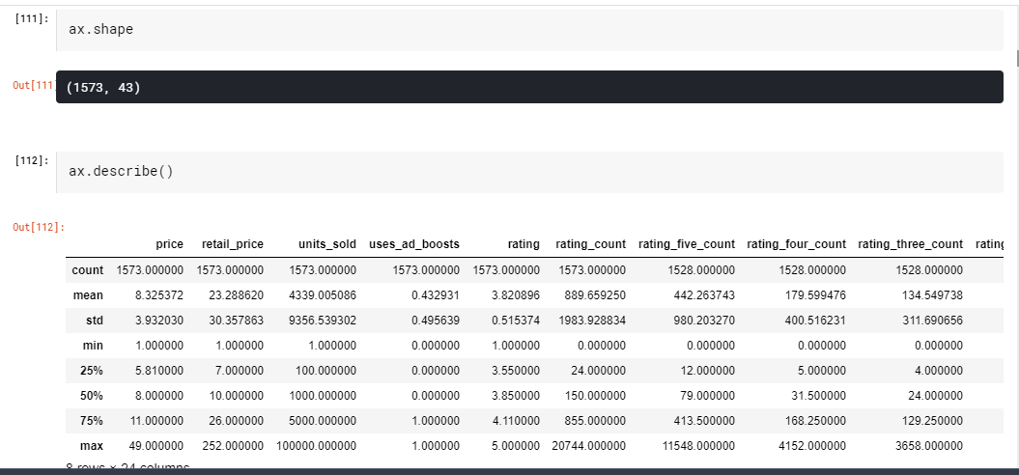
Data analysis

Slide 4
There are 43 columns with 1573 rows
Price : price of the clothes
Units sold : no of clothes sold
Ratings : feedback from customers
Origin : origin of clothes
Product url : url of specific cloth

Slide 5
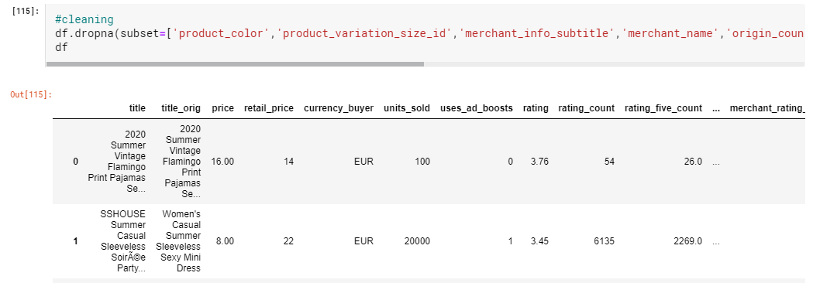
DATA cleaning
Data cleaning
Initially the dataset is not clean as it has many null and inconsistent values
We have to fix this
First we remove the colums in which majority of the values are missing
We remove all the outliers in the column product_variation_size_id
Then we remove the rows in which values of rating column are missing as product without rating is not recommended

Slide 6
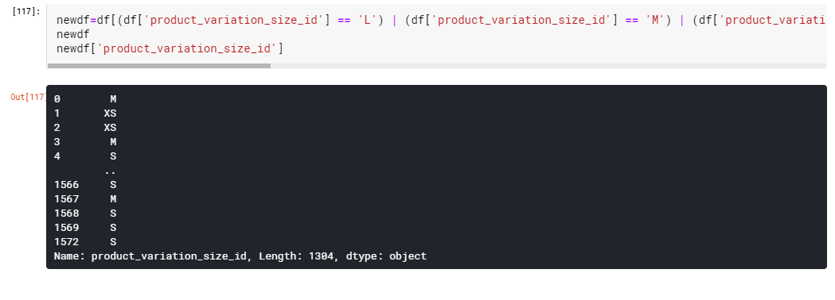

Slide 7
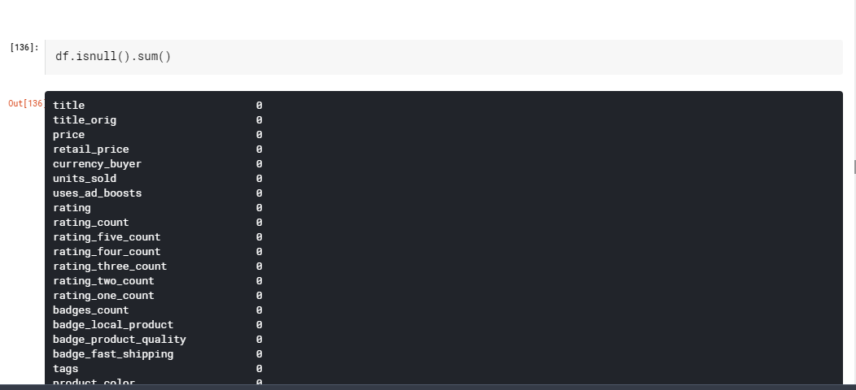

Slide 8
GRAPHS VISUALISATION
The idea here is to derive meaningful insights from the dataset chosen. This aids the better understanding of data and deriving meaningful insights which can help in an in-depth analysis. Also, we can have a wider look at the data in a moment by looking at the graphs.
Since the data deals with clothing sold for summer, it would be a good insight to know how people rate the clothing. Hence, the first plot was the number of merchandises to the rating given by the customers. This allows us to understand what the customers feel about the clothing.

Slide 9
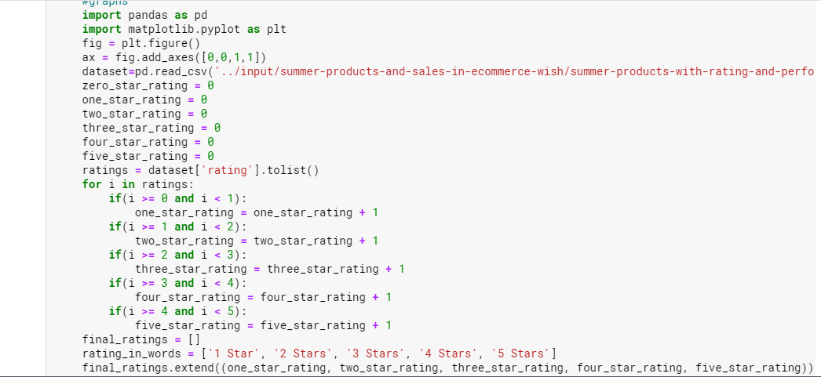

Slide 10
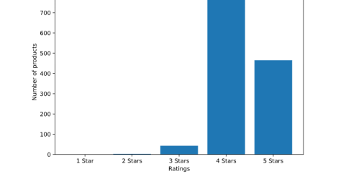

Slide 11
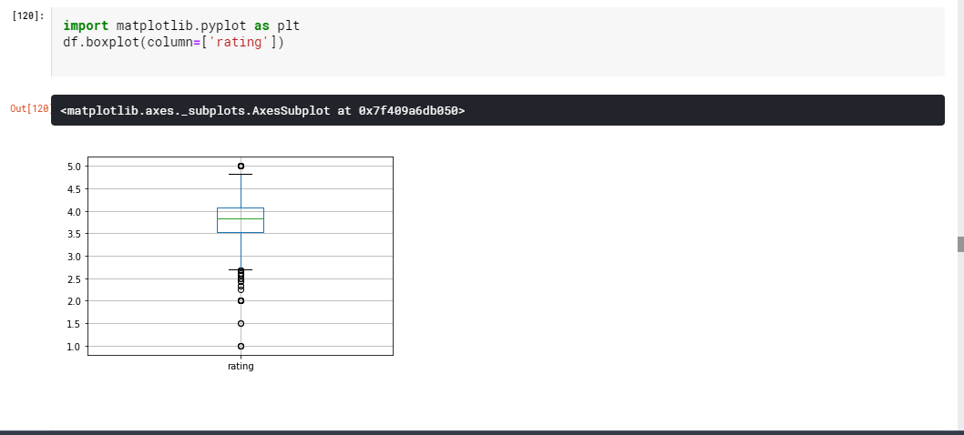
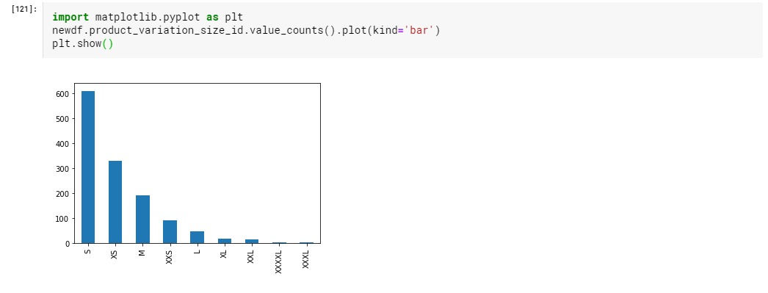

Slide 12
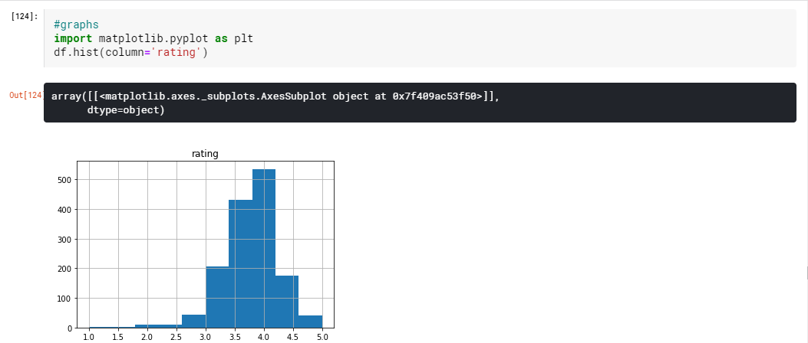

Slide 13
normalisation
Normalisation is done so that all the input variables have same treatment in the dataset.
It also helps to keep the data clearer ,easier to maintain and also convenient to change
Standardization is useful when data has varying scales.It assumes data Gaussian(bell curve).
Custom lambda function is used to normalise the data set

Slide 14
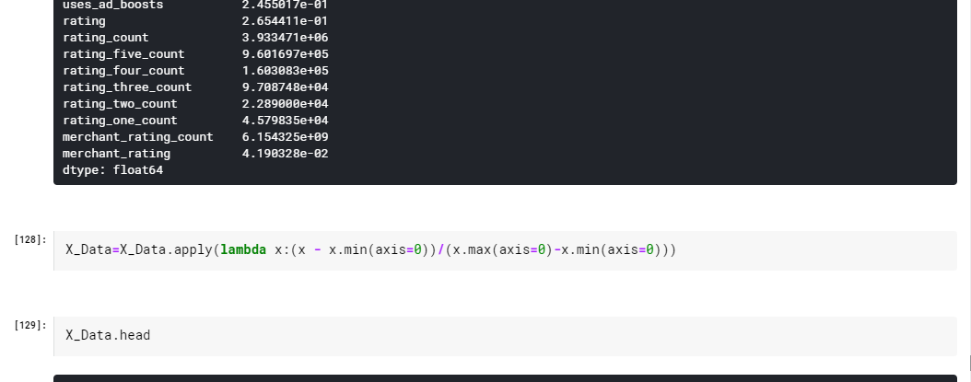

Slide 15
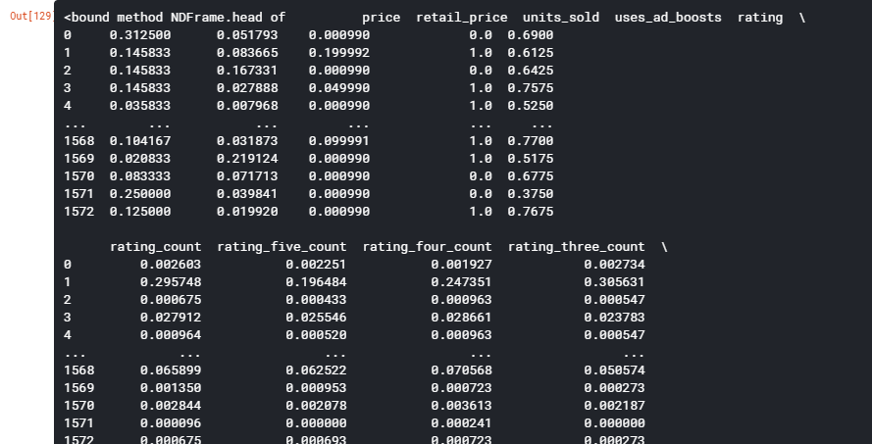

Slide 16
hypothesis
A hypothesis is an assumption about population parameter
In our data set let's assume null hypothesis is 5000 and alternate hypothesis is not equal to 5000
It's a 2 tail test
Initially we consider significance level to be 5% which is 0.05
From significance level and inferring from the z table we need to get the value between -1.96 and 1.96 as that's the acception region
Since our value lies between the intervals
We can conclude that our null hypothesis is accpeted

Slide 17
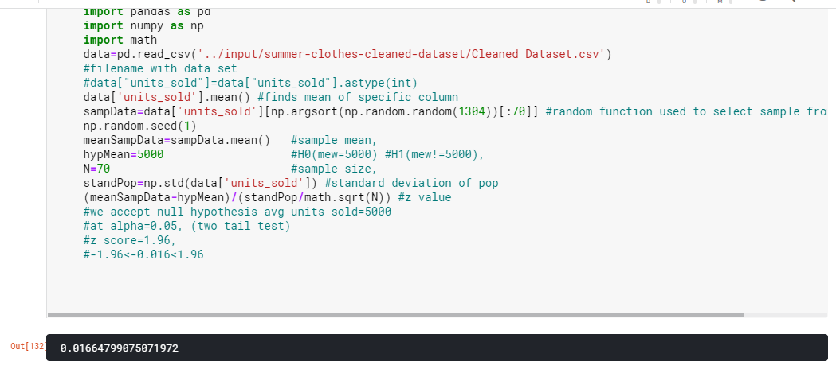

Slide 18
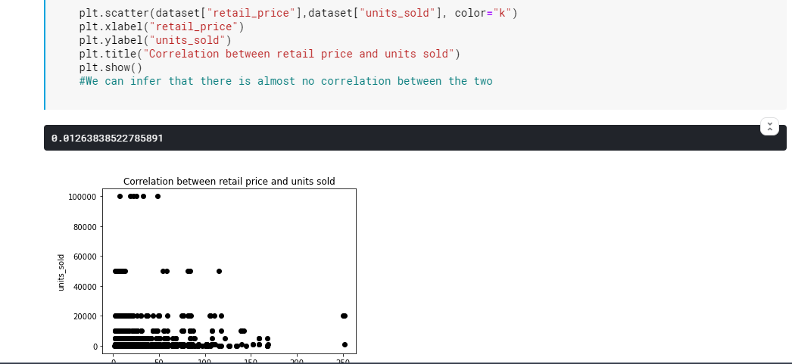
correlation

