Slide 1

Bangladesh Army University of Science And Technology
Project Presentation
Title: Airbnb price prediction model.
Submitted to,
Md. Mamun Hossain
Asst. Professor
Department of Computer Science and Engineering
Ragib Rohan (170201009)
Nayan- E- Alam (170201018)

Slide 2

Outline
Introduction
Problem statements
Objective
Related works
System model
Methods and Techniques
Dataset and working process
Conclusion and future works
References

Slide 3
Introduction
Airbnb is a service that lets property owners rent out their spaces to travelers looking for a place to stay.
It is the landing platform for providing lodging and tourism experiences.
Travelers can rent a space for multiple people to share, a shared space with private rooms, or the entire property for themselves.

Slide 4
Problem statement
Airbnb hosts need guidance when choosing a pricing range when they property online.
People can’t decide on the price list because they don’t know how much similar booking cost.
Options of choosing different services depending on the price.

Slide 5
Objective
To provide a accurate model for price prediction to help users to set the price correctly or help users to choose the best option according to their price range.

Slide 6
Related Work
Tang and Sanghani [2015] work on the task of price prediction for San Francisco Airbnb listings. They turn the regression problem into a binary classification problem by splitting the price according to the median, which effectively reduces the difficulty of the task.
, Kalehbasti et al. [2019] work on price regression for Airbnb listings in New York. They use a range of methods including tree-based models, SVR, KMC, NN, etc and integrate sentiment analysis into their model.
Tiancheng Cai, Kevin Hen, Han Wu of Standard University using different machine learning model.

Slide 7
System Model
Airbnb Data model
Load Data
Data Preparation
This is our very basic system model of our Airbnb model.
Exploratory data Analysis
Preprocessing
Train the model
Machine learning Model
Final Model

Slide 8
Method and Techniques:
Linear Regression machine learning model.
Lasso Regression model.
Ridge Regression model.

Slide 9
Linear Regression:
Linear regression is a linear approach for modeling the relationship between a scaler response and one or more explanatory variables. In this model, the relationships are modeled using linear prediction functions.
Lasso Regression:
It is a regression analysis technique that performs both variable selection and regularization in order to enhance the prediction accuracy and interpretability of the resulting statical model. The main purpose is the feature selection and regularization of data models.
Ridge Regression:
Ridge regression is the method used for the analysis of multicollinearity in multiple regression data. It is use to deal with overfitting and when the dataset is large.

Slide 10
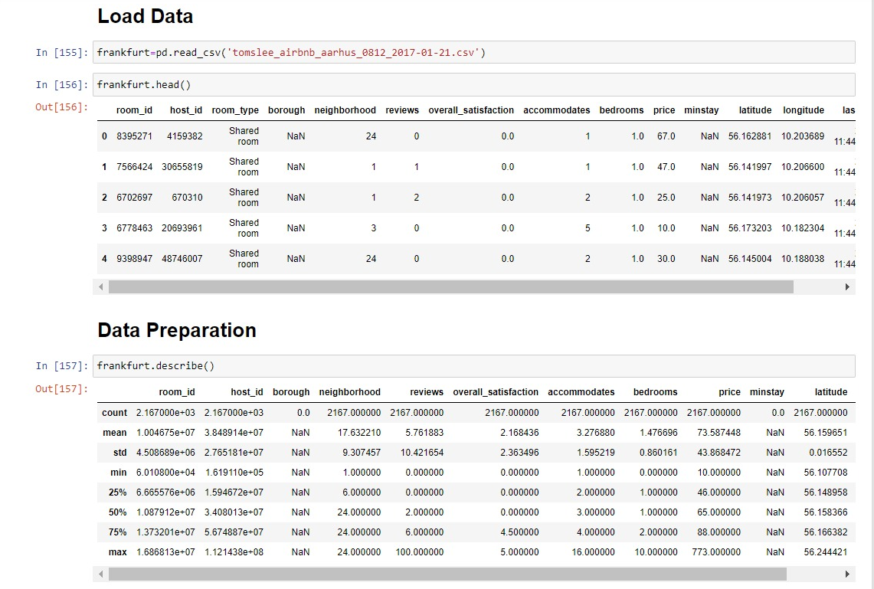
Dataset and Working process:
Loading and visualizing our data model

Slide 11
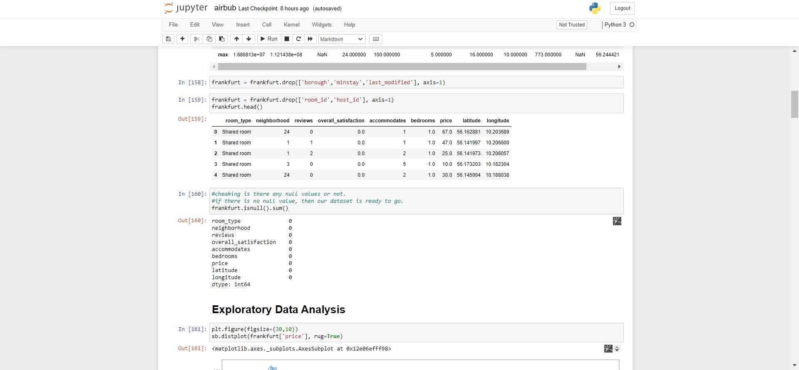
Dataset and Working process:
Preparing the dataset and Searching is there any null value in any column.

Slide 12
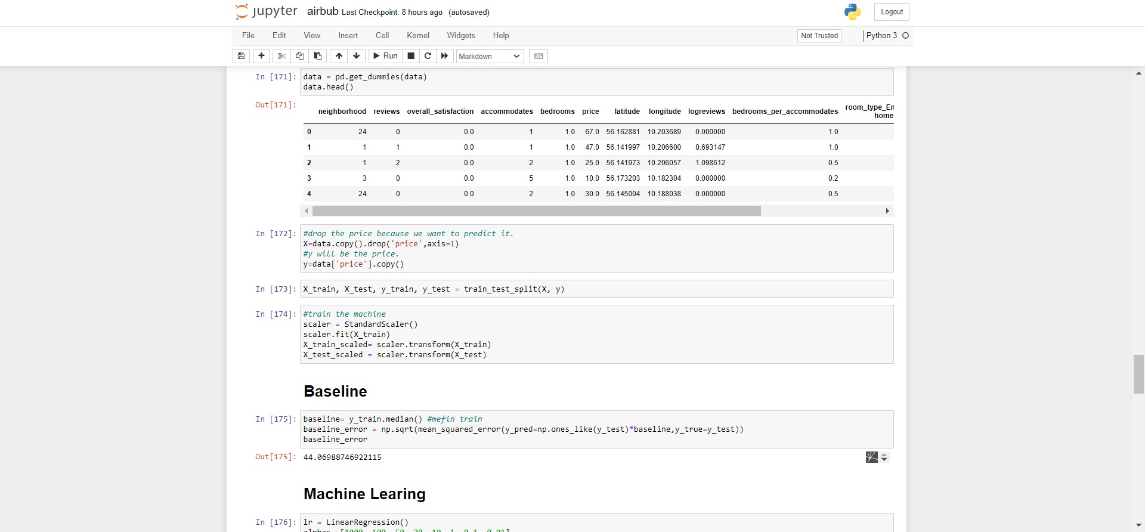
Dataset and Working process:
Training our machine.

Slide 13
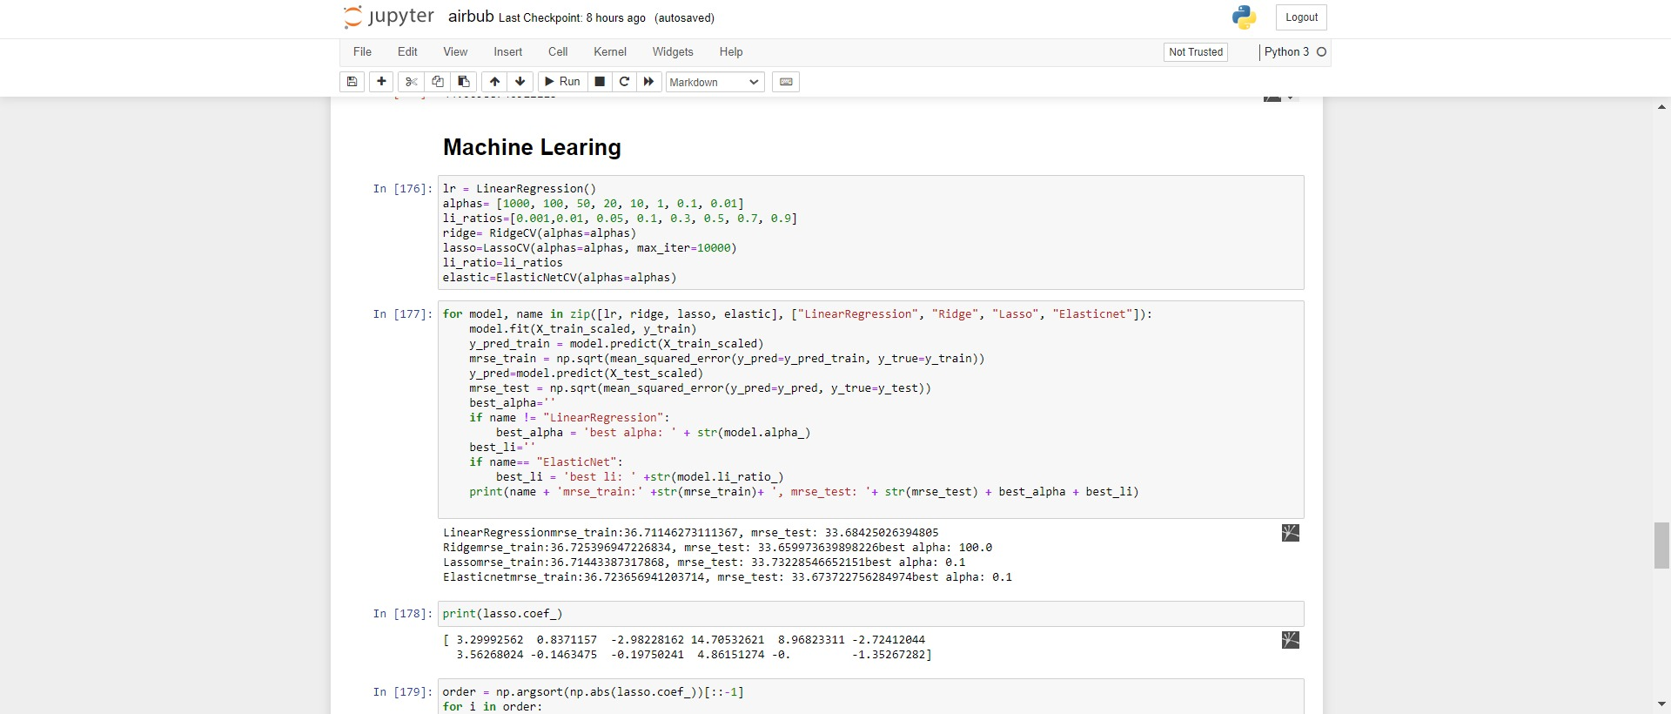
Dataset and Working process:
Training and testing the model.

Slide 14
Predicted Accuracy
We use two data set of Airbnb for experimental purpose.
For 1st dataset the accuracy level is:
Liner Regression: 34%
Ridge: 34%
Lasso: 35%
For 2st dataset the accuracy level is:
Liner Regression: 41%
Ridge: 42%
Lasso: 39%

Slide 15
Conclusion And Future Work
This project will provide an accurate model for price prediction to help hosts to set the price correctly when they want to post up their house for the online rental market.
In future we will use other machine learning model to achieve more accuracy level to our machine learning model and user larger dataset in it.

Slide 16
Reference
Melbourne airbnb open data. https://www.kaggle.com/tylerx/melbourne-airbnb-open-data, 2018
L. Buitinck, G. Louppe, M. Blondel, F. Pedregosa, A. Mueller, O. Grisel, V. Niculae, P. Prettenhofer, A. Gramfort, J. Grobler, R. Layton, J. VanderPlas, A. Joly, B. Holt, and G. Varoquaux. API design for machine learning software: experiences from the scikit-learn project. In ECML PKDD Workshop: Languages for Data Mining and Machine Learning, pages 108–122, 2013.
F. Chollet et al. Keras. https://keras.io, 2015.
Furuta, 2018. URL https://gist.github.com/furuta/eb2453a0ad13ca51b780caef5f3c95c7.
T. Hastie, R. Tibshirani, and J. Friedman. The Elements of Statistical Learning. Springer-Verlag, New York, 2009.
P. R. Kalehbasti, L. Nikolenko, and H. Rezaei. Airbnb price prediction using machine learning and sentiment analysis, 2019.
D. P. Kingma and J. Ba. Adam: A method for stochastic optimization, 2014

Slide 17
Thank You For your support And Staying with us

Slide 18

Questions?

