Slide 1
THE PROJECT OF HANGMAN GAME
Project by,
Sabbir Hossain
Ragib Rohan
MoShaheb Hossain
Tanvir
Submited To,
Fatima Jahan Sarmin

Slide 2
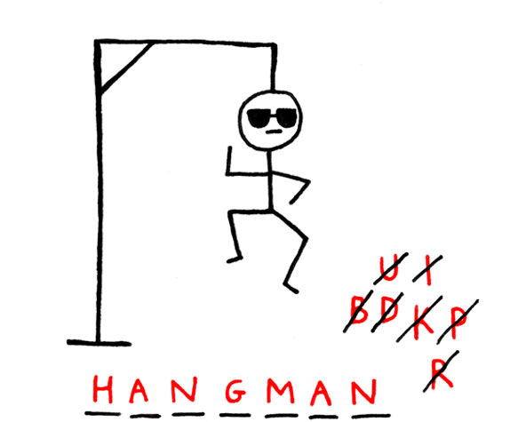
WELCOME to the hangman game

Slide 3
TITLE PAGE
Introduction
Objectives
Output of code
Scope

Slide 4
Introduction
Hangman is a popular word guessing game where the player attempts to build a missing word by guessing one letter at a time. After a certain number of incorrect guesses, the game ends and the player loses. The game also ends if the player correctly identifies all letters of the missing word.

Slide 5
OBJECTIVES
This is a game ,where a player can learn some new words. Also it will increase the thinking ability of the player.

Slide 6
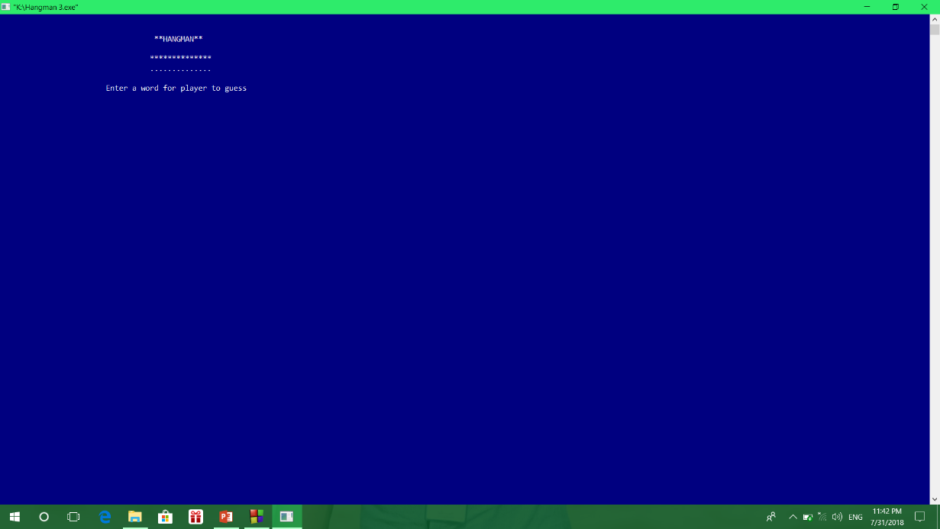
The first view of the output.

Slide 7
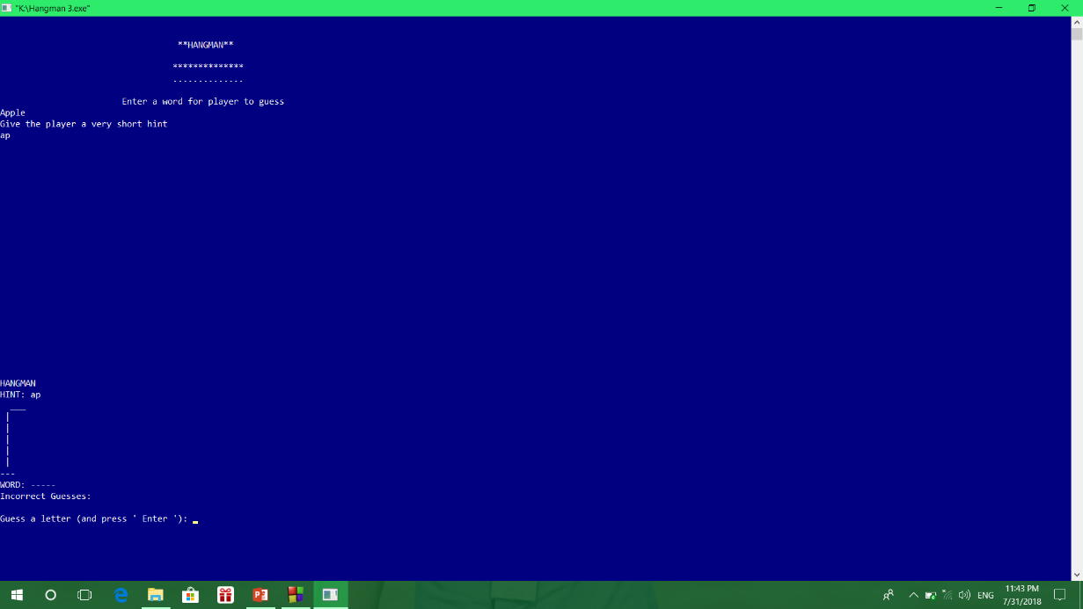
The view of giving a word and hint of that word.

Slide 8
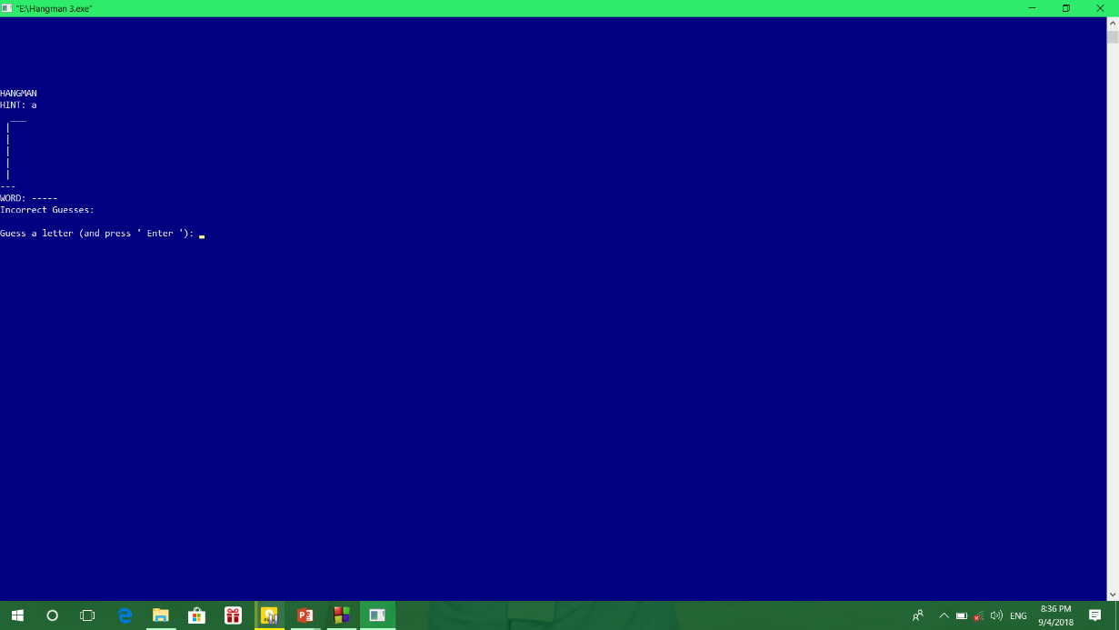
Player guess a letter

Slide 9
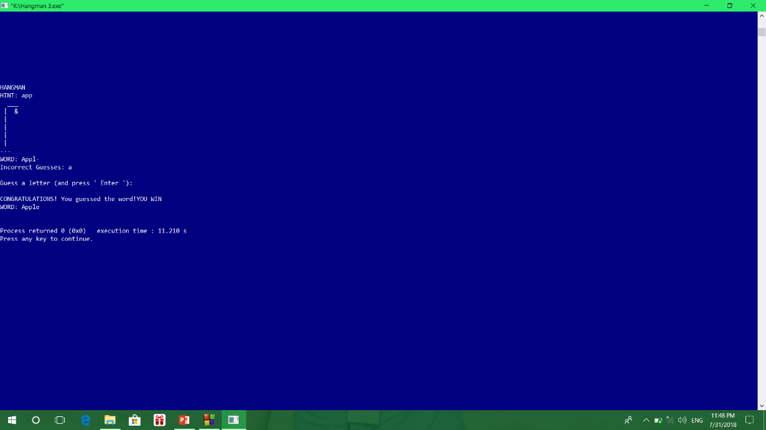
The player guess the correct word

Slide 10
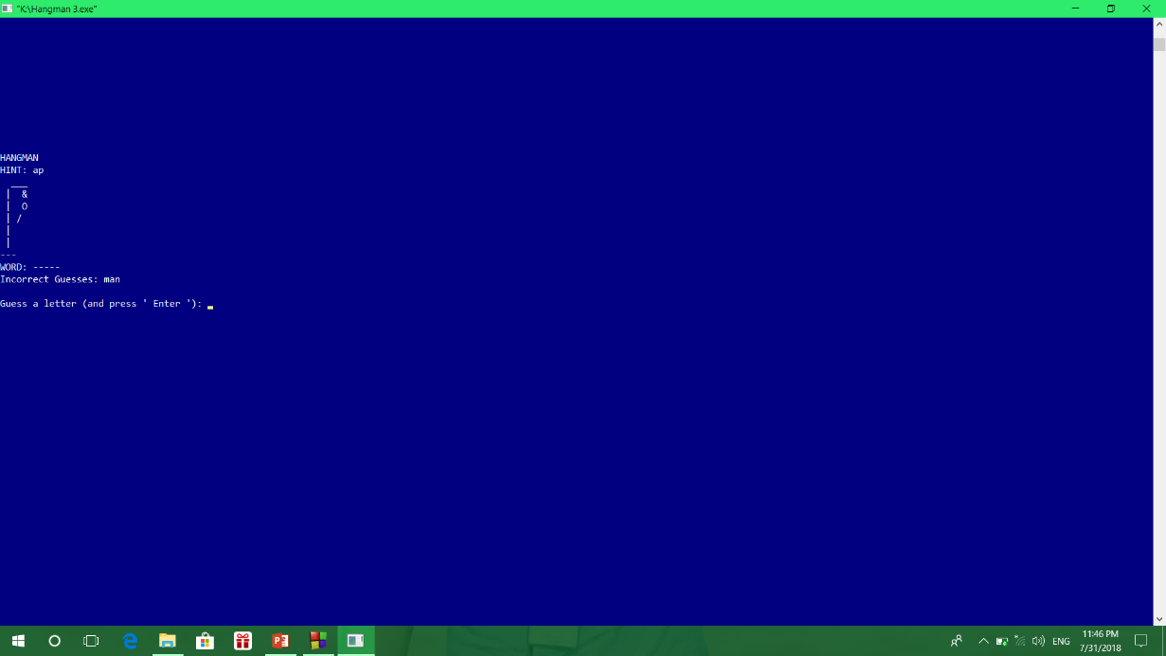
Guessing wrong word and adding body parts of the hanging man.

Slide 11
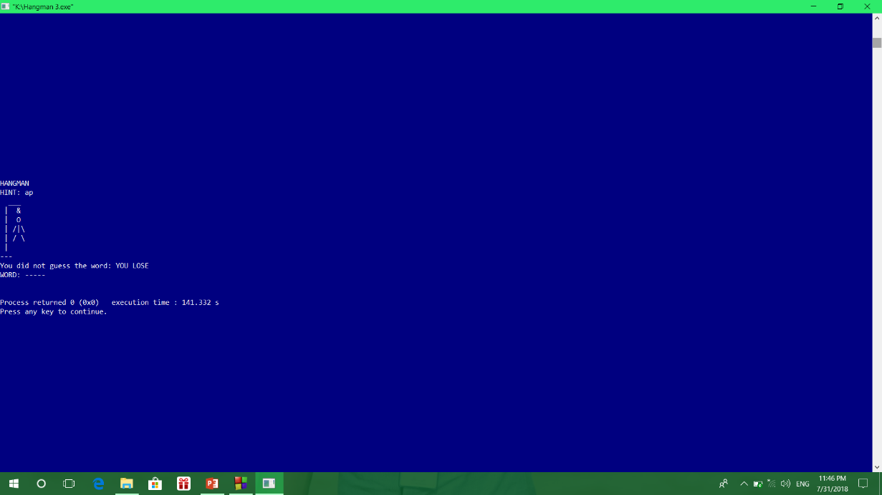
The player guess all the words wrong and he lose.

Slide 12
Game Over

Slide 13
SCOPE OF THE PROJECT
The scope of this project is to developed our skills of coding and make progress.

Slide 14
THANK YOU
ALL
FOR SUPPORTING US.

