Slide 1
INTRODUCTION
Project Name: MINI GAME
This Mini game project is collection of two classic games. (1) HANGMAN GAME
(2) SNAKE GAME

Slide 2
OBJECTIVES
To develop creativity & individuality in problem solving & performing tasks.
Prepare to working in teams.
To develop competences necessary for us to be employed in the area of information technologies & the industry of game development.

Slide 3
Used library function in mini game
#include<iostream>
#include <conio.h>
#include <windows.h>
#include <vector>
#include <fstream>
#include <string>
#include <time.h>
#include<cstdlib>
#include<stdlib.h>

Slide 4
The functions and Statements used in the game
We have used
Boolean functions
Colour Functions
Time Function
Const variables
User define functions
Loops(For & While())
If, Else
Switch ,Case, Default
Break

Slide 5
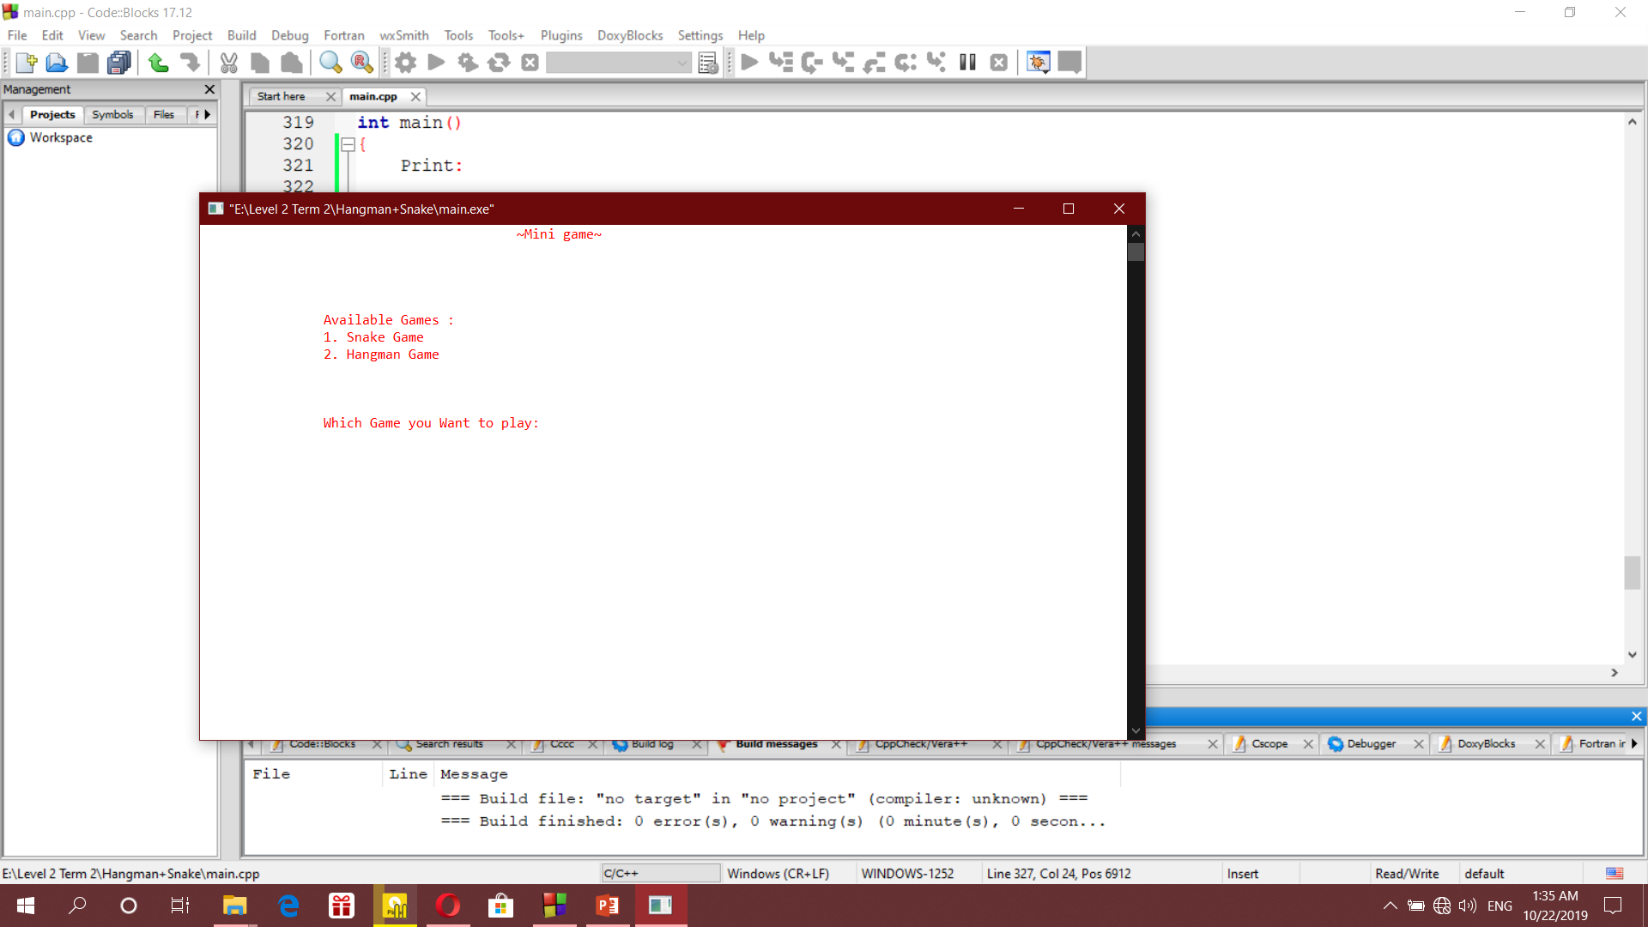
Menu
In menu, we can select any available game in our mini game project.

Slide 6
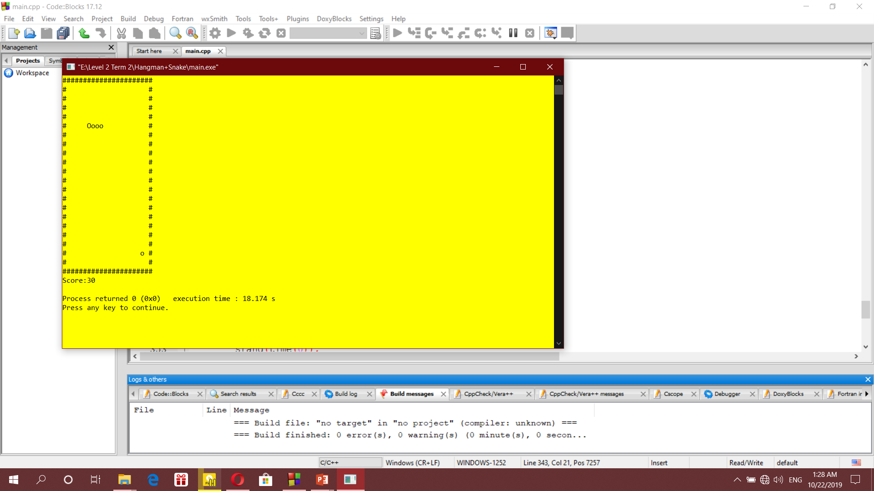
Snake
In snake game we will play as a snake where the snake will eat fruits and other things and grow bigger.
By eating each fruits or element the player will get 10 point.
If the snake bite itself then the game will be over, and the score will be shown.

Slide 7
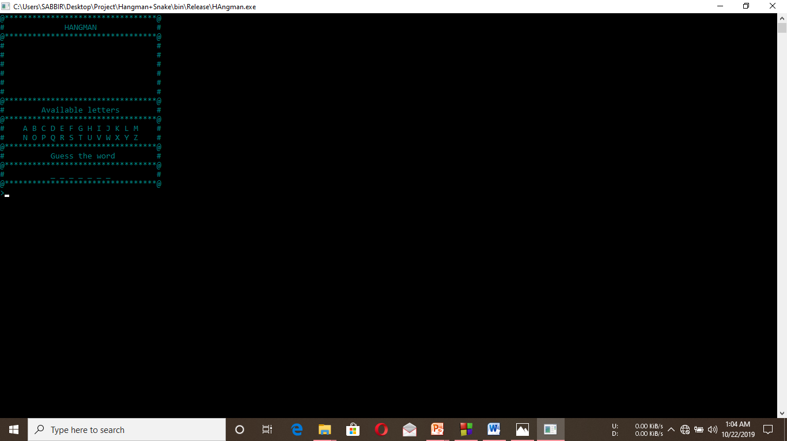
Hangman
It is a word guessing game, in where the player need to guess words for win the game.

Slide 8
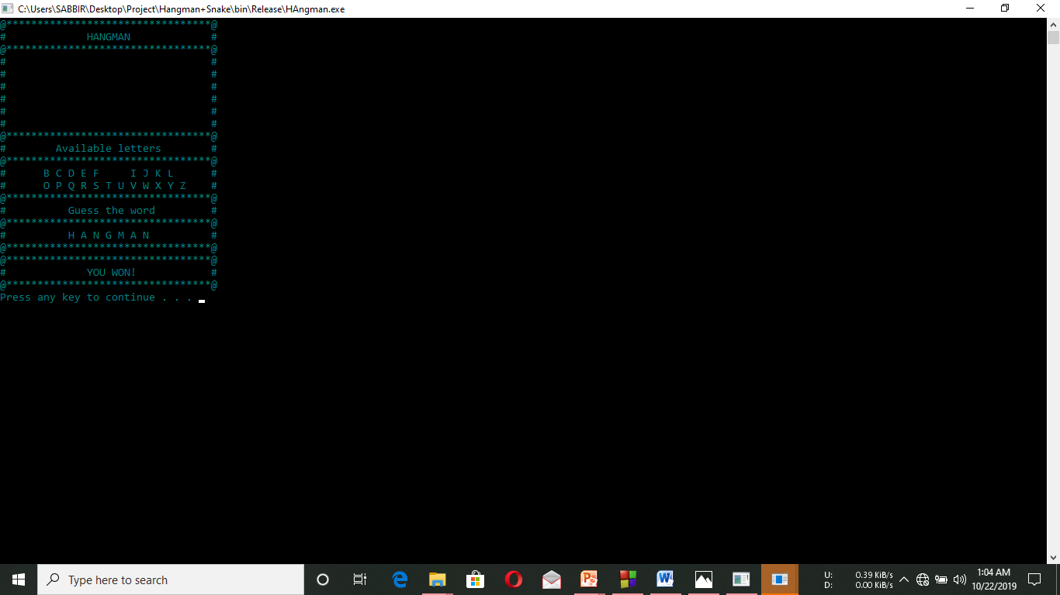
Hangman Output 2
If the player guess the right word then the player will win the game and the game will be finished.

Slide 9
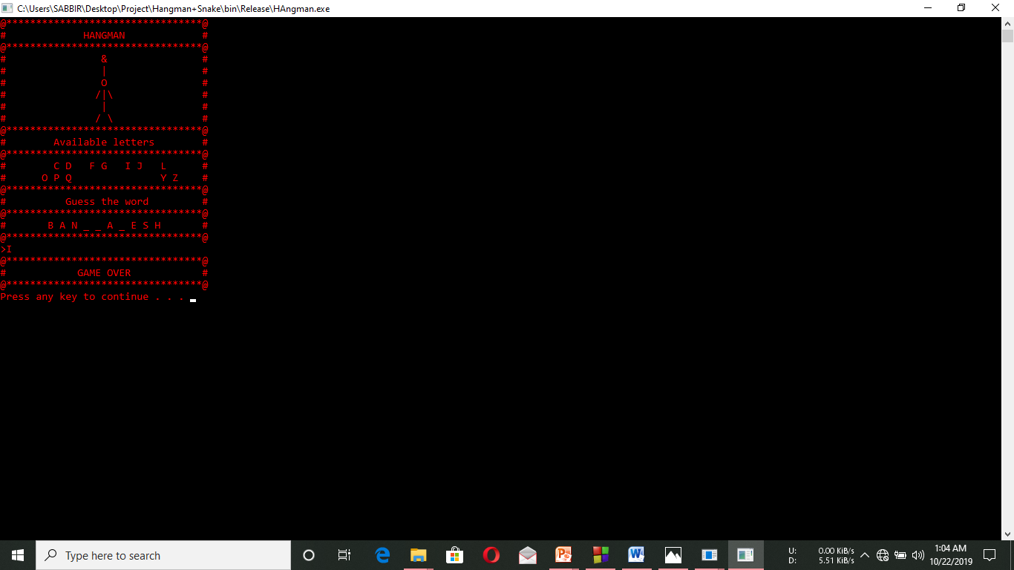
Hangman Output 3
If the player can’t guess the word then the game will be over with the shape of a hanging man.

Slide 10
Thank you for supporting us

