Slide 1
Project- Regression and Time Series Model Group 6

Slide 2
Objective: To study the factors affecting long run inflation rates in the United States of America between 1970-2014

Slide 3
Literature Review
1
William Philips tried to establish an empirical relationship between inflation and unemployment of UK from 1861-1957
Criticism from Friedman, Phelps, Lucas in post OPEC crisis period

Slide 4
“The prediction of Keynesian models were wildly incorrect and the doctrine on which they were based were fundamentally flawed.”
-Lucas and Sargent (1979)

Slide 5
Causes of Inflation
Demand-Pull Factors: When the aggregate demand in an economy strongly outweighs the aggregate supply, prices increase.
Cost-Push Factors: A phenomena in which the general prices levels rise due to increases in the cost of wages and raw materials.

Slide 6
Quantity Theory of Money
“Price level is proportional to money supply, so that the rate of inflation equals rote of growth of money supply.”
P = M^{s} / (k* Y)
P : General level of Prices
M^{s} : Money Supply
Y : Real Income

Slide 7
Modern Quantity Theory of Money
“Inflation rate equals the growth rate of nominal stock of money minus the growth rate of real money demand”
G^{p} = G^{m} - G^{Y}

Slide 8
Factors affecting inflation
Broad Money to Total Reserves
Broad Money(% of GDP)
Broad Money Growth
Real Interest Rate
Lending Interest Rate
Central Government Debt(% of GDP)
Crude oil price per barrel(in dollars)
Real GDP growth

Slide 9
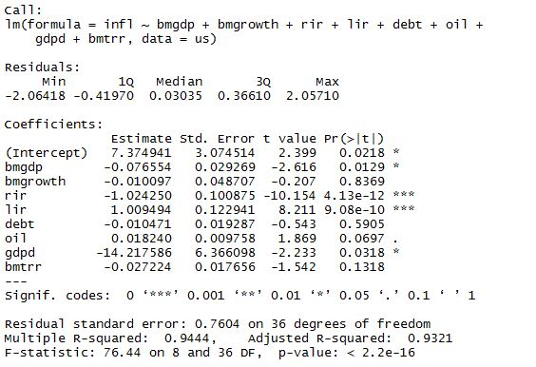
Place your screenshot here
Initial Linear Regression Model

Slide 10
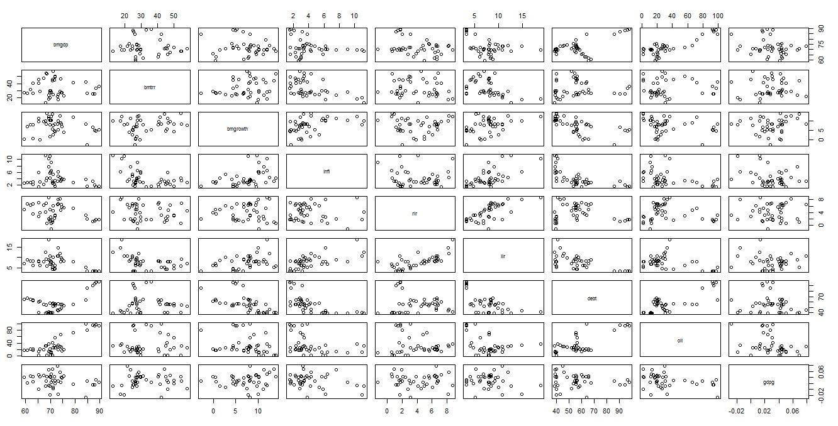
Scatterplot Matrix
bmgdp
bmtrr
bmgrowth
inf
rir
lir
debt
oil
gdpg

Slide 11
Multicollinearity?
Variance Inflation factor(VIF)
Second
Last

Slide 12
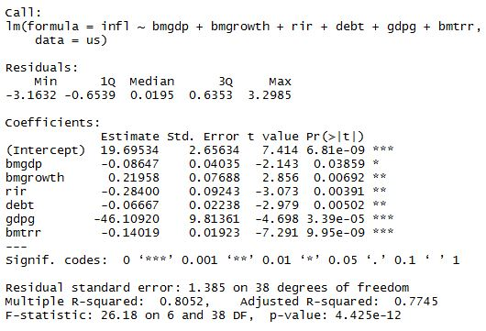
Place your screenshot here
Final Linear Regression Model ?

Slide 13
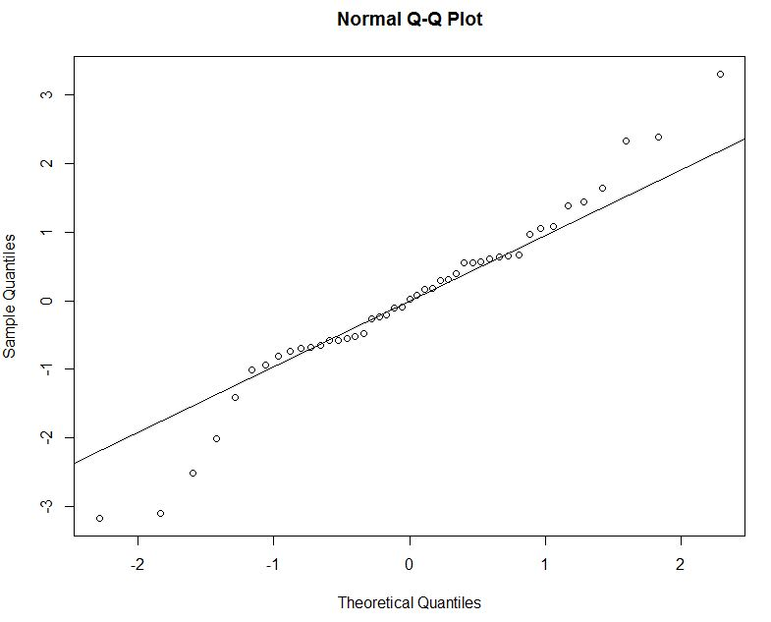
Place your screenshot here
Normal Probability Plot

Slide 14
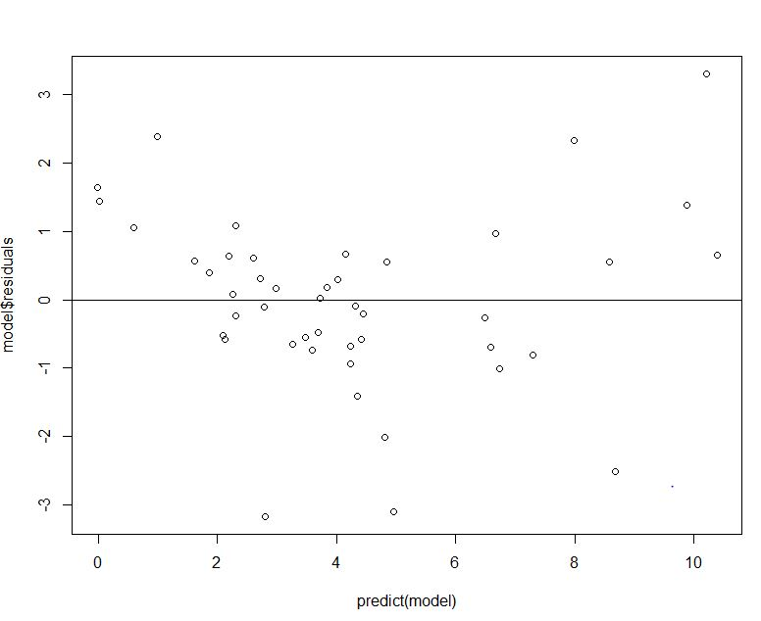
Place your screenshot here
Residuals Vs Fitted values

Slide 15
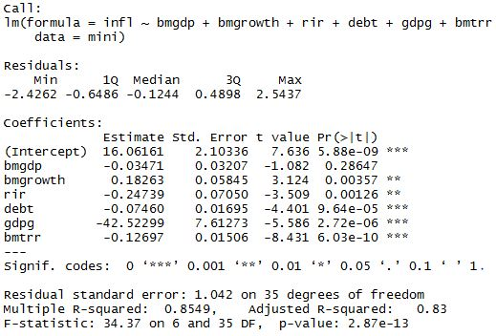
Place your screenshot here
Linear Regression Model after removing outliers

Slide 16
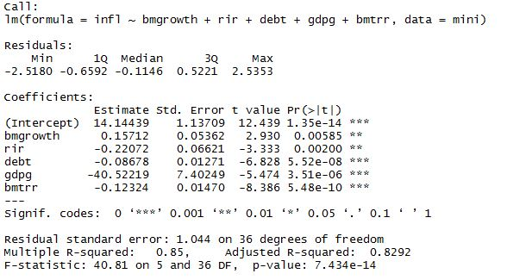
Place your screenshot here
Final Linear Regression Model

Slide 17
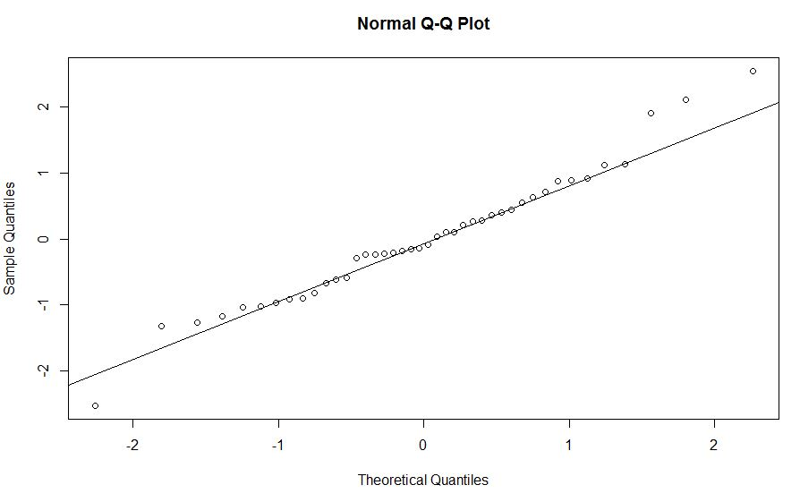
Place your screenshot here
Normal Probability Plot

Slide 18
Place your screenshot here
Comparison between the
predicted value and the actual value

Slide 19
Conclusion
This model explains 85% of regression model as significant as we found R-squared value is 0.85.
Depends on Broad Money Growth, Broad Money to Total Reserves, Real Interest Rate Lending Interest Rate, Central Government Debt(% of GDP),Real GDP growth.
Correlation between Lending Interest Rate and Real Interest Rate and between Broad Money(% of GDP) and Crude oil price per barrel(in dollars)and also between Central Government Debt(% of GDP) and Crude oil price per barrel(in dollars).
After removing multicollinearity Broad Money as a percentage of GDP comes out to be insignificant.

