Slide 1

SUDOKU
Group members:
PC35 Prakhar singh rajput
PC33 Mayannk kumar singh
PC41 Abhijeet Takle
In the guidance
Of
Prof. Mrunal Annadate

Slide 2
Aim & Objectives
AIM:
To Write a C++ program to create a Sudoku game.
OBJECTIVES:
To learn rules of the Sudoku.
To learn concept of recursion.

Slide 3
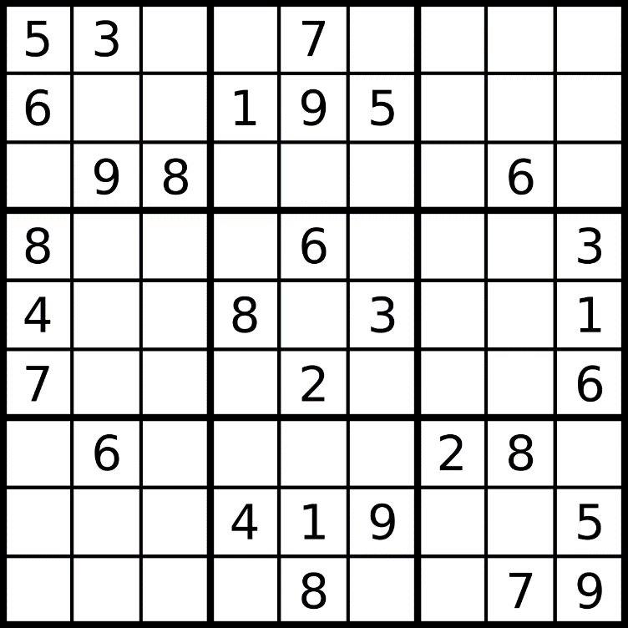
SUDOKU
Sudoku is 9x9 grid which has 9 3x3 sub grids.
We need to fill the Sudoku such that,
Each row have 1-9 numbers ,each column has 1-9 numbers.
And Each Sub grid should also have 1-9 numbers.
Without repeating any number in row ,column ,or sub grid.

Slide 4
Sudoku Solving Algorithm
start
Step1- Find the empty space in Sudoku.
Step2- Check if put number 1-9 is safe.
Step3- If safe place it and move to next column.
Step4- Go to step2
Step5- If not safe, move to previous block.
Step6- Go to step 2
Step7- Repeat above steps until there are no empty space left.
stop

Slide 5
Members Contribution
Prakhar Singh Rajput: research ,report;
Mayannk Kumar Singh: research ,report;
Abhijeet Takle: research ,code;

Slide 6
THANK YOU

