Slide 1
2026 IEEE International Conference on Communication, Networks and Satellite (ComNetSat 2026)
Enhancing Trust in Federated Learning Through Blockchain-Based Model Verification and Zero-Knowledge Proofs
PRESENTER 1
PRESENTER 2
[ INSERT
PRESENTER
PHOTO ]
[ INSERT
PRESENTER
PHOTO ]
A Decoupled Framework: FedProx + Groth16 zk-SNARKs + IPFS + Reputation-Weighted FedAdam
Authors: Kiet Dao-Anh, Nguyen Tran-Bui-Nhat, Thuat Nguyen-Khanh*, Dung Tran-Thi, Quan Le-Trung
Faculty of Computer Networks and Communications, University of Information Technology (UIT), VNU-HCM
Emails: {23520810, 23521059}@gm.uit.edu.vn | {thuatnk, dungtt, quanlt}@uit.edu.vn
Kiet Dao-Anh
Presenter & Co-Author
University of Information
Technology (UIT)
VNU-HCM
23520810@gm.uit.edu.vn
Voice-over / Video
Nguyen
Tran-Bui-Nhat
Presenter & Co-Author
University of Information
Technology (UIT)
VNU-HCM
23521059@gm.uit.edu.vn
Voice-over / Video
Acknowledgment: Funded by University of Information Technology - VNU-HCM under grant CS4-2026-80290.
Session Format: 10-Minute Video Presentation (Voice-Over or Video) + 5-Minute Live Q&A

Slide 2
IEEE COMNETSAT 2026
Presentation Roadmap
02 / 13
01
Motivation & Research Challenges
Non-IID client drift, untrusted edge participants, and blockchain storage bottlenecks.
02
Four-Tier Decoupled Architecture
End-to-end framework: FedProx, Groth16 ZKP, IPFS off-chain storage, and smart contracts.
03
Decoupled Groth16 Gatekeeper
Why an O(1) circuit with exactly 67 constraints solves edge computational feasibility.
04
Reputation & Anomaly Detection
Scale-invariant Euclidean distance, dynamic cohort IQR fences, and Non-IID fairness.
05
Azure AKS Cloud Deployment
Rigorous evaluation across 4 namespaces, 2 vCPUs/7GB pods, and 47-class EMNIST.
06
Convergence & Empirical Accuracy
IID (75.2%) vs. Non-IID (71.2%) convergence dynamics and loss stability.
07
Byzantine Attack Resilience
Maintaining 71.2% robust accuracy against Gaussian poisoning vs. 21.8% baseline collapse.
08
Ablation, SOTA & Future Outlook
Literature benchmark (VPFL, zkFL, VerifBFL, BFLP) and scaling to deep Transformers.

Slide 3
IEEE COMNETSAT 2026
Motivation: Why Trust in Decentralized FL is Hard
03 / 13
Statistical Skew (Non-IID)
Byzantine Adversaries
The Blockchain Trap
Client Data Heterogeneity
• Edge clients gather highly skewed local datasets (class imbalance & distribution shift).
• Standard FedAvg experiences severe client drift toward local minima instead of global optimum.
• Divergent legitimate gradients naturally mimic malicious anomalous patterns.
Untrusted Edge Participants
• Malicious participants submit arbitrary updates: label-flipping (y -> 61-y) and Gaussian noise.
• Unbounded gradient explosion can derail the entire global model in a single communication round.
• Server cannot inspect local private datasets due to strict privacy boundaries.
Storage & Proving Bottlenecks
• Storing multi-MB neural network parameters on-chain exceeds EVM block gas limits.
• Ledger immutability alone cannot guarantee training computation correctness.
• In-circuit backpropagation requires >10^7 R1CS constraints, exceeding edge device RAM.
Dirichlet Skew: alpha = 0.5
Risk: Catastrophic Client Drift
Adversarial Noise: N(0, 3.0^2)
Risk: 21.8% Accuracy Collapse
Ethereum Gas Limit: 30M
Risk: >10^7 R1CS Constraint Trap
CORE RESEARCH QUESTION:
How can we deliver verifiable cryptographic gatekeeping and robust Byzantine resilience on resource-constrained edge devices without incurring millions of constraints or on-chain ledger bloat?

Slide 4
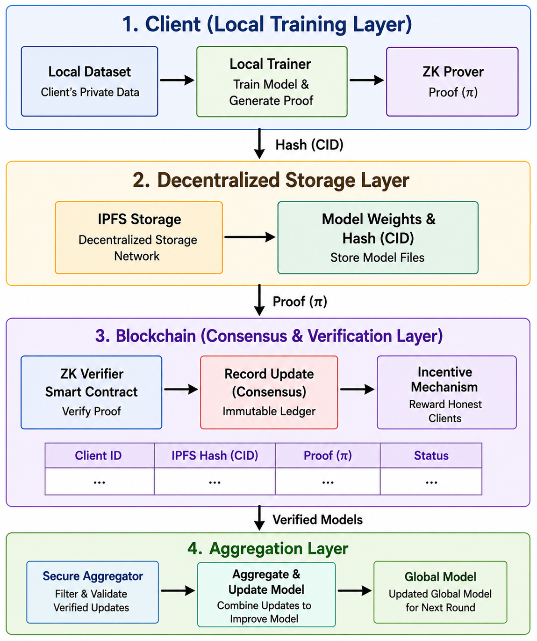
IEEE COMNETSAT 2026
Proposed Architecture: Decoupled 4-Tier Trust Framework
04 / 13
Tier 1: Edge Client Optimization (FedProx)
Clients optimize locally on private data using FedProx proximal regularization (mu=0.001) to bound Non-IID client drift within an admissible ball.
Tier 2: Cryptographic Gatekeeper (Groth16 ZKP)
Clients generate an ultra-fast Groth16 proof (67 R1CS constraints) verifying identity commitments and parameter bounds (W_max = 5*10^9).
Tier 3: Storage & Ledger Tier (IPFS + Ganache)
Raw model weights are stored off-chain in IPFS. Only the 32-byte CID and verification metadata are committed on-chain, preventing ledger bloat.
Tier 4: Trust-Aware Aggregation (FedAdam)
Server screens updates via relative Euclidean distance & dynamic IQR fences, updates EMA reputation, and aggregates via reputation-weighted FedAdam.

Slide 5
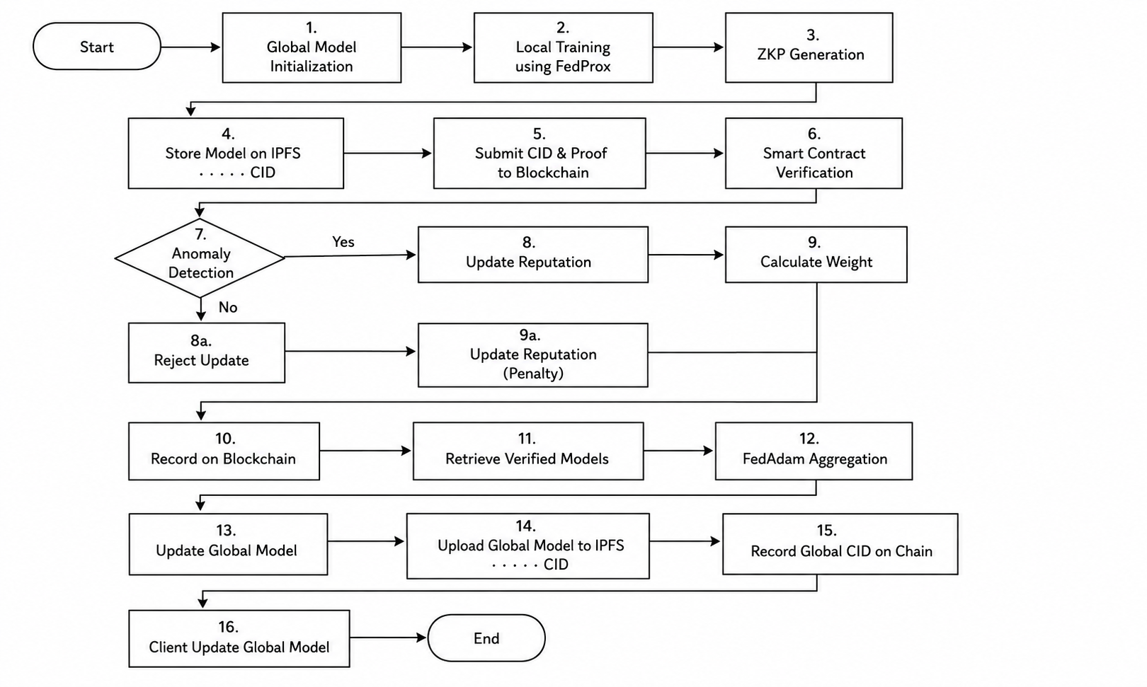
IEEE COMNETSAT 2026
End-to-End Communication Round Workflow
05 / 13
1
Global Model Broadcast
Aggregation server broadcasts global model parameters W_t to participating edge clients.
2
Local Optimization & Proof Generation
Clients run 2 FedProx epochs; SnarkJS compiles witness into Groth16 proof (0.35 s latency).
3
IPFS Storage & Smart Contract Audit
Model published to IPFS; 32-byte CID, client ID, and proof hash committed to Ganache contract.
4
Proof Verification & Anomaly Detection
Server verifies Groth16 proof (<0.05 s), calculates relative distance, and screens via IQR fences.
Communication Round Overhead Profile (Total: ~9.6 s):
• Local Training (2 FedProx epochs): ~8.8 s (91.7% of round time)
• Edge Groth16 Proving (T_prove): ~0.35 s (3.6% overhead — fully edge-compatible)
• Smart Contract & Proof Verify: ~0.18 s (< 2.0% overhead, single 32-byte CID)
5
Reputation Update & FedAdam Aggregation
EMA reputation updated (alpha=0.3); verified updates weighted and integrated via adaptive FedAdam.

Slide 6
IEEE COMNETSAT 2026
Decoupled Cryptographic Gatekeeper: Groth16 ZKP
06 / 13
The Edge Computing Dilemma (Prior Works)
Our Solution: O(1) Gatekeeper Relation R
Why In-Circuit Backpropagation Fails on Edge Devices:
• Constraint Explosion: Proving non-linear ReLU activations requires bit-decomposition (32–64 constraints per neuron).
• Complexity O(P): A modest CNN generates >10^7 R1CS constraints over multi-epoch local training.
• Hardware Barrier: Demands 16–32 GiB RAM and minutes of compute time per client.
• Verdict: Edge IoT devices, mobile phones, and lightweight edge gateways crash under these memory footprints.
Decoupling Cryptographic Sanity from Statistical Learning:
• Gatekeeper Relation R:
R = { (x, w) | (w_id^3 + w_id = x_hash) AND (sum |W_k| <= W_max) }
• Exact 67 R1CS Constraints Breakdown (Circom 2.2 / BN-128):
- Identity cubic commitment: 2 constraints
- 60-bit LessThan comparator: 60 constraints
- Boolean output enforcement: 5 constraints
• O(1) Parameter Independence: Circuit size is invariant to model depth!
• Edge Metrics: T_prove = 0.35 s, RAM < 50 MB, Verify < 0.05 s.
Pragmatic Trade-off: The Groth16 circuit serves strictly as an ultra-fast sanity gatekeeper (blocking identity fraud and gradient explosion), while directional correctness and anomaly filtering are delegated to statistical detection layers.

Slide 7
IEEE COMNETSAT 2026
Reputation System & Non-IID Fairness Guarantees
07 / 13
Scale-Invariant Distance & Dynamic IQR
Composite Behavioral Score S_i^t
3-Fold Non-IID Fairness Protections
• Relative Euclidean Distance:
delta_i^t = ||w_i^t - w_t||_2 / (||w_t||_2 + eps)
Normalizes for natural weight contraction across training rounds.
• Dynamic Cohort IQR Fences:
- Compute round Q1 (25th) and Q3 (75th) percentiles
- Upper Anomaly Threshold = Q3 + 1.5 * IQR
- Dynamically expands when cohort variance is high (Non-IID).
• Formally Defined Composite Score:
S_i^t = clip(0.4*sim_i^t + 0.3*(1 - d_i^t) + 0.3*acc_norm
- 0.2*loss_norm - 0.2*I_outlier, -1.0, 1.0)
• Components:
1. sim_i^t: Cosine similarity with global descent direction
2. d_i^t: Scaled distance in [0, 1]
3. I_outlier: IQR indicator penalty
• EMA Update: R_i^{t+1} = R_i^t + 0.3 * (S_i^t - R_i^t)
How honest Non-IID clients avoid false penalties:
1. FedProx Regularization (mu=0.001):
Bounds local client drift within an admissible optimization ball.
2. Dynamic Cohort Fences:
Thresholds are adaptive to the cohort, avoiding rigid static penalties.
3. Directional Alignment:
Honest Non-IID gradients maintain positive cosine similarity (sim > 0.1), whereas attacks flip direction.
Adaptive Scaling:
Scaling factor s_t = median({Delta_i^t}) contracts naturally with global model convergence.
Reputation Recovery:
R_i in [0.1, 1.0]. EMA momentum alpha = 0.3 allows honest nodes to recover from transient noise.
Directional Test:
Positive cosine similarity (sim > 0.1) reliably discriminates Non-IID skew from Byzantine attacks.

Slide 8
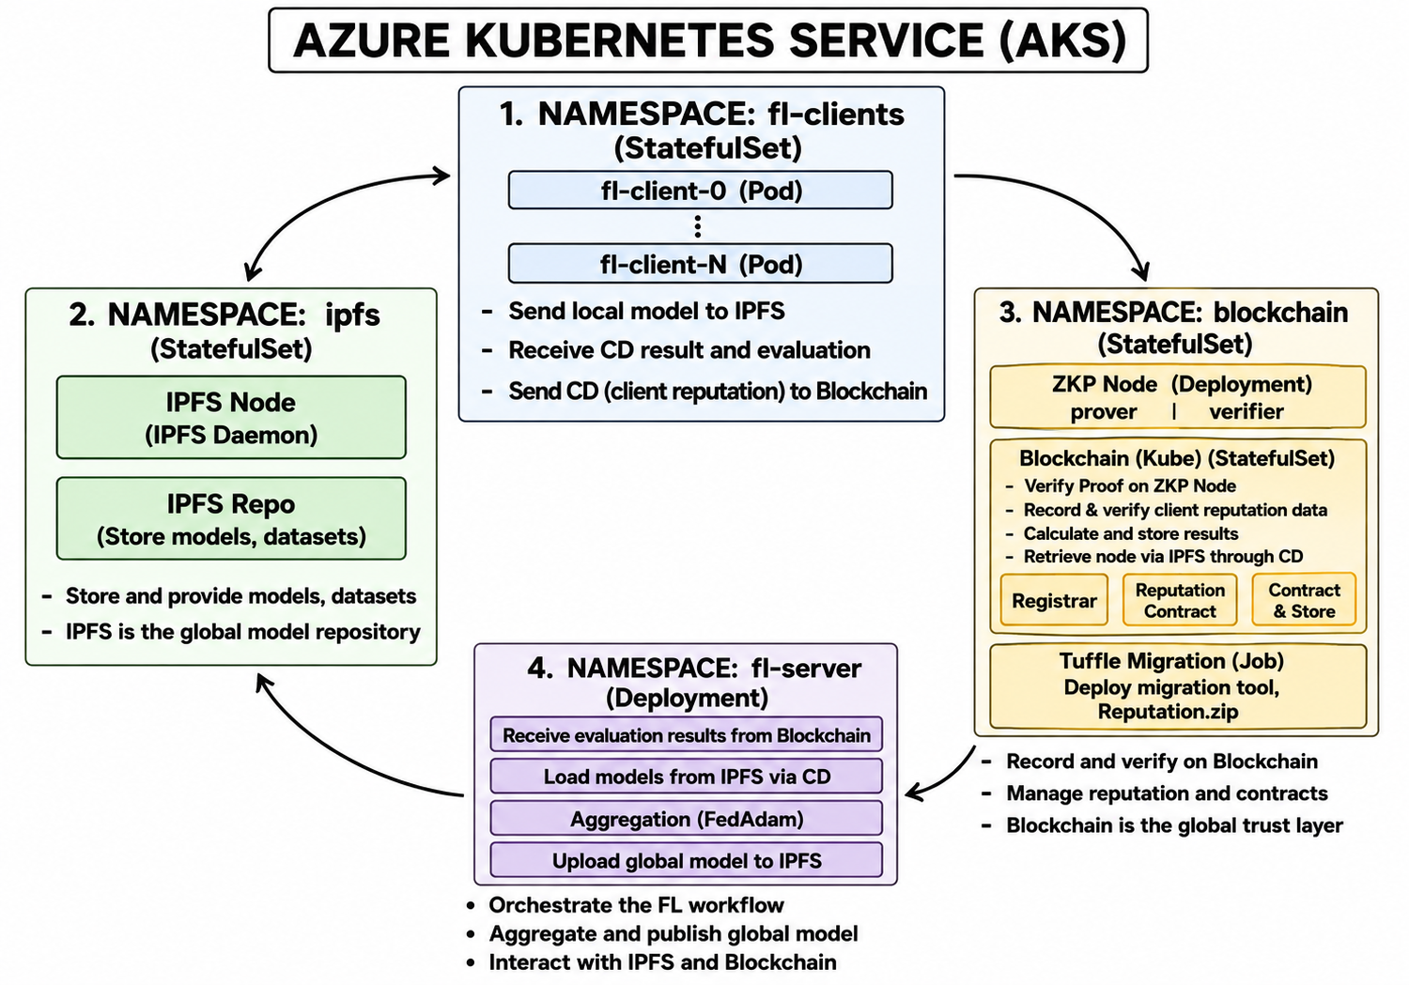
IEEE COMNETSAT 2026
Experimental Setup & Cloud Deployment on Azure AKS
08 / 13
Hardware & Benchmark Specifications
• Cloud Infrastructure:
Microsoft Azure Kubernetes Service (AKS) cluster
• Client Pod Hardware Profile:
2 vCPUs @ 2.4 GHz (Intel Xeon Platinum 8272CL), 7.0 GiB RAM (matching edge IoT gateway compute envelopes)
• Benchmark Dataset:
EMNIST Balanced (47 handwritten character classes, 131,600 total samples) across 5 edge clients
• Partitioning Regimes:
IID (uniform distribution) vs. Non-IID (heterogeneous class subsets simulating real-world client drift)
• Model Architecture:
CNN: 2 Conv layers + MaxPool + Dropout + Dense(128) + Output(47)
• Hyperparameters:
Clients: FedProx (mu=0.001, lr=0.0005, batch=128, 2 local epochs)
Server: FedAdam (eta=0.0007, beta1=0.9, beta2=0.99, eps=1e-8)
Reputation: momentum alpha=0.3, rounds=40
Four Isolated Kubernetes Namespaces on Azure AKS:
• fl-clients: Edge pods running FedProx training & Circom proof generation
• aggregation: Server pod executing IQR anomaly filter & FedAdam
• ipfs: Decentralized storage daemon managing model parameter CIDs
• blockchain: Ganache EVM node running verification & reputation contracts

Slide 9
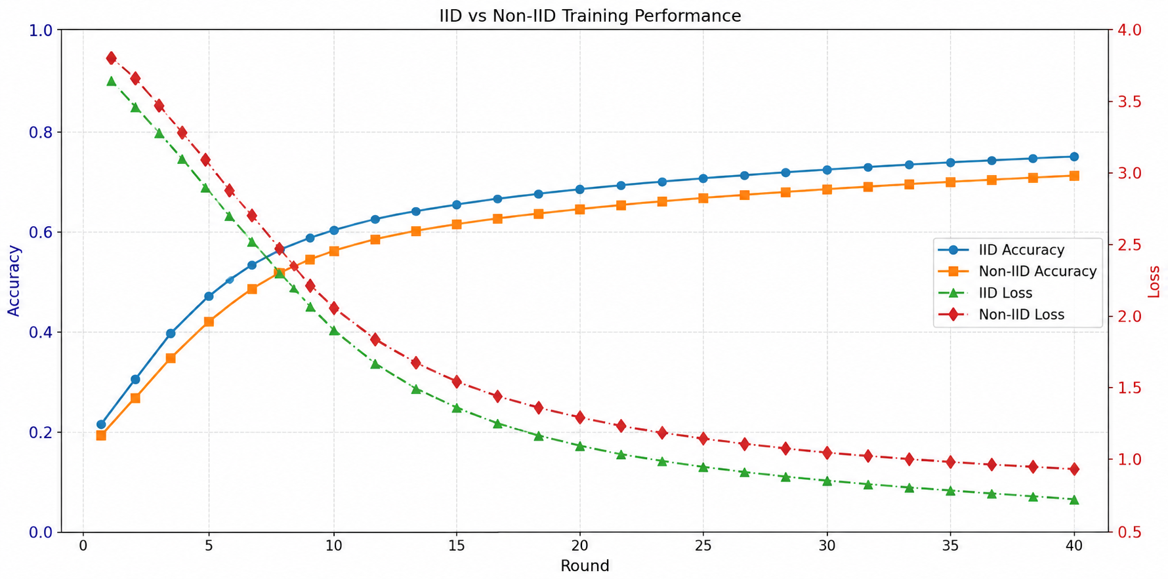
IEEE COMNETSAT 2026
Training Performance: IID vs. Non-IID Convergence
09 / 13
Empirical Analysis of Convergence
• Overcoming Statistical Heterogeneity:
Under Non-IID Dirichlet skew, standard FedAvg typically exhibits severe client drift. In our framework, the FedProx proximal penalty (mu=0.001) successfully constrains local parameter divergence.
• Second-Order Variance Damping:
FedAdam server optimization maintains running first-moment (momentum) and second-moment estimators. This dynamically dampens high-frequency gradient noise caused by Non-IID client partitions.
• ZKP Gating Stability:
Despite enforcing strict Groth16 parameter magnitude boundaries (W_max = 5*10^9), honest gradients stay well within bounds, causing zero false rejections during normal training.
• Trust-Weighted Stability:
Reputation weights dynamically down-weight noisier updates without starving clients of gradient feedback, preserving continuous model progress.
Key Quantitative Milestones (47-Class EMNIST Balanced):
• IID Top-1 Accuracy: 75.2% | Non-IID Top-1 Accuracy: 71.2%
• Non-IID Accuracy Penalty: Only 4.0 percentage points degradation!
• Loss Trajectory: Monotonically decreasing without oscillations or divergence.

Slide 10
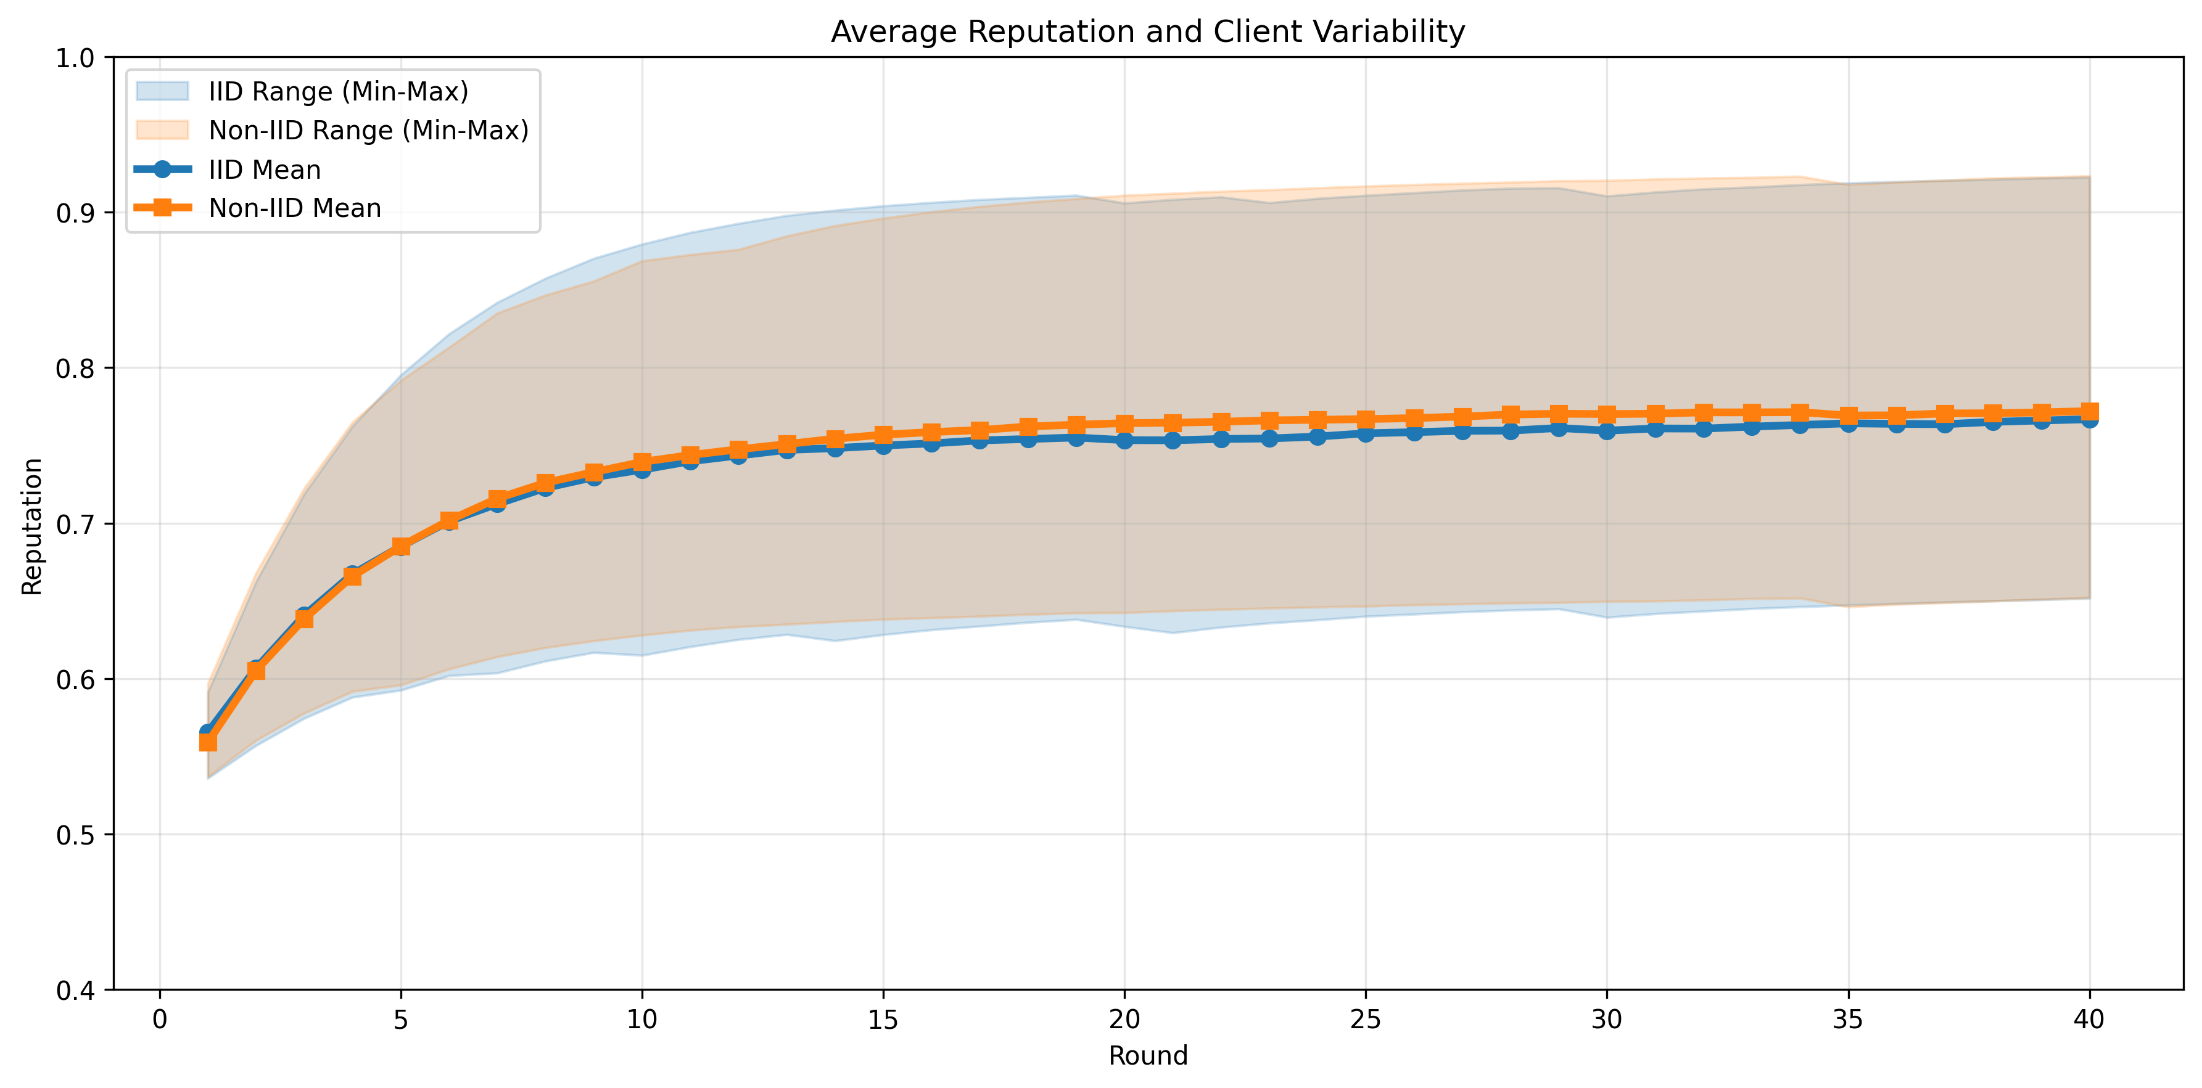
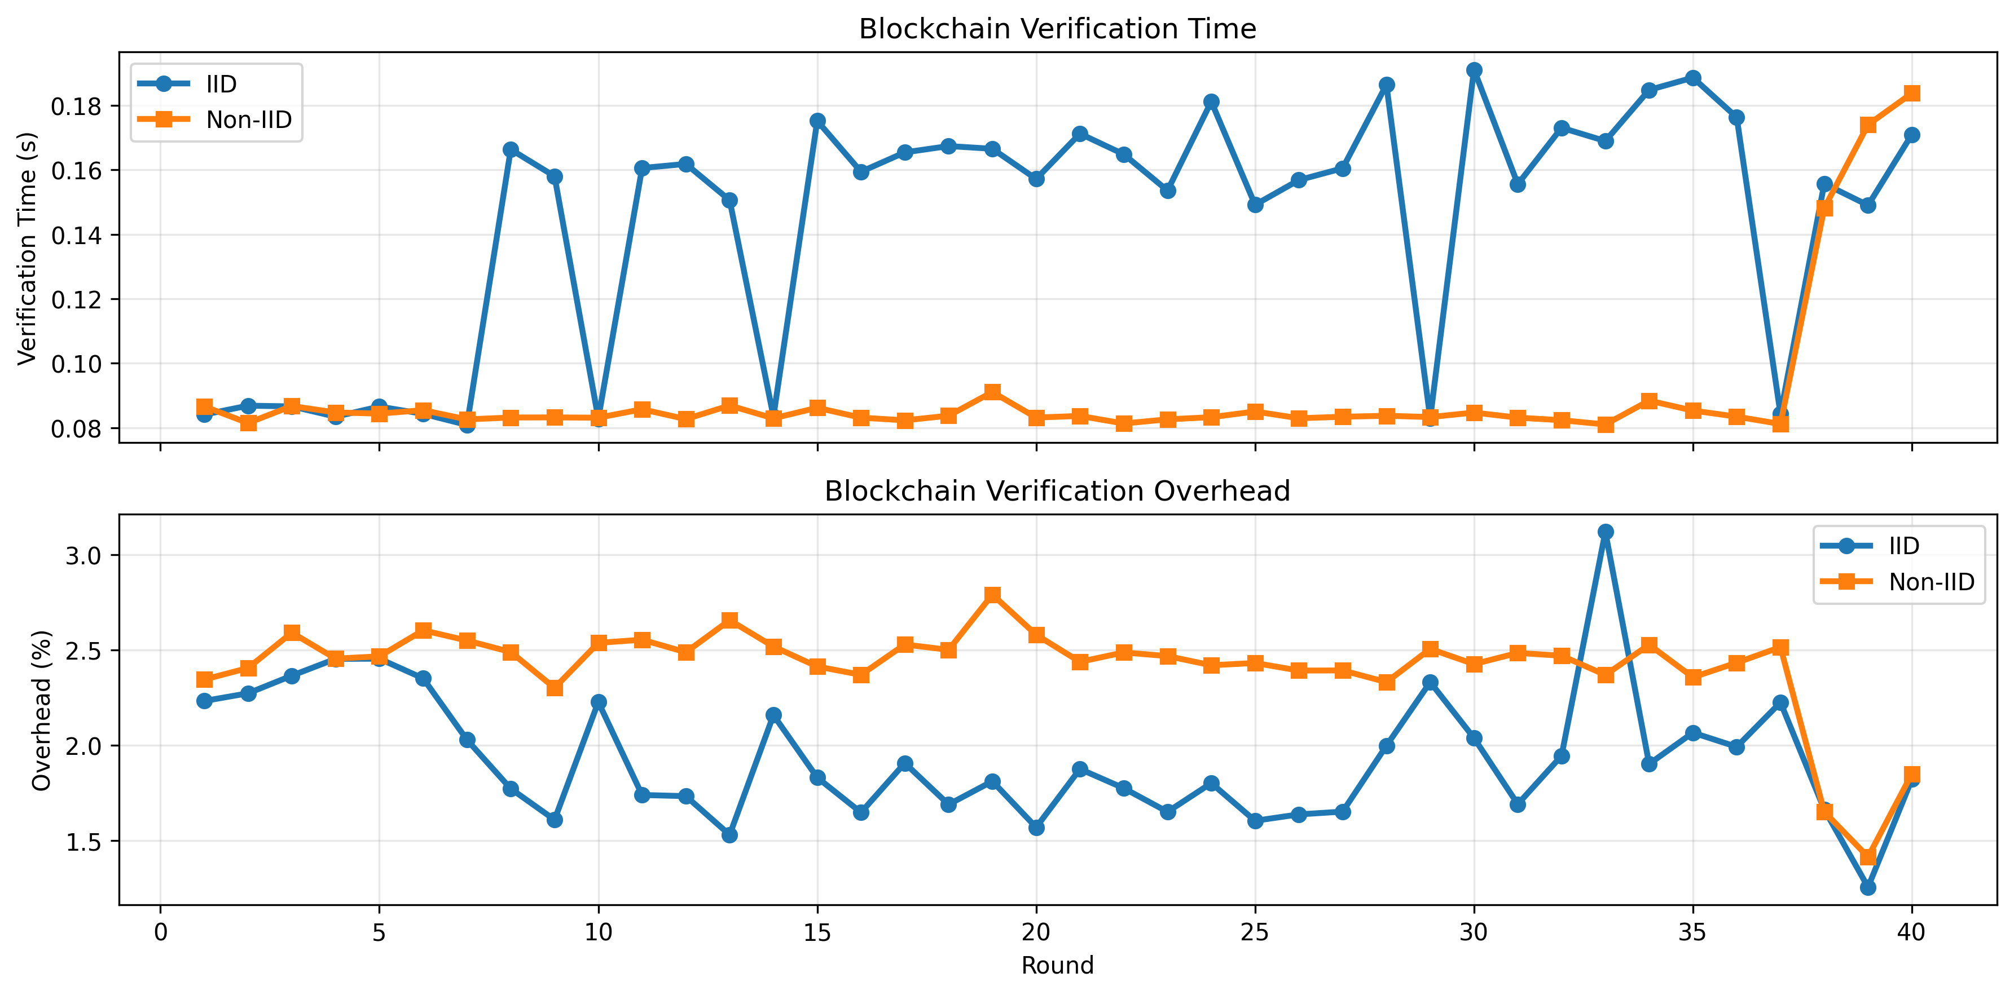
IEEE COMNETSAT 2026
Reputation Evolution & System Overhead
10 / 13
Operational Trust Convergence & Blockchain Overhead Profile:
• Stable Reputation Convergence: Average client reputation stabilizes reliably at 0.76 – 0.77 across both IID and Non-IID partitions, providing consistent aggregation baselines without variance drift.
• Negligible Blockchain Overhead: Server verification and smart contract transaction execution require < 0.20 s per round (< 3.0% of total communication round time).
• Edge Prover Efficiency: Client Groth16 proof generation takes 0.35 s, accounting for under 3.5% of local training time and consuming < 50 MB RAM.
• Zero Ledger Bloat: Off-chain IPFS storage reduces on-chain data footprint to a single 32-byte CID per client per round, eliminating EVM gas exhaustion.

Slide 11
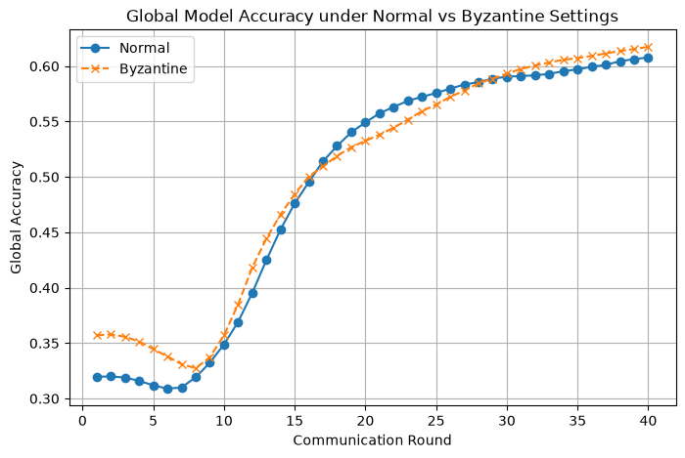
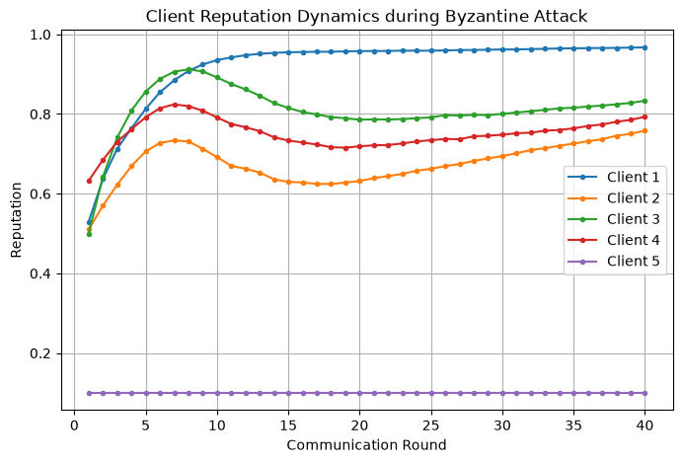
IEEE COMNETSAT 2026
Byzantine Attack Resilience & Defense Evaluation
11 / 13
Defense Under Active Byzantine Adversaries (Gaussian Noise + Label-Flipping y -> 61 - y):
• Catastrophic Baseline Collapse: Unprotected baseline (standard FedProx + FedAdam without ZKP/trust scoring) collapses to 21.8% accuracy!
• Complete Proposed System Resilience: Maintains 71.2% robust accuracy under active Byzantine attacks — matching normal non-attack convergence.
• Rapid Adversary Isolation: Malicious client updates immediately violate dynamic IQR fences. Their reputation drops from 0.76 down to 0.10 by round 5.
• Honest Client Protection: Legitimate Non-IID clients maintain high reputation (~0.76) throughout the attack, proving zero false penalties.

Slide 12
IEEE COMNETSAT 2026
Ablation Study & State-of-the-Art Benchmark
12 / 13
Table I: Baseline Ablation Study (Quantifying Defense Contributions)
Configuration | IID Acc. | Non-IID Acc. | Byzantine Acc. | Round Time | Defense Status
Baseline (FedProx + FedAdam) | 76.4% | 72.1% | 21.8% (COLLAPSED) | 8.8 s | Unprotected
Proposed w/o ZKP (Reputation only) | 75.3% | 71.3% | 62.4% (DEGRADED) | 9.1 s | Vulnerable to exploding weights
Proposed System (COMPLETE) | 75.2% | 71.2% | 71.2% (ROBUST) | 9.6 s | End-to-End Multi-Layer Defense
Table II: Benchmark Comparison Against Recent Literature (Practical Engineering Trade-off)
Scheme | ZKP Target | Prover Complexity | Storage | Byzantine Defense | Non-IID Support
VPFL (Ma 2024) | Local gradient | O(P x B) (>10^6 constraints) | On-chain hash | Static threshold | No
zkFL (Wang 2025) | Gradient sum | O(K x P) (Heavy backprop) | Off-chain | None (Integrity only) | No
VerifBFL (Bellachia 2025) | Local epoch | O(P) (Moderate) | On-chain | Staking penalty | No
BFLP (Li 2026) | Contribution | O(1) (Light) | On-chain | Peer auditing | Partial
Proposed (Ours) | Range sanity bound | O(1) (67 constraints, 0.35s) | IPFS + 32B CID | Dynamic IQR + Reput. | FedProx Regulariz.
Inherent Design Trade-off: While VPFL and zkFL offer exhaustive in-circuit backpropagation proofs, they incur severe O(P) constraint explosion (>10^6 constraints) unfeasible on edge hardware. Our framework explores a pragmatic, edge-oriented trade-off: an ultra-lightweight O(1) sanity gatekeeper (67 constraints) combined with off-chain IPFS storage and statistical anomaly detection.

Slide 13
IEEE COMNETSAT 2026
Conclusion & Future Research Directions
13 / 13
Summary of Core Contributions
• Decoupled Trust Architecture:
Decoupled cryptographic parameter verification from statistical optimization, avoiding millions of R1CS constraints while preserving Byzantine defense.
• Edge-Feasible Groth16 Gatekeeper:
Achieved an O(1) circuit with exactly 67 constraints (0.35 s proving latency, <50 MB RAM), introducing <3.5% client computational overhead.
• Storage-Efficient Ledger Integration:
Eliminated on-chain storage bloat by pairing IPFS off-chain weights with 32-byte smart contract CIDs, avoiding Ethereum block gas limits.
• Proven Byzantine Resilience:
Maintains 71.2% robust accuracy under active Gaussian poisoning and label-flipping attacks where unprotected baselines suffer catastrophic collapse to 21.8%.
Future Research Directions
• Recursive SNARKs (Nova / Halo2):
Investigating folding schemes to verify training iterations recursively in step-wise O(1) complexity without constraint explosion.
• Chunked Poseidon Merkle Commitments:
Layer-wise hash trees allowing edge clients to verify sub-layer parameter updates on deep models like ResNet and Transformers.
• Cross-Silo Enterprise Deployments:
Extending Kubernetes multi-cluster architecture to federated healthcare and IoT environments.
Thank You for Your Attention!
Questions & Answers (Q&A Session)
Presenters: Kiet Dao-Anh & Nguyen Tran-Bui-Nhat
Faculty of Computer Networks & Communications, UIT VNU-HCM
Contact: {23520810, 23521059}@gm.uit.edu.vn | thuatnk@uit.edu.vn
System Performance At A Glance:
• Model Accuracy: 75.2% (IID) / 71.2% (Non-IID) on 47-class EMNIST
• Byzantine Resilience: 71.2% maintained (vs. 21.8% collapse)
• Edge Gatekeeper: 67 constraints, 0.35 s proving (< 3.5% overhead)
• Blockchain Footprint: 32-byte CID (< 0.20 s verification latency)

