Slide 1
IoT and Automation
Problem Category

Slide 2
Problem Statement IA-SN-03
Agriculture advancement is demand of the time.
Introduction of sensor in the field of agriculture will boost the production.
Develop a sensor based application that monitors the plant and soil health by analyzing various parameters.

Slide 3
TEAM JOSH
ATULYA ALOK (Electronics and sensor part)
ASHWINI KUMAR(Electronics and sensor part)
KSHITIJ SHARMA(Coding implementation on Arduino)
ANISH GANGULY( Bluetooth based user friendly android App for farmers and Hardware)
SPARSH ARYA(Machine Learning for weather prediction and for best crop prediction using linear regression module)

Slide 4
Problems faced by the farmers that spoils the soil and plant health.
Excess acidic nature of soil due to use of excess artificial fertilisers.
Excess moisture content of soil that affects the plant health and makes the soil unhealthy.

Slide 5
Reason of excess moisture content.
Nowadays buildings are being constructed near agriculture farm that forms a shadow on the agriculture land, and the area covered under shadow are already moisturized and don't need any further irrigation.
But farmers are unable to control this and they do irrigation uniformly thus making the soil under shadow more wet than the required.
This shadow can also be due to the mountains present nearby fields.
One more important point is uneven land. The part of land which is relatively at lower level than other land suffers water logging.

Slide 6
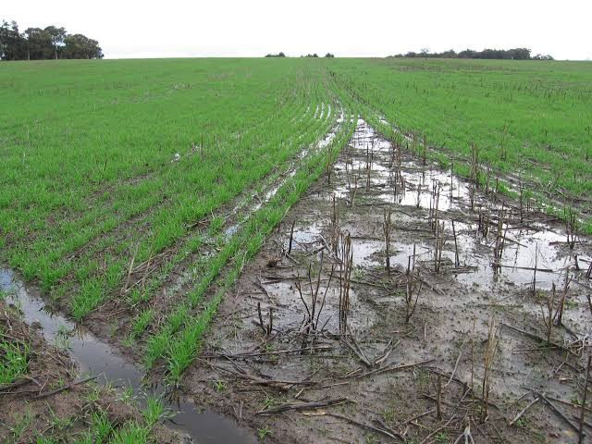
Water logging

Slide 7
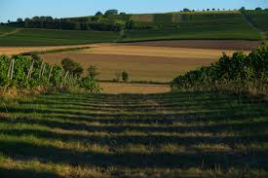
Shadows on the filed
Reasons: Shadows of building and mountain

Slide 8
Project not only works on identifying the problems but also controlling the moisture and ph of soil.

Slide 9
Our solution
Controlled drip irrigation for moisture control.
We are going to do irrigation in controlled way.
The part of land which is already wet and have the moisture content more than required will not have irrigation.
We are neutralizing the acidic nature of soil by adding lime in it in a controlled way.
In place of lime, nutrients can also be used to add manures and fertilizers.
User friendly android app for farmers
Machine learning for weather and crop prediction.

Slide 10
Controlled drip irrigation
Irrigation will be done on that part of the soil only where moisture content is low.
At every regular or critical points where water logging can be there , soil moisture will be kept.
This soil moisture will measure the content of moisture in it and will transfer the data to micro-controller.
This micro-controller will keep the valve closed during irrigation so that the soil should not get further moisturised.
Components used :- Servo motors/Solenoid valve, Moisture sensor and arduino.

Slide 11
TO control the acidity of soil
Using a pH sensor the pH value will be measured at different locations.
If the pH value is found to be more acidic than required then the message will be displayed on the mobile screen of the app.
And also the micro-controller will give command to a servo motor which will allow the lime powder to fall in the water reservoir.
Using a centrifugal pump this lime will be mixed with the water and irrigation will be done to that part only having acidic nature.
Components used are pH sensor ,servo motors, mixture tank and centrifugal pump.

Slide 12
Machine learning
Machine learning is implemented to incorporate a regression model for temperature and rainfall conditions of a certain place.
Based on the temperature and rainfall patterns, the machine learning algorithm learns to give the right crop suitable for the given climatic conditions.
This project used python coding with mathematical graphs for easy interpretation of data.

Slide 13
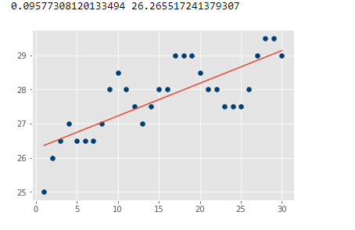
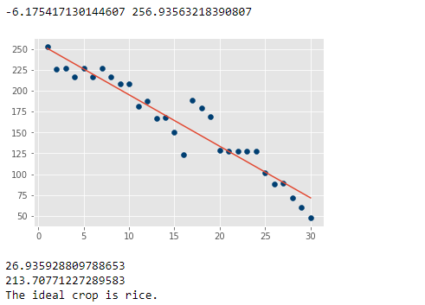
Linear Regression model

Slide 14
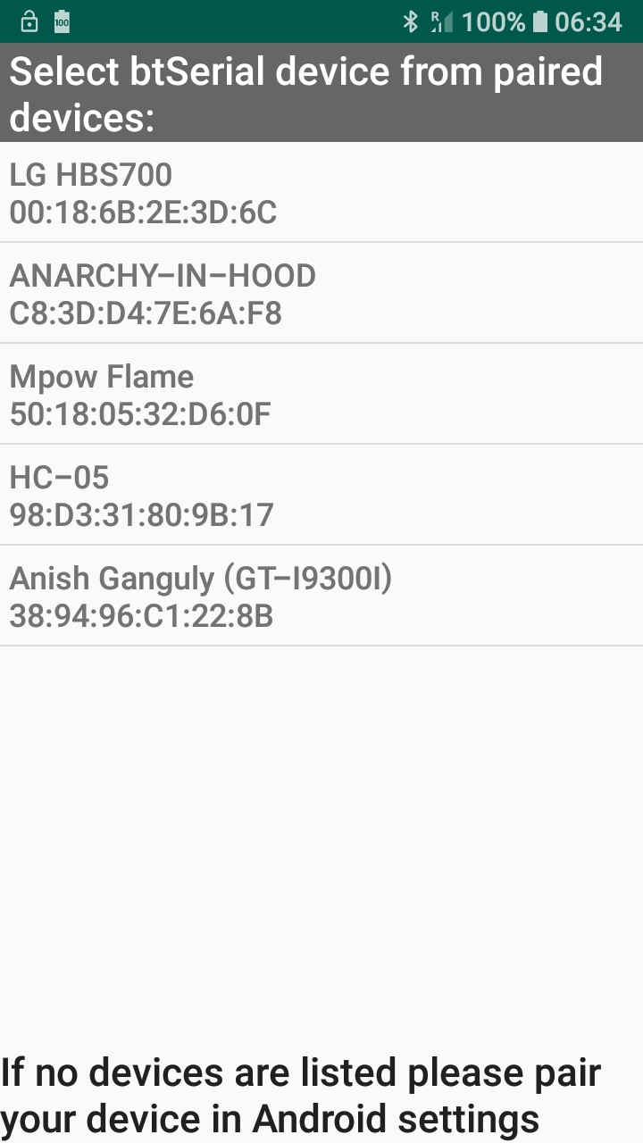
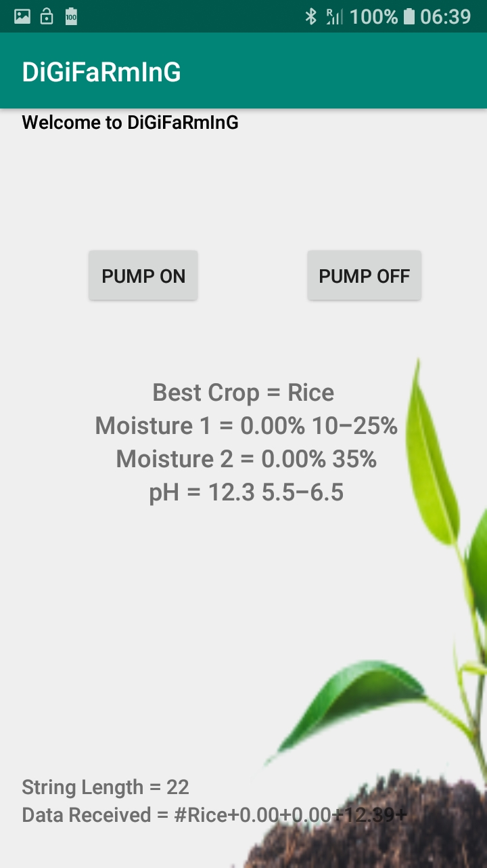
app

Slide 15
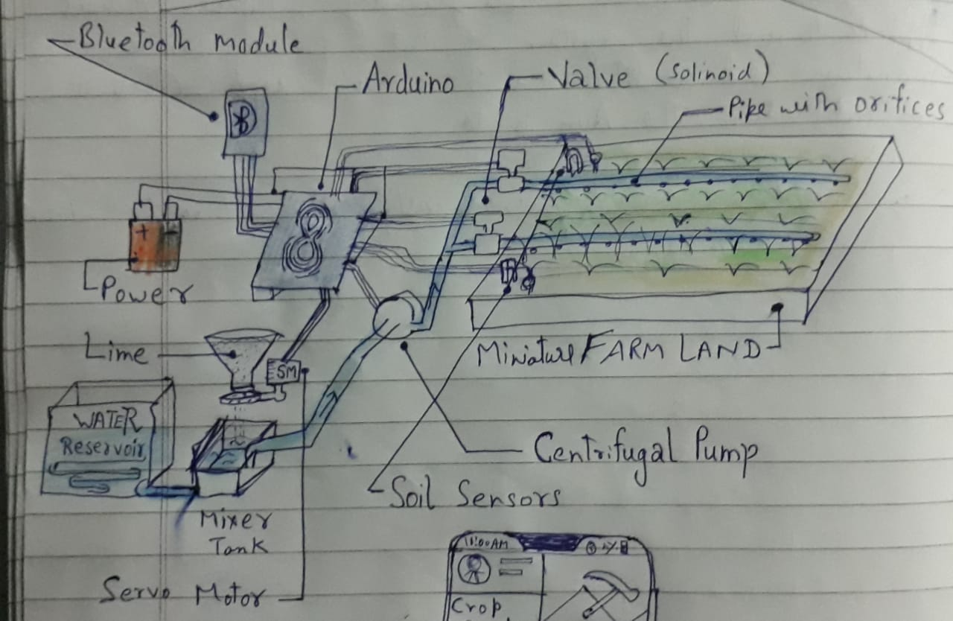
Our project plan

Slide 16
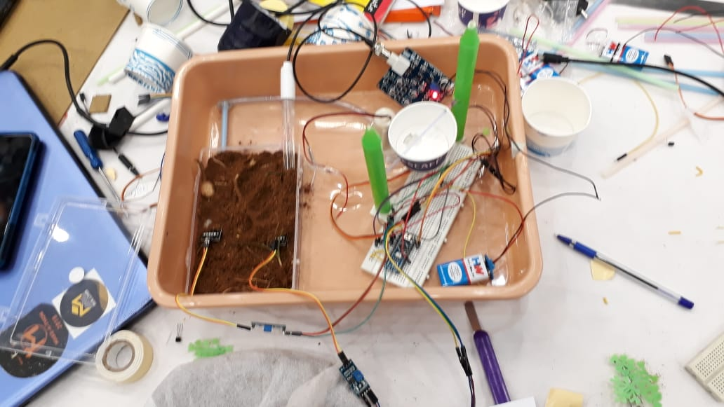
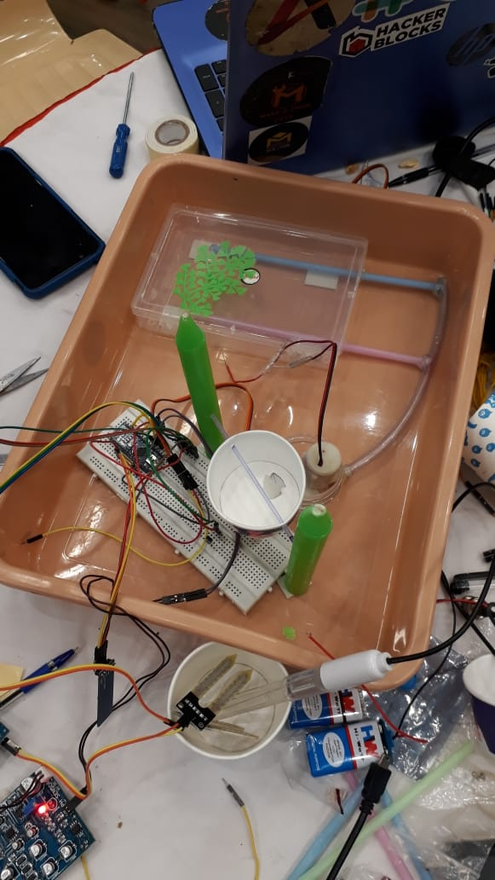
ACTUAL PHOTOGRPAHS

Slide 17
Actual Photographs

Slide 18
Problem solved
The major problems faced by the farmer one the moisture content and the excess acidity of the soils both have been solved.

Slide 19
Market value
Cost effective
One time investment.
Low maintain ace
Using farmer friendly App
Extra cost will be only of the pH sensors ,moisture sensor and the arduino.
Huge amount of labor work will be saved.
A Huge burden of the farmers will be solved.
The cost of the installation setup depends on the farm land.

Slide 20
advantages
Our farmer is cost effective for the farmers which is very important.
They can used the system again and again after the harvesting and for different crops as well.
Not only identifying the problem and alerting the farmer it also solves the problem.
Easy circuit no complexity.
Bluetooth controlled app helps the farmer to see the details and operate remotely and in easy way.

Slide 21
Thank you!!

