Slide 1
Summary of Module - I Name : Ragini Sharma Branch : CSE ID : B120062

Slide 2

Critical Reading
Critical reading means that a reader applies certain processes, models, questions, and theories that result in enhanced clarity and comprehension. Critical reading involves presenting a reasoned argument that evaluates and analyses what you have read. Being critical, therefore - in an academic sense - means advancing your understanding, not dismissing and therefore closing off learning.

Slide 3
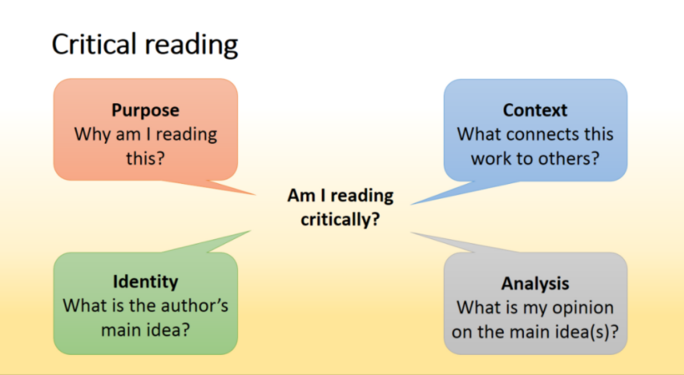

Slide 4

IMPORTANCE OF CRITICAL READING:
Critical reading skills play an important role in the success of a student. A student who has excellent critical reading skills is able to evaluate a piece of writing as he or she reads. Also, a critical reader asks questions about the validity of facts in a written piece.

Slide 5
Strategies of Critical Reading:
Previewing : Previewing is a strategy that readers use to recall prior knowledge and set a purpose for reading.
Annotating: Annotating is any action that deliberately interacts with a text to enhance the reader's understanding of, recall of, and reaction to the text.
Summarizing: A summary is a synthesis of the key ideas of a piece of writing, restated in your own words.
Analyzing: Analyzing a text involves breaking down its ideas and structure to understand it better, think critically about it, and draw conclusions. .
Re-reading : It is an act of reading something again especially from a different perspective
Responding: It is to say or do something as a reaction.

Slide 6
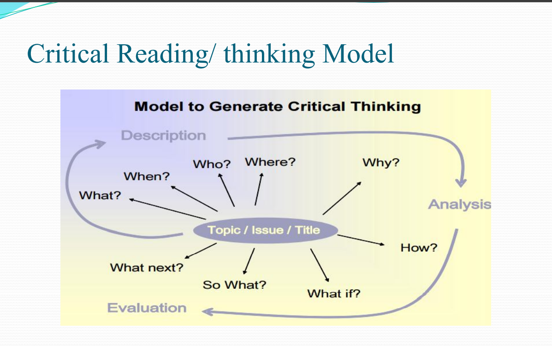

Slide 7

Textual analysis:
Textual analysis is a methodology that involves understanding language, symbols, and/or pictures present in texts to gain information regarding how people make sense of and communicate life and life experiences

Slide 8
How important is textual analysis?
Textual analysis is the most important method in literary studies. Almost all work in this field involves in-depth analysis of texts – in this context, usually novels, poems, stories or plays. ... Researchers aim to understand and explain how these elements contribute to the text's meaning.

Slide 9
To understand the relation between reading and a text: Passive or Interactive.
Passive reading is when a reader does technically read the words but absorbs next to nothing about what is written. Active readers begin reading with a desire to find out what is going to be said.Passive reading means reading something but not engaging fully with the text. The reader doesn't think critically about the book.Active (and close) reading means the reader is engaging with the text.The difference between active and passive reading is the desire to learn something versus the desire to finish reading.

Slide 10
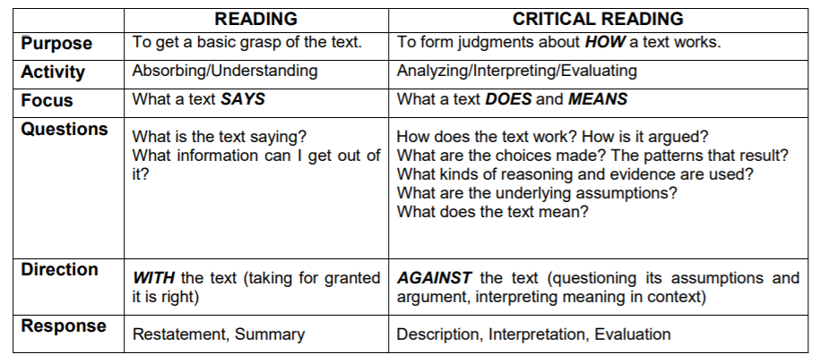
DIFFERENCE BETWEEN READING AND CRITICAL READING-

Slide 11
SUMMARY
Critical thinking enables them to think beyond the barriers of their own biases. Critical thinking builds confidence in communication. It is far easier to communicate when you are prepared with facts, arguments, perspectives and possible solutions. Communicating is one thing. Understanding point of view is a critical reading practice because point of view is often inferred rather than explicitly expressed and its exploration leads to an appreciation of the constructed nature of the text. Outline the main points and ideas. See the connections between the ideas in the paper/lecture.

Slide 12
See the connections between what you are reading now and what you have read before. Find questions that need to be answered. Skimming - used to understand the "gist" or main idea. Scanning - used to find a particular piece of information. Extensive reading - used for pleasure and general understanding. Intensive reading - accurate reading for detailed understanding. Text Analysis is the process of analysing unstructured and semi-structured text data for valuable insights, trends and patterns.It is typically used in instances where there is a need to process large volumes of text-based data for insights, but would otherwise be too resource and time-intensive to be analysed manually by humans.

Slide 13
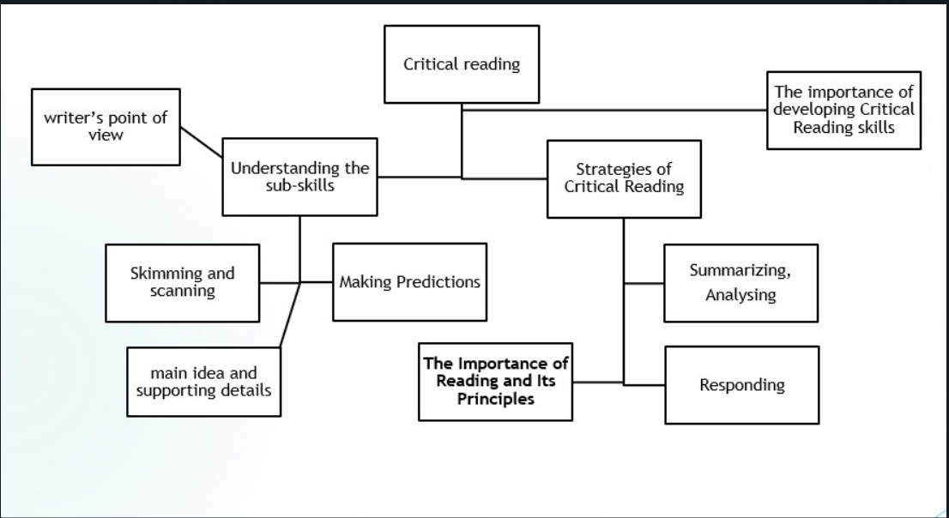

Slide 14
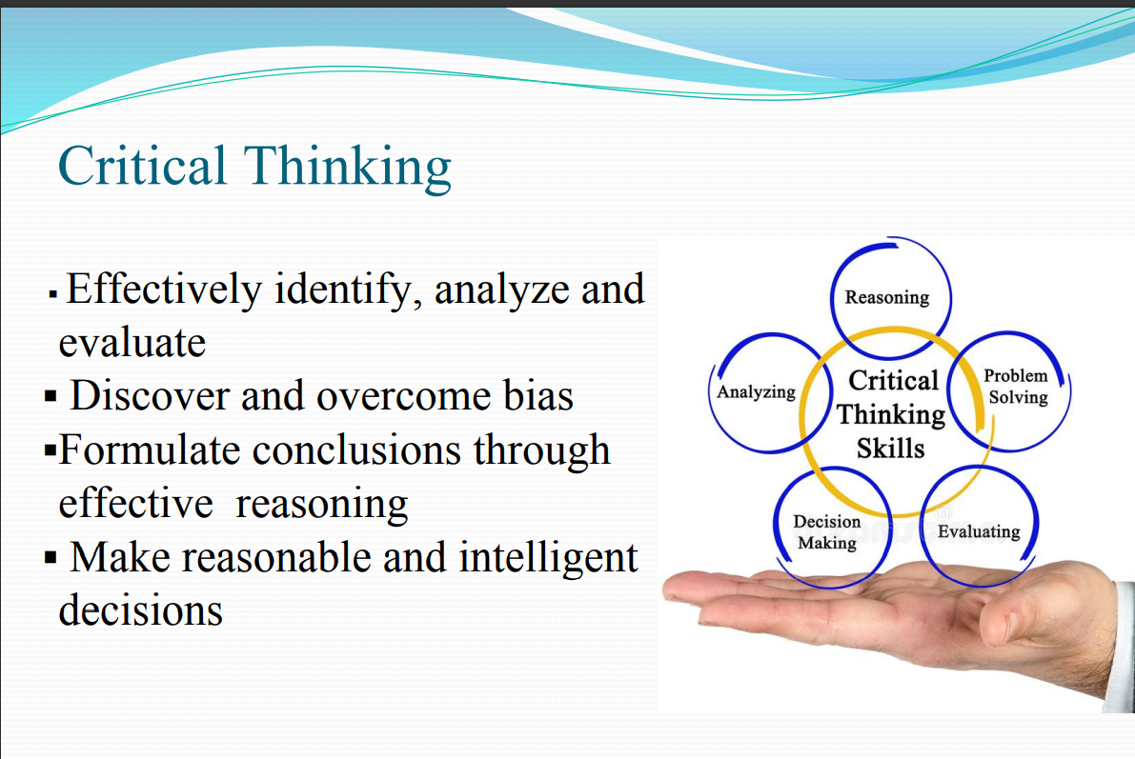

Slide 15
Critical reading points that I applied to the eight texts
In A Snake in the Grass by R.K. Narayan we have the theme of responsibility, honesty, trust, fear, control and tradition .Narayan uses humour, motes and many other figures of speeches that enrich the story with tastes and tranquility. Narayan may also be exploring the theme of tradition. Something that is noticeable through the mother and the beggar’s. It may also be a case that Narayan is exploring the theme of control. The snake-charmer has control over snakes. Dasa is supposed to have control over the garden yet it is growing wild and the family are supposed to have control over Dasa. conversation. It is an apt title and is not meant to be taken literally.A snake in the grass is used as an metaphor in the story.Dasa, the servant is a decietful person who decieves his employer to save his job.The author compares Dasa with a venomous snake indirectly
.

Slide 16
Katherine Mansfield creates a melancholic and darkly humorous tone of “The Fly”
SIMILES “he peered out of the great, green leather armchair… as a baby peers out of its pram”. The comparison makes Woodifield vulnerable and predicts his physical situation. For instance, he suffers from memory loss and has a frail body that limits his freedom.
METAPHOR The boss calls Woodifield as the “planted there in the midst…. that frail old figure in the muffler”. He recognizes him as something aged and weak planted in the chair with a pathetic life. However, it is later revealed that it is the boss who suffers from memory loss and is a pitiable figure.
C) IRONY In the beginning, the boss is considered a youthful vigor. He takes great pride in the memory loss of Woodifield. However, the boss transforms into a weak figure that trips and suffers from the memory of his son.
D) PARALLELISMThe symbol of the fly is paralleled with the boss’s son. The boss kills the fly directly through his attempts in testing the fly’s strength and courage. Also, he sends his son to war and exposes him to the cruelty of the battle. Similarly, he intentionally forgets the memory of his son and removes him from his world.

Slide 17
The Night Train at Deoli by Ruskin Bond
In this short story, Ruskin Bond narrates his experience during one of his train journeys to Dehra as an eighteen- year-old. Each episode has some connection with the fundamental string of the story. The last area of the plot, the conclusion is relatively concise and falls by and large in the last section of the story. In the conclusion the succession of related occasions reaches an end. In this accumulation a couple of conclusions are somewhat more. In the conclusion the grouping of related occasions arrives at an end and there are maybe a couple lines toward the end.

Slide 18
The Dog of Tithwal :-
Pastoral SettingPastoral literature portrays nature as being idyllic, peaceful, and free of the constraints and struggles of human society. Pastoral settings often allow human characters to find solace and peace that are not possible in a human-made setting.The story is set in the mountains of Tithwal during temperate and pleasant days in late September.
B) Journalistic StyleManto uses a direct, succinct style, almost like an unbiased reporter writing of an actual incident. There is no diatribe; Manto does not tell his readers what to think but lets the facts speak for themselves. His use of dialogue to tell the story further contributes to the journalistic style.

Slide 19
Lajwanti
The author goes on to describe how some of the women who had been returned were not acknowledged by their husbands, brothers and parents, for fear of God, or worse, society.
Such situations had arisen because of the ignorance of the people at home, who hadn’t been abducted, who hadn’t gone through what the abducted did, and who did not understand that it was not the abducted that were immoral – it was the abductors that were lecherous. They could not understand the futility of killing yourself for honour, or rather people’s perception of it. Rajinder Singh Bedi addressed this issue in Lajwanti, because he wanted society to see how their loved ones who did not commit suicide would be treated.
The second issue I will address here is the interpretation of the holy texts to either prove a point that the women must not be accepted into their homes or to debunk it.
The author shows the deification of Lajwanti as Sunder Lal's attempts to put her up on a pedestal - unattainable, not relatable-to - and to distance Lajwanti from himself, in a cruelly duplicitous manner."

Slide 20
Notes on the English Character
Notes on the English Character”, an essay, written by E.M. Forster. This essay includes certain notes in which he has drawn a comparison between English man and an Indian man. When we read the whole essay it becomes evident that this essay gives a clear distinction of powerful and powerless, superior and inferior, Occident and Orient etc. In short, this essays revolves around the issue of identity.
He gives the justification by saying that they have well developed body, fairly developed minds but they are not cold/cruel rather have undeveloped heart. He explains that English man is strong enough to control his emotions. They have learnt from their public school that “feeling is bad form”.
. So, we can say that the whole note depicts that Forster has made the division of us/them. He has exaggerated the true feelings of Indians by pointing out that they do not think before doing anything so they have undeveloped minds. On the other hand, English people plan for their future. Here we find that Forster is obsessed with the identity of English man. Hence exaggerating it in his note quite obviously.

