Slide 1

Query optimization using Indexing and sharding
Advanced Database Topics Project

Slide 2
Introduction
Index in MongoDB is a special data structure that holds the data of few fields of documents on which the index is created.
Indexes improve the speed of search operations in database because instead of searching the whole document,the search is performed on the indexes that holds only few fields.
MongoDB provides a method called createIndex() that allows user to create an index.
Performance Evaluation of queies using the concept of Indexing and sharding.

Slide 3
SHARDING
Method for distributing data across multiple machines.
MongoDB uses sharding to support deployments with very large data sets and high throughput operations.
Database systems with large data sets or high throughput applications can challenge the capacity of a single server. For example, high query rates can exhaust the CPU capacity of the server. Working set sizes larger than the system's RAM stress the I/O capacity of disk drives.

Slide 4
Existing Works
Research Paper/Conferences | Web-link | Limitations
Performance Evaluation of MongoDB and PostgreSQL for spatio-temporal data | http://www.master-project-h2020.eu/wp-content/uploads/2019/03/BMDA_3.pdf | Shared clusters not included.
MongoDB Indexing for Performance Improvement | https://www.researchgate.net/profile/Vigneshwaran-Pandi/publication/340253980_101007_978-981-15-0936-0/links/5e7f6c42a6fdcc139c101c00/101007-978-981-15-0936-0.pdf#page=523 | Indexing on a single dataset.
PERFORMANCE EVALUATION OF MYSQL AND MONGODB DATABASES | https://d1wqtxts1xzle7.cloudfront.net/59431690/PERFORMANCE_EVALUATION_OF_MYSQL_AND20190528-97716

Slide 5
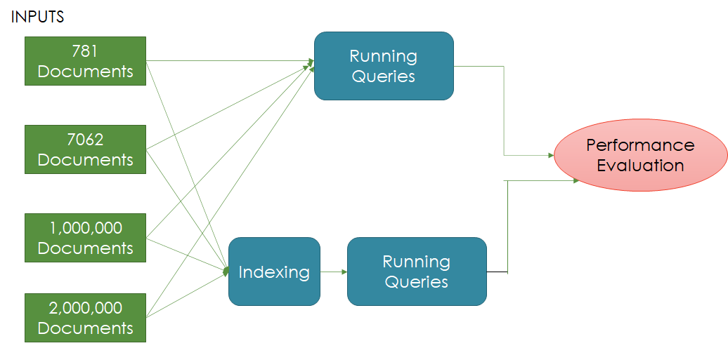
Indexing

Slide 6
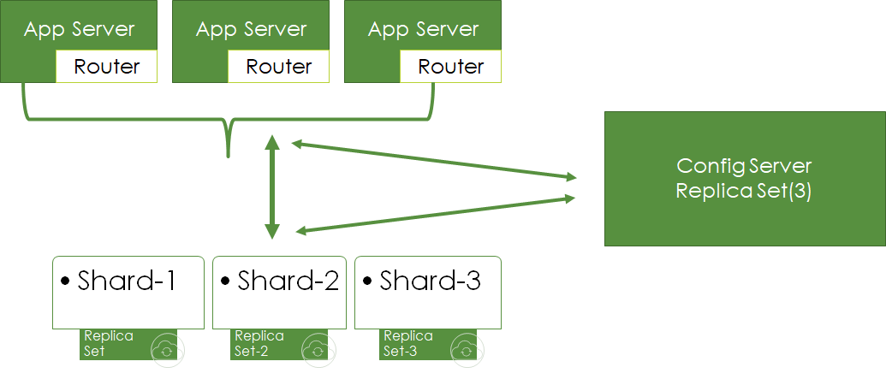
Sharding

Slide 7
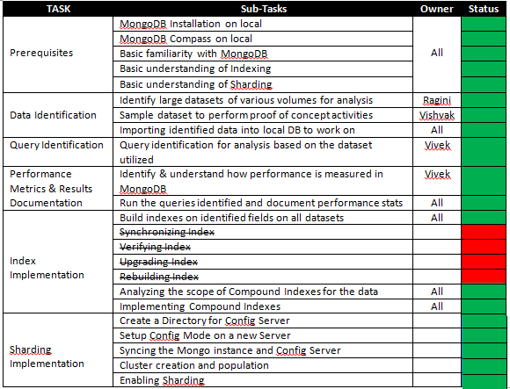

TASKS

Slide 8
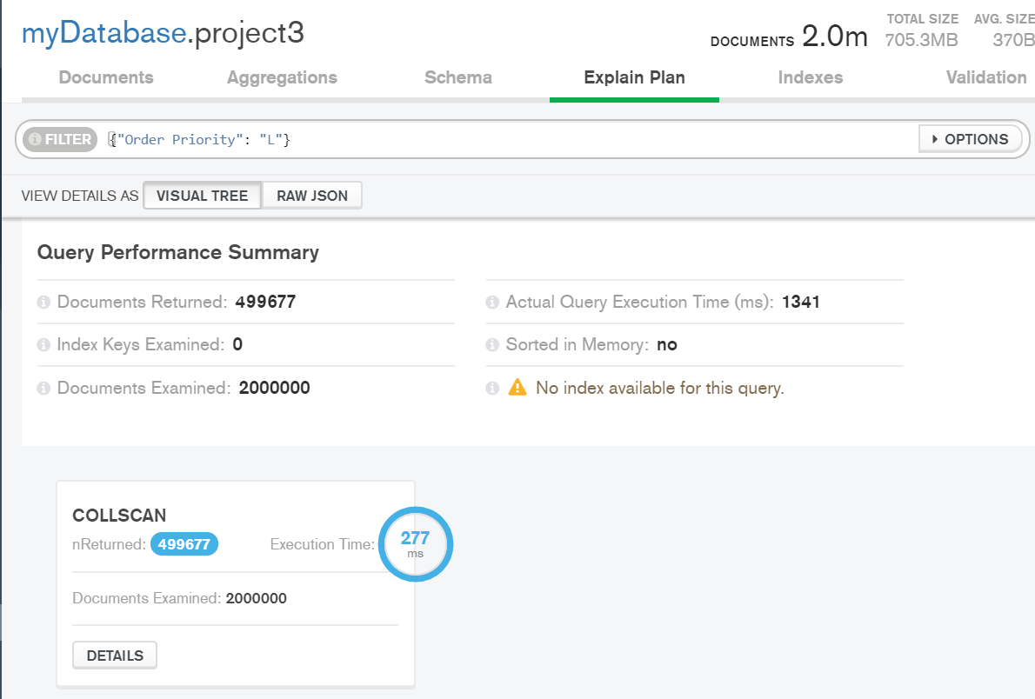
Results Demo: Indexes (Before Indexing)

Slide 9
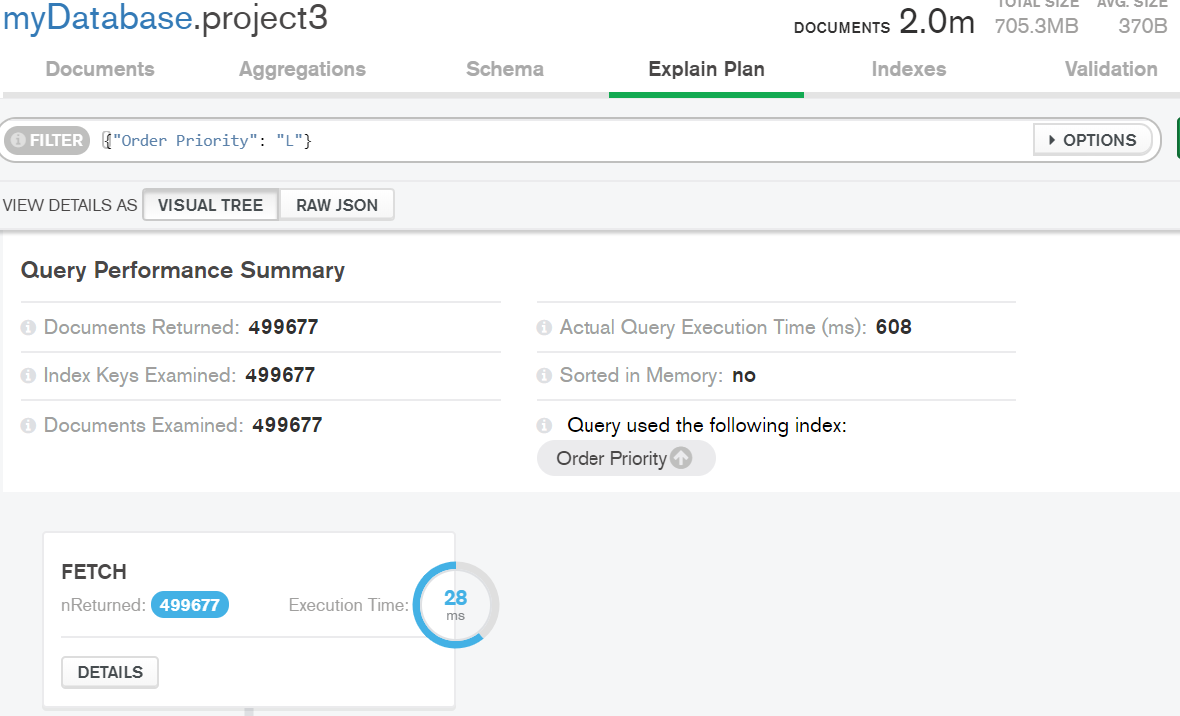
Results Demo: Indexes (After Indexing)

Slide 10
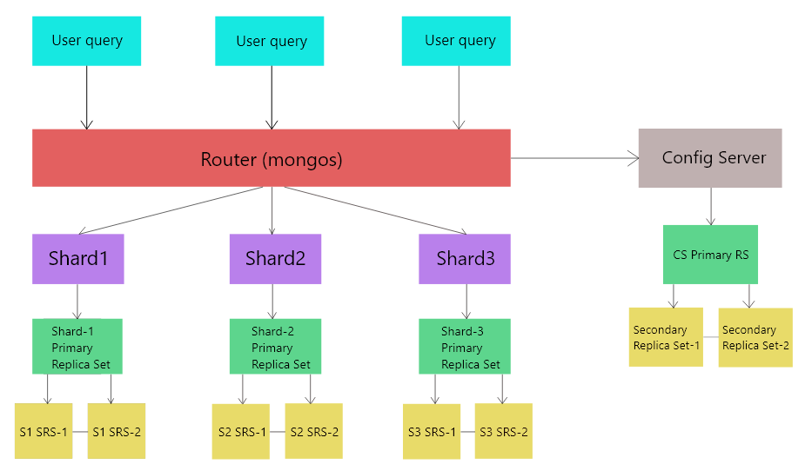
Results Demo: Sharding Architecture

Slide 11
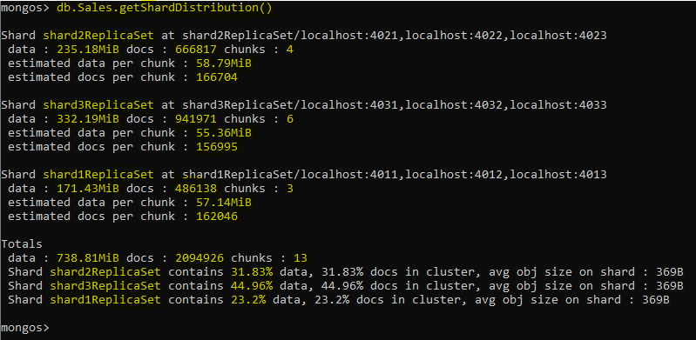
Results Demo: Sharding Results

Slide 12
Takeaways
We have analyzed and compared the performance in terms of response time on MongoDB databases, a document-based NoSQL datastore.
We implemented a set of queries without indexing and then the run-time after indexing.
Performance evaluation was based on ExecutionSuccess, executionTime, total keysExamined, totalDocsExamined.
We employed a replica set and a streaming replication cluster setup for MongoDB on our local system.
Both Indexing and Sharding definitely do improve performance and the results are much more visible in case of larger datasets.

Slide 13
Future Scope of Learning
Implementing indexes on sharded database architecture.
Implementing sharding on a database deployed over a server or on cloud using MongoDB Atlas
Exploring other implementation strategies using configuration files instead of command line
Automatic instance startup and modifying replication strategies

Slide 14
References
•https://docs.mongodb.com/manual/indexes/
•https://youtu.be/0WkJKa_Nv_o
•https://docs.mongodb.com/manual/tutorial/analyze-query-plan/
•https://data.edd.ca.gov/Industry-Information-/Current-Employment-Statistics-Mono-County/ru45-rtii
•https://www.youtube.com/watch?v=ekuQjQUnj20&list=PLqfPEK2RTgChVygd5NPFDhyVCVU00-KqP&index=10
•http://eforexcel.com/wp/downloads-18-sample-csv-files-data-sets-for-testing-sales/

