Slide 1
Retail Customer
Analytics & Segmentation
Data Mining for Customer Segmentation & Purchase Pattern Discovery
Data Mining Case Study | Retail Analytics
Notes:
Let me start with a simple story.
Imagine an online gift shop in the UK. They sell products like teacups, gardening products and decorative gifts.
For one year, they collected almost half a million transactions.
But having data is not enough.
The real question is:
Can we use this data to understand customers and increase revenue?
That's what I tried to solve using K-Means and Apriori.

Slide 2
INTRODUCTION
Introduction
Retailers collect huge amounts of transaction data every day. Most of it is never really used. This project shows how two simple data mining techniques can turn that raw data into decisions a shop can actually act on.
Customer Segmentation
Market Basket Analysis
K-Means Clustering
Apriori
Groups customers by how recently, how often, and how much they buy.
Finds which products are commonly bought together.
2
Notes:
Retailers collect a lot of information from every order.
But if we don't analyse it, it just remains data.
So I asked two simple questions.
Who are our customers?
For this, I used K-Means.
And:
What products do customers buy together?
For this, I used Apriori.
So remember:
K-Means = customers
Apriori = products
Together, they help turn raw data into business decisions.

Slide 3
WHICH DATASET
Which Dataset
A real UK-based online gift shop provided the data: one year of transactions, from December 2010 to December 2011.
495,478
3,920
3,833
354,321
Transactions recorded
Customers who purchased
Different products sold
Reliable rows after cleaning
Each row records one product on one order: what was bought, how many, the price, the date, and which customer placed it.
Before use, the data was cleaned: cancelled orders, rows with no customer ID, and rows with invalid quantity or price were removed. 354,321 reliable transactions remained, and this is the data used for every result in this project.
3
Notes:
Now let's look at the data.
It is from a real UK-based online gift shop and covers one year, from December 2010 to December 2011.
There were 495,478 transactions, 3,920 customers, and 3,833 products.
But the data needed cleaning.
I removed cancelled orders, missing customer IDs and invalid values.
After cleaning, I had 354,321 reliable transactions.
This cleaned data was used for the analysis.

Slide 4
PROBLEM STATEMENT
Problem Statement
Without using this data, retailers run into three common problems.
1. Missed Opportunities
2. The Same Message for Everyone
3. Customers Leaving Unnoticed
Products that are often bought together are not placed or promoted together.
A loyal customer and a one-time buyer get treated exactly the same way.
Some customers quietly stop buying, and nobody catches it in time.
The next sections explain which algorithms were used, and how they solve each of these three problems.
4
Notes:
So what was the business problem?
There were three main problems.
First, missed opportunities — products that customers buy together may not be promoted together.
Second, everyone was treated the same — loyal customers and inactive customers could receive the same type of marketing.
Third, customers could leave unnoticed.
So my goal was simple:
Understand customers, find buying patterns, and turn them into actions.

Slide 5
WHICH ALGORITHM USED
Which Algorithms Were Used
Two data mining techniques were used together, because each one answers a different part of the problem.
K-Means Clustering
Apriori (Association Rule Mining)
Chosen to group customers by behaviour, so that different types of customers can be treated differently instead of all the same way.
Chosen to find which products are bought together, so that these combinations can be used for promotions and store placement.
Both algorithms are explained, together with what they found, in the next section.
5
Notes:
To solve these problems, I used two algorithms.
K-Means groups customers with similar behaviour.
Apriori finds products that are commonly bought together.
So:
K-Means tells us WHO.
Apriori tells us WHAT.
Now let's see what they found.

Slide 6
HOW IS THAT SOLVING THIS PROBLEM
Grouping Customers with K-Means
Each customer is described using three measurements, known together as RFM. The algorithm then groups customers who are similar, without being told in advance what the groups should look like.
Recency: when did the customer buy last?
Frequency: how often do they buy?
Monetary: Total amount spent
Result: Four Customer Groups
Champions: 3 customers, very high spend
Loyal: 52 customers, frequent buyers
Regular: 2,876 customers, the largest group
At-Risk: 989 customers, inactive for 8 months
This solves problem 2: different customer groups can now be treated differently.
6
Notes:
I used three measures called RFM.
Recency — when did the customer last buy?
Frequency — how often do they buy?
Monetary — how much do they spend?
K-Means grouped similar customers together.
We got four groups:
Champions — 3 customers
Loyal — 52
Regular — 2,876
At-Risk — 989
The important finding is the At-Risk group.
These customers had been inactive for around eight months.
Now the business doesn't have to treat everyone the same.
It can target each group differently.

Slide 7
HOW IS THAT SOLVING THIS PROBLEM
Finding Buying Patterns with Apriori
Apriori looks through every order to find products bought together more often than chance would explain, using three measurements.
Support: How common the combination is
Confidence: How often buying one leads to the other
Lift: Whether the pattern is real, not coincidence
Pink Regency Teacup buyers are also very likely to buy the matching Green and Roses colours.
Lift score: 19.6
Regular and Loyal customers also show a strong pattern with Gardener's Kneeling Pad products, not visible when all customers are looked at together.
This solves problem 1: products with a high lift score can be placed together, bundled, or promoted as a set.
7
Notes:
Now we know who the customers are.
The next question is:
What are they buying together?
That's where Apriori helps.
It looks for products that appear together more often than expected.
It uses Support, Confidence and Lift to measure these patterns.
One strong finding was with the Pink Regency Teacup.
Customers buying it were also likely to buy the matching green and rose versions.
The Lift was 19.6, showing a strong relationship.
We also found a gardening-product pattern among Regular and Loyal customers.
The business can use these findings to:
bundle products, recommend them, or place them together.

Slide 8
HOW IS THAT SOLVING THIS PROBLEM
Checking Reliability and Measuring Impact
Before trusting any pattern, sample size was checked. The Champions group had only 3 customers, which produced thousands of misleading, statistically perfect-looking patterns, so this group was excluded from pattern-level analysis, and only groups with at least 10 customers were trusted.
Action | Before | After | Value
Bundling teacups (Apriori) | No bundle offer exists | Offer sent to 404 eligible customers | £2,490
Reaching At-Risk (K-Means) | Same marketing for everyone | 989 customers sent a win-back offer | £206,535
Total |  | Both actions combined | £209,024
This solves problem 3: At-Risk customers are now identified early instead of being noticed too late. Together, both actions represent an estimated £209,024 increase, about 2.87% of current revenue.
8
Notes:
Before using these results, I checked whether the patterns were reliable.
The Champions group had only 3 customers.
With such a small group, we can get patterns that look very strong but may not be reliable.
So I used a simple rule:
At least 10 customers were needed before trusting the patterns.
Champions was therefore excluded from this part of the analysis.
Now we can look at the business impact.
The At-Risk group had 989 customers, representing about £518,990 of revenue at risk.
The analysis suggests two possible actions.
A teacup bundle for 404 eligible customers had an estimated value of £2,490.
And a win-back campaign for the At-Risk customers had an estimated value of £206,535.
The dashboard shows a projected revenue uplift of £209,024, or about 2.87%.
The important point is:
These are projected opportunities, not money already earned or spent.

Slide 9
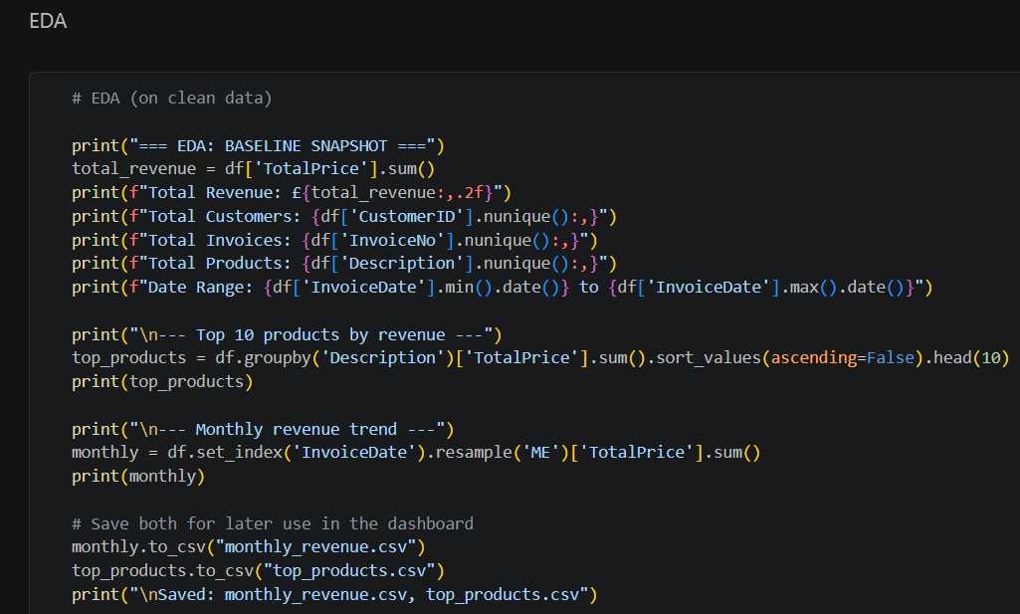
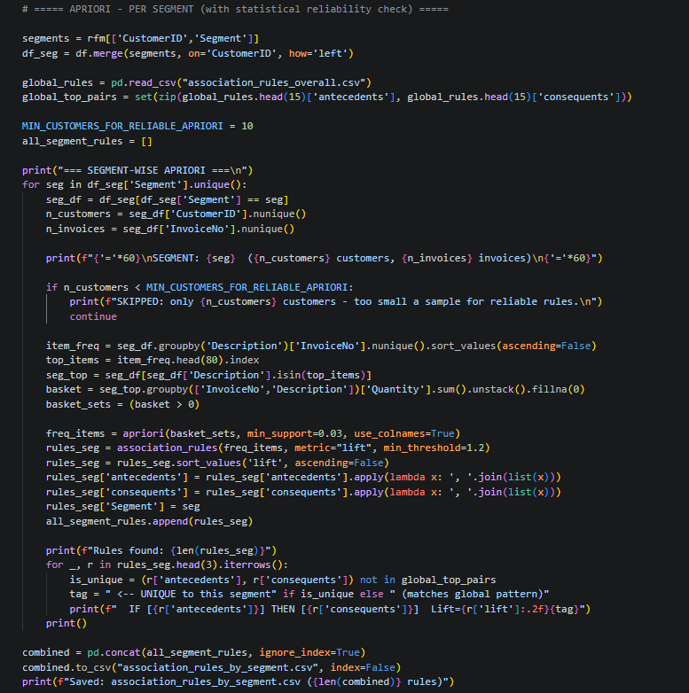
PYTHON SCREENSHOT
Python Screenshot
Data Cleaning
Association Rule Mining
Both scripts were run in Python, using pandas for data handling, scikit-learn for clustering, and mlxtend for association rule mining.
9
Notes:
This is the Python implementation behind the analysis.
I used:
pandas for data handling,
scikit-learn for K-Means,
and mlxtend for Apriori.
So these results came from an actual data analysis workflow.

Slide 10
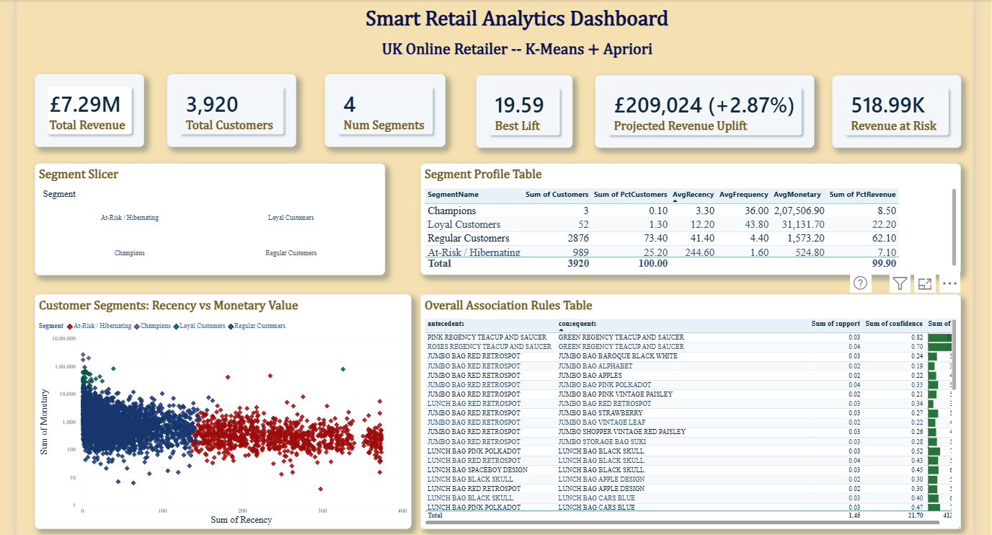
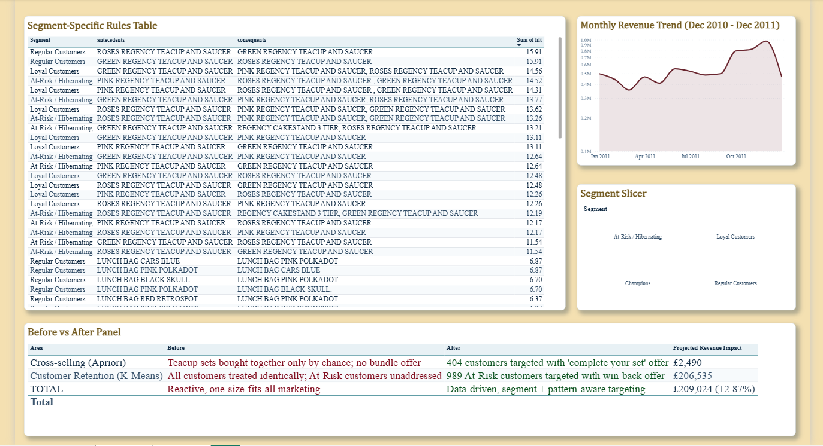
POWERBI SCREENSHOT
Power BI Screenshot
All customer groups, buying patterns, and business impact numbers are combined into one interactive dashboard.
10
Notes:
After the analysis, I brought the results into Power BI.
The dashboard puts the customer groups, buying patterns and business impact in one place.
A business user can quickly answer:
Who should I target?
What should I promote?
Where is the revenue opportunity?
So Python helped me analyse the data, while Power BI helps the business understand and use the results.

Slide 11
CONCLUSION
Conclusion
Customers naturally fall into 4 distinct groups
Products with strong buying patterns were identified
Small sample sizes were checked before trusting results
The combined findings point to a £209,024 opportunity
Forecasting future demand for inventory planning
Testing the win-back offer with real customers
Refreshing customer groups automatically each month
Applying the same method to more product categories
Summary
Future Scope
“ Data alone doesn't create value.
Using data to make better business decisions does ”
11
Notes:
So let's come back to our UK gift shop.
We started with a large amount of raw transaction data.
K-Means helped us understand four types of customers.
Apriori helped us find products that are bought together.
We also checked whether our patterns were reliable.
And finally, the analysis showed a projected revenue uplift of £209,024.
The next step would be to test these offers with real customers, update the segments regularly, and use forecasting for future demand.
So my main takeaway is:
Data alone doesn't create value.
Using data to make better business decisions does.

Slide 12
REFERENCES
References
1. Chen, D. (2015). Online Retail Data Set. UCI Machine Learning Repository.
2. Pedregosa, F., et al. (2011). Scikit-learn: Machine Learning in Python. Journal of Machine Learning Research, 12, 2825 to 2830.
3. Raschka, S. (2018). MLxtend: Providing Machine Learning and Data Science Utilities. Journal of Open Source Software.
4. McKinney, W. (2010). Data Structures for Statistical Computing in Python (pandas). Proceedings of the 9th Python in Science Conference.
5. Microsoft. Power BI Documentation. Microsoft Learn.
12
Notes:
These are the main sources and tools used in the project.

