Slide 1
Core Azure Management Services
By
Ragini Kulkarni

Slide 2




Management Tools
Log Analytics
Cost Management+ Billing
Automation Account
Metrics

Slide 3
Management Tools
Log Analytics
Cost Management+ Billing
Automation Account
Metrics
Log Analytics is the primary tool in the Azure portal for writing log queries and interactively analyzing their results

Slide 4
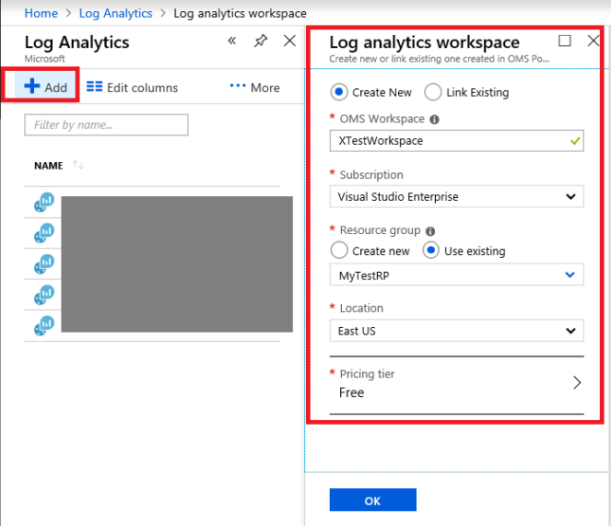

Slide 5
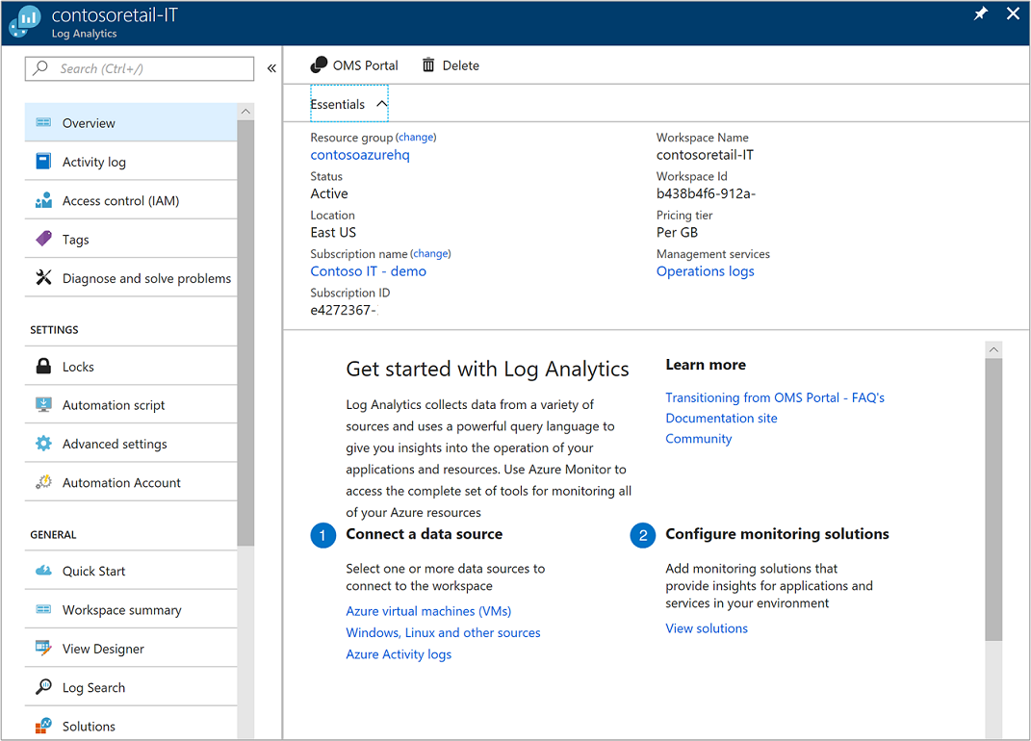

Slide 6
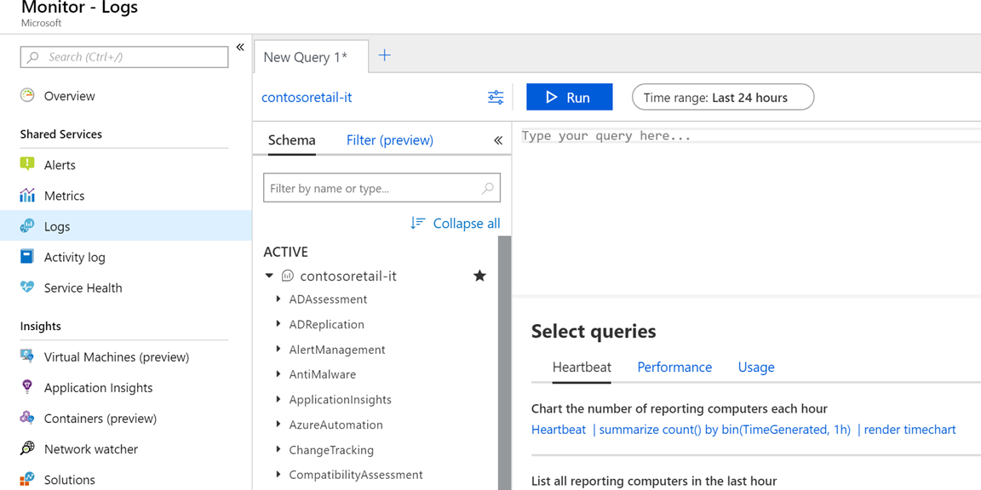

Slide 7
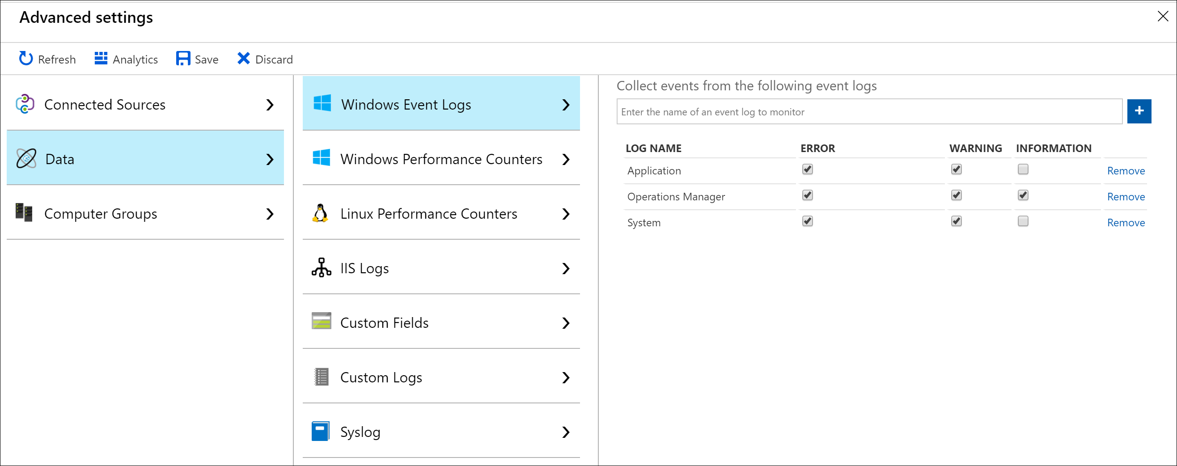

Slide 9
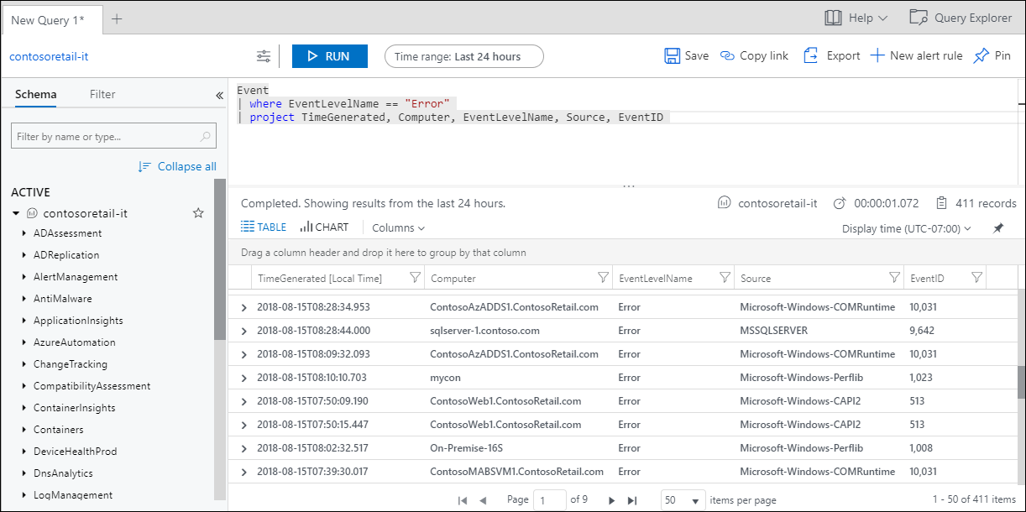

Slide 10
Management Tools
Cost Management+ Billing
Log Analytics
Automation Account
Metrics
Azure Billing features are used to review your invoiced costs and manage access to billing information. Cost management is the process of effectively planning and controlling costs involved in your business.

Slide 11
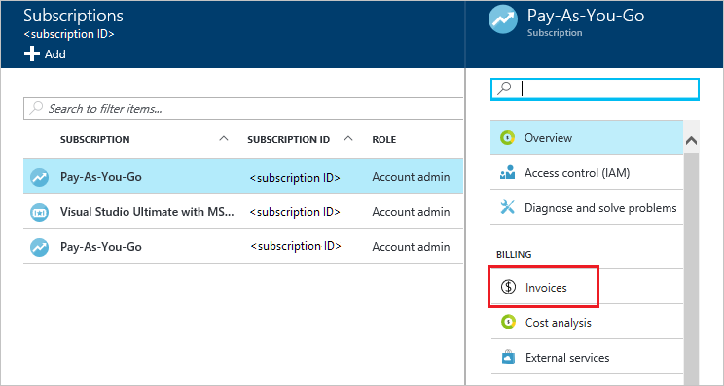
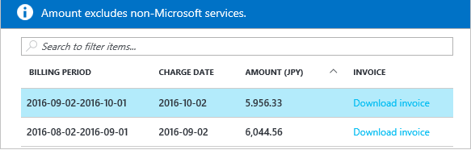

Slide 12
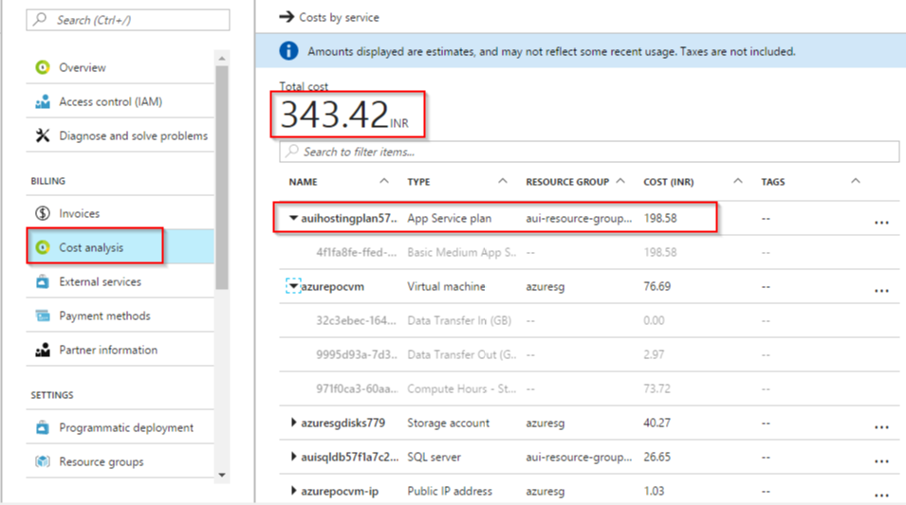

Slide 13
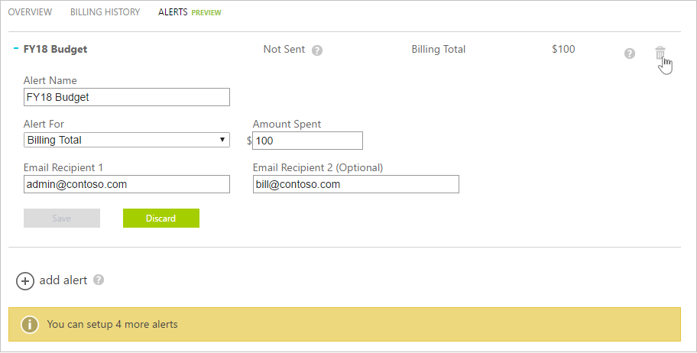

Slide 14
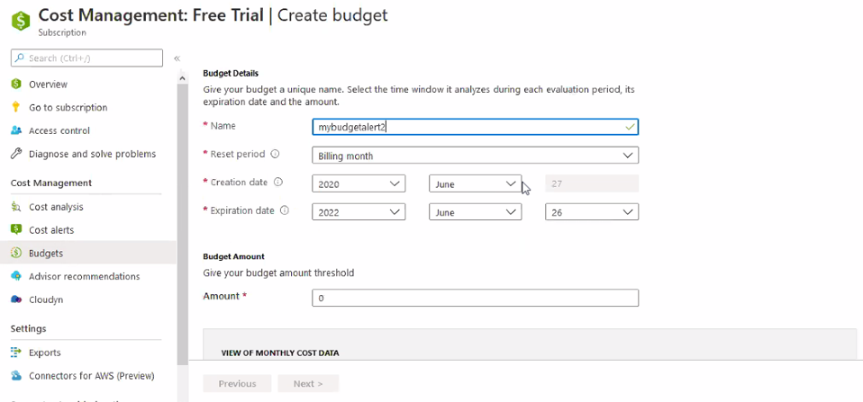

Slide 15
Management Tools
Cost Management+ Billing
Log Analytics
Automation Account
Metrics
Azure Automation delivers a cloud-based automation and configuration service that supports consistent management across your Azure and non-Azure environments.

Slide 16
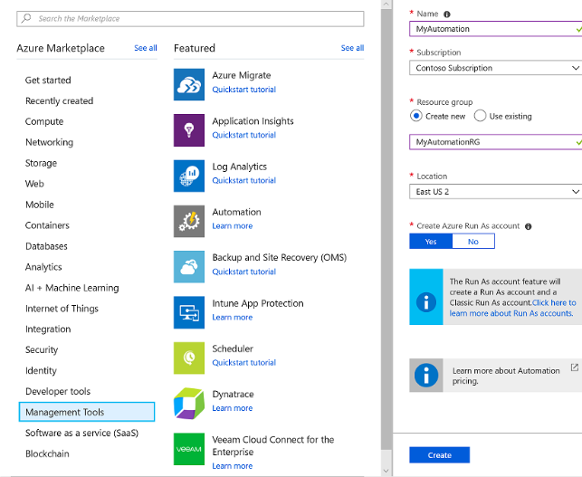

Slide 17
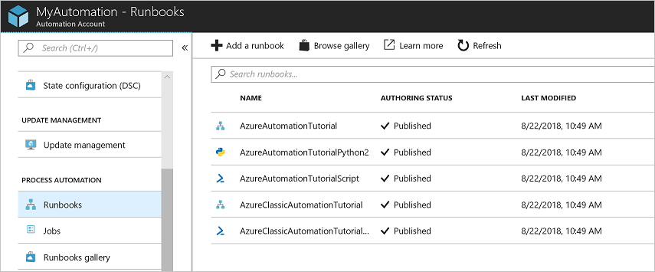

Slide 18
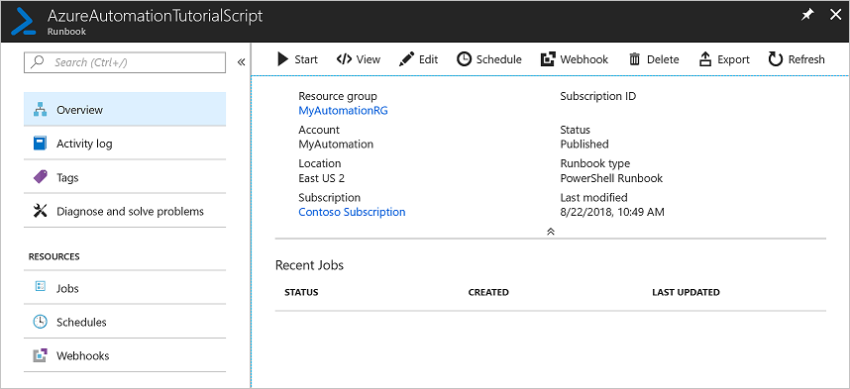

Slide 19
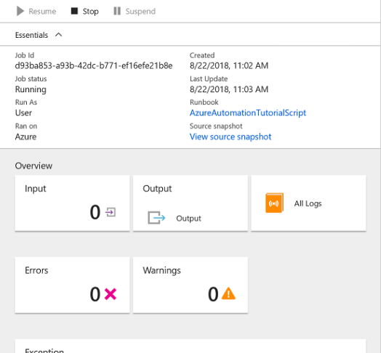
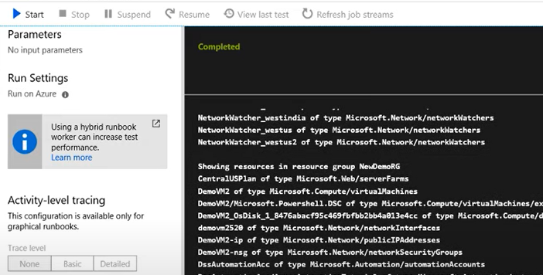

Slide 20
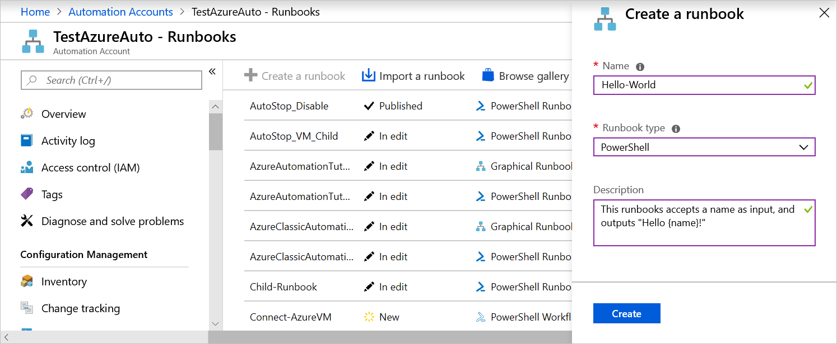
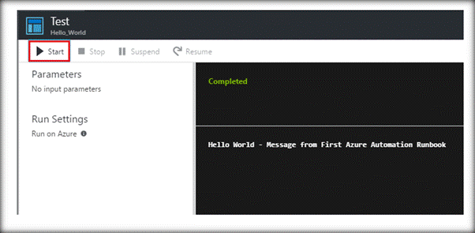

Slide 21
Management Tools
Cost Management+ Billing
Log Analytics
Automation Account
Metrics
Metrics are available for interactive analysis in the Azure portal with Metrics Explorer. They can be added to an Azure dashboard for visualization in combination with other data & used for real time alerting.

Slide 22
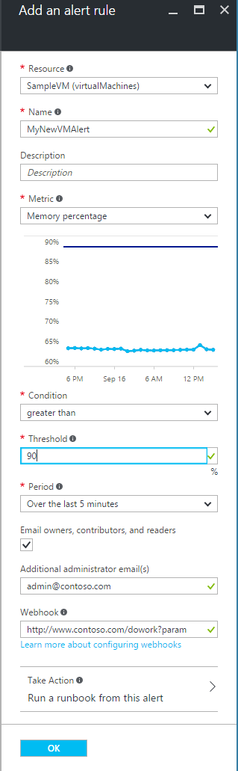
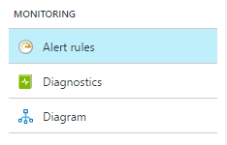

Slide 23
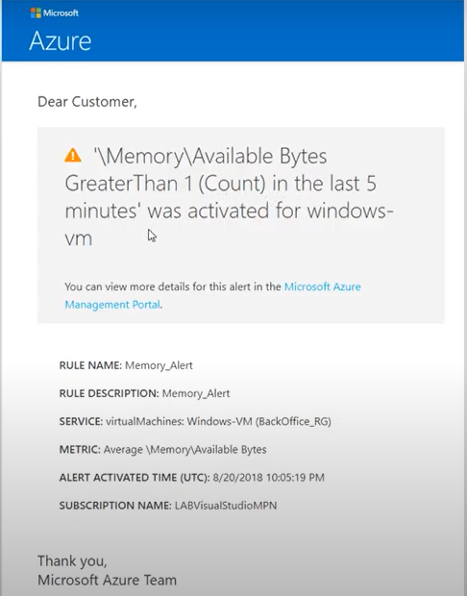

Slide 24
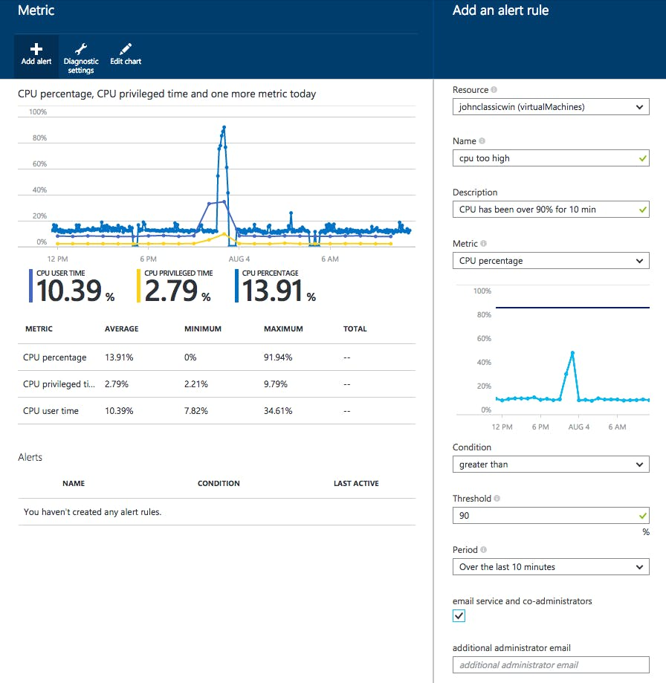
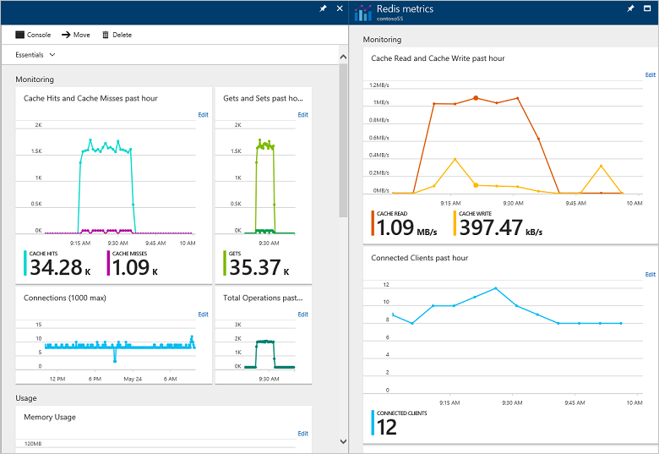

Slide 25
Azure Compute service by Sudheesh
Oracle Consulting Services, FSGBU

Slide 26
Azure Compute service
The word compute here refers to the hosting model for the computing resources on which our application runs.
Following are the main compute options available in Azure:
Virtual Machine: It is an IaaS service, allowing us to deploy and manage VMs inside a virtual network (VNet).
App Service: It is a managed PaaS offering for hosting web apps, mobile app back ends,
Azure Kubernetes Services: It manages a hosted Kubernetes service for running containerized applications.
Azure Functions: It is a managed FaaS service.
Oracle Consulting Services, FSGBU

Slide 27
Virtual Machine
In computing, a virtual machine is an emulation of a computer system. Virtual machines are based on computer architectures and provide functionality of a physical computer. Their implementations may involve specialized hardware, software, or a combination.
Microsoft Azure provides various types of Virtual Machine(VM) and have classified them based on the Memory, Storage and Compute types. If you want to create a Virtual machine in Azure Cloud, you first need to check your application and workloads and can select the VM machine based on the available types.
Oracle Consulting Services, FSGBU

Slide 28
Following are the configuration choices that Azure offers while creating a Virtual Machine.
Operating system (Windows and Linux)
VM size, which determines factors such as processing power, how many disks we attach etc.
The region where VM will be hosted
VM extension, which gives additional capabilities such as running anti-virus etc.
Compute, Networking, and Storage elements will be created during the provisioning of the virtual machine.
Oracle Consulting Services, FSGBU

Slide 29
Below provided is a list of VM types with a short description.
Type | Description
Compute optimized | High CPU-to-memory ratio.
Memory optimized | High memory-to-CPU ratio.
Storage optimized | High disk throughput and IO
GPU | Specialized virtual machines targeted for heavy graphic rendering and video editing.
High performance Compute | Fastest and most powerful CPU virtual machines with optional high-throughput network interfaces (RDMA).
.
Oracle Consulting Services, FSGBU

Slide 30
Virtual machines can be created and managed using
Azure Portal
Azure PowerShell and ARM templates
Azure CLI
Client SDK's
REST APIs
Oracle Consulting Services, FSGBU

Slide 31
Azure App Service?
Azure App Service is a fully managed web hosting service for building web apps, mobile back ends and RESTful APIs. From small websites to globally scaled web applications, we have the pricing and performance options and that fit your needs.
There are two types of hosting environments within App Service App Service plan and App Service environment.
Oracle Consulting Services, FSGBU

Slide 32
To enable communication between apps in the App Service plan and apps installed on virtual machines within the virtual network. There are two ways we can do it.
One way is to establish Point-to-site VPN between apps in the App Service plan and virtual network via which the apps can communicate with each other.
And the second way is if we have the App service environment. Because it will get deployed into a virtual machine by itself, the Apps within that App Service environment can seamlessly communicate with the apps installed on virtual machines within the virtual network.
Oracle Consulting Services, FSGBU

Slide 33
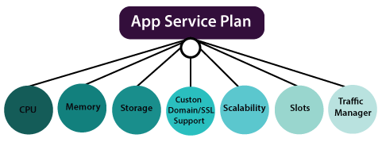
App Service plan
An app service plan denotes a set of features and capacity that we can share across multiple apps in the same subscription and geographical region. A single or dual app can be configured to run on the same computing resources.
Oracle Consulting Services, FSGBU

Slide 34
Each App Service plan defines: Region (West US, East US, etc.) Number of VM instances Size of VM instances (Small, Medium, Large) Pricing tier
Oracle Consulting Services, FSGBU

Slide 35
Azure Functions
Azure Function is a serverless compute service that enables user to run event-triggered code without having to provision or manage infrastructure. Being as a trigger-based service, it runs a script or piece of code in response to a variety of events.
The events can be in azure or can be occurring in third-party services ,and premises systems.
Azure functions allows developers to take action by connecting to data source or messaging solutions thus makes it easy to process and react to events
Azure functions are scale based and on demand ,so we pay for the resources we consume
Azure Functions support various languages like C#, F#, JavaScript, node.js and more
Oracle Consulting Services, FSGBU

Slide 36
Azure Functions can be triggered by the events from other services. Being event driven, the application platform has capabilities to implement code triggered by events occurring in any third-party service or on-premise system.
Azure Functions provides templates to get you started with key scenarios, including the following:
HTTPTrigger-Trigger the execution of your code by using an HTTP request.
TimerTrigger– Execute clean up or other batch tasks on a predefined schedule.
CosmosDBTrigger-Process Azure Cosmos DB documents when they are added or updated in collections in a NoSQL database.
BlobTrigger-Process Azure Storage blobs when they are added to containers. You might use this function for image resizing.
QueueTrigger-Respond to messages as they arrive in an Azure Storage queue.
Oracle Consulting Services, FSGBU

Slide 37
EventGridTrigger-Respond to events delivered to a subscription in Azure Event Grid. Supports a subscription-based model for receiving events, which includes filtering. A good solution for building event-based architectures.
EventHubTrigger-Respond to events delivered to an Azure Event Hub. Particularly useful in application instrumentation, user experience or workflow processing, and internet-of-things (IoT) scenarios
ServiceBusQueueTrigger-Connect your code to other Azure services or on-premises services by listening to message queues.
ServiceBusTopicTrigger-Connect your code to other Azure services or on-premises services by subscribing to topics.
Oracle Consulting Services, FSGBU

Slide 38
Azure Kubernetes Service (AKS)
Deploy and manage containerised applications more easily with a fully managed Kubernetes service. Azure Kubernetes Service (AKS) offers serverless Kubernetes, an integrated continuous integration and continuous delivery (CI/CD) experience and enterprise-grade security and governance. Unite your development and operations teams on a single platform to rapidly build, deliver and scale applications with confidence.
Azure Kubernetes Service offers provisioning, scaling, and upgrades of resources as per requirement or demand without any downtime in the Kubernetes cluster and the best thing about AKS is that you don’t require deep knowledge and expertise in container orchestration to manage AKS.
Oracle Consulting Services, FSGBU

Slide 39
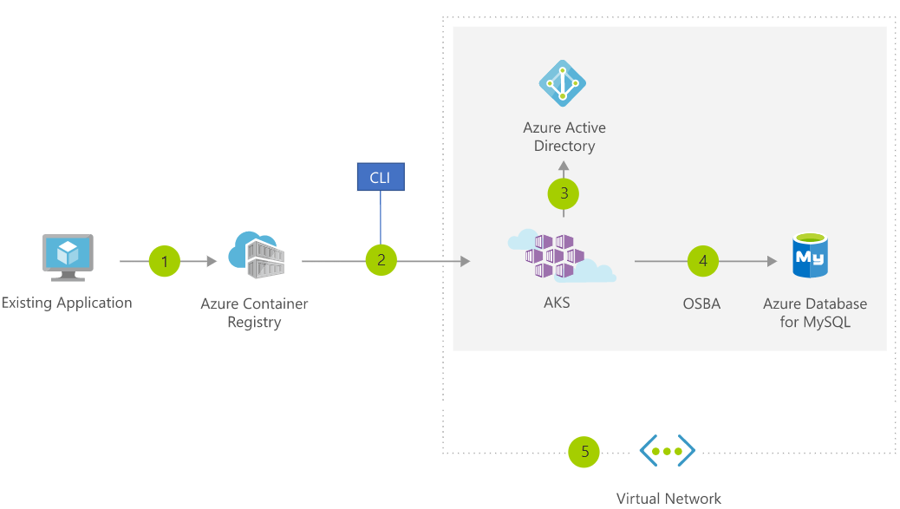
Common uses for Azure Kubernetes Service (AKS): Migrating existing application
Oracle Consulting Services, FSGBU

