Slide 1
Core Azure Management Services
By
Ragini Kulkarni

Slide 2


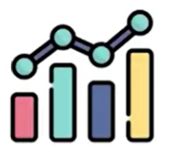

Management Tools
Log Analytics
Cost Management+ Billing
Automation Account
Metrics

Slide 3
Management Tools
Log Analytics
Cost Management+ Billing
Automation Account
Metrics
Log Analytics is the primary tool in the Azure portal for writing log queries and interactively analyzing their results

Slide 4
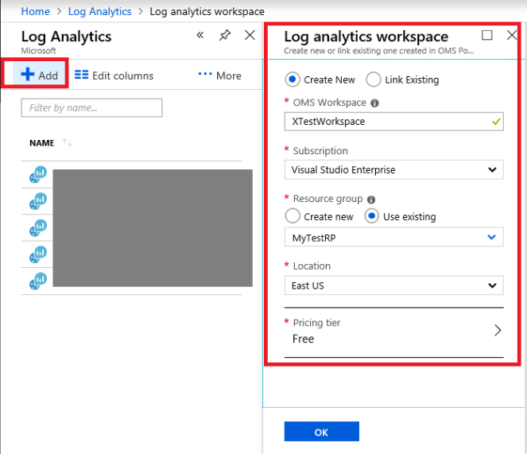

Slide 5
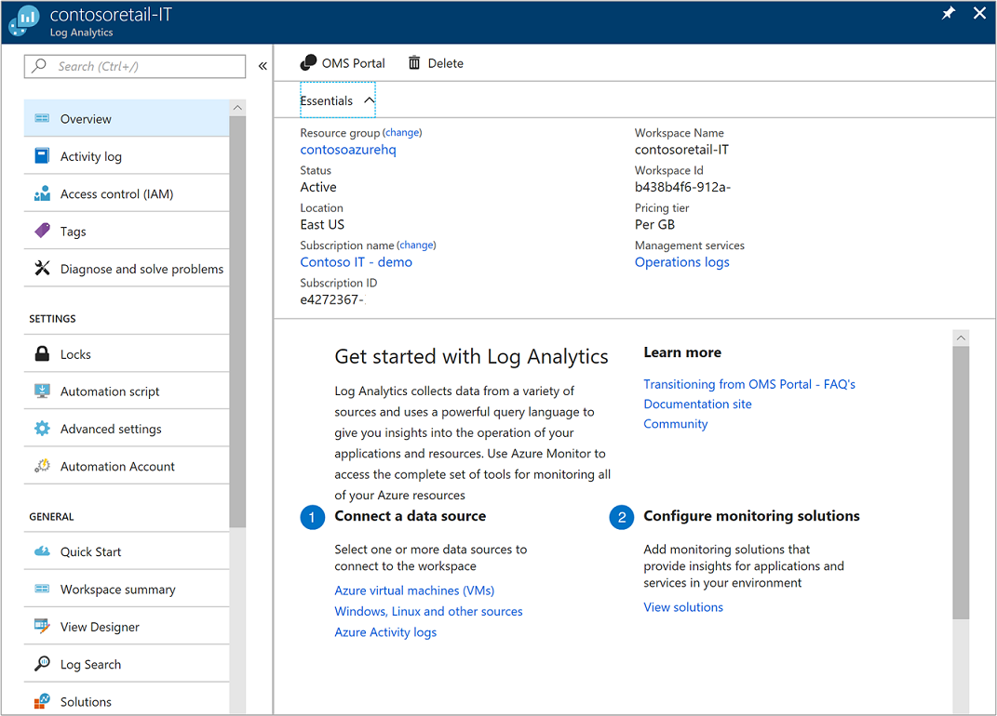

Slide 6
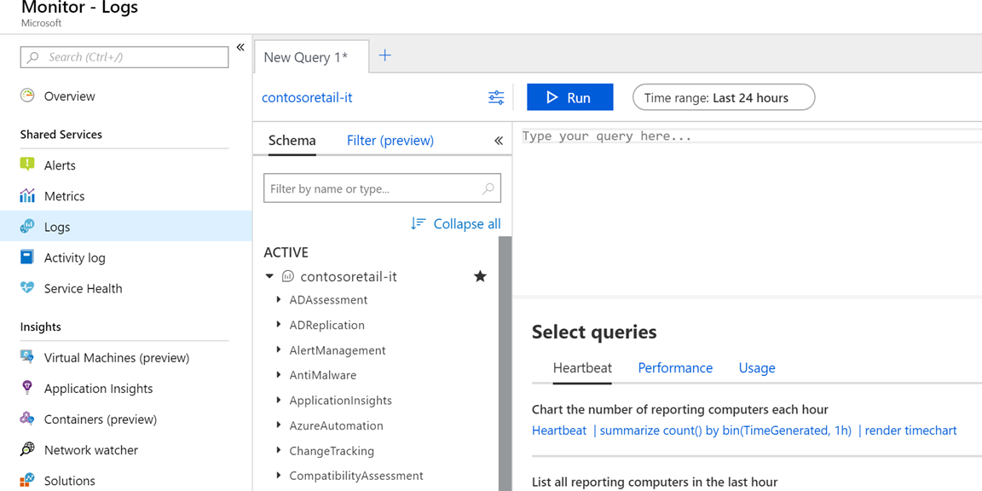

Slide 7
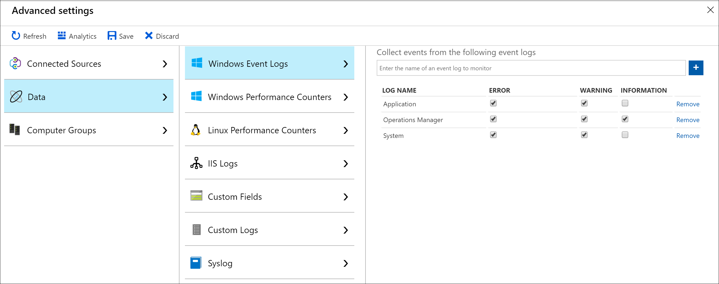

Slide 9
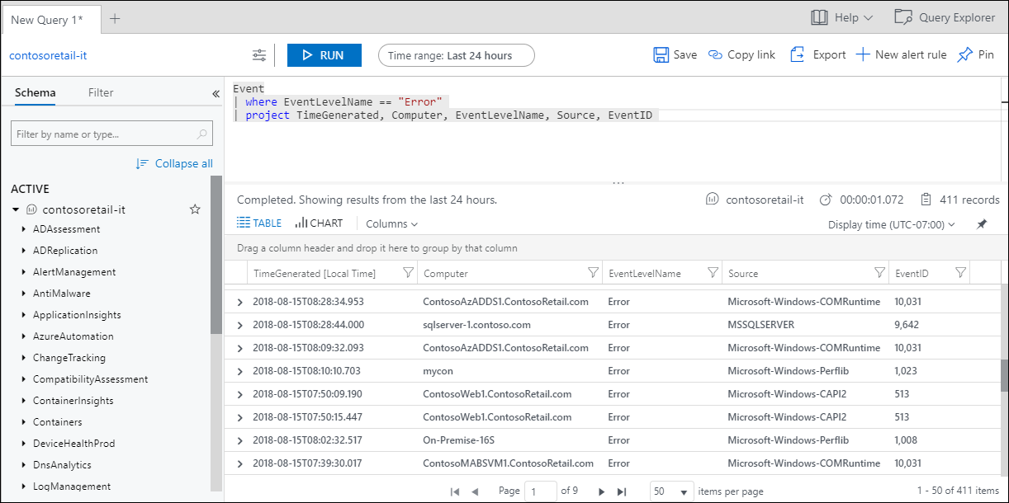

Slide 10
Management Tools
Cost Management+ Billing
Log Analytics
Automation Account
Metrics
Azure Billing features are used to review your invoiced costs and manage access to billing information. Cost management is the process of effectively planning and controlling costs involved in your business.

Slide 11
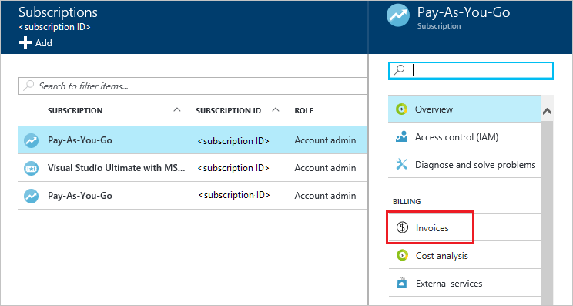
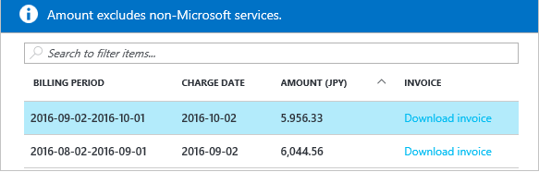

Slide 12
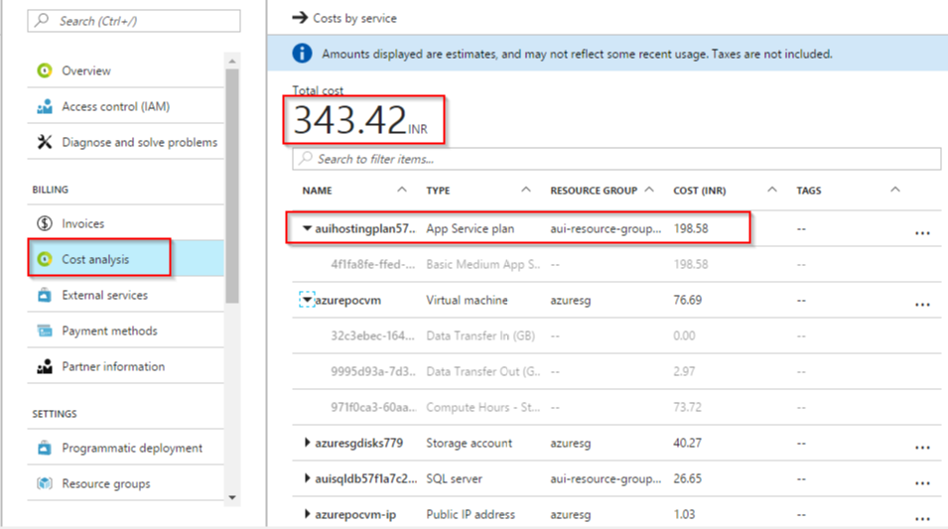

Slide 13
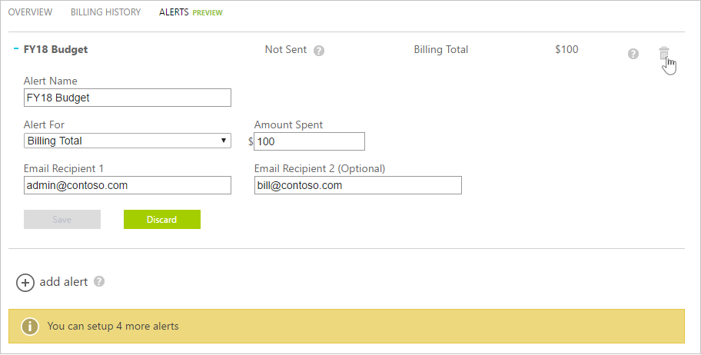

Slide 14
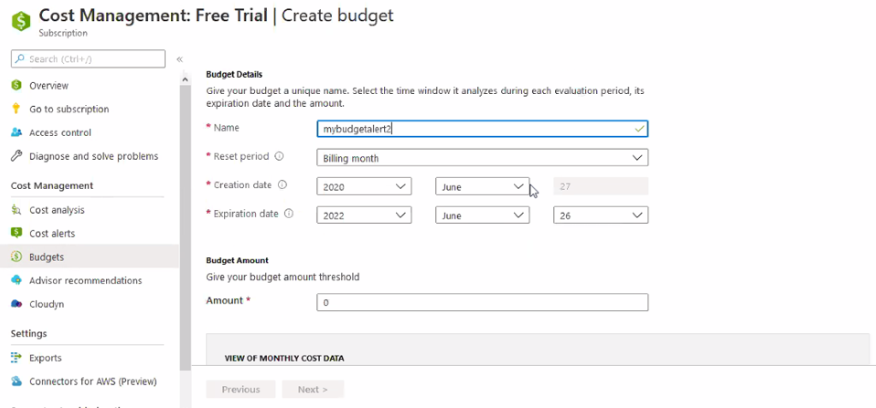

Slide 15
Management Tools
Cost Management+ Billing
Log Analytics
Automation Account
Metrics
Azure Automation delivers a cloud-based automation and configuration service that supports consistent management across your Azure and non-Azure environments.

Slide 16
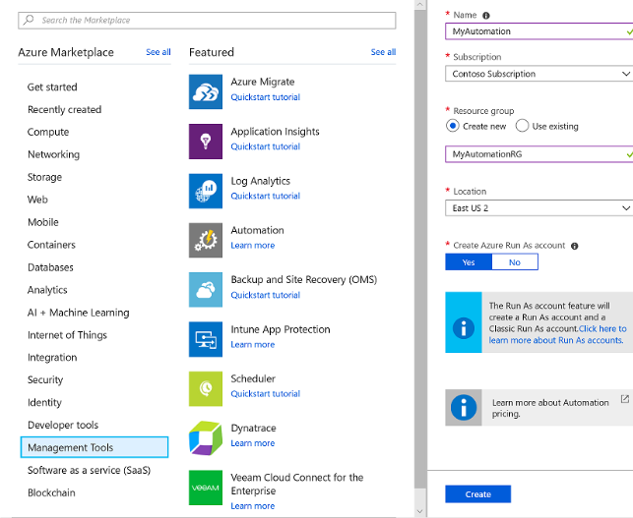

Slide 17
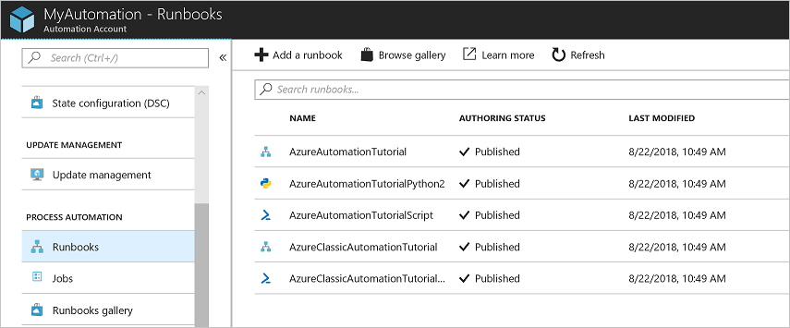

Slide 18
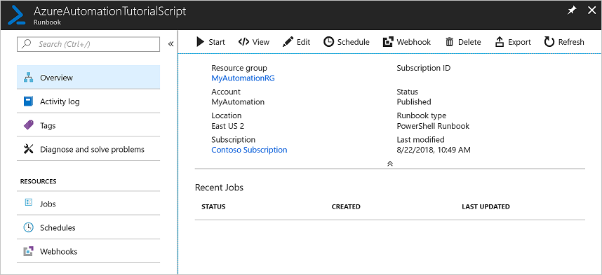

Slide 19
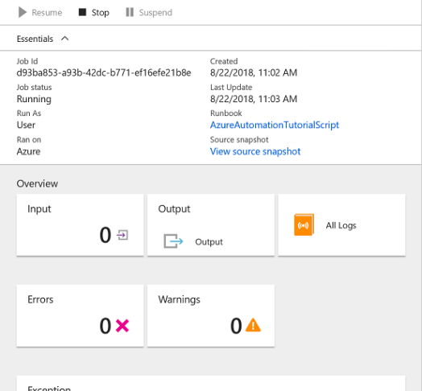
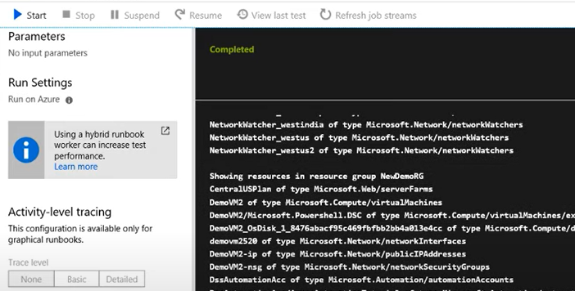

Slide 20
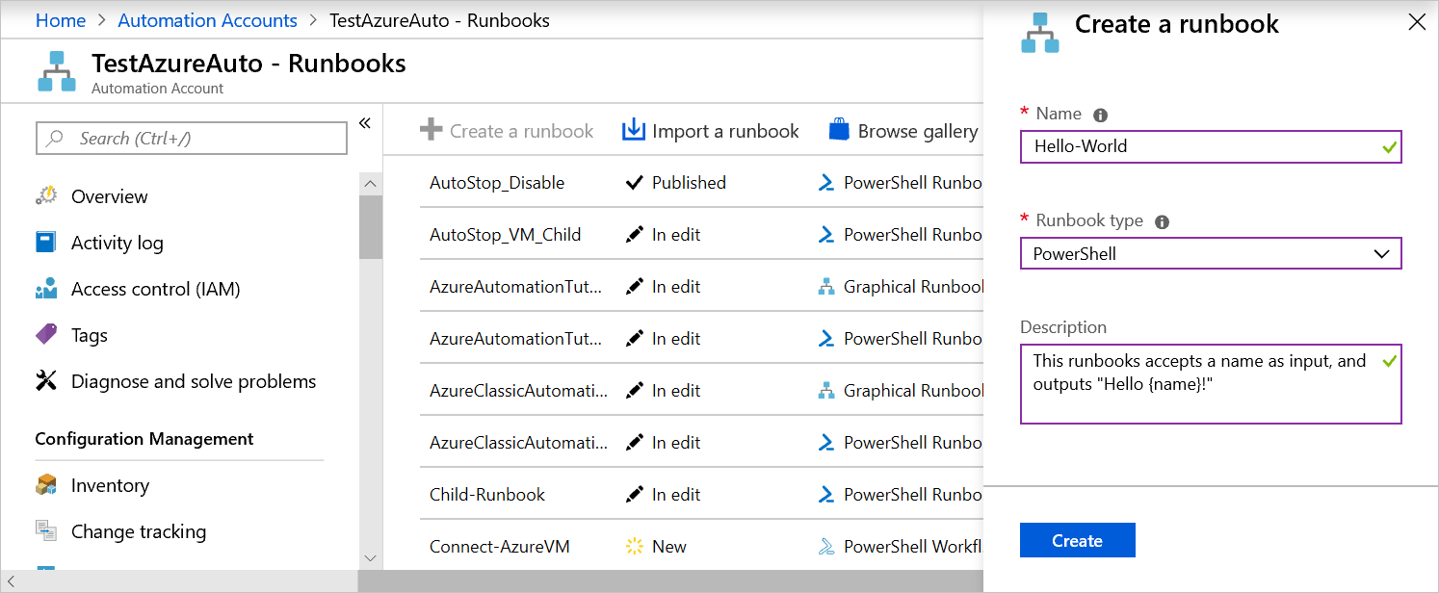
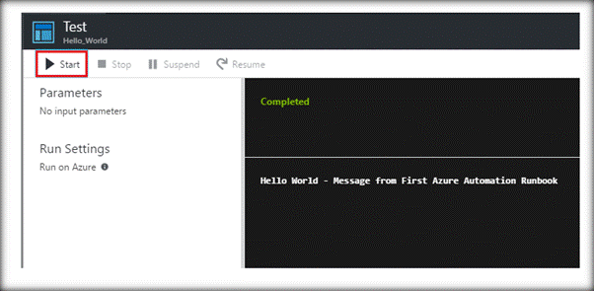

Slide 21
Management Tools
Cost Management+ Billing
Log Analytics
Automation Account
Metrics
Metrics are available for interactive analysis in the Azure portal with Metrics Explorer. They can be added to an Azure dashboard for visualization in combination with other data & used for real time alerting.

Slide 22
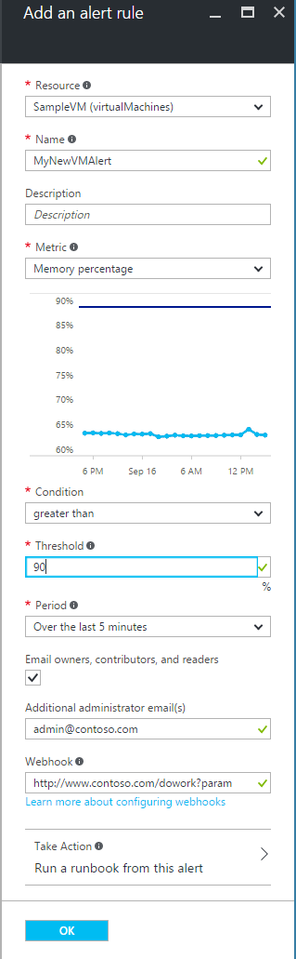
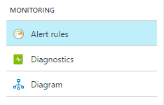

Slide 23
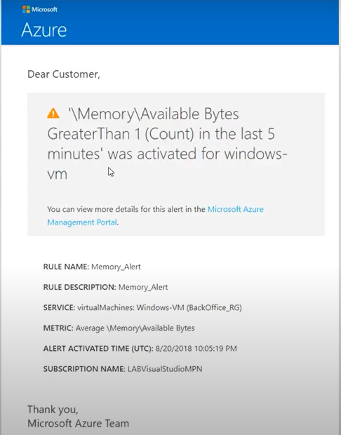

Slide 24
