Slide 1
Level – 3 Demo

Slide 2
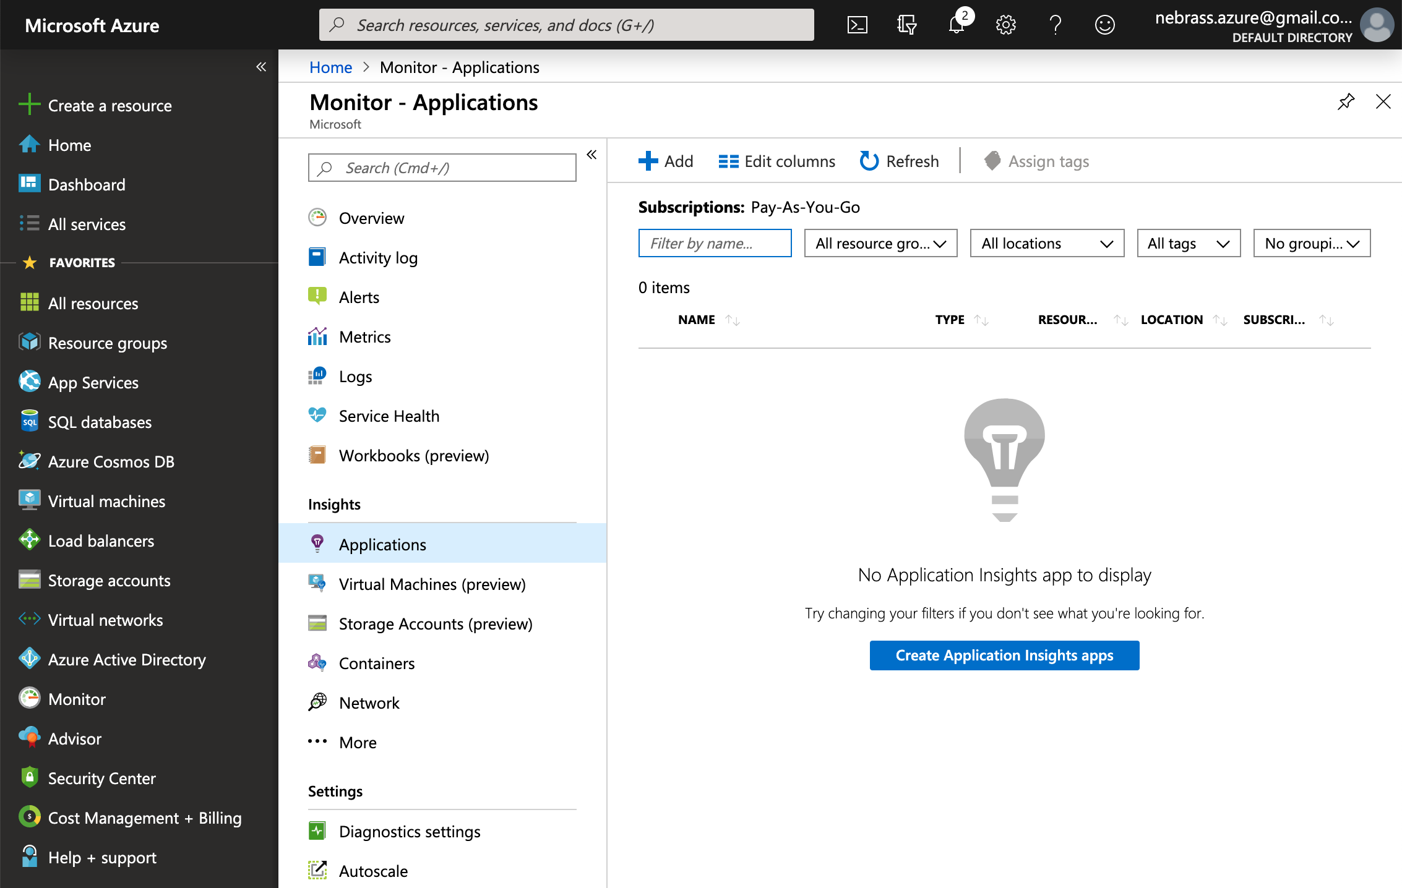

Slide 3
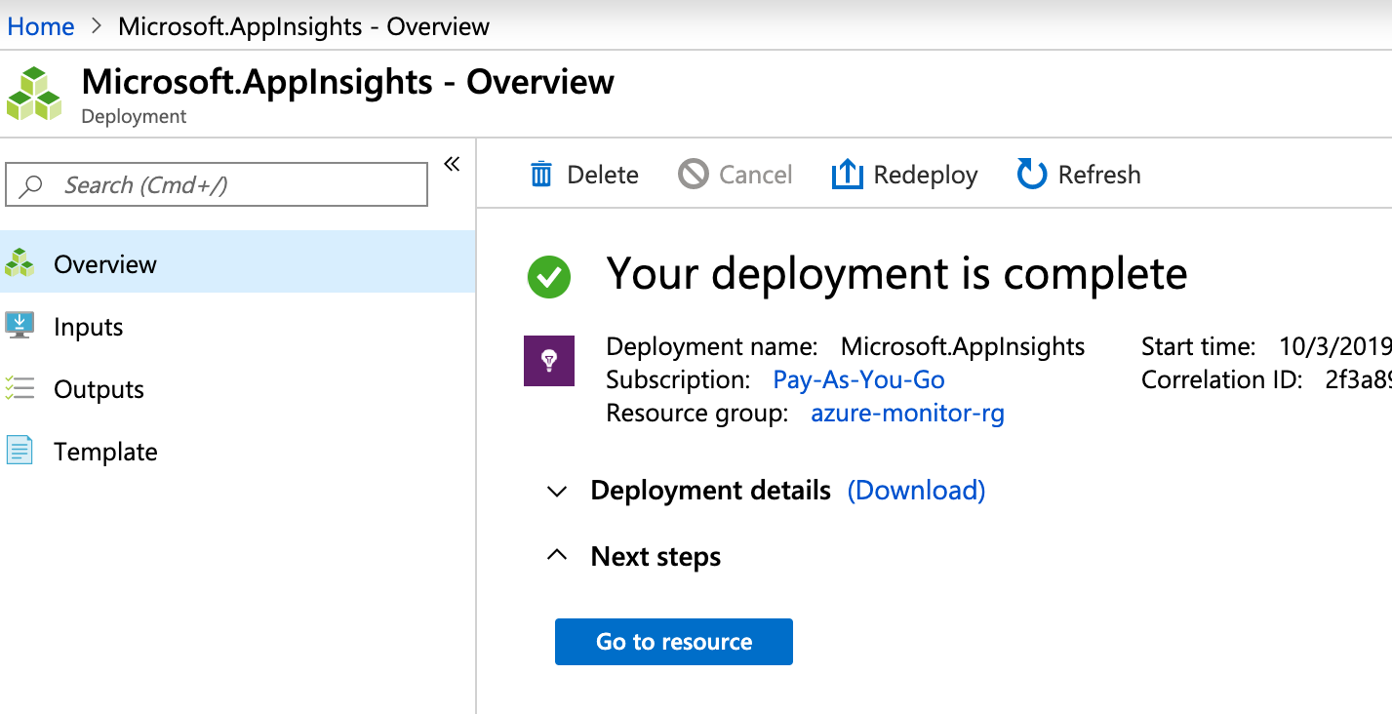

Slide 4
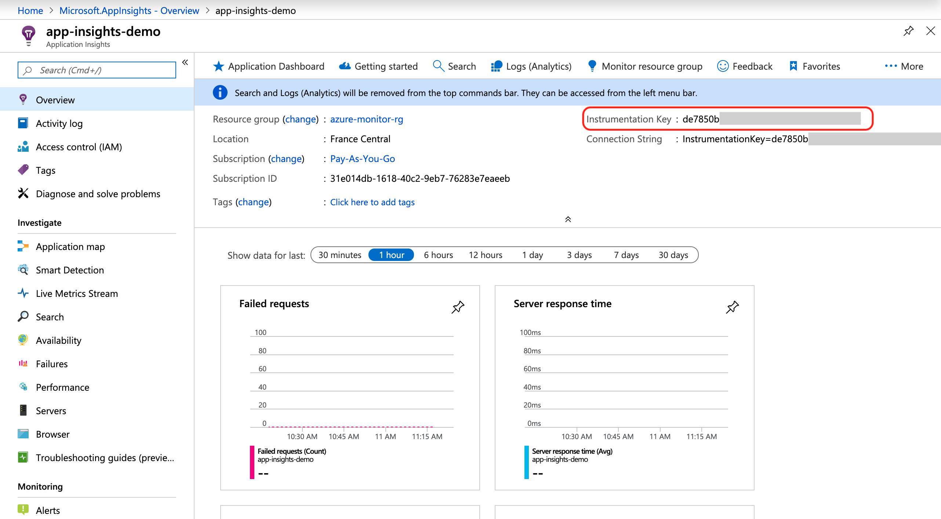

Slide 5
Event telemetry: represents an event that occurred in your application. Typically it is a user interaction such as button click or order checkout. It can also be an application life cycle event like initialization or configuration update. Semantically, events may or may not be correlated to requests. However, if used properly, event telemetry is more important than requests or traces. Events represent business telemetry and should be a subject to separate, less aggressive sampling.
Trace telemetry: represents a textual styled trace. Log file entries are translated into instances of this type. The trace does not have measurements as an extensibility.
Metric telemetry: There are two types of metric telemetry : single measurement and pre-aggregated metric.
Single measurement is just a name and value.
Pre-aggregated metric specifies minimum and maximum value of the metric in the aggregation interval and standard deviation of it. It assumes that aggregation period was one minute.
Dependency Telemetry: represents an interaction of the monitored component with a remote component such as SQL (like what we simulated in our example) or an HTTP endpoint.
Request Telemetry: represents the logical sequence of execution triggered by an external request to your application. Every request execution is identified by unique ID and url containing all the execution parameters. You can group requests by logical name and define the source of this request. Code execution can result in success or fail and has a certain duration. Both success and failure executions may be grouped further by resultCode.

Slide 6
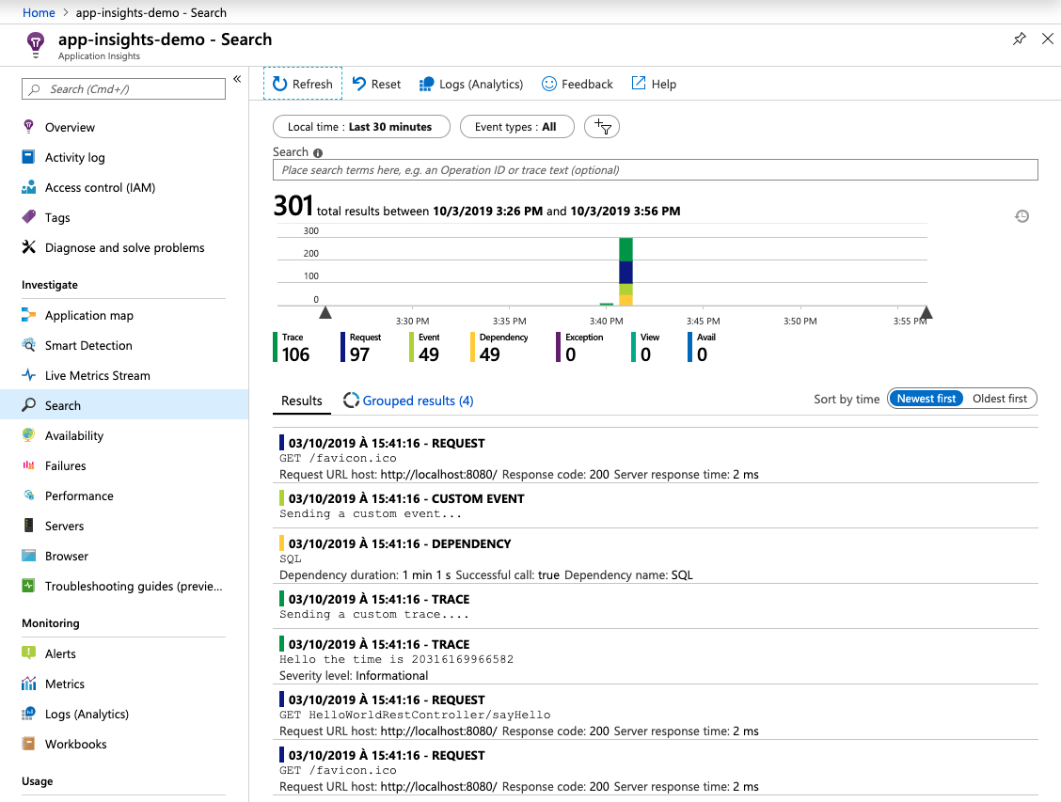

Slide 7
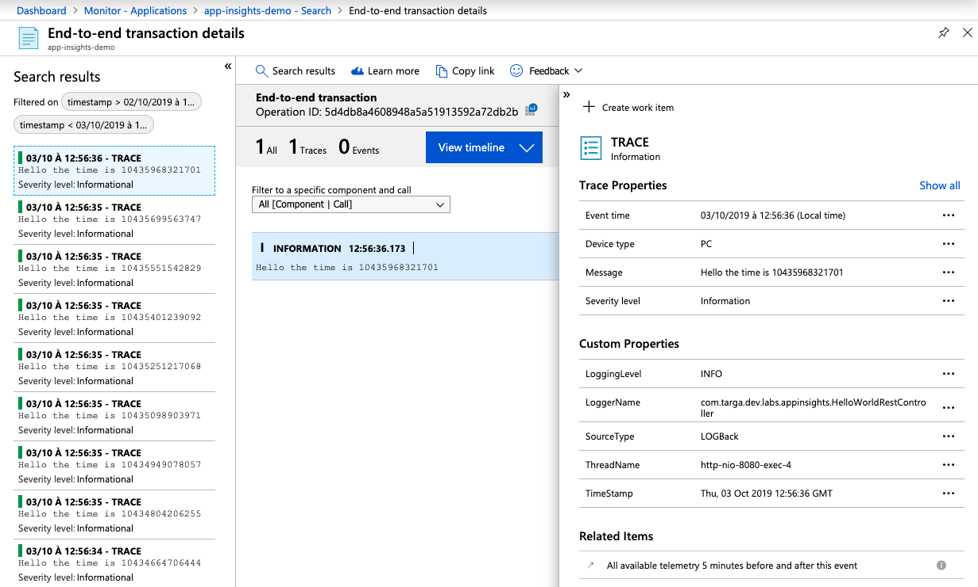

Slide 8
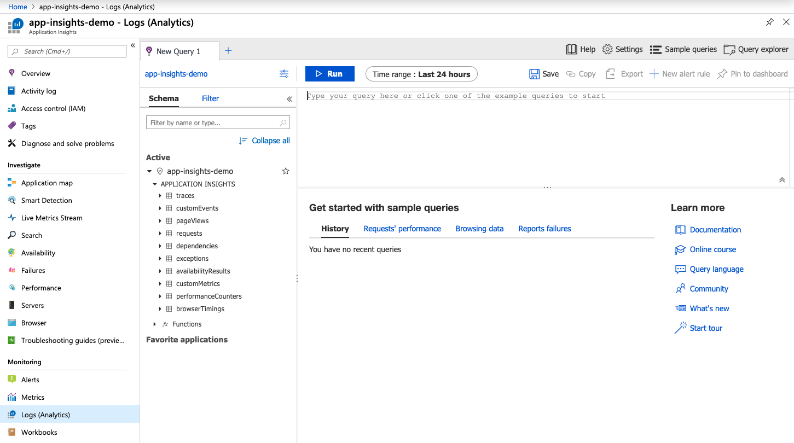

Slide 9
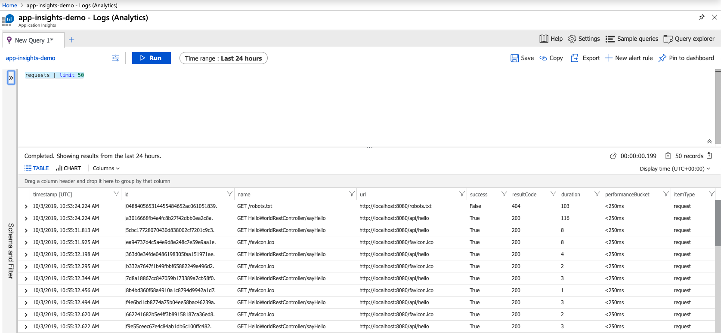

Slide 10
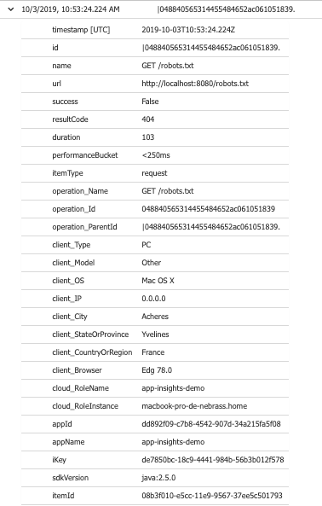

Slide 11
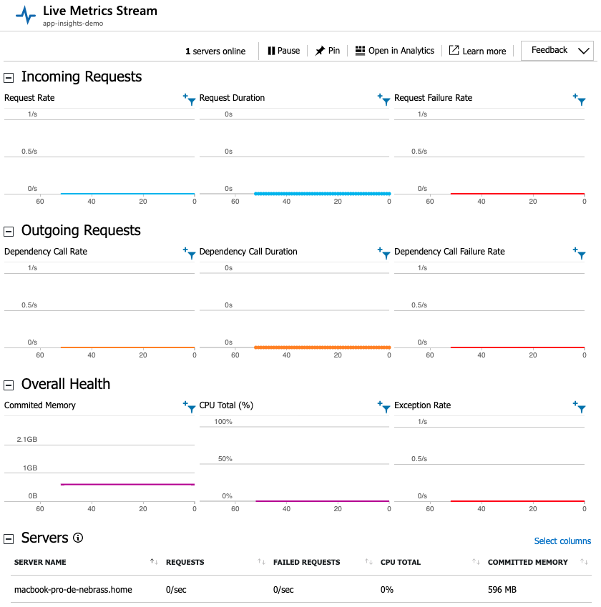

Slide 12
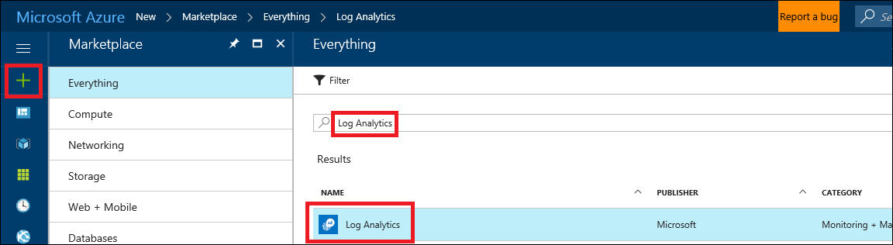

Slide 13
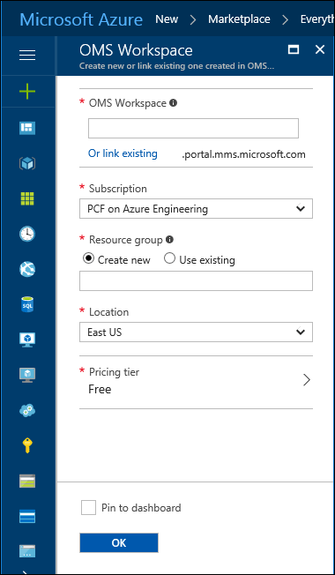

Slide 14
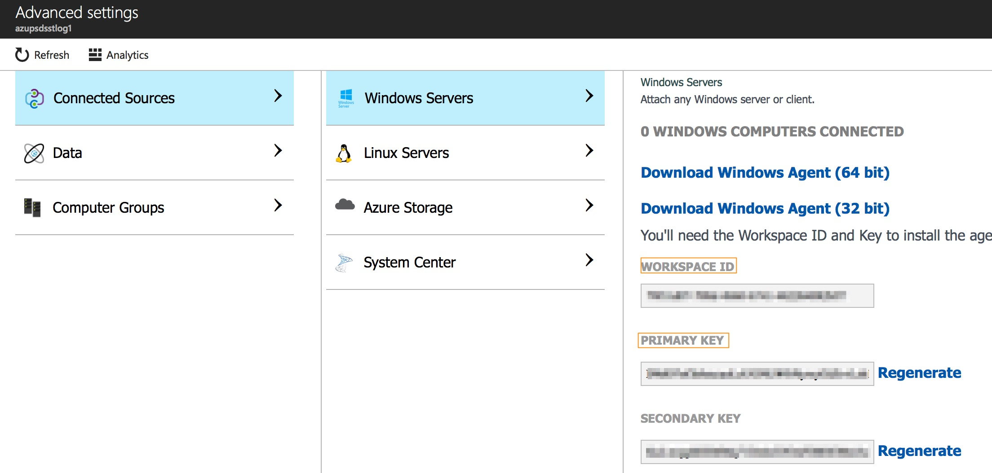

Slide 15
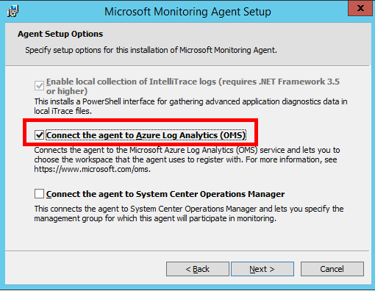

Slide 16
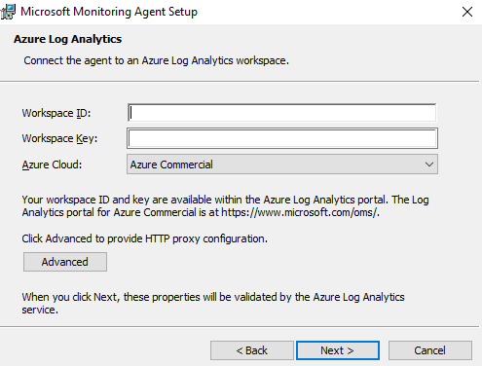

Slide 17
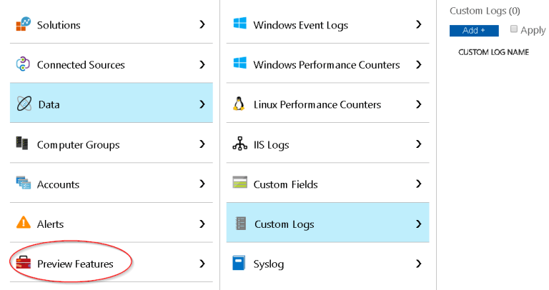

Slide 18
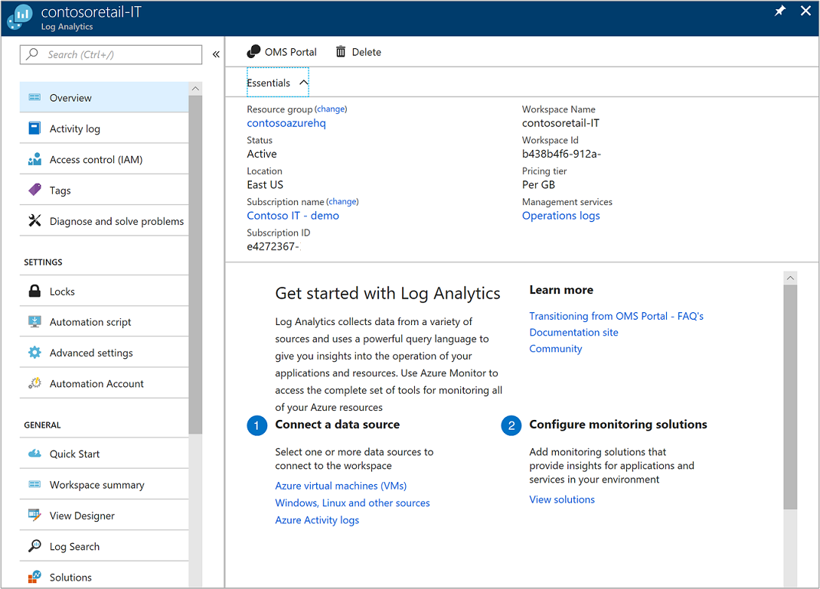

Slide 19
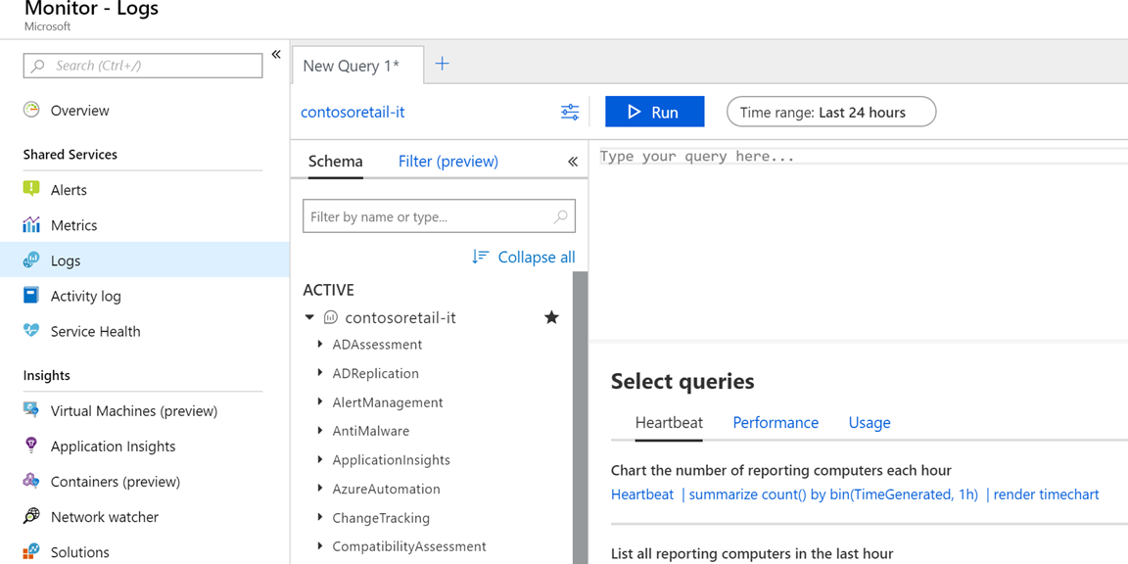

Slide 20
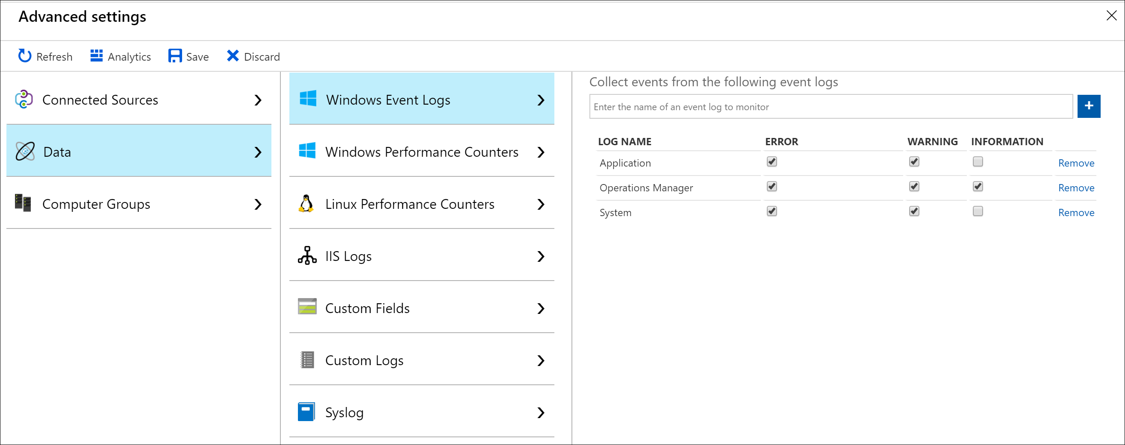

Slide 21
