Slide 1
CDC Fraud Detection Demo
Spring Data Flow Platform

Slide 2
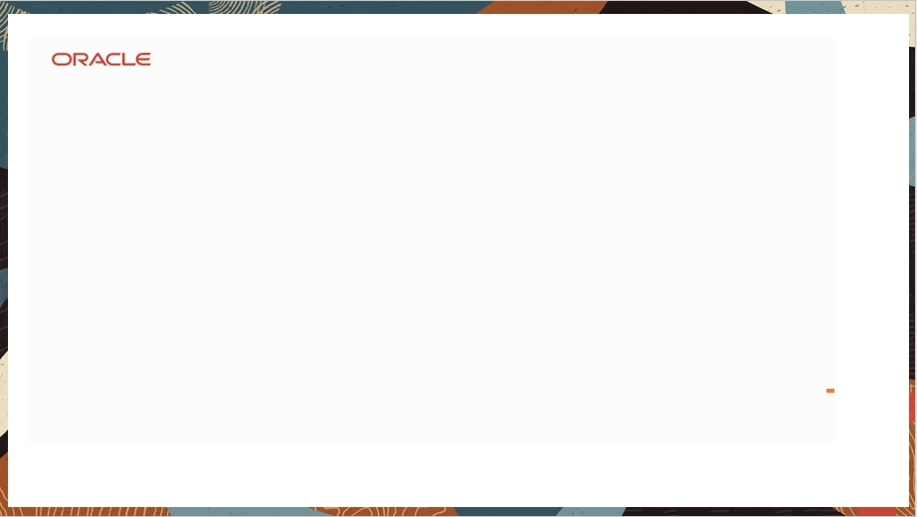
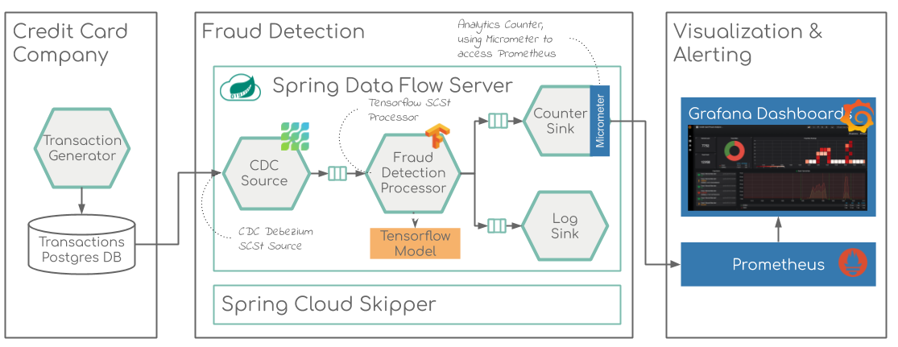
Realtime Credit Card fraud detection, using CDC (Change Data Capture) data source and TensorFlow model from a Kaggle competition.

Slide 3
Credit Card Fraud Detection Using
CDC (Change Data Capture) Debezium
Debezium is an open source distributed platform for change data capture.
https://debezium.io/
TensorFlow Model
https://www.kaggle.com/currie32/predicting-fraud-with-tensorflow
Micrometer
Prometheus
Grafana
Postgres (Database)
Platform
Spring Cloud Data Flow Server on top of
Skipper Server

Slide 4
Spring Cloud Data Flow
Spring Cloud Data Flow provides tools to create complex topologies for streaming and batch data pipelines. The data pipelines consist of Spring Boot apps, built using the Spring Cloud Stream or Spring Cloud Task microservice frameworks.
A flow that receives an event from an input, perform some action(s) and send the result to an output. From here, we can design more sophisticated and complex pipelines. The good thing with Spring Cloud Data Flow is that it’s fully integrated with Spring Integration, so we can implement any message patterns we can achieve with Spring Integration.
The inputs are the Source, the outputs are the Sink and then we have the Processor that consumes the data and returns it to the output. It can be any of these: a RabbitMQ queue, a Kafka, Amazon Kinesis, Google Pub/Sub, Azure Event, a database … or another component within your pipeline.

Slide 5
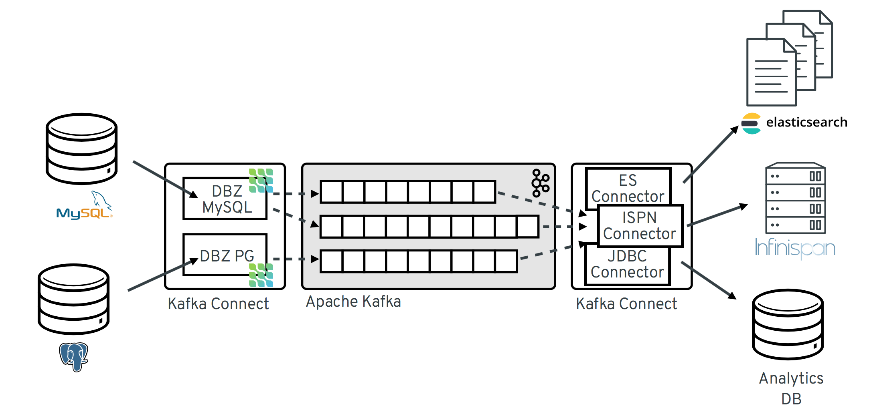

Slide 6
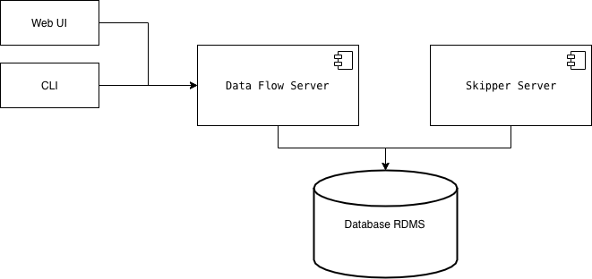
Spring Data flow platform
Data Flow Server: backend for Web and CLI, validate pipelines, registering .jar and docker images, deploying batch jobs, …
Skipper Server: stream jobs management (deploying, upgrading, history, …)
Both servers use a RDMS database. If not provided, it will use a volatile H2 instance.

Slide 8
Transaction Generator:
Standalone application that can continuously generate data records compliant with the data format specified in [Credit Card Fraud Detection]
Postgres DB:
The data records are generated in random intervals and pushed into a pre-configured Database.
For confidentiality reasons the values of most of the original features, such as `V1`, `V2`, ... `V28` have been anonymized using a principal components obtained with PCA.
Transaction Handling with Event Source : Event sourcing persists the state of a business entity such an Order or a Customer as a sequence of state-changing events. In this use case on Credit Card Transaction whenever the state of a business entity changes, a new event is appended to the list of events.

Slide 9
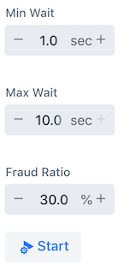
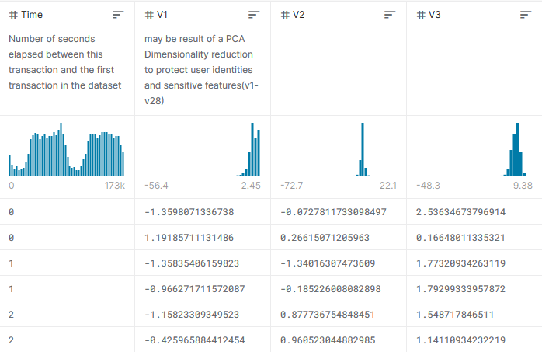
Transaction Generator
Data format specified in Credit Card Fraud Detection

Slide 11
Skipper Server
Skipper is a tool that allows you to discover Spring Boot applications and manage their lifecycle on multiple Cloud Platforms. You can use Skipper standalone or integrate it with Continuous Integration pipelines to help achieve Continuous Deployment of applications.
Skipper Server does the app import and Stream Creation and then same will be deployed on Spring Cloud Data Flow platform.
CDC Source/CDC Debezium
Debezium is an open source distributed platform for change data capture. Start it up, point it at your databases, and your apps can start responding to all of the inserts, updates, and deletes that other apps commit to your databases.
Data pipeline implementation
The data captured from the source will then be posted to the Kafka topic. Kafka will inject log to transaction processor . Then the processor will consume the data from Kafka for the further task.

Slide 12
Fraud Detection Processor
Custom Spring Cloud App Starter that extends the TensorFlow Processor to support a specific TensorFlow model build for the Credit Card Detection solution.
https://www.kaggle.com/currie32/predicting-fraud-with-tensorflow
fraud_detection_graph.pb loaded as resource and it has been used as template to analysis the transaction received from transaction generation.

Slide 13
Data analysis with TensorFlow : TensorFlow Data Validation identifies anomalies in training and serving data, and can automatically create a schema by examining the data. The component can be configured to detect different classes of anomalies in the data. It can
Compares multiple datasets. Helps in identifying data and distribution skew between train, eval and serving datasets
Automatically enervates a schema based on underlying data as well as use the schema to inspect out of time datasets
Identify anomalies, such as missing features, out-of-range values among others
Detect data drift by looking at a series of data
Micrometer is an open-source project and provides a metric facade that exposes metric data in a vendor-neutral format that a monitoring system can understand
Counter is a single, monotonically increasing, cumulative metric.

Slide 15
Prometheus
Prometheus stores our metric data in time series in memory by periodically pulling it via HTTP. The data can be visualized by a console template language, a built-in expression browser, or by integrating Grafana (which we will do after setting up Prometheus).
Grafana
The included Prometheus browser graph is nice for basic visualization of our metrics but we will use Grafana instead. Grafana provides a rich UI where you create, explore and share dashboards that contain multiple graphs.
Grafana can pull data from various data sources like Prometheus, Elasticsearch, InfluxDB, etc.

Slide 16
Technology Stack
Subtitle
Framework/Platform
Spring boot
Spring data flow
Spring Cloud stream reactive
Spring Cloud Tasks
Tensor flow
Micrometer
Prometheus
Grafana
Debezium
Language
Java
Python
Pandas
Numpy
Database
Postgres
MySQL
Influx DB
Messaging
Kafka

Slide 17
Use Case Support
Spring Cloud Data Flow supports a range of data processing use cases, from ETL to import/export, event streaming, and predictive analytics.
Event Driven Micro service for transaction support.
Data pipeline between service.

Slide 18
Demo

Slide 19
Thank You

